Slide 1
Exploratory Data Analysis
Book Dataset Business Intelligence Report
Task 2 – EDA & Business Intelligence
Internship Program
Prepared by: Megha Tagade

Slide 2
Dataset Overview
  Total Books: 298
  Variables Analyzed: Rating, Price, Reviews Count, Genre, Publishing Year, Print Length
  Data cleaning and transformation completed in Task 1
  Structured dataset prepared for SQL-based analysis

Slide 3
Descriptive Statistics
  Average Rating: 4.67
  Average Price: 11.66
  Total Reviews: 28M+
  Ratings remain consistently above 4.4 across most genres, indicating strong overall reader satisfaction.

Slide 4
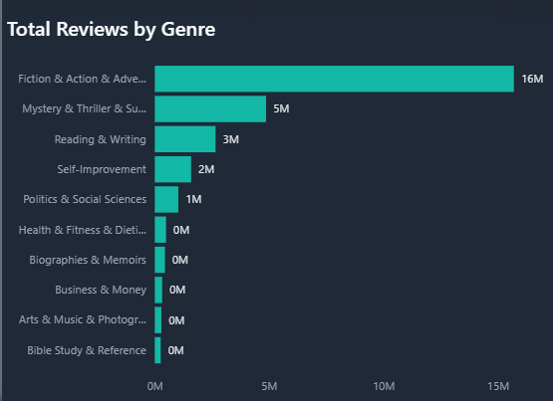
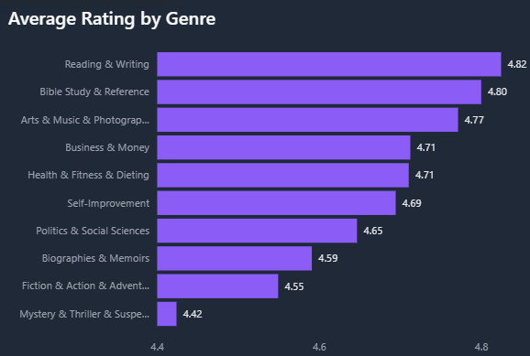
Genre Performance Analysis
  Fiction & Action contributes the highest share of total review volume (~16M), indicating strong market demand.
  Reading & Writing records the highest average rating (4.82), reflecting strong reader satisfaction.
  High review concentration in top 3 genres suggests uneven engagement distribution across categories.
  Lower-volume genres show stable but limited audience reach.
  Overall, market engagement is volume-driven in Fiction, while quality perception is strongest in Reading-focused genres.

Slide 5
Correlation Analysis
  Price vs Rating correlation ≈ 0
  → Pricing does not significantly influence customer ratings.
  Reviews vs Rating correlation is slightly negative
  → Highly reviewed books are not necessarily higher rated.
  High popularity does not guarantee higher perceived quality.

Slide 6
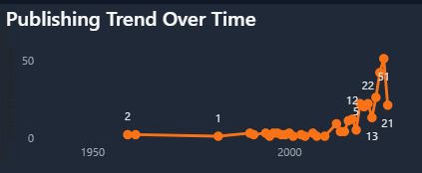
Publishing Trend Over Time
  Publishing activity remained relatively stable before 2018.
  A noticeable acceleration in releases is observed post-2018.
  Peak publishing volumes occur in 2023–2024, indicating recent market momentum.
  The upward trend suggests expansion in content production and category diversification.

Slide 7
Key Business Insights
  Market engagement is strongly genre-driven, with Fiction & Action dominating review volume.
  Customer ratings remain consistently high across most categories (4.4+ average).
  Shorter books show slightly higher average ratings compared to longer formats.
  Pricing shows minimal correlation with perceived quality.
  Publishing trends indicate steady growth, with accelerated expansion in recent years.

