Slide 1

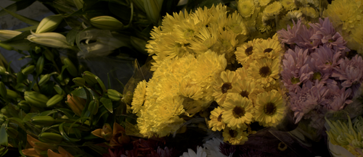
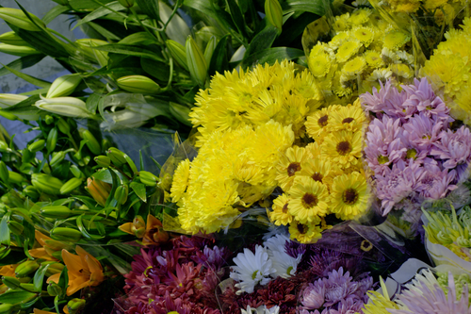
//
01
Personalized Agent-based Image Enhancement
Personalized Agent-based
Image Enhancement via User
Preference Modeling
ORIGINAL
Learning how a user edits,
from their editing history.
EXPERT B
EXPERT E
p(z | image, history)
One scene, different recorded edits.
FiveK references, not model predictions.
Client
Marvin Tao
Yuchen Deng
Gary Xu
Sihan Fang
Tutor
Chuanzhi Xu
Yiming Chen
Yiheng Guo
Lunyan Wang
SOFT3888_TH18_04
Weishao Su
XingTang Chen
Zihao Zhang
REPORT COVER
01 / 25
Notes:
Presenter 1 — unassigned
Hello, everyone. We are Group SOFT3888_TH18_04. Our project is Personalized Agent-based Image Enhancement via User Preference Modeling. We will present our objectives, architecture, evaluation and final outcomes.
Source: report Cover.
The interactive source remains available in the course project folder.

Slide 2
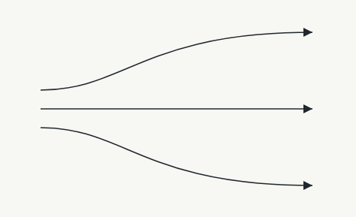




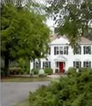
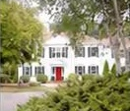


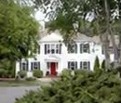

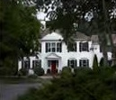

//
02
Project background
One image. Three users. Three preferences.
User A
User B
Original image
User C
User A
Historical examples
User B
Historical examples
User C
Historical examples
Original
User A edit
Original
User A edit
Original
User B edit
Original
User B edit
Original
User C edit
Original
User C edit
Learn from historical edits. Adapt to unseen users without additional training. Preference illustration.
REPORT 1.1
02 / 25
Notes:
Presenter 1 — unassigned
Personalized image retouching should reflect individual preferences. Different users may prefer different edits of the same image. We learn from historical original-and-edited pairs and adapt to unseen users without additional training. The supplied image illustrates the problem; it is not a model prediction.
Source: report 1.1.
The supplied preference illustration is conceptual and is not a model prediction.
The interactive source remains available in the course project folder.

Slide 3
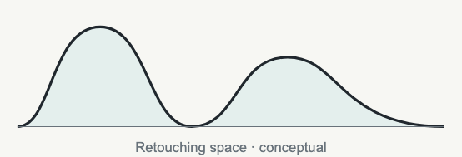
//
03
Existing methods and our core idea
User-specific training
OUR CORE IDEA
01
Learn a distribution
AdaInt / RSFNet
of possible edits.
A separate user or expert model.
02
Additional instructions
DiffRetouch / PerTouch
Explicit editing guidance.
03
One preference vector
PieNet
P(z | current image, user history)
History compressed into one representation.
Hypothesis: one image and user may admit several acceptable edits.
REPORT 1.1–2.2
03 / 25
Notes:
Presenter 1 — unassigned
AdaInt and RSFNet can require user- or expert-specific training. DiffRetouch and PerTouch may need explicit controls. PieNet summarizes preferences in one vector. Our hypothesis is that more than one edit may be acceptable. We therefore model P(retouching parameters | current image, user history).
Source: report 1.1–2.2.
The interactive source remains available in the course project folder.

Slide 4
//
04
Project goals and achievements
Three objectives. One shared model.
OBJECTIVE 01
OBJECTIVE 02
OBJECTIVE 03
Automatic
Generalizable
Multimodal
No editing instructions
No user-specific fine-tuning
Several candidate edits
3D space
Transformer
Flow
Compact retouching representation
Image and history conditioning
Continuous conditional density
3D
edit space
→
Transformer condition
→
Conditional Flow
A two-stage architecture supports automatic, training-free, multimodal retouching.
REPORT 1.2–1.3
04 / 25
Notes:
Presenter 2 — unassigned
Our three goals are automatic retouching without instructions, adaptation to unseen users without fine-tuning, and multiple editing candidates. We combine a compact retouching space, Transformer conditioning and Conditional Normalizing Flow.
Source: report 1.2–1.3.
The interactive source remains available in the course project folder.

Slide 5
//
05
User stories and functional requirements
Three user needs guide the system design.
FR-01
FR-02
FR-03
Automatic
Adapt to new
Generate
personalization
users
alternatives
Current image + user history
Eight historical examples
Continuous preference distribution
↓
↓
↓
No editing instructions
No additional training
Multiple retouching solutions
Automatic editing → training-free adaptation → multimodal prediction
REPORT 2.1
05 / 25
Notes:
Presenter 2 — unassigned
FR-01 uses the current image and history for automatic enhancement. FR-02 adapts to unseen users with fixed model weights. FR-03 generates several candidates from a continuous conditional distribution.
Source: report 2.1.
The interactive source remains available in the course project folder.

Slide 6
//
06
Acceptance criteria and constraints
REQUIREMENT
ACCEPTANCE CHECK
EVALUATION EVIDENCE
FR-01
No instructions or query targets
FiveK / PPSD · PSNR and SSIM
FR-02
8 history pairs · fixed weights
Expert E + 50 unseen PPSD users
FR-03
Multiple sampled edit candidates
Density analysis + Top-1 / Best-of-K
Constraints
Compute budget
History availability
Leakage prevention
Fixed model weights
The query target enters scoring only after prediction.
REPORT 3.3
06 / 25
Notes:
Presenter 2 — unassigned
Acceptance checks map to all three requirements: predict without instructions or the query target; adapt using eight historical pairs and no weight update; and generate multiple candidates. Constraints include compute, available history, leakage prevention and global LUT editing.
Source: report 3.3.
The interactive source remains available in the course project folder.

Slide 7
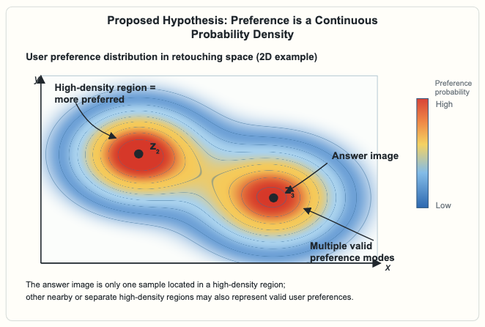
//
07
Modelling user preferences
≈30%
READ THE MAP
High density
Early similarity-retrieval accuracy
More plausible
retouching region.
Similarity alone
Low density
is not enough.
Less likely under the
learned distribution.
P(z | image, history)
z = (x, y)
Each point is a possible
A continuous retouching space allows
retouching solution.
more than one plausible edit to coexist.
One recorded edit is an observation; a conditional density can represent several possible edits.
Conceptual density. A single recorded target cannot validate every candidate preference.
REPORT 2.2
07 / 25
Notes:
Presenter 3 — unassigned
Early image-similarity retrieval achieved approximately 30% accuracy. Similar images do not reliably identify one unique edit. We instead model a continuous, potentially multimodal density. Its peaks are candidate editing regions; the experiment does not establish that every peak is a true preference.
Source: report 2.2.
The interactive source remains available in the course project folder.

Slide 8
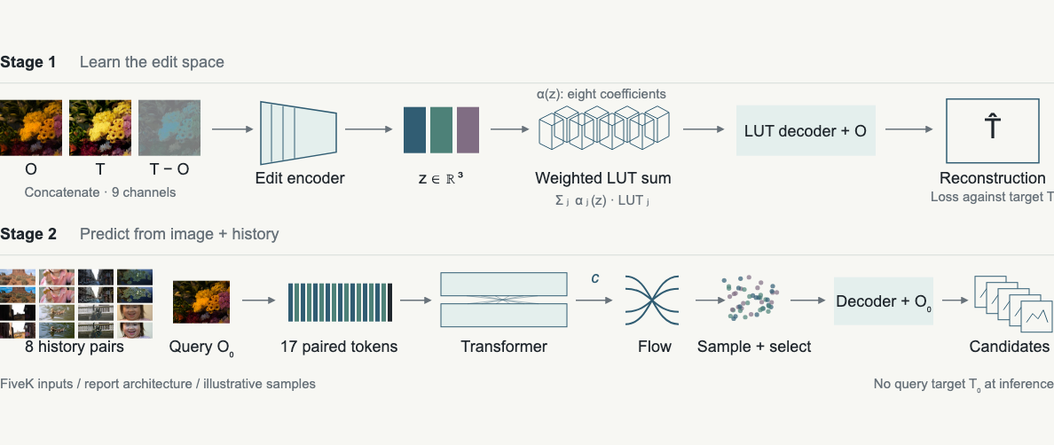
//
08
Overall system architecture
Stage 1: compact edit vectors. Stage 2: image + history → conditional density → candidate edits.
REPORT 2.3–2.6
08 / 25
Notes:
Presenter 3 — unassigned
Stage 1 learns a low-dimensional retouching representation from original and expert-edited images. Stage 2 uses the query and user history to predict a distribution over that space. Sampling and the LUT decoder produce alternative edits.
Source: report 2.3–2.6.
The interactive source remains available in the course project folder.

Slide 9

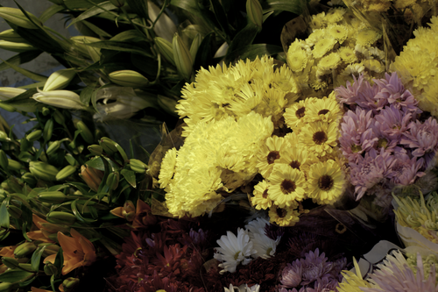
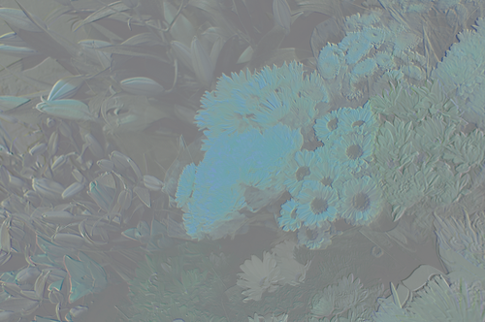
//
09
Stage 1 · Retouching encoder and decoder
Encoder
Decoder
Reconstruct
z → FC → w₁, …, w₈
Original O
Apply final LUT to O
Target T
LUT 1
LUT 2
LUT 3
LUT 4
→
Convolution
→
→
+ downsampling
Difference
↓
T − O
Flatten → FC
LUT 5
LUT 6
LUT 7
LUT 8
T̂
9 input channels
z
Σ wᵢ · LUTᵢ
3D edit vector
8 learnable basis LUTs
Reconstruction loss
→
Backpropagation ↶
L
(T̂, T) · prediction vs expert target
Jointly update encoder, decoder and basis LUTs.
rec
REPORT 2.3
09 / 25
Notes:
Presenter 3 — unassigned
The encoder receives the original, target and pixel-wise difference: nine channels in total. It produces a three-dimensional edit vector. The decoder maps this vector to eight coefficients, combines eight learned LUT bases and reconstructs the edit. Target images are used here for Stage 1 training, not as query inputs at inference.
Source: report 2.3.
The interactive source remains available in the course project folder.

Slide 10
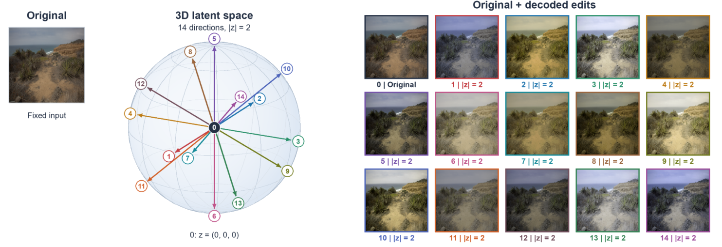
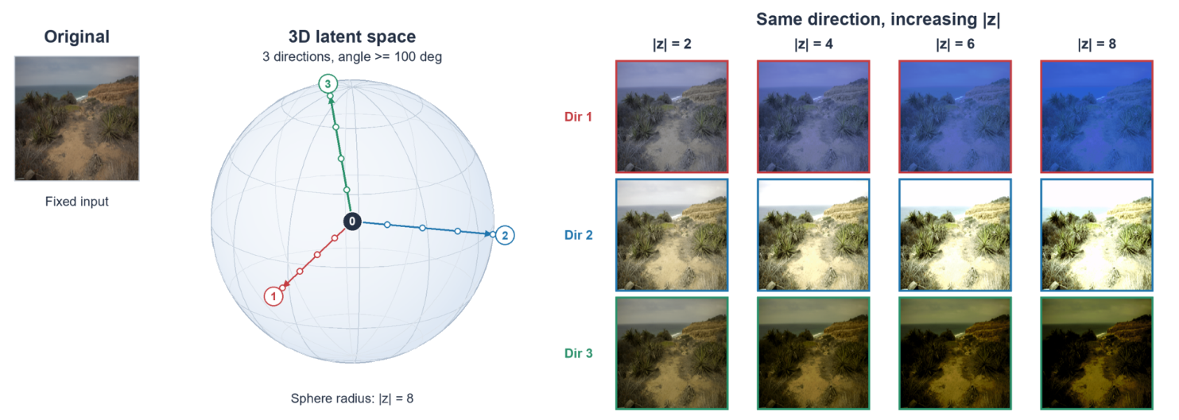
//
10
Understanding the retouching space
Continuous
Nearby vectors, similar edits
z = ‖z‖ · ẑ
Direction → editing type
Magnitude → editing strength
14 directions · fixed magnitude ‖z‖ = 2
3 directions · magnitudes 2, 4, 6, 8
Different directions change colour and tone.
The same direction produces progressively stronger edits.
Editing type and strength vary within one continuous 3D space.
REPORT 3.4
10 / 25
Notes:
Presenter 4 — Yuchen Deng
The learned retouching space has two properties: continuity and directionality. Similar vectors generally produce similar editing results. The unit direction of z represents adjustment type; its magnitude represents adjustment strength. Increasing magnitude produces progressively stronger edits in this continuous three-dimensional space.
Source: report 3.4.
The interactive source remains available in the course project folder.

Slide 11
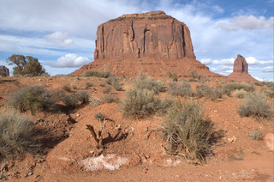
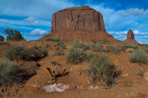
//
11
Stage 2 · Transformer-based conditioning
01
Image content
One shared encoder
02
Editing history
8 original–target pairs
→
→
FC
→
→
FC
Shared image encoder
Ẽᵢ ∈ ℝᴰ
Stage 1 edit encoder
z̃ᵢ ∈ ℝᴰ
O₀ · query
O₁…O₈
Conv + downsample → Eᵢ
Oᵢ
Tᵢ
(Oᵢ, Tᵢ, Tᵢ − Oᵢ) → zᵢ ∈ ℝ³
Pair the history, then append the query
17 tokens · common dimension D
Ẽ1
z̃1
Ẽ2
z̃2
Ẽ3
z̃3
Ẽ4
z̃4
Ẽ5
z̃5
Ẽ6
z̃6
Ẽ7
z̃7
Ẽ8
z̃8
Ẽ₀
H1
H2
H3
H4
H5
H6
H7
H8
QUERY
FC projections align image features and 3D edit vectors to D dimensions.
Two-layer Transformer
Image–edit relationships via self-attention
Read updated query token
c
↓
Layer 1
Layer 2
→
Ẽ′₀ = c ∈ ℝᴰ
→
Self-attention + FFN
Self-attention + FFN
To the Conditional Flow
Image + history inform c
Unseen users · no weight updates
No query target at inference
REPORT 2.4
11 / 25
Notes:
Presenter 4 — Yuchen Deng
Stage 2 predicts the editing distribution from the current image and eight historical examples. A shared image encoder extracts image features; Stage 1 provides historical retouching vectors. These tokens enter a two-layer Transformer. The updated current-image representation becomes the condition vector for density estimation.
Source: report 2.4.
The interactive source remains available in the course project folder.

Slide 12



//
12
Conditional Flow and candidate generation
c
Current image + 8 history pairs → Transformer
Shared condition · z, u ∈ ℝ³
01 / TRAINING
Train the density
Maximise log p(z | c)
A
B
C
OPTIMISE THE MAP
Ground-truth z
Conditional Flow
Standard Gaussian
Conditional log-likelihood
L = −log p(z | c)
f
log p(z | c) = log p(u) + log |det J|
→
→
Stage 1 encodes (O, T)
J = ∂f(z; c) / ∂z
u = f(z; c)
u ∼ N(0, I)
log p(u) = −½‖u‖² − ³⁄₂ log(2π)
Invertible transformation
↶ Backpropagation updates Flow parameters.
02 / INFERENCE
Generate candidates
Reverse the map, then select
01
02
03
04
05
Monte Carlo
Inverse Flow + c
K-means in z space
Rank clusters
Top-1 … Top-K
→
f⁻¹
→
→
→
z₁
z₂
…
M samples u ∼ N(0, I)
z = f⁻¹(u; c)
K groups of edit vectors
Mean log p(z | c)
LUT decoder + original O
M candidate edit vectors
One representative per cluster
Multiple retouched images
Density-ranked alternatives
No query target during generation. Best-of-K uses the target only for offline evaluation.
REPORT 2.5
12 / 25
Notes:
Presenter 4 — Yuchen Deng
Conditional Normalizing Flow models the distribution of retouching vectors. Training learns an invertible mapping between retouching space and a Gaussian latent space. At inference, Monte Carlo sampling generates candidate vectors. K-means groups similar samples, and mean probability density ranks the clusters. We obtain multiple representative candidates rather than one deterministic output.
Source: report 2.5.
The interactive source remains available in the course project folder.

Slide 13
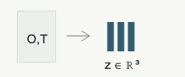


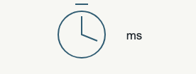
//
13
Testing strategy and quality assurance
01
02
03
04
Can the edit be
Does prediction
What drives the
What does inference
represented?
generalise?
prediction?
cost?
Encoder–decoder
FiveK and PPSD evaluation
Input ablations and Top-K
Controlled GPU benchmark
reconstruction
coverage
Test 3D representation capacity.
Test with fixed model weights.
Swap conditions; compare Top-1
Measure candidate generation.
/ Best-of-K.
PSNR · SSIM · latent continuity
Fidelity · held-out expert / users
PSNR changes · candidate coverage
Latency · throughput · memory
Keep prediction separate from
Reconstruction, accuracy, unseen users, ablations, multimodality and computational performance.
scoring
Report §3.1 / schematic diagrams, not measured results.
REPORT 3.1–3.3
13 / 25
Notes:
Presenter 5 — unassigned
We test reconstruction, prediction quality, unseen-user generalization, conditioning ablations, candidate coverage and computational cost. These controlled model experiments evaluate the project requirements.
Source: report 3.1–3.3.
The interactive source remains available in the course project folder.

Slide 14
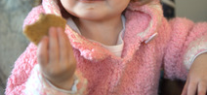
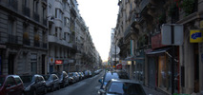
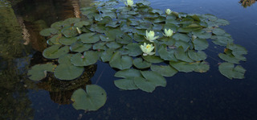
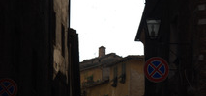
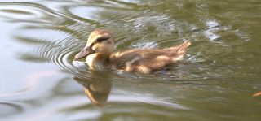
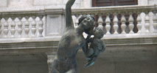
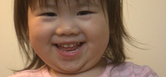




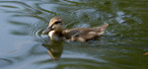


//
14
Datasets and evaluation protocol
FiveK · 5,000 originals
PPSD
Experts A–D · train
Expert E
250 train users
50
unseen
unseen
Five expert-retouched versions per image
Training-free adaptation to held-out users
Eight historical pairs per query
Original + retouched image
H1 · C
H2 · C
H3 · C
H4 · C
H5 · C
H6 · C
H7 · C
H8 · C
Fixed model parameters. No query ground truth at inference.
REPORT 3.2
14 / 25
Notes:
Presenter 5 — unassigned
We evaluated MIT-Adobe FiveK and PPSD. FiveK contains 5,000 originals and edits from five experts. Experts A–D train the model; Expert E is excluded. PPSD uses 250 training users and 50 unseen validation users. Each prediction uses eight historical examples, without user-specific fine-tuning or access to the current image’s ground-truth edit.
Source: report 3.2.
The interactive source remains available in the course project folder.

Slide 15
//
15
Test cases and requirement coverage
9
3
Fixed
controlled checks
requirements
inference weights
FR-01
FR-02
FR-03
Automatic retouching
Unseen users
Multiple candidates
TC-01
PSNR / SSIM
TC-03
Held-out Expert E
TC-07
History-conditioned density
TC-02
Existing methods
TC-04
50 PPSD users
TC-08
Top-1 / Best-of-K
TC-05
Wrong history
TC-09
Candidate comparisons
TC-06
Wrong image
Prediction → held-out evaluation → conditioning and candidate analysis
Nine experimental checks evaluate automatic retouching, unseen-user adaptation and multimodal prediction.
REPORT 3.3.3
15 / 25
Notes:
Presenter 5 — unassigned
Nine experimental test cases evaluate the functional requirements. For automatic retouching, we measure PSNR and SSIM. For training-free adaptation, we test unseen experts and users. For multimodality, we examine probability distributions and Top-K candidate performance. Wrong conditioning inputs test whether image content and user history meaningfully influence prediction.
Source: report 3.3.3.
The interactive source remains available in the course project folder.

Slide 16
//
16
Retouching space reconstruction evaluation
28.5
28.2
3D
dB
dB
FiveK reconstruction PSNR
PPSD reconstruction PSNR
Compact retouching space
Preserves substantial global colour and tone information.
REPORT 3.4
16 / 25
Notes:
Presenter 6 — unassigned
We first tested whether a three-dimensional retouching space can reconstruct expert edits. Reconstruction PSNR reached 28.5 dB on FiveK and 28.2 dB on PPSD. Changing vector direction and magnitude evaluated continuity. A low-dimensional representation preserves substantial information about global colour and tone adjustments.
Source: report 3.4.
The interactive source remains available in the course project folder.

Slide 17
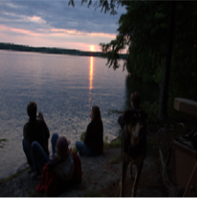
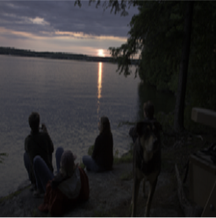

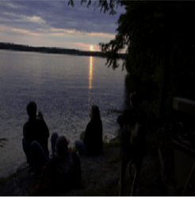
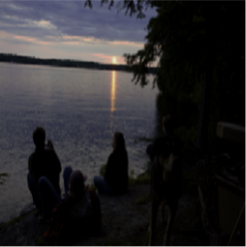
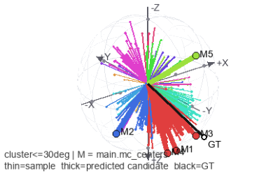
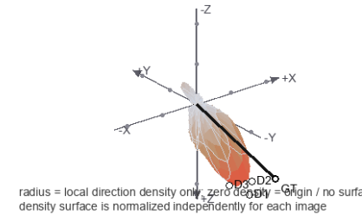
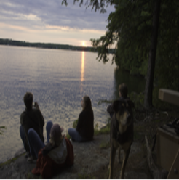
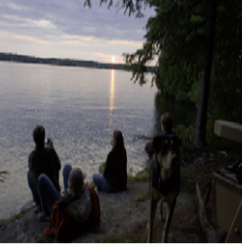
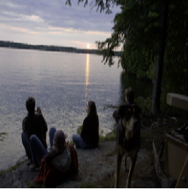

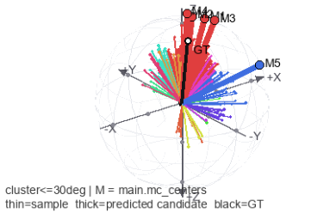
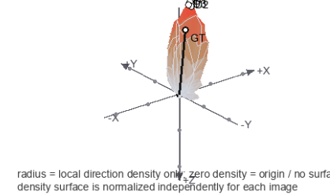
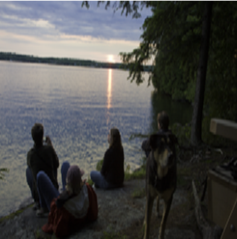
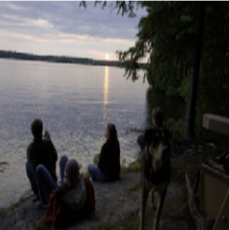
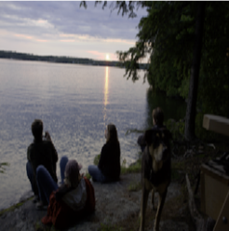

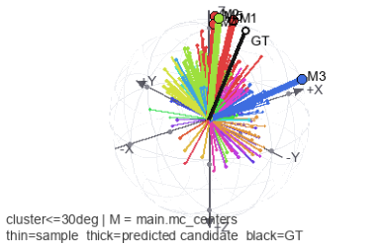
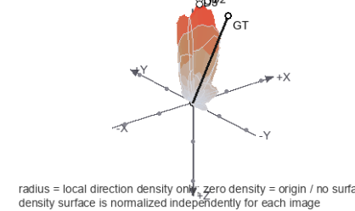
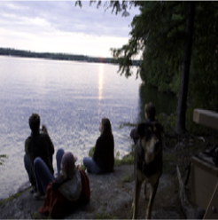
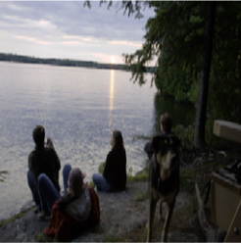
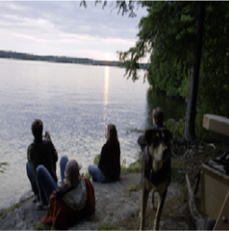
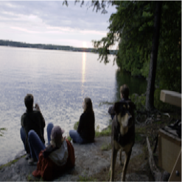
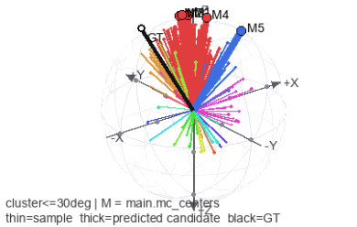
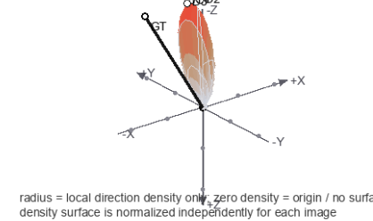
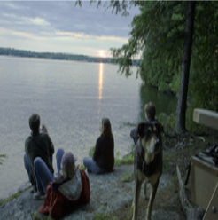
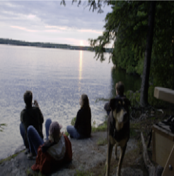




//
17
Quantitative results on FiveK
Same image · different expert histories
FiveK PSNR (dB)
Selected training-image diagnostic · not test averages
Expert E excluded from training
Target
Top-1
Best-3*
Best-5*
Samples
Density
EXPERT
TOP-1
BEST-3*
BEST-5*
A
A
23.591
25.721
26.809
B
25.177
26.378
27.135
B
C
23.595
25.173
26.344
D
22.183
23.735
25.167
C
E
23.263
24.947
25.617
D
Mean
23.562
25.191
26.214
23.263 dB
0.8852
E
Unseen Expert E · Top-1
Mean Top-1 SSIM
*Best-of-K uses the target offline.
Higher scores show candidate coverage, not automatic best-edit selection.
Thin rays: sampled z vectors; thick rays: representatives; black: target. Direction density is normalised per image.
REPORT 3.5.1
17 / 25
Notes:
Presenter 6 — unassigned
FiveK mean Top-1 PSNR reached 23.562 dB. Top-3 and Top-5 results reached 25.191 and 26.214 dB. Expert E, completely excluded from training, reached 23.263 dB Top-1. These results support adaptation to unseen editing preferences without further training. Improved Best-of-K scores indicate better candidate coverage.
Source: report 3.5.1.
The interactive source remains available in the course project folder.

Slide 18






























//
18
Comparison with existing methods
FiveK · Top-1 PSNR (dB)
PPSD candidate examples
Selected examples from the supplied figure
Input
Target
#1
#2
#3
1
30.03
28.45
31.51
2
31.87
29.23
31.36
3
METHOD
SSIM
HISTORY / REFS
31.94
36.63
18.55
PieNet
0.851
100
4
33.50
34.84
20.90
RefRetouch
0.9
100
5
Our model
0.8852
8
32.50
27.46
27.23
PPSD: 24.5 dB
6
PrefLUT: 22.094 dB · differing protocols
31.64
35.53
17.36
Candidate PSNR (dB) · model order; #1 need not score highest.
Performance context, not a matched benchmark. Splits and reference counts differ; RefRetouch has higher SSIM.
REPORT 3.5
18 / 25
Notes:
Presenter 6 — unassigned
We compared with personalized retouching methods including PieNet and RefRetouch. Our model achieved competitive FiveK PSNR with eight historical examples, and approximately 24.5 dB on PPSD. Training configurations, reference counts and evaluation procedures differ, so the comparisons provide context rather than proving superiority under identical conditions.
Source: report 3.5.
The interactive source remains available in the course project folder.

Slide 19
//
19
Ablation studies
Both conditions contribute. Current-image information has the larger effect.
−3.3
dB
Wrong current image
−1.2
dB
Wrong user history
Relative to the complete model: 23.5 dB.
Current image
+
Historical preferences
→
Conditional prediction
REPORT 3.6
19 / 25
Notes:
Presenter 7 — unassigned
The complete model achieved 23.5 dB. Wrong current-image conditioning reduced this to 20.2 dB, and wrong history reduced it to 22.3 dB. Expert-average vectors reached 22.1 dB; the original image scored 18.3 dB. Both conditions contribute, with stronger image dependence in this experiment.
Source: report 3.6.
The interactive source remains available in the course project folder.

Slide 20


//
20
Multimodal evaluation and test limitations
What the figures show
One condition can produce several
candidate edits.
Thin rays: samples.
Marked rays: candidate vectors.
Black ray: recorded target.
Density radius shows local direction
counts, normalised per image.
Conditioning → sampled edit space → multiple outputs
Testing limitations
Best-of-K uses ground truth offline.
One recorded edit cannot establish that
every candidate is preferred.
Top: schematic with two history pairs drawn; the model
uses eight. Bottom: a supplied PPSD result.
3D samples: direction + magnitude
Direction density: ignores magnitude
REPORT 2.5, 3.3, 3.5
20 / 25
Notes:
Presenter 7 — unassigned
We evaluated multimodality through probability-density visualization and Top-K analysis. The learned conditional distribution generates different candidates, and Best-of-K improves as more candidates are considered. However, ground truth selects the best candidate offline. With usually only one recorded edit per image and user, these experiments cannot establish that every candidate represents a genuine preference.
Source: report 2.5, 3.3, 3.5.
The interactive source remains available in the course project folder.

Slide 21
//
21
Discipline knowledge, implementation and tools
Python
PyTorch
CUDA
One integrated research pipeline
01
→
02
→
03
→
04
CNN
3D z + LUTs
Transformer
Flow
Image features
Compact edits
History context
Conditional density
Computer vision
Representation learning
Sequence learning
Probabilistic modelling
≈39.7
115.9
RTX 4060
ms
MiB
Monte Carlo inference
Peak CUDA allocation
Laptop GPU · 256 × 256
Batch 1, fresh history; inputs on GPU, historical z cached. Model-side timing excludes loading, disk I/O and application overhead.
REPORT 3.7, 4.1
21 / 25
Notes:
Presenter 8 — unassigned
Our project combines convolutional image encoding, learnable LUT reconstruction, Transformer history processing and Conditional Normalizing Flow density modelling. We implemented the system primarily with Python, PyTorch and CUDA. Under the specified GPU benchmark conditions, single-image Monte Carlo inference took approximately 39.7 milliseconds.
Source: report 3.7, 4.1.
The interactive source remains available in the course project folder.

Slide 22





//
22
Client feedback and architecture evolution
From one edit to a distribution
Experiments + client feedback
01
→
02
→
03
→
04
→
05
✓
Language +
Dynamic grouping
Memory slots
Similarity retrieval
Conditional density
segmentation
Instructions → regions
Similar edits → groups
History → stored styles
Image → nearest edit
Image + history → p(z)
Segmentation errors; still
Edit groups did not represent
Soft retrieval averaged edits;
≈30% accuracy; one
A distribution represents
needs instructions.
real users.
hard retrieval fixed styles.
neighbour was unreliable.
multiple possible edits.
Regular client discussions and experimental findings shaped the architecture.
REPORT 2.7, 4.6
22 / 25
Notes:
Presenter 8 — unassigned
We explored semantic controls, dynamic grouping, memory, and similarity retrieval before adopting conditional density modelling. Experiments exposed deterministic retrieval and preference representation limits. Regular client discussions informed priorities; no individual architectural change is attributed to a particular meeting without evidence.
Source: report 2.7, 4.6.
The interactive source remains available in the course project folder.

Slide 23
//
23
Project management and collaboration
ENGINEERING
01
COMMUNICATION
02
DELIVERY
03
GitHub
Zoom + WeChat
9 members
Version control · integration
Client reviews · team alignment
Shared, evolving responsibilities
01
→
02
→
03
→
04
↺
Research
Prototype
Evaluate
Review
Review literature
Build & integrate
Run experiments
Discuss with client
Agree on a testable hypothesis.
Coordinate model interfaces in
Compare findings and feasibility.
Adjust priorities and
GitHub.
responsibilities.
Self-managed research workflow with regular client communication.
REPORT 4.1–4.6
23 / 25
Notes:
Presenter 9 — unassigned
Our team used GitHub for version control and collaboration, and Zoom and WeChat for communication. Regular client reviews linked literature, prototypes, experiments and revised priorities. Responsibilities evolved with feasibility and experimental findings.
Source: report 4.1–4.6.
The interactive source remains available in the course project folder.

Slide 24
//
24
Individual contributions
Nine contributors, one delivery chain.
YD
Yuchen Deng
GX
Gary Xu
SF
Sihan Fang
Prototype; integration; client coordination.
Completed work not specified in Table 6.
Completed work not specified in Table 6.
YC
Yiming Chen
YG
Yiheng Guo
LW
Lunyan Wang
Progress reflections; presentation and
Doomsayer; deliverables not specified.
Flow5 model; training; evaluation.
demo review.
WS
Weishao Su
XC
XingTang Chen
ZZ
Zihao Zhang
Team management; meeting minutes.
Interactive slides; FiveK preparation;
Tracker; deliverables not specified.
report.
Contributions: report Table 6. Deliverable gaps remain explicit.
Research → development → evaluation → delivery
REPORT 6, TABLE 6
24 / 25
Notes:
Presenter 9 — unassigned
Our team contributed across literature review, neural network development, data preparation, experimental evaluation, software testing, documentation and client communication. Responsibilities followed the needs of each development stage. Members integrated the retouching encoder–decoder, Transformer, Flow and evaluation pipeline. All nine members are summarized here.
Source: report 6, Table 6.
The interactive source remains available in the course project folder.

Slide 25

//
25
Reflections, limitations and conclusion
Personalization as
a distribution of edits.
P(z | image, history)
Original and recorded expert edit, FiveK a0412.
Current limitations
Weaker history dependence
Global colour and tone edits only
Limited subjective preference validation
3D + LUTs
Transformer
Flow
Thank you / Q&A
compact edits
history context
multiple candidates
REPORT 5.1–5.5
25 / 25
Notes:
Presenter 9 — unassigned
Our primary contribution is reformulating personalized retouching as conditional probability density modelling rather than single-output prediction. A low-dimensional retouching representation makes continuous density estimation practical. Transformer conditioning and Conditional Normalizing Flow generate multiple candidates for unseen users without additional training. Historical preference modelling remains limited, and the LUT decoder mainly supports global colour and tone adjustments. Thank you for listening.
Source: report 5.1–5.5.
The interactive source remains available in the course project folder.

