Slide 1


Furniture Store Information Management System
GROUP 18

Slide 2
Members of the group
BI11-189 Phạm Lê Đức Minh
BI11-173 Hoàng Nhật Minh
BA10-044 Trần Xuân Phong
BA10-033 Lê Duy Long
BI11-192 Phùng Phú Mỹ
BI10-057 Ngô Hoành Hiệp
BI11-280 Hoàng Minh Tuấn

Slide 3
TABLE OF CONTENTS
01
02
03
04
Product Introduction
Structure
Demo
Conclusion

Slide 4
01
Product introduction

Slide 5
Furniture store information management system provides detailed information about customers such as name, address, phone number, as well as essential information about the item such as price, quantity,...

Slide 6
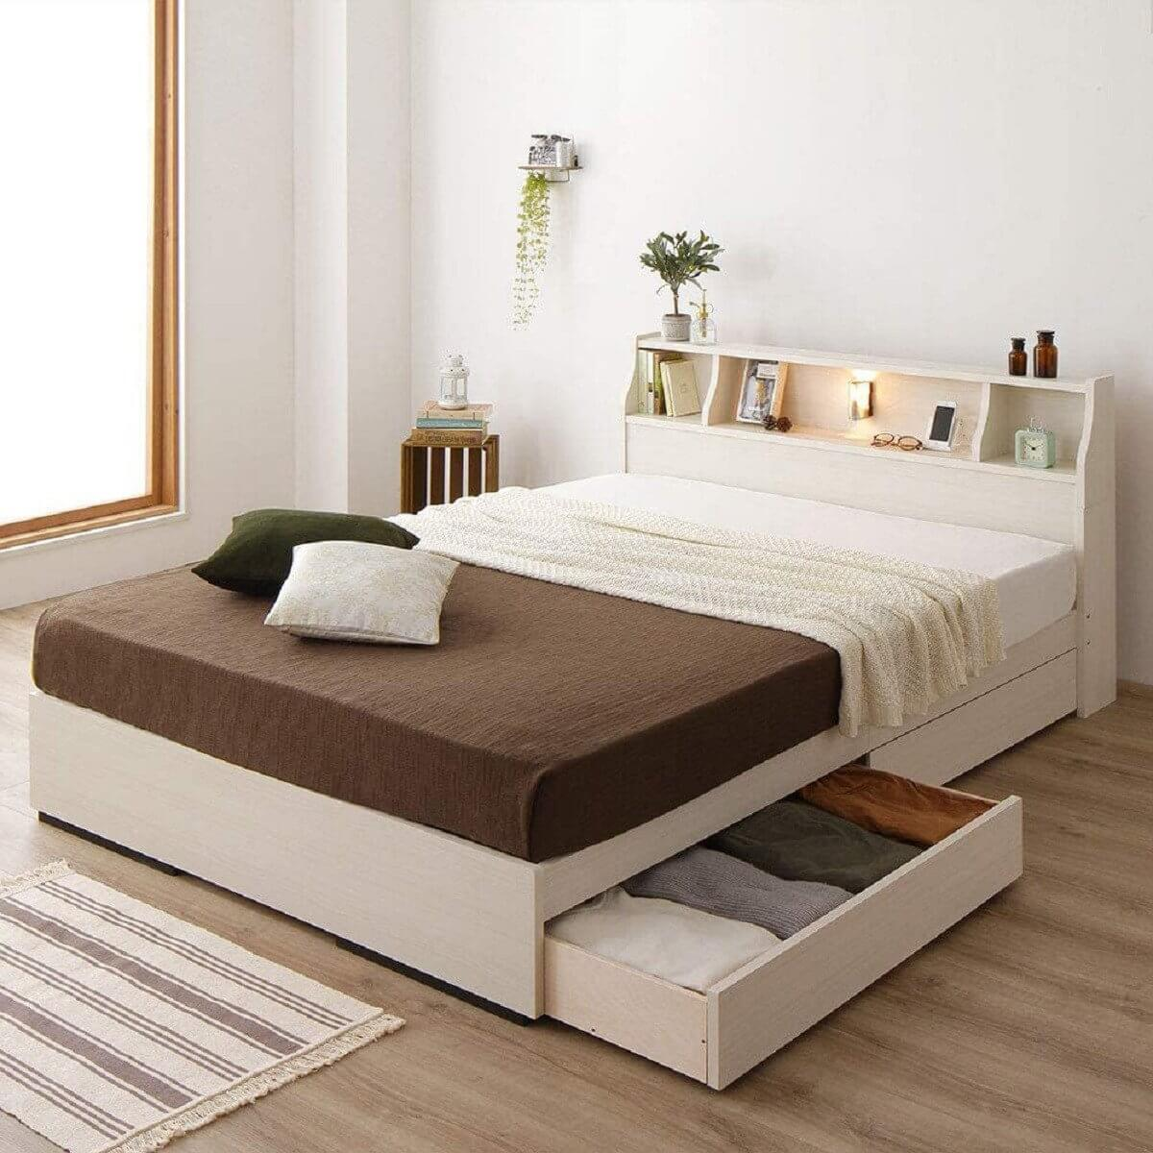
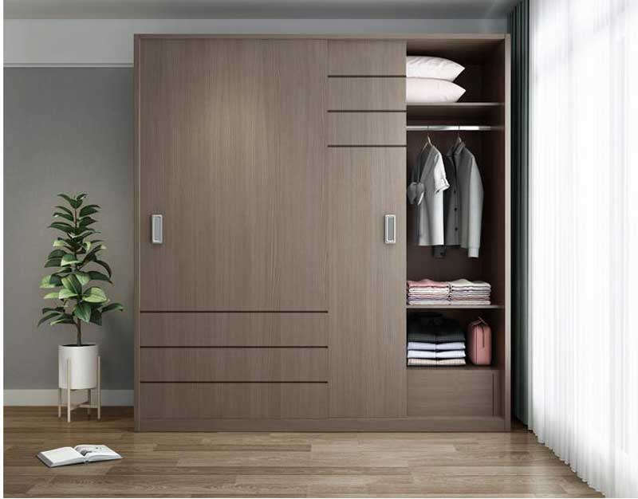

Our system provides the host company with information about existing products, and at the same time, easily update product information. Not only that, customers can easily choose the products that are suitable for their pocket.
Our system provides the host company with information about existing products, and at the same time, easily update product information. Not only that, customers can easily choose the products that are suitable for their pocket

Slide 7

02
Structure

Slide 8
Class
Login class: provide the interface and system features in the management of products and customer information
Bill class: Provide necessary information about products as well as customers.
Product class: Product information management.

Slide 9
Modules & Package
Sign up: Managers can log in to their account to view product details as well as customer information.
Administration: Manager can update information, delete, add, view list of products as well as customers.
Package: (tkinter) user interface creation pack

Slide 10
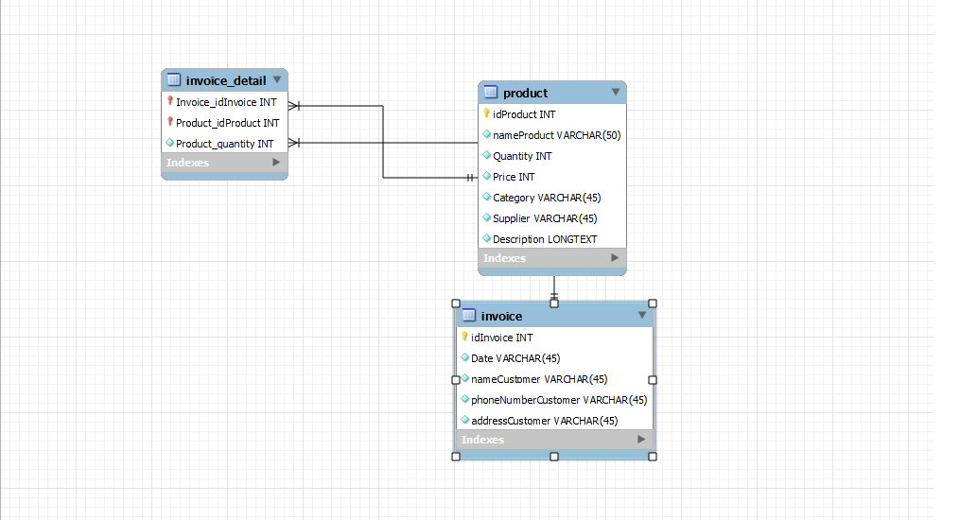
Database

Slide 11
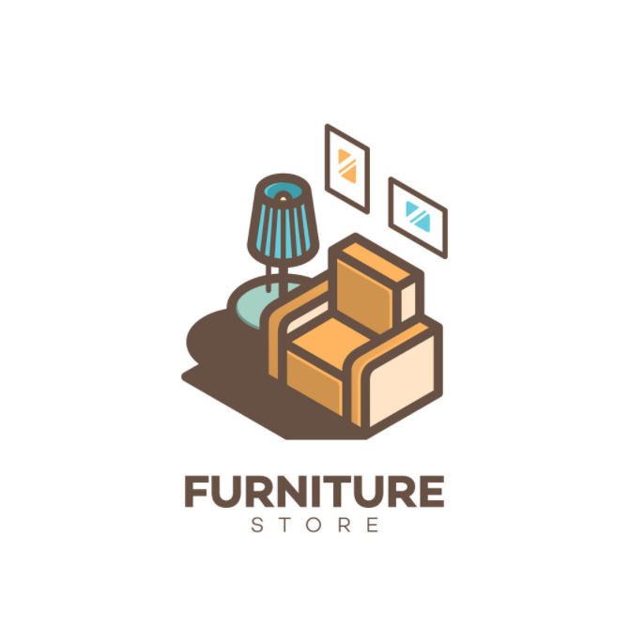
03
Demo

Slide 12
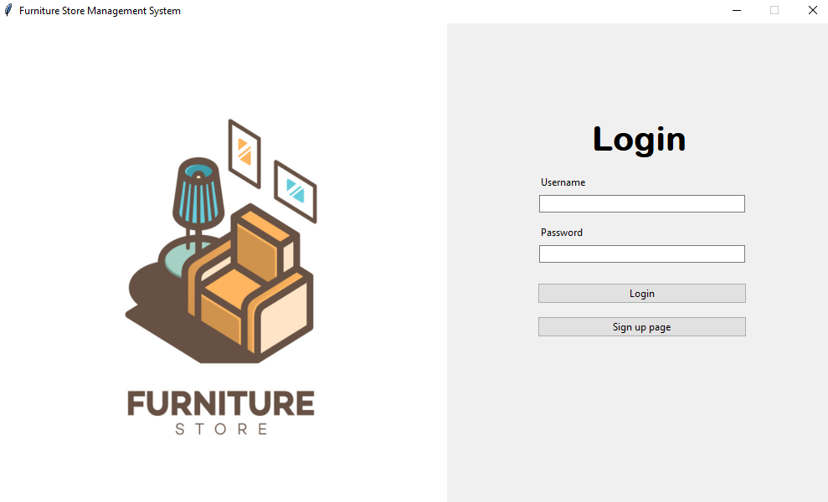

Slide 13
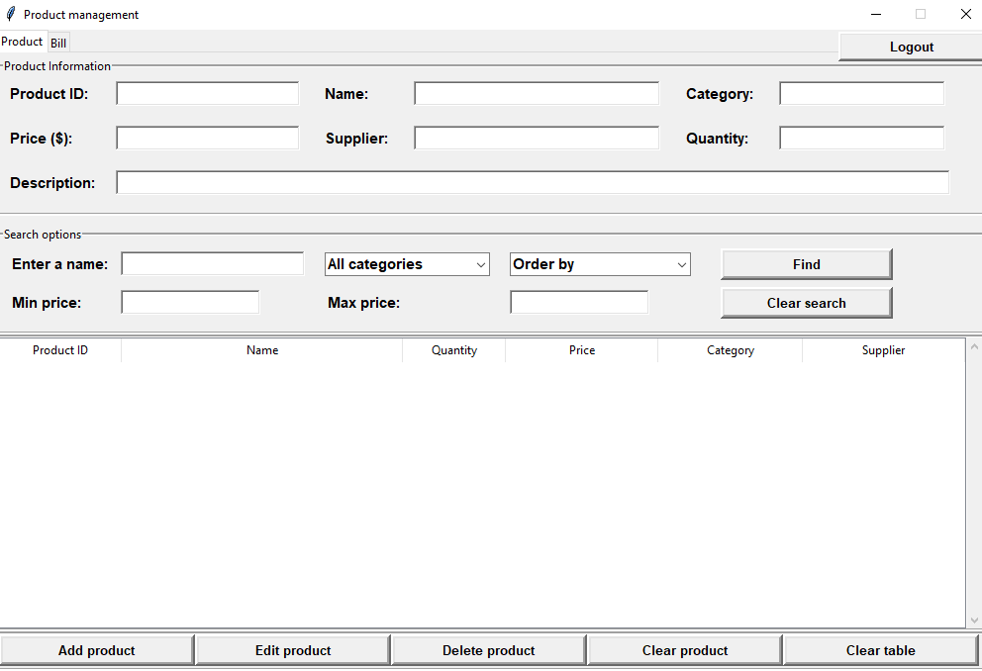

Slide 14
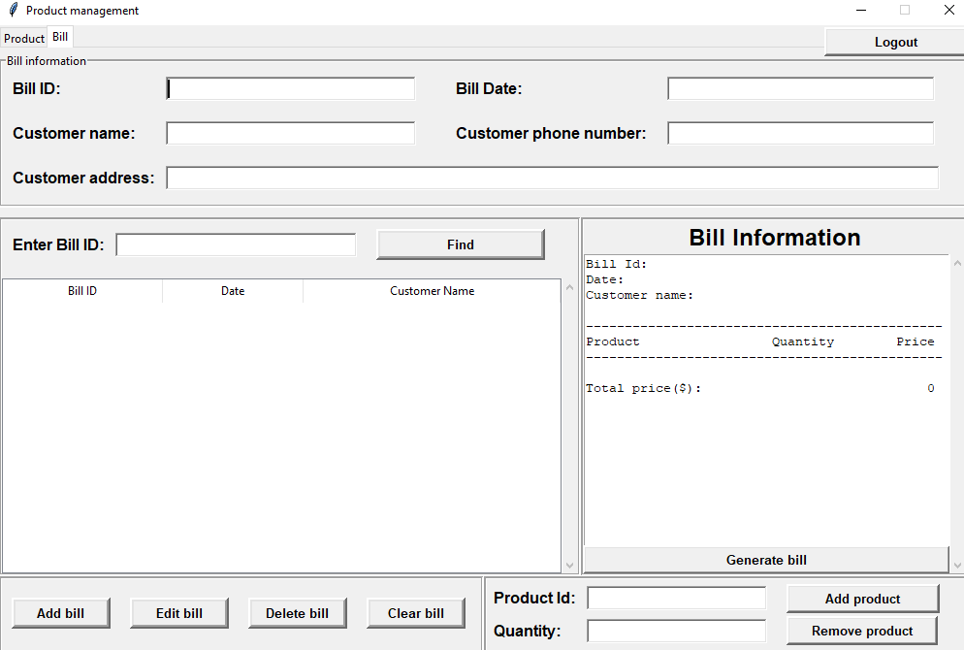

Slide 15

04
CONCLUSION

Slide 16

Our system helps managers easily access product information as well as capture customer information.
Although the system is a bit simple, we always try to make it the best we can.

Slide 17

Thank you for listening

