Slide 1
Natural Scene Classification
Comparing classical ML, a from-scratch CNN, and transfer learning
for automated photo scene tagging
Capstone Three • Data Science Career Track

Slide 2
The Problem
Can a model automatically tell what kind of scene a photo shows — without a human tagging it?
Buildings
Forest
Glacier
Mountain
Sea
Street
6 target classes — Intel Image Classification dataset
~17,000
11,928
3,000
labeled photographs
training images
held-out test images
Why it matters: photo apps, mapping platforms, and content moderation all need to auto-tag scenes at scale — manual tagging doesn't.

Slide 3
Three Models, Increasing Complexity
Rather than jump to the fanciest technique, we measured what each step actually adds.
1
2
3
Random Forest
CNN from Scratch
Transfer Learning
Classical ML baseline
Learns its own features
MobileNetV2 + ImageNet
7 hand-engineered features: color averages, brightness, contrast, edge density, blue-hue fraction
Convolutional network trained directly on raw, normalized pixels — no manual feature engineering
Frozen backbone pretrained on 1.4M ImageNet images, with a new classifier head trained on top
All three trained on the same split; best validation performer evaluated once on the untouched test set.

Slide 4
Transfer Learning Wins, By a Wide Margin
90.1%
Transfer learning validation accuracy
+8.8 pts
Improvement over from-scratch CNN
+36.6 pts
Improvement over Random Forest baseline

Slide 5
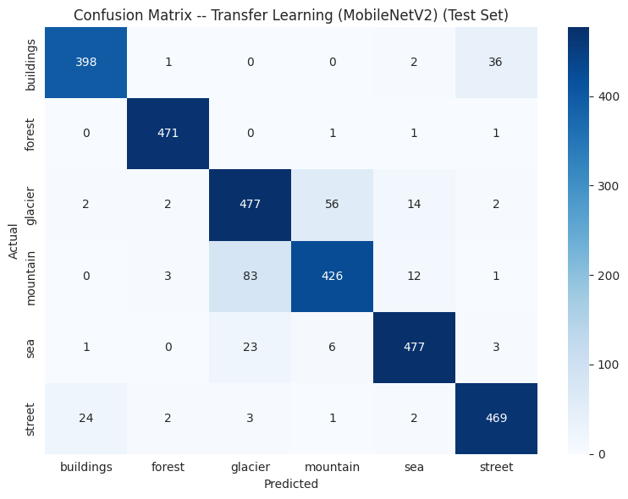
Where the Model Struggles
Final test set: 90.6% accuracy • 0.909 macro F1
Main confusion: glacier ↔ mountain
56 glacier images predicted as mountain; 83 mountain images predicted as glacier. Both share rocky, snow-covered color palettes and composition — a mistake a person could plausibly make too.
Strongest classes
Forest: 99% F1
Sea: 94% F1 • Street: 93% F1 • Buildings: 92% F1
Secondary mix-up: buildings ↔ street (urban color/structure overlap)

Slide 6
Recommendations
1
Deploy the transfer-learning model
90.6% test accuracy is strong enough to meaningfully cut manual tagging effort, and the frozen MobileNetV2 backbone is light enough to run at scale or on-device.
2
Target glacier/mountain data collection
That single confusion accounts for the large majority of remaining errors. A focused data effort there beats collecting more data uniformly across all six classes.
3
Use confidence-based human review
Flag low-confidence predictions on the glacier/mountain boundary for review — catching most likely errors without reviewing every prediction.
Further research: fine-tuning the backbone, data augmentation, alternative pretrained architectures, and image-level error analysis.

