Slide 1
01
Big Data Analytics Micro-Project.
Name :- Muhammed Raihan
Group:- 10
Topic :-Website Log Analysis Using MapReduce in R Without Hadoop

Slide 2
Introduction
02
A local, chunk-based approach to understanding website activity and server performance.
Analyzes large website access log files to understand user activity and server performance.
Processes an approximately 3.26 GB access log file.
Uses R to process the file in chunks of 50,000 lines to reduce memory usage.
Extracts client IP addresses, requested URLs, HTTP status codes, request methods, timestamps, and response sizes.
INPUT SCALE
≈ 3.26 GB
access log file
PROCESSING UNIT
50,000
lines per chunk

Slide 3
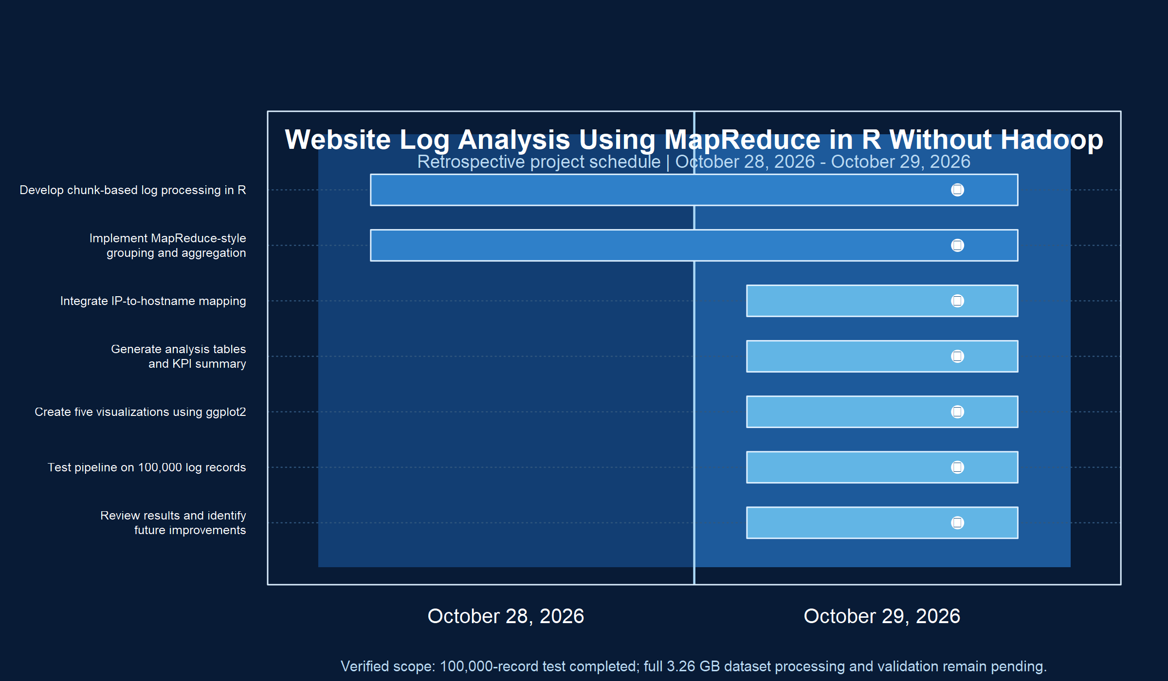
03

Slide 4
Objectives
04
Analyze popular URLs and active client IP addresses.
Understand HTTP status code distribution and request methods.
Calculate bandwidth usage and identify missing resources.
Identify potential anomalous traffic patterns.
Generate analysis tables, summary reports, and visualizations using ggplot2.
ANALYTICS OUTPUTS
POPULARITY
URLs and clients
RELIABILITY
Status codes and missing resources
USAGE
Bandwidth and methods
INSIGHT
Potential anomalies

Slide 5
Current Results: 100,000-Record Test
05
RECORDS
URLS
CLIENT IPS
BANDWIDTH
404 RATE
100,000
2,793
6,797
1.604 GB
0.66%
valid requests
unique URLs
unique clients
served
665 errors
TOP REQUESTED URLS
STATUS AND METHOD DISTRIBUTION
1
/images/NASA-logosmall.gif
6,085
6.08%
200 • 91.10% 304 • 6.85% 302 • 1.38% 404 • 0.66%
2
/images/MOSAIC-logosmall.gif
4,804
4.80%
GET • 99.70% HEAD • 0.29% POST • 0.01%
3
/images/USA-logosmall.gif
4,802
4.80%
TOP ACTIVE CLIENT
4
/images/WORLD-logosmall.gif
4,750
4.75%
edams.ksc.nasa.gov — 662 requests
5
/images/ksclogo-medium.gif
4,639
4.64%
Potential anomalous traffic indicators are presented for investigation only.

