Slide 1




SUPERVISED MACHINE LEARNING PREDICTS STUDENT PERFORMANCE
Advancing SDG 4 — Quality Education
Presented by: Sharon Kipsang

Slide 2



01
THE PROBLEM
SDG 4 Goal:
Ensure inclusive, equitable, and quality education for all.
Challenge
🔸 Many students fail or drop out due to lack of early support.
🔸 Educators often only realize issues after poor final grades.
Impact
✔️ If we can predict student performance, educators can offer help before it’s too late.

Slide 3

02
ML APPROACH
Dataset :
UCI Student Performance Dataset (395 students)
Target :
Final grade (G3)
Features :
Academic (G1, G2), absences, study time, failures, family background, and behavior.
ML Model :
Random Forest Regressor — supervised learning
Goal :
Predict final grade → support at-risk students

Slide 4
03
HOW THE MODEL WORKS
Student data (grades, absences, study time, family info)
Input :
This student is likely to score 13 out of 20 in the final exam."
Prediction :
G1, G2 → earlier grades
Absences, Study Time
Failures
Strong Predictors:
R² = 81% (explains most of the variation)
MAE = 1.16 points error (on average)
Model Accuracy

Slide 5

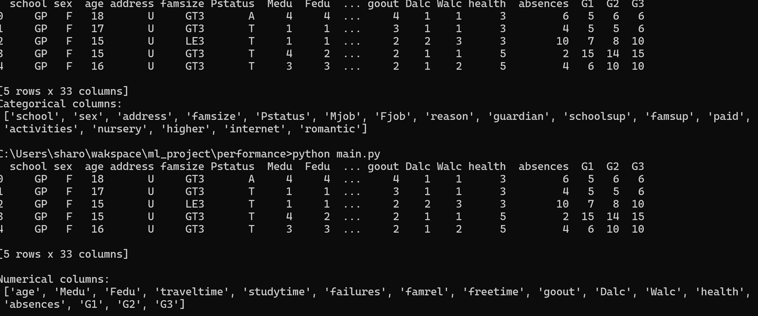
a. Data Display
04
MODEL IN ACTION
Data categorization into categorical and numerical

Slide 6
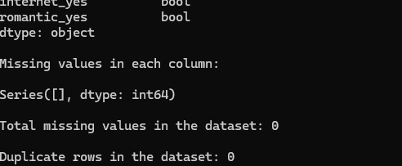
b. Preprocessing
- Check and handle missing values (none found).
- Check for and handle duplicate rows.
- Split the data into training (80%) and testing (20%)

Slide 7

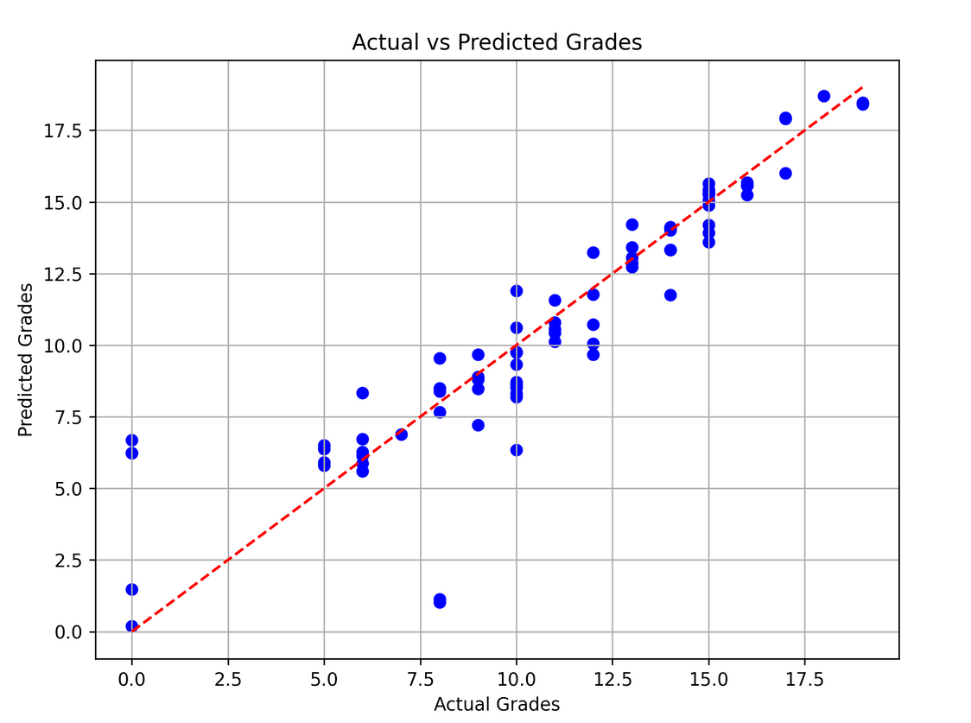
c. Results after training
Actual vs Predicted Grades scatter plot where data points are closely clustered along the red diagonal line
A few points deviate.

Slide 8


RESULTS :
Strong Influencers:
🔸First and second grades variables had the most direct impact on predicting G3
05
Moderate Influencers:
🔸Absence, study time and past class failures
RESULTS & ETHICAL CONSIDERATIONS
Least Influencers:
🔸 Sociodemographic Factors:
These have some but lesser impact:
Medu and Fedu (Mother's and Father's education).
ETHICAL :
🔸 Protect student privacy (family & personal data).
🔸 Avoid reinforcing social biases — use predictions to help, not label.
🔸 Model is a tool to assist teachers, not replace them.

Slide 9


07
IMPACT ON SDG
🌟 How This Supports SDG 4
✅ Enables early interventions before final exams.
✅ Helps educators offer support: tutoring, counseling, mentorship.
✅ Reduces failure and dropout — improving equitable education

Slide 10

Q & A
Project by:
Name: Sharon Kipsang
Git:

