Slide 1

NS Spoofing Attack using Ettercap Collapse
Introduction to DNS Spoofing
What is DNS Spoofing?
DNS Spoofing, or DNS Cache Poisoning, is an attack where malicious DNS responses are sent to a victim, causing them to visit fraudulent websites.
Why is it Dangerous?
Data theft: Stealing sensitive login credentials and personal details.
Malware injection: Redirecting victims to compromised servers for malware delivery.
Phishing and ransomware: Redirecting to fake sites resembling legitimate ones.

Slide 2
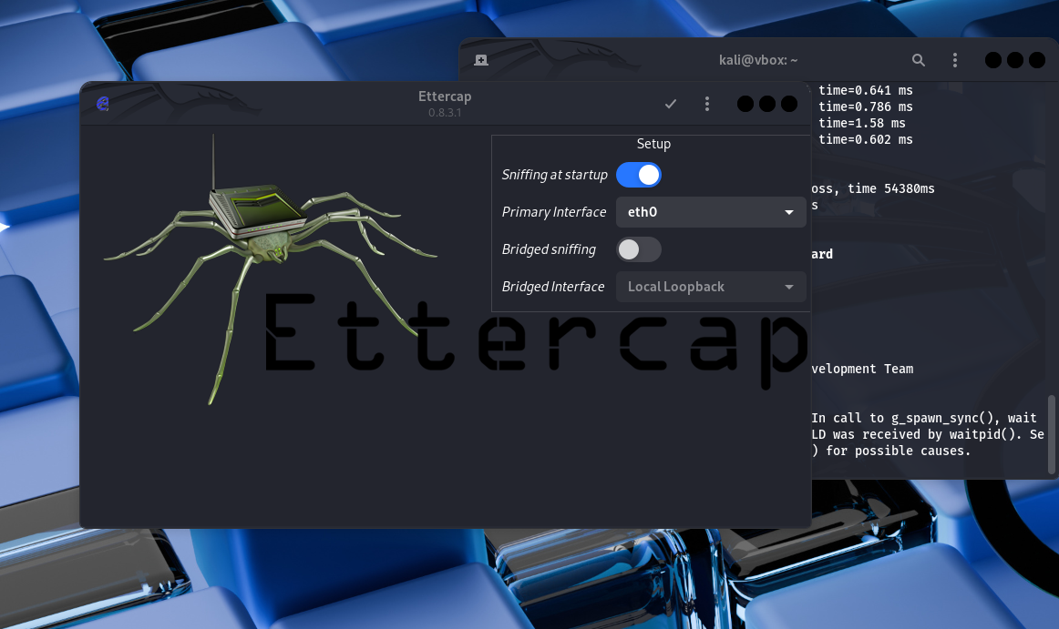
NS Spoofing Attack using Ettercap Collapse
Tools Used
Kali Linux:
Attacker machine equipped with penetration testing tools like Ettercap.
Ubuntu:
Victim machine receiving DNS responses from the attacker.
Ettercap:
Tool used to perform ARP poisoning and DNS spoofing.
Supports active and passive sniffing, and network traffic manipulation.
Kali Linux (Attacker Machine) with Ettercap installed.

Slide 3
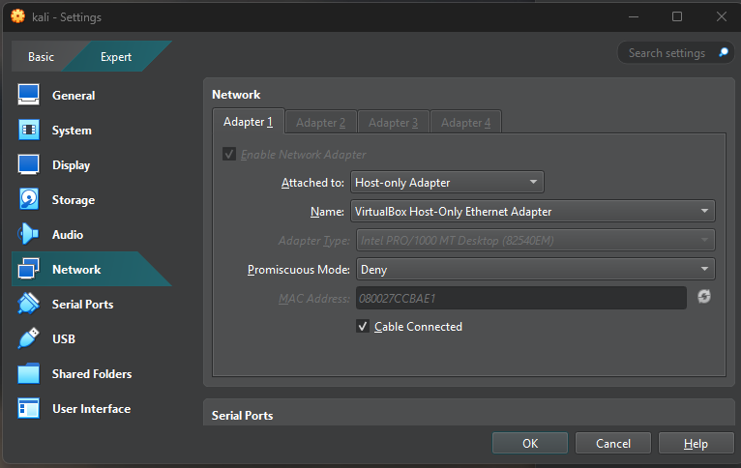
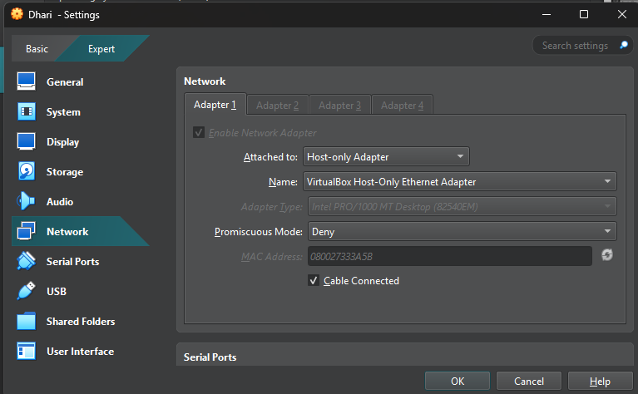
NS Spoofing Attack using Ettercap Collapse
Network Setup
Attacker: Kali Linux (ARP Spoofing, DNS Spoofing).
Victim: Ubuntu (receives poisoned DNS responses).
Gateway: Network router directing traffic between attacker and victim.
Network Configuration: Kali Linux (Attacker) and Ubuntu (Victim) on the same isolated network using Host-Only Adapter

Slide 4
NS Spoofing Attack using Ettercap Collapse
ARP Spoofing - Command Example
What is ARP Spoofing?
ARP Spoofing is a technique where the attacker sends false ARP (Address Resolution Protocol) messages on the network, misleading the victim into thinking the attacker’s machine is the network's gateway. This allows the attacker to intercept and potentially manipulate the victim's network traffic.
Command Example:
sudo arpspoof -i eth0 -t <192.168.56.104> <192.168.56.1>
This command redirects traffic from the victim to the attacker.

Slide 5
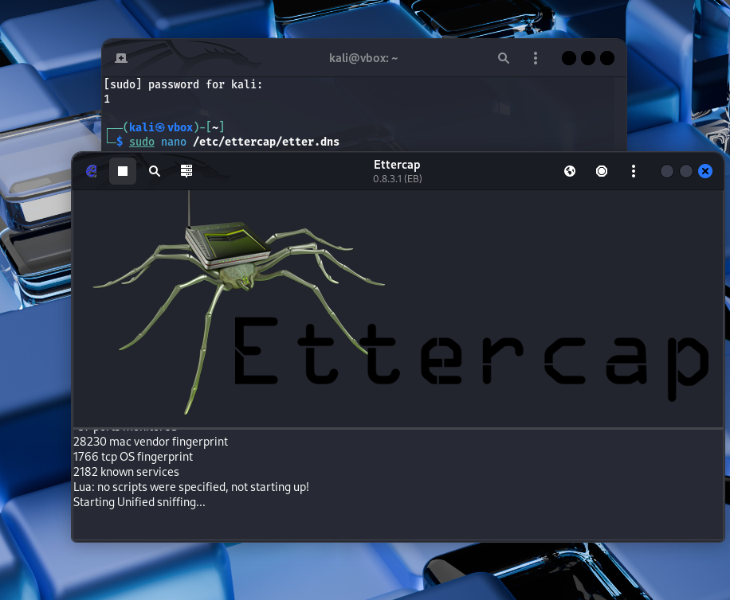
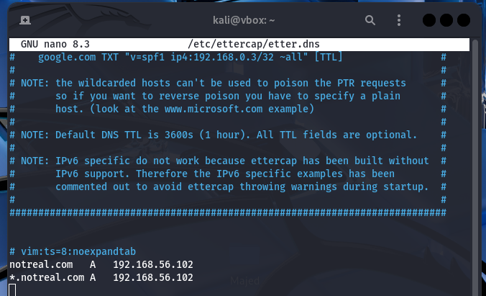
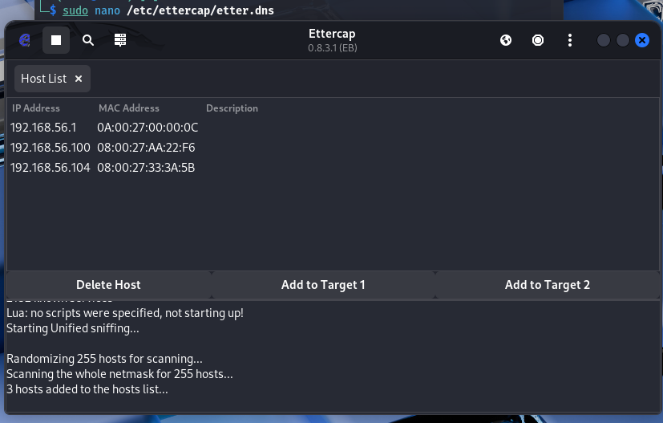
NS Spoofing Attack using Ettercap Collapse
DNS Spoofing with Ettercap
Ettercap Setup:
Start Ettercap in graphical mode using the following command:
sudo ettercap –G
DNS Spoofing Plugin Configuration:
Enable the DNS Spoofing plugin in Ettercap.
Modify the etter.dns file to specify fake DNS mappings (e.g., redirect www.google.com to http://notreal.com)

Slide 6
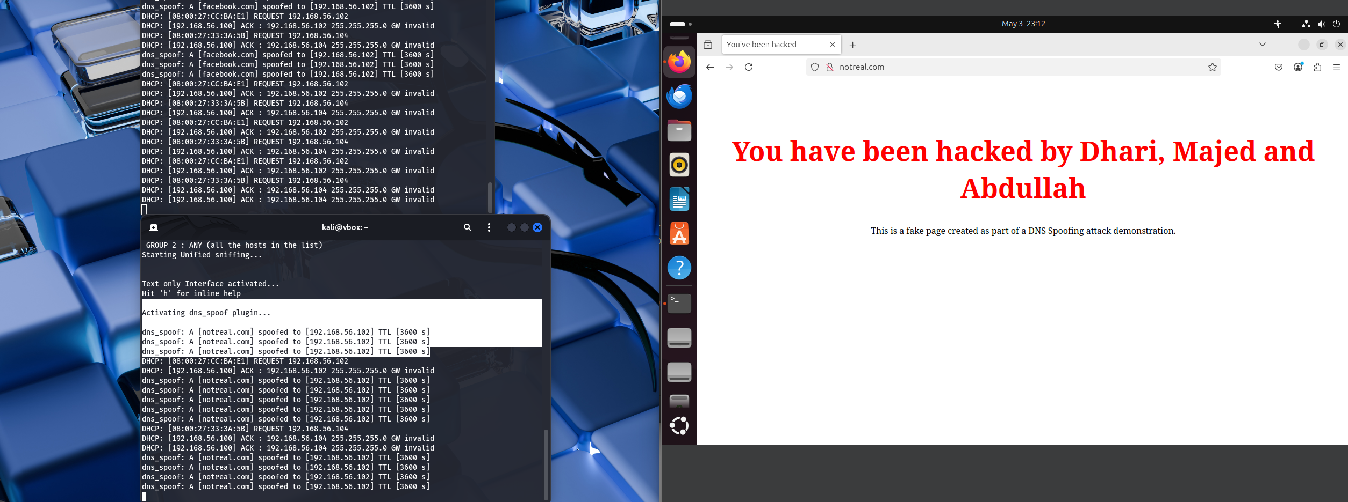
NS Spoofing Attack using Ettercap Collapse
Impact on the Victim
Phishing:
The victim is redirected to a fake website, http://notreal.com, where sensitive information (e.g., usernames and passwords) can be stolen.
Malware Infection:
The victim could unknowingly download malware from the spoofed site.
Man-in-the-Middle Communication:
The attacker can intercept and manipulate the victim's communication with legitimate websites.
Victim’s browser accessing the fake website: http://notreal.com.
Victim’s browser accessing the fake website: http://notreal.com.

Slide 7
NS Spoofing Attack using Ettercap Collapse
Prevention and Mitigation
DNSSEC (DNS Security Extensions): DNSSEC ensures that DNS responses are authentic and unmodified by using cryptographic signatures.
Static DNS Entries: Configure static DNS settings on client machines to prevent redirection.
Network Security: Use firewalls and IPSec to block malicious DNS traffic and enforce encrypted communication channels.
Regular Monitoring: Monitor DNS traffic and audit network systems to detect suspicious patterns or anomalies.

Slide 8
NS Spoofing Attack using Ettercap Collapse
Conclusion
Summary: DNS Spoofing is a serious attack method that can lead to data theft, malware infection, and phishing. Ettercap is an effective tool for demonstrating such attacks in a controlled environment.
Mitigation: To reduce the risks of DNS Spoofing, implement DNSSEC
(Domain Name System Security Extensions),
use static DNS entries, and continuously monitor network traffic

Slide 9
NS Spoofing Attack using Ettercap Collapse
References
Ettercap Documentation - Ettercap Project
DNS Spoofing Overview - CSO Online
Kali Linux Tools - Kali.org
Cybersecurity Basics - CSO Online

