Slide 1
Is Data Dangerous?
A.K.A. How Easy is it to be Evil?

Slide 2
With enough data one could:
Insight violence by identifying individuals' vulnerabilities and providing direct, provocative, false information… Russia
Increase voter turnout for a specific demographic by selectively displaying voting information… Facebook
Racially profile job candidates… Amazon
Lose all your data to a hacker and have to buy the data back with bitcoins… Hancock Regional Hospital
Cultivate extremism by only providing agreeable information… Google
Harvest the organs of religious minorities… China

Slide 3
What can we do with ride data?
Can we find where celebrities live by cross referencing social media with ride data?
so we can stock them
Can we find regions frequented by ride companies but not the police?
so we can steal cars
Can we find regions only one ride companies goes to?
so we can jack up the prices
Can we know which regions will vote republican or democrat in the 2020 election?
so we can strategically cause traffic jams on voting day

Slide 4
What can we do with ride data?
Nope
Can we find where celebrities live by cross referencing social media with ride data?
so we can stock them
Can we find regions frequented by ride companies but not the police?
so we can steal cars
Can we find regions only one ride companies goes to?
so we can jack up the prices
Can we know which regions will vote republican or democrat in the 2020 election?
so we can strategically cause traffic jams on voting day
Nope
Nope
Yep

Slide 5
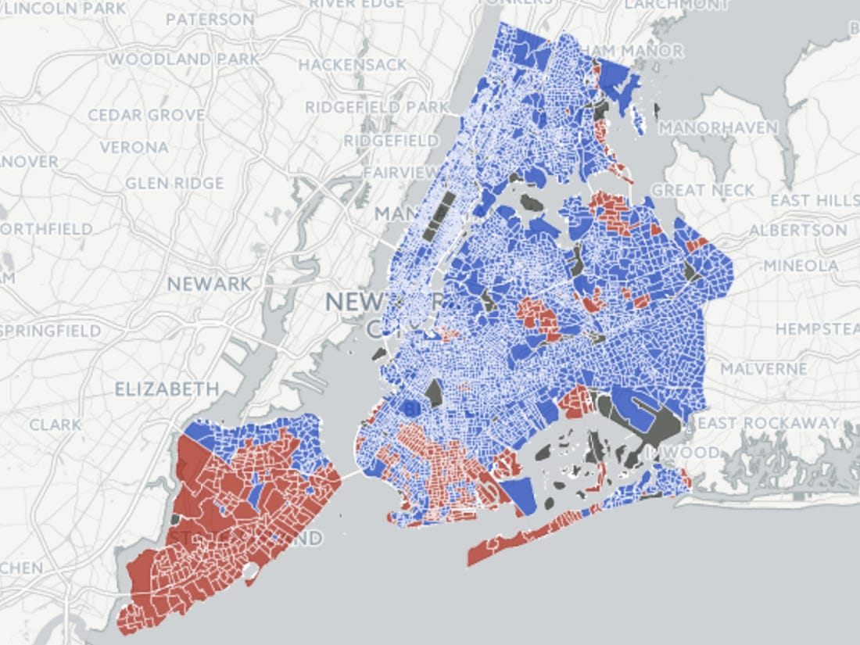
The Data
Inputs: Ratio of ride services used, and total trips, for each NY neighborhood in 2015.
Output: Did most people in the neighborhood vote for Donald Trump?
Note: The data is generalizable to other regions, as it has no location-based data.
https://image.businessinsider.com/583865efe02ba75c658b5342?width=1100&format=jpeg&auto=webp

Slide 6
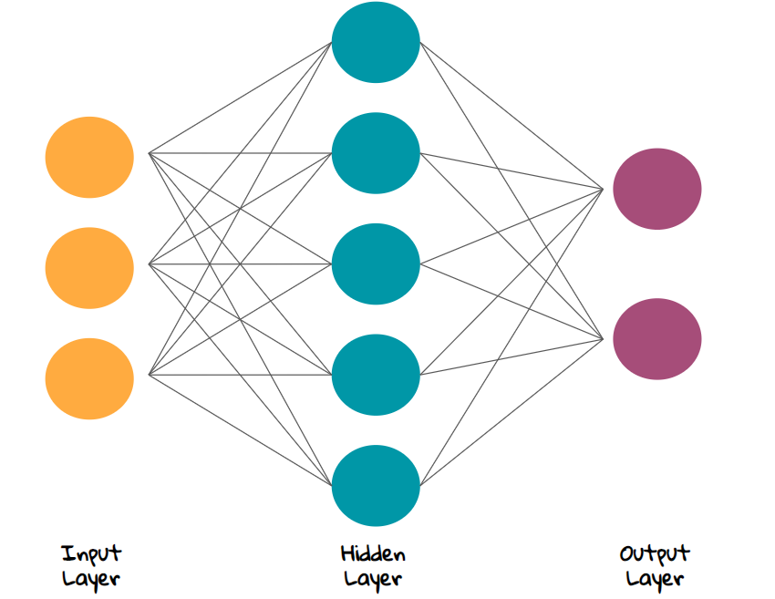
The Model
Feed-forward neural network with one hidden layer of 16 perceptrons with sigmoid activation functions.
Benefits: Non-linear, fast, probabilistic output
Built with Keras
https://miro.medium.com/max/1700/1*-NKbWbT9C8akN7Ht_W8nDw.png

Slide 7
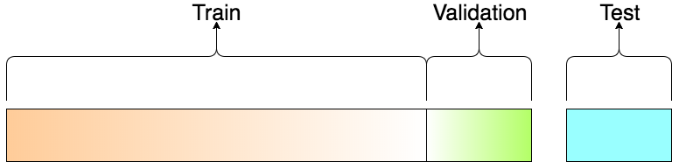
Training
258 neighborhoods had voter data available
60% of neighborhoods used for training
20% of neighborhoods used to prevent overfitting and adjust model parameters
20% of the neighborhoods held out for testing
No Overfitting!
https://miro.medium.com/max/1552/1*Nv2NNALuokZEcV6hYEHdGA.png

Slide 8
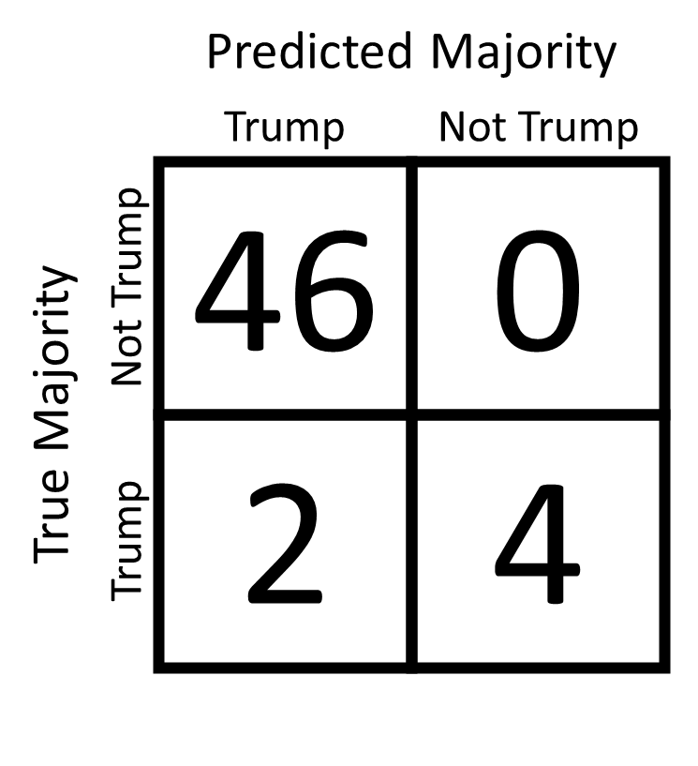
Results
WE DID IT!
Wow that was easy.
Like, why was that so easy?

Slide 9
Conclusions
Can you be evil?
Yes, but you’d need a lot of resources to do any real damage.
Should you be evil?
Ethics are subjective.

