Slide 1
Ride Services and Politics
Mia Barger ▪ Quincy Hershey ▪ Alexander Moore ▪ Ethan Prihar

Slide 2
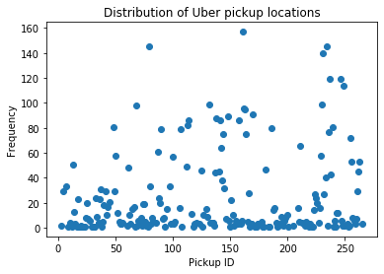
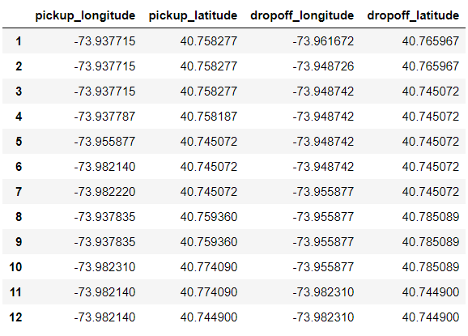
Data Exploration

Slide 3
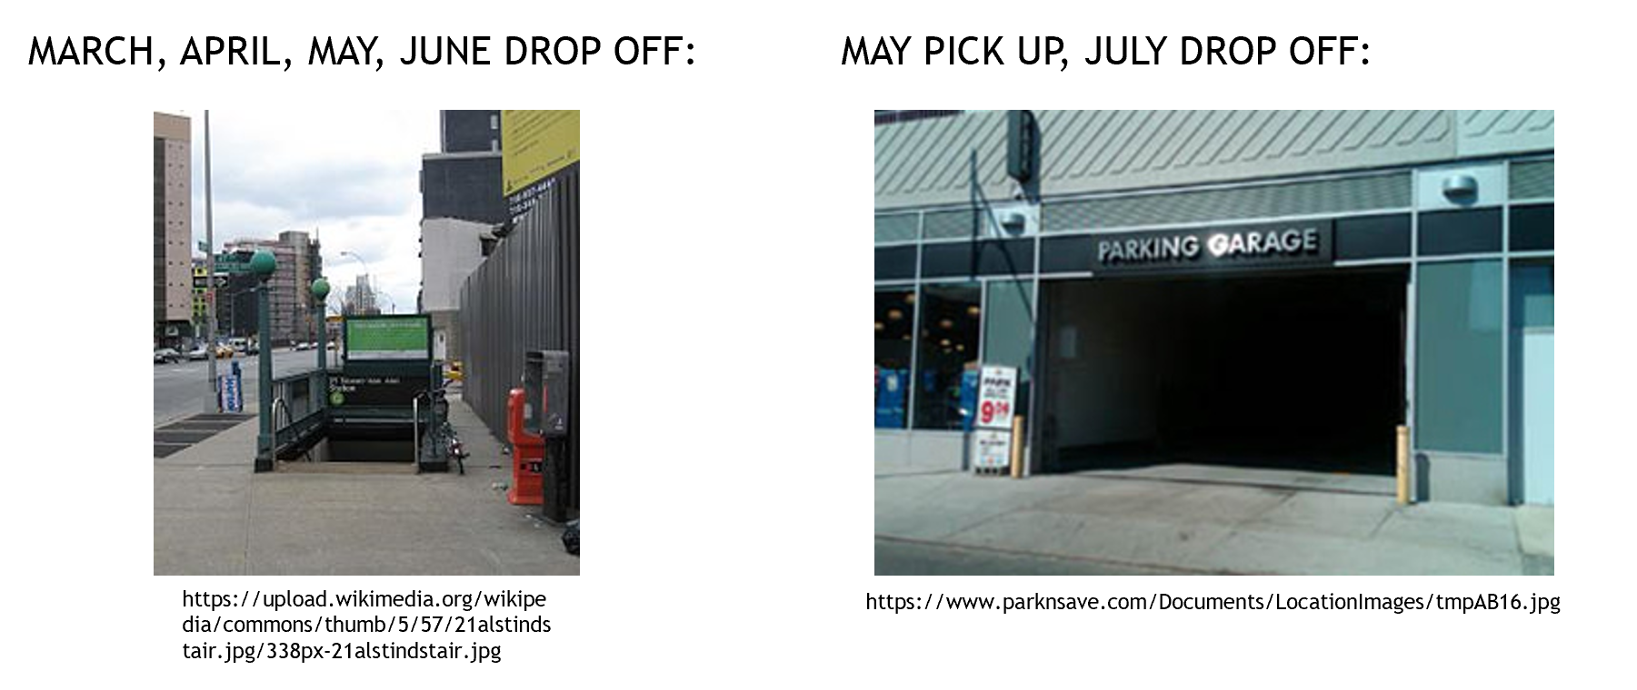
Data Exploration

Slide 4
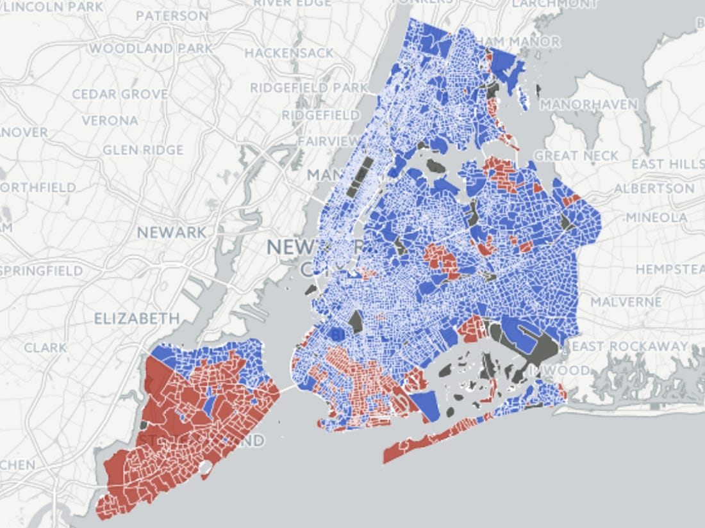
Political Data
Inputs: Ratio of ride services used, and total trips, for each NY neighborhood in 2015.
Output: Did most people in the neighborhood vote for Donald Trump?
Note: The data is generalizable to other regions, as it has no location-based data.
https://image.businessinsider.com/583865efe02ba75c658b5342?width=1100&format=jpeg&auto=webp

Slide 5
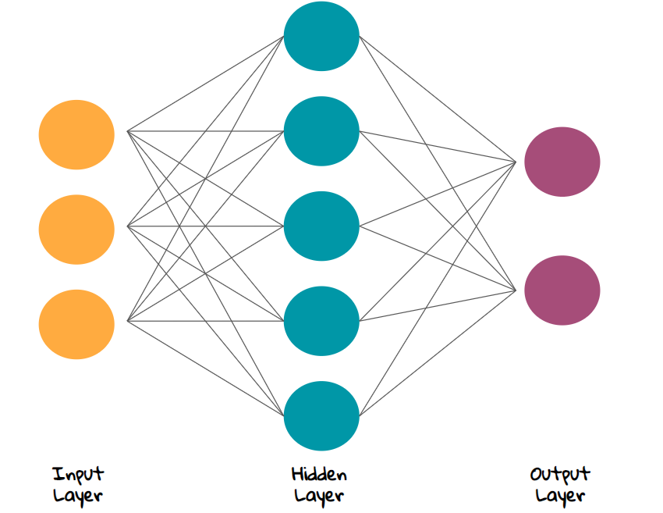
The Model
Feed-forward neural network with one hidden layer of 16 perceptrons with sigmoid activation functions.
Benefits: Non-linear, fast, probabilistic output
Built with Keras
https://miro.medium.com/max/1700/1*-NKbWbT9C8akN7Ht_W8nDw.png

Slide 6
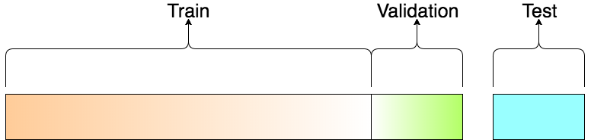
Training
258 neighborhoods had voter data available
60% of neighborhoods used for training
20% of neighborhoods used to prevent overfitting and adjust model parameters
20% of the neighborhoods held out for testing
No Overfitting!
https://miro.medium.com/max/1552/1*Nv2NNALuokZEcV6hYEHdGA.png

Slide 7
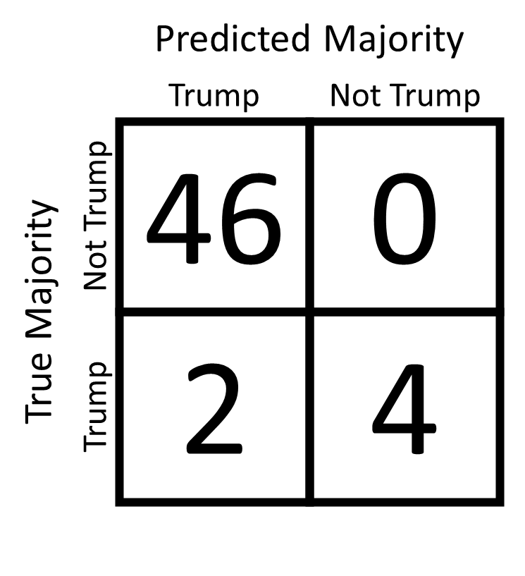
Results
WE DID IT!
96.2% Accuracy
WOOO!

Slide 8
What can you do with this model?
Any region can potentially be politically mapped if it has ride services.
Politicians can assess the political leanings of regions with limited polling data.
Political ad campaigns can purchase ad space in specific ride services.

