Slide 1
Data-Driven-Traffic-State-Prediction (DDTSP)
Using CTM as the predictive simulation and SEMSim as the real world

Slide 2
Model of the DDTSP

Slide 3
Implementation details
Calibrate CTM model parameters to ensure that it is as close as possible to SEMSim.
The parameters calibrated in CTM were:-
Ramp merge priorities
The time gap of vehicles. (Though it is kept constant in SEMSim at 1.5 seconds, the time gap of vehicles in CTM was varied from 1.25 sec to 1.5).

Slide 4
Parameters to calibrate in CTM
Merge priority on ramp
Merge priority expressway.
Time-gap
Lane-drop term
Ramp merge term

Slide 5
Calibration
Calibrate to ensure that the least square difference in the number of vehicles is minimal at the end of the simulation horizon for SEMSim and CTM for all expressway cells.
One iteration of SEMSim and compute number of vehicles on all expressway cells.
Vary CTM parameters and run several iterations to compute the least square difference in number of vehicles to the above SEMSim iteration.

Slide 6
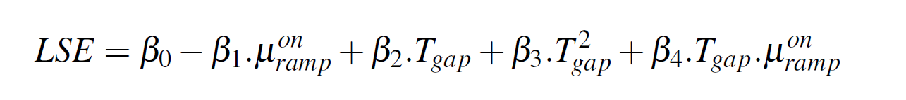
Linear regression for calibration
Multiple R-squared: 0.815,

Slide 7
Based on the plot before, the time-gap was set 1.25 seconds while on-ramp merge priority was set to 0.22.
Merge priority of expressway was set to 0.95. Other parameters same as METANET.

Slide 8
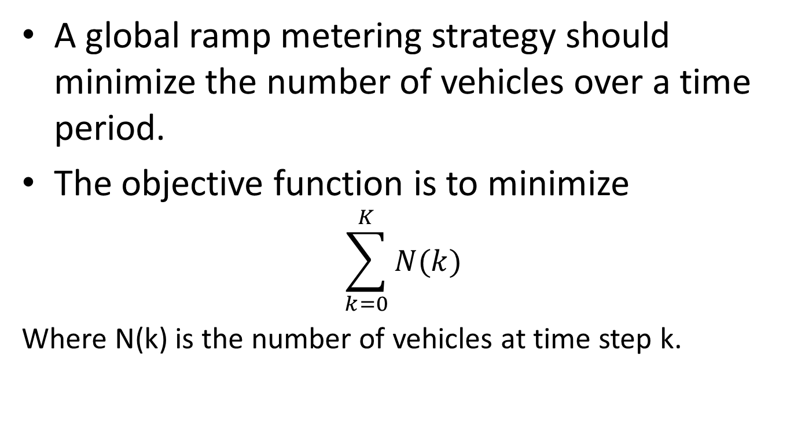
Ramp metering
A global ramp metering strategy should minimize the number of vehicles over a time period.
The objective function is to minimize
$$\sum_{k=0}^{K}{N(k)}$$
Where N(k) is the number of vehicles at time step k.

Slide 9
Ramp metering
Ramp metering essentially translates to controlling the flow along ramps while ensuring that the queue along the ramp does not spill over to the adjacent main street.
The ramp metering strategy minimizes the total travel time along P.I.E and the total wait time along the ramps.

Slide 10
Ramp metering for P.I.E using GA
Ramp flows are controlled using queue-percentages (QP).
QP=nt/nMax for the ramp.
QP_{Max} for all on ramps is 0.8. That is, the controller sets the phase to green when QP exceeds 0.8.
Find the ideal QP for all ramps so as to minimize the objective function.
Other self imposed constraints.
MIN Phase time is 10 seconds.
MAX Red time along a ramp is set to 120 seconds. After which there is a compulsory 20 second green time.

Slide 11
ISSUES
Both CTM and SEMSim are stochastic simulations in the sense that vehicle speeds in cell and link have a fair degree of variance. Up to 10 (m/s)^2.
Hence the GA has to contend with a lot of local minima. There could be several optimal solutions.
Not sure if there is global minima. Will do a literature review.

Slide 12
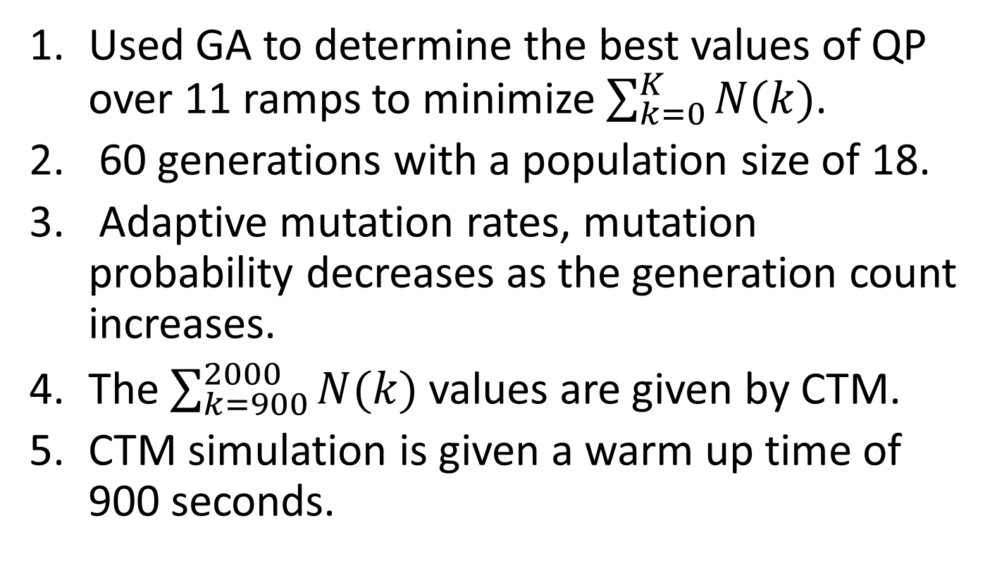
Best ramp metering strategies as per GA
Used GA to determine the best values of QP over 11 ramps to minimize $\sum_{k=0}^{K}{N(k)}$.
60 generations with a population size of 18.
Adaptive mutation rates, mutation probability decreases as the generation count increases.
The $\sum_{k=900}^{2000}{N(k)}$ values are given by CTM.
CTM simulation is given a warm up time of 900 seconds.

Slide 13
Applying the recommendations to SEMSim

Slide 14
Conclusions
My version of CTM which incorporates a cell based model from 3 different papers can be tuned to match the state of SEMSim to an acceptable degree.
GA based ramp metering strategy provided more than expected improvement in SEMSim.
This approach definitely looks promising as proof of concept.
Currently writing the longish paper.

