Slide 1
Data-Driven-Traffic-State-Prediction (DDTSP)
Using CTM as the predictive simulation and SEMSim as the real world

Slide 2
Model of the DDTSP
XML-traffic state
(details next slides)
SEMSim
(representation of the real world)
Stochastic CTM
(Predictive simulation)
Compare traffic states of SCTM with SEMSim
Prediction accuracy of SCTM

Slide 3
Features of SCTM
The randomness in traffic is modelled via probability distributions governing sending and receiving functions of vehicles from one cell to another.
A 15 minute simulation takes 300 ms to complete.
Time taken to complete is linearly proportional to the number of cells simulated.
Also incorporates features of the widely cited macroscopic traffic simulation METANET.

Slide 4
Traffic state input to SCTM
<RoadParameters>
<Flow>
<source id="30633">3600</source>
</Flow>
<!– for on ramps>
<MergePriorities>
<merge>
<road id="28377">0.75</road>
<road id="30634">0.85</road>
</merge>
</ MergePriorities>
<!– For off ramps>
<TurnRatios>
<turn>
<road id="28485">0.25</road>
<road id="30636">0.75</road>
</turn>
</TurnRatios>
<TrafficState simid="57" timestep="4200">
<zone from="0.0" to="1437">
<speed mean="7.65" sd="0.424"/>
<density upper="115" lower="112">113</density>
</zone>
</TrafficState>

Slide 5
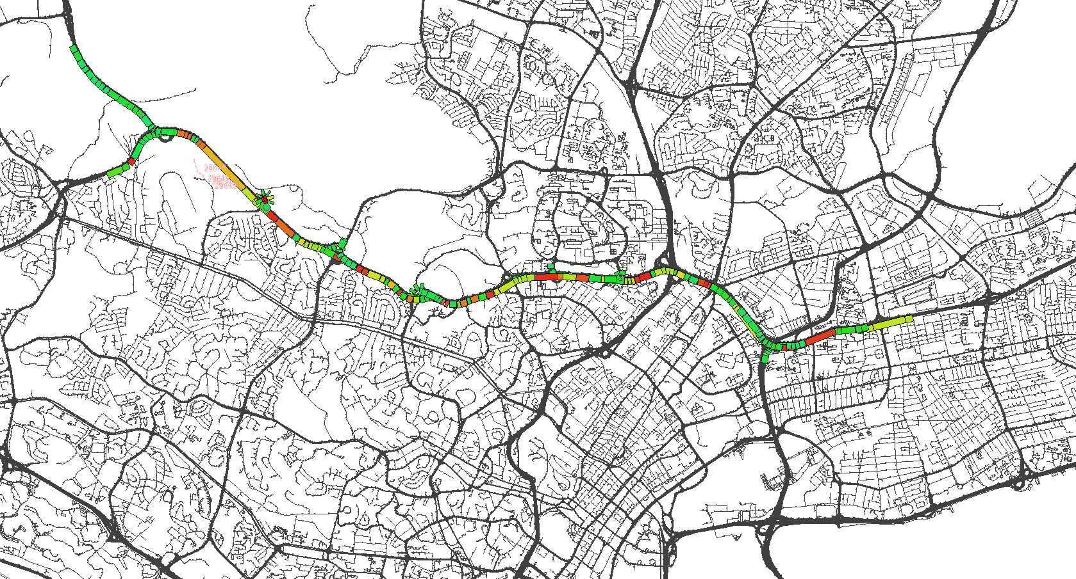
Stochastic CTM based simulation of P.I.E
Colour = f((average cell speed)/(free flow speed of cell))

Slide 6
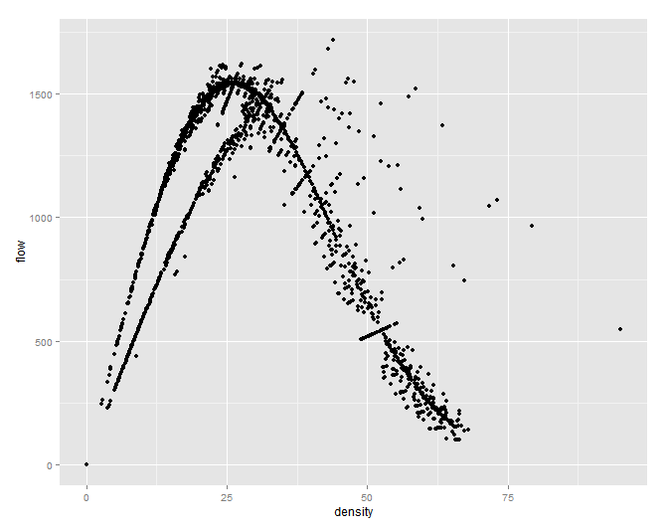
Initial results of SCTM
Density is in number of vehicles/km/lane

Slide 7
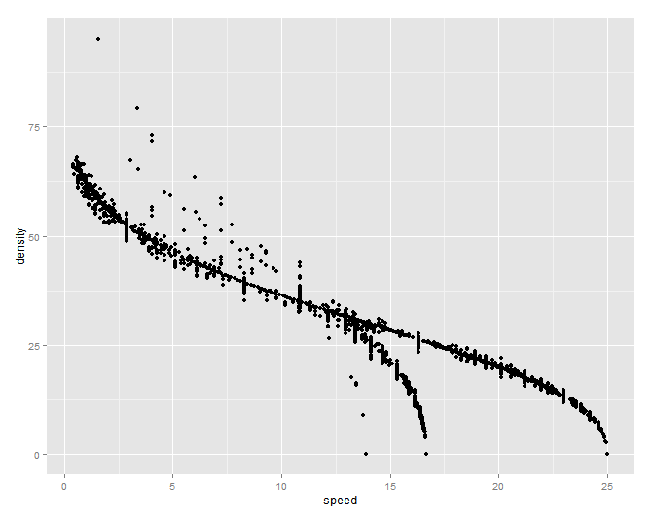
Initial results of SCTM
Shape indicates some calibration required.
Density is in number of vehicles/km/lane

Slide 8
Question to ponder
How reliable is SCTM? i.e. what is the prediction accuracy need to compare with SEMSim.
Help me to calibrate a few parameters used in SCTM such as merge priorities at on-ramps.

Slide 9
Question to ponder
There are three major applications of predictive simulations I can think of now:-
Ramp metering.
Adaptive speed limits
Dynamic routing
All the three mentioned approaches help minimize the total time spent on the main P.I.E expressway and the associated on-off ramps.

Slide 10
Approaches for travel time minimization
Simulation Optimization (Metaheuristics)
Hill climbing , Simulated Annealing, Tabu Search etc.
Population based methods. (Evolutionary algorithm)
Reinforcement learning

