Slide 1
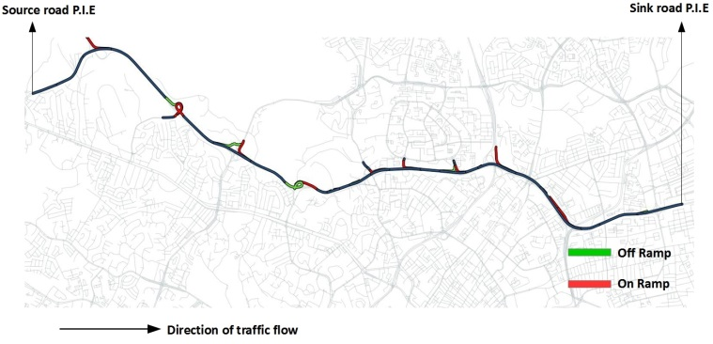
Artificial neural network
Action with max Q-action value
Traffic state
Action chosen using epsilon greedy policy
Delay
Stochastic traffic simulator

