Slide 1
Deep Q learning for Ramp metering
Based on
Human-level control through deep reinforcement
learning
Volodymyr Mnih1*, Koray Kavukcuoglu1*, David Silver1*, Andrei A. Rusu1, Joel Veness1, Marc G. Bellemare1, Alex Graves1,
Martin Riedmiller1, Andreas K. Fidjeland1, Georg Ostrovski1, Stig Petersen1, Charles Beattie1, Amir Sadik1, Ioannis Antonoglou1, Helen King1, Dharshan Kumaran1, Daan Wierstra1, Shane Legg1 & Demis Hassabis1
ABHINAV SUNDERRAJAN

Slide 2
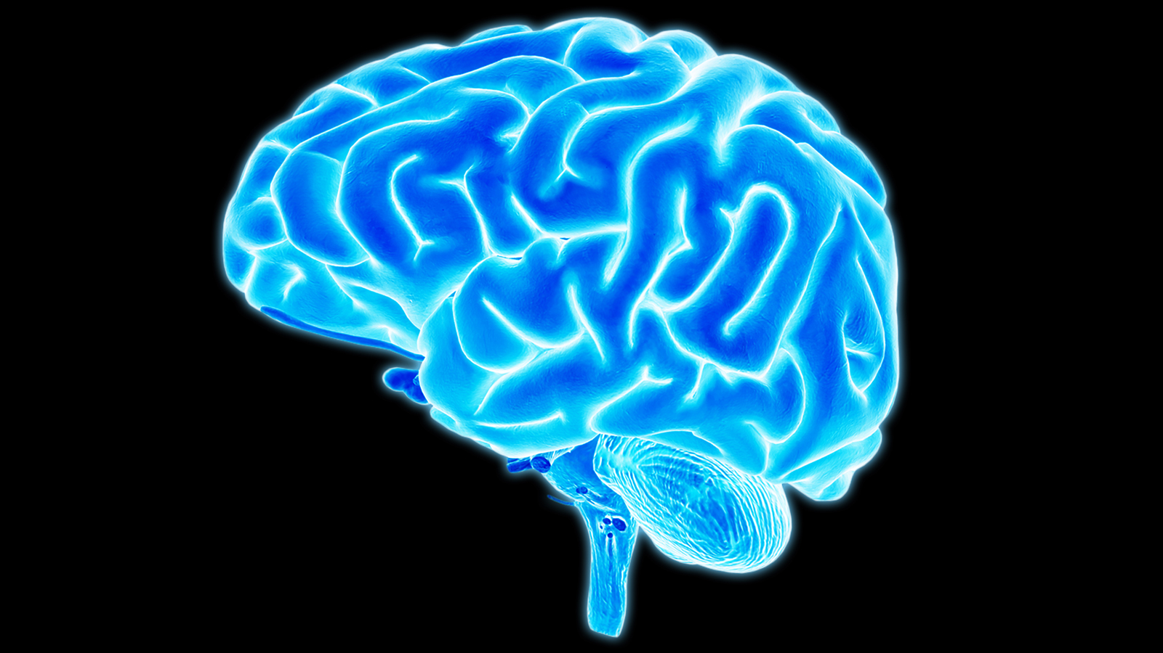
Model free learning
An agent interacts with an environment and learns by maximizing a scalar reward signal.
No models, labels, demonstrations, or any other human-provided supervision signal.
Reinforcement learning agent
Markov Decision process
Next state
Scalar
Reward
Action
ENVIRONMENT

Slide 3
Markov Decision process
Actions transform the environment into a new state.
The rules on how to choose an action when in a particular state is called a policy.
The environment in general is stochastic, which means the next state may be somewhat random for the same action.
The set of states and actions, together with rules for transitioning from one state to another, make up the MDP.
A Markov decision process relies on the Markov assumption, that the probability of the next state s_{i+1} depends only on current state s_{i} and action a_{i}, but not on preceding states or actions.

Slide 4
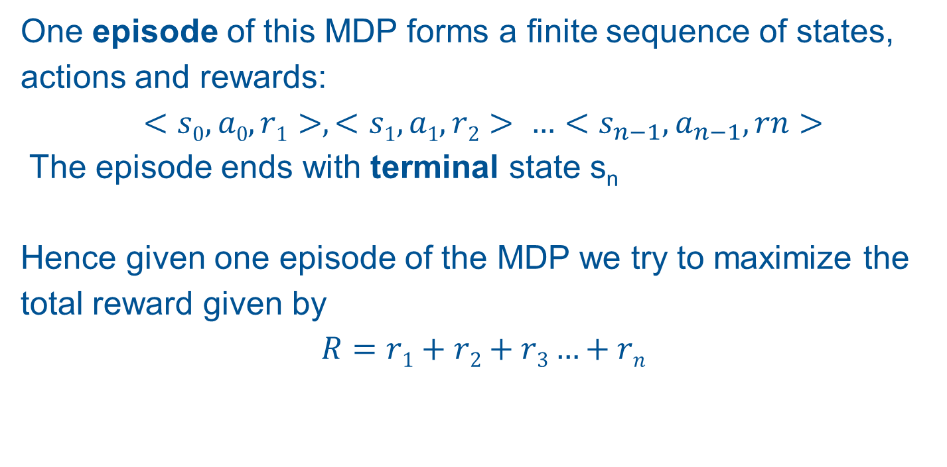
Markov Decision Process
One episode of this MDP forms a finite sequence of states, actions and rewards:
$$<s0,a0,r1>, <s1,a1,r2> …<s_{n−1},a_{n−1},rn>$$
The episode ends with terminal state s_{n}
Hence given one episode of the MDP we try to maximize the total reward given by
$$R=r1+r2+r3…+rn$$

Slide 5
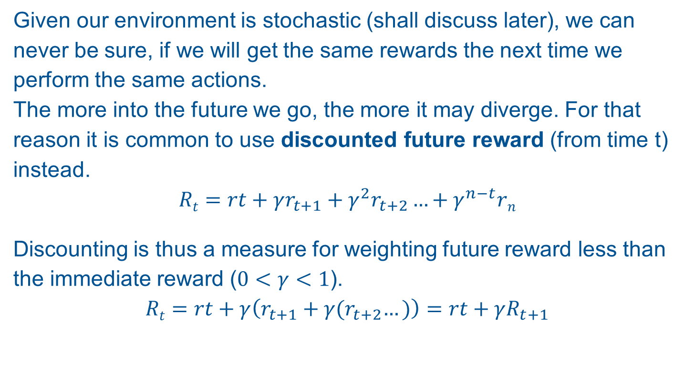
MDP DISCOUNTED REWARD
Given our environment is stochastic (shall discuss later), we can never be sure, if we will get the same rewards the next time we perform the same actions.
The more into the future we go, the more it may diverge. For that reason it is common to use discounted future reward (from time t) instead.
$$Rt=rt+γr_{t+1}+γ^{2}r_{t+2}…+γ^{n−t}rn$$
Discounting is thus a measure for weighting future reward less than the immediate reward ($0<γ<1$).
$$Rt=rt+γ\left(r_{t+1}+γ{(r}_{t+2}…)\right)=rt+γR_{t+1}$$

Slide 6
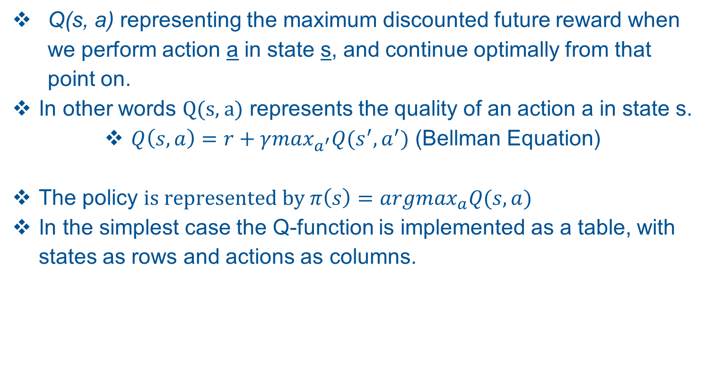
Q LEARNING
Q(s, a) representing the maximum discounted future reward when we perform action a in state s, and continue optimally from that point on.
In other words Q(s, a) represents the quality of an action a in state s.
$Q\left(s,a\right)=r+γ\max_{a^{′}}Q(s^{′},a^{′})$ (Bellman Equation)
The policy $is represented by π\left(s\right)={argmax}_{a}Q(s,a)$
In the simplest case the Q-function is implemented as a table, with states as rows and actions as columns.

Slide 7
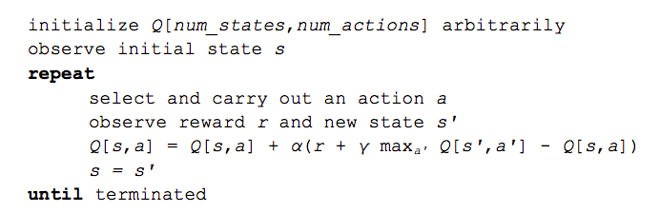
Q LEARNING ALGORITHM

Slide 8
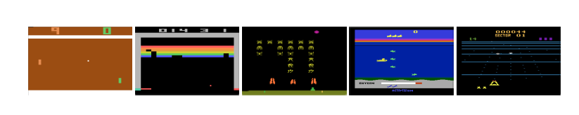


Deep Q Network
For any real world interesting problem, the number of states is humongous.
For the paper that I have based my work upon, The raw pixel data is considered to be the game state.
An image consists of 84X84 pixels with each pixel when converted to grayscale has 256 levels. Thus the total number of states is ${256}^{84∗84}$.
This is where a neural network steps in to approximate the state of the environment .
w represents the weight of the ANN
State
NEURAL NETWORK
Q value each action
Action

Slide 9
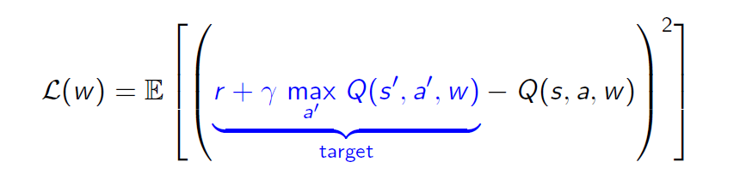
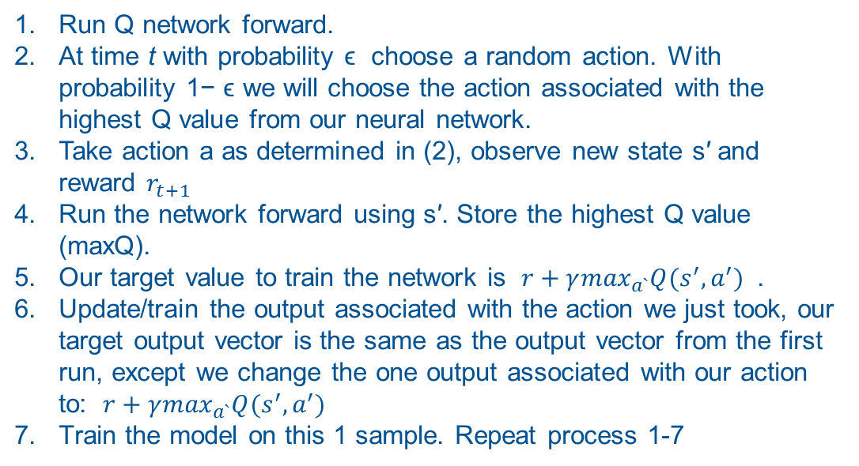
Deep Q Learning
while epoch < number_of_epochs
while episode not over
Run Q network forward.
At time t with probability ϵ choose a random action. With probability 1− ϵ we will choose the action associated with the highest Q value from our neural network.
Take action a as determined in (2), observe new state s′ and reward $r_{t+1}$
Run the network forward using s′. Store the highest Q value (maxQ).
Our target value to train the network is $r+γ\max_{a`}Q(s^{′},a^{′})$ .
Update/train the output associated with the action we just took, our target output vector is the same as the output vector from the first run, except we change the one output associated with our action to: $r+γ\max_{a`}Q(s^{′},a^{′})$
Train the model on this 1 sample. Repeat process 1-7
The above algorithm boils down to a regression problem where the error is minimized using stochastic gradient descent with mean square error being the loss function
Notes:
I have not discussed experience replay which is the algorithm used in the paper. refer to paper for more details

Slide 10
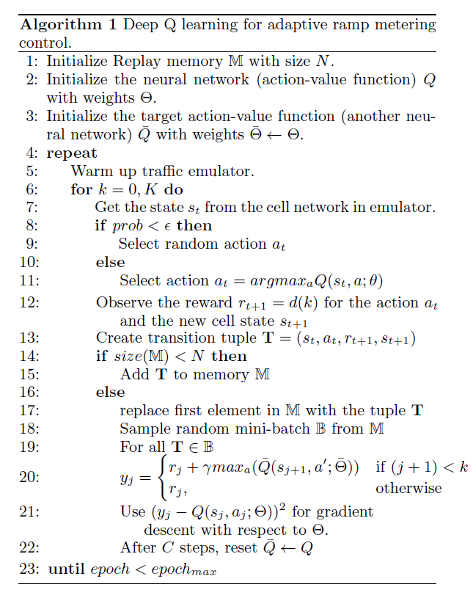
Q Learning with experience replay

Slide 11
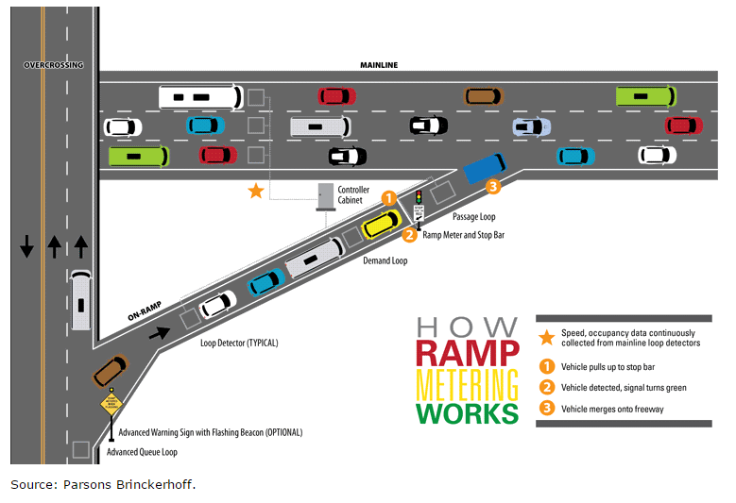
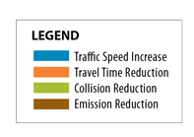
Deep RL for Ramp metering

Slide 12
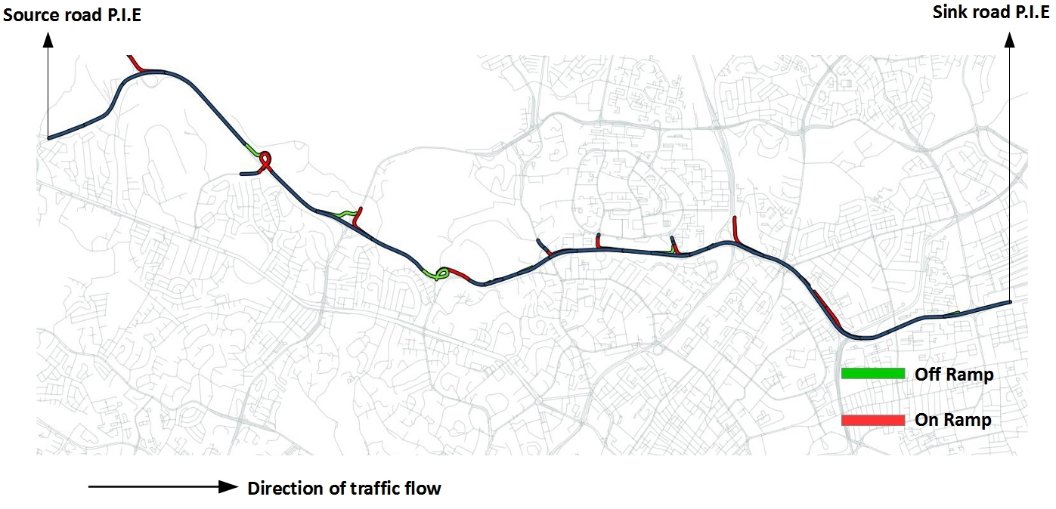
Deep RL for Ramp metering
13 km stretch of P.I.E (Pan Island Expressway) in central Singapore with all on ramps and off ramps.

Slide 13
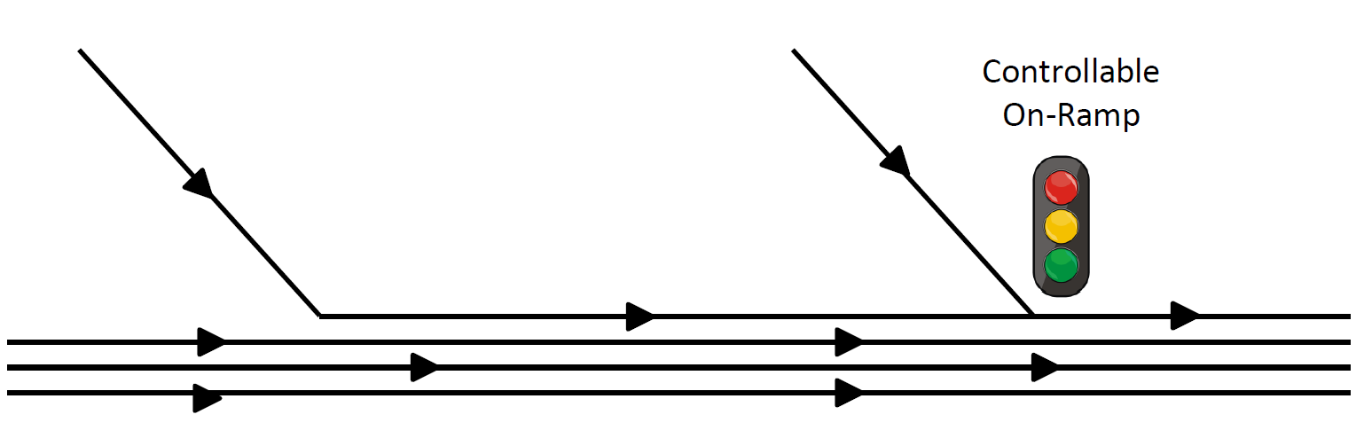
Deep RL for Ramp metering

Slide 14
Deep RL for Ramp metering
The on ramps and the first P.I.E link are sources for the vehicles/agents entering the simulation. There are a total number of 11 on ramps through which vehicles enter the simulation.
The off ramps and the last link on P.I.E are sinks through which the vehicles exit the simulation.
The turn ratios for all off-ramps is kept constant at 0.25. This implies that 25% of all vehicles exit at a given o ramp while the remaining 75% of the vehicles continue to travel on the main expressway.
The goal is to find the optimal ramp metering strategy so as to minimize the total delay experienced by all vehicles along including those vehicles on the on-ramps. (I shall define total delay in the upcoming slides)

Slide 15
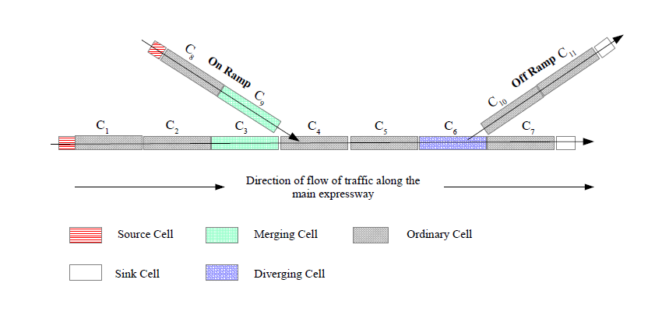
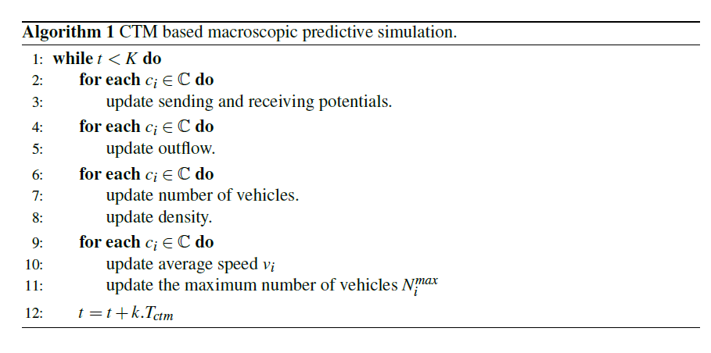
Traffic Emulator Model
CTM based macroscopic traffic simulator
Total number of cells in the simulated stretch of the expressway is 212
https://www.researchgate.net/publication/303940227_SYMBIOTIC_TRAFFIC_SIMULATION_FRAMEWORK

Slide 16
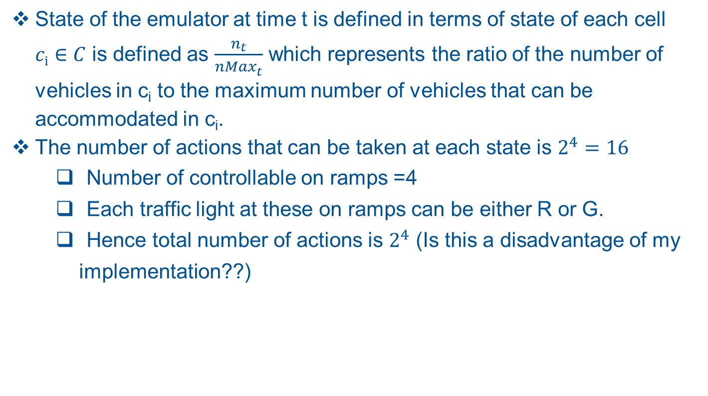
Traffic Emulator State and Action
State of the emulator at time t is defined in terms of state of each cell $ci∈C$ is defined as $\frac{n_{t}}{{nMax}_{t}^{}}$ which represents the ratio of the number of vehicles in c_{i} to the maximum number of vehicles that can be accommodated in c_{i}.
The number of actions that can be taken at each state is $2^{4}=16$
Number of controllable on ramps =4
Each traffic light at these on ramps can be either R or G.
Hence total number of actions is $2^{4}$ (Is this a disadvantage of my implementation??)

Slide 17
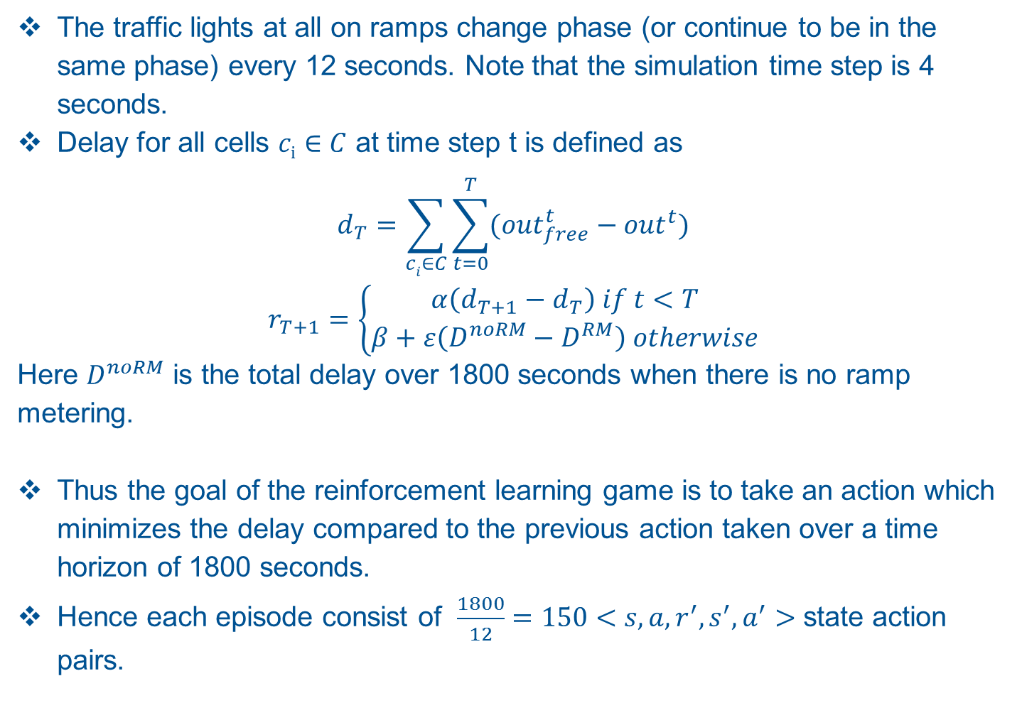
Traffic Emulator Reward
The traffic lights at all on ramps change phase (or continue to be in the same phase) every 12 seconds. Note that the simulation time step is 4 seconds.
Delay for all cells $ci∈C$ at time step t is defined as
$$d_{T}=\sum_{ci∈C}{\sum_{t=0}^{T}{{(out}_{free}^{t}}}−{out}^{t})$$
$$r_{T+1}=\left\{\begin{aligned}α\left(d_{T+1}−d_{T}\right) if t<T \\ β+ε\left(D^{noRM}−D^{RM}\right) otherwise\end{aligned}\right.$$
Here $D^{noRM}$ is the total delay over 1800 seconds when there is no ramp metering.
Thus the goal of the reinforcement learning game is to take an action which minimizes the delay compared to the previous action taken over a time horizon of 1800 seconds.
Hence each episode consist of $\frac{1800}{12}=150<s,a,r^{′},s^{′},a^{′}>$ state action pairs.
Notes:
Explain why you designed this kind of reward system.

Slide 18
Training
The number of epochs =300;
For each epoch set random (bounded) flow rates for all source cells of the expressway.
The CTM based traffic simulation gives the reward over 1800 seconds (of simulation time) which is back propagated to train the Neural network shown below.
100,000<s,a,r’,s’> records stored in memory for Experience replay
batch size for Neural network update is 32.

Slide 19
TRAINING
MultiLayerConfiguration conf = new NeuralNetConfiguration.Builder()
.seed(random.nextLong())
.optimizationAlgo(OptimizationAlgorithm.STOCHASTIC_GRADIENT_DESCENT)
.iterations(1)
.activation("leakyrelu")
.weightInit(WeightInit.RELU)
.learningRate(learningRate)
.updater(Updater.RMSPROP)
.rmsDecay(0.9)
.regularization(true)
.l2(2.0e-4)
.list()
.layer(0,
new DenseLayer.Builder().nIn(numOfCells).nOut(204).activation("leakyrelu")
.weightInit(WeightInit.RELU).build())
.layer(1,
new DenseLayer.Builder().nIn(204).nOut(150).activation("leakyrelu")
.weightInit(WeightInit.RELU).build())
.layer(2,
new OutputLayer.Builder(LossFunction.MSE).activation("identity").nIn(150)
.nOut(numOfActions).build()).pretrain(false).backprop(true).build();

Slide 20
TESTING
Generate random flow at the source links with constant mean inter-arrival times.
Determine the net delay experienced by all vehicles with no ramp metering over 1800 seconds.
Determine the net delay experienced by all vehicles with the ramp metering strategy determined by the trained neural network i.e. choose the action with the highest assigned probability by feeding forward the current state.
Compare and plot the results from steps 2 and 3.

Slide 21
RESULTS
Source Link ID | Mean IAT
30633 | 3800
82 | 1400
29310 | 1300
28946 | 1000
30790 | 1400
37980 | 1400
28595 | 1400
29152 | 1000
29005 | 1000
29553 | 1500
28613 | 1500
31991 | 800
PROOF OF Q-LEARNING
Action-Value Function
Without Ramp Metering | With Deep-RL based ramp metering
1026160 | 947915

Slide 22
RESULTS

Slide 23
RESULTS
Total delay over 1800 seconds
50 Random flow rates
1 million <s,a,r’,s’> records stored in memory for experience replay.
1500 epochs of training

Slide 24
CONCLUSION
The results how that deep reinforcement learning has promise for optimizing traffic flow through control mechanisms such a ramp metering.
A more suitable emulator (Cellular Automata based) is required to analyze and optimize the effect of other control mechanisms such as variable speed limits, adaptive cruise control but I confident that Deep Q Learning will be just as effective.
I have not found a single paper which uses Deep Q learning for traffic flow optimization and more specifically with ramp metering. This is the biggest contribution of this paper.

Slide 25
STRUCTURE OF PAPER
Introduction
Related Work
Stochastic Traffic Simulation
Deep Queue Learning for Ramp Metering
Ramp metering
Traffic State Estimation
Reward Computation
Experiments
The Simulated Environment
Training
Results
Conclusions and Future Work

