Slide 1

Light The Traffic
BTW

Slide 2

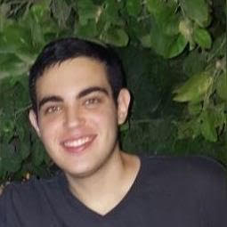
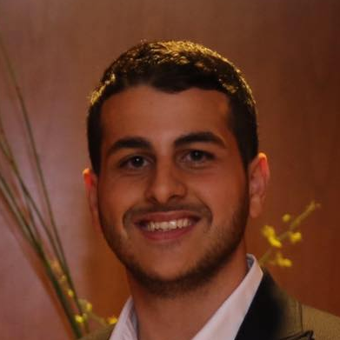

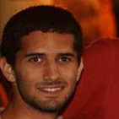

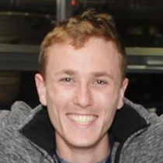
The Team
Eylon Shoshan
Liran Farhi
Tom Palny
Supervisor
Yair Feldman
Ran Yeheskel
Dor Granat
Tomer Kay

Slide 3

The Pain
Naïve Traffic Lights Scheduling
Unnecessary traffic loads

Slide 4

Helping municipalities monitor & Control traffic lights in real time
Save time
Increase productivity
Reduce costs

Slide 5
Autonomous Dynamic Scheduling
Optimize scheduling
Measure traffic on roads
Identifying loads

Slide 6
Scheduler Idea
The algorithm* decides at each iteration what are the best traffic lights to schedule, i.e, the traffic lights to set to be green.
The algorithm takes into account:
The queue length at each lane
The overhead of changing the traffic light scheduling
Which traffic lights could be green at the same time.
* Based on “An Intelligent Traffic Light Scheduling Algorithm Through VANETs” (Maram Bani Younes Azzedine Boukerche).
Notes:
We would like to take the time in this meeting and go through Servi mobile and web application as well as discuss go to market strategies development and business milestones and other financial aspects. If you have any more topics you would like to raise feel free to do so.

Slide 7
Generate Simulated Traffic
Connects all project modules
Traffic Simulator for Development
Customizable in junction resolution

Slide 8
Simulation steps
1
2
3
4
Step 1
Step 2
Step 3
Step 4
Choose number
of vehicles
Choose frequency
of the vehicles
Randomly choose initial and final coordinates for each vehicle
Run a shortest path algorithm

Slide 9



Management Tool for Municipalities
Live Statistics
Editing City Settings
Evaluate Scheduling Performance

Slide 10





Testing & Evaluation
Mainly manual testing
Testing performance
Real-time commands are based on tested open-source code
Comparing different schedulers on same simulations
Measured speedups are indications for success
Notes:
We would like to take the time in this meeting and go through Servi mobile and web application as well as discuss go to market strategies development and business milestones and other financial aspects. If you have any more topics you would like to raise feel free to do so.

Slide 11


Logging
Exporting information after finishing simulations
Validation of simulation data
Assuring correct usage of each module logics
Notes:
We would like to take the time in this meeting and go through Servi mobile and web application as well as discuss go to market strategies development and business milestones and other financial aspects. If you have any more topics you would like to raise feel free to do so.

Slide 12
Live Demo

Slide 13
Next Steps Advanced Features
Importing an actual city map into the simulator
Enriching simulations with pedestrian traffic
Building even more sophisticated scheduler, supporting multiple junctions considerations
Notes:
We would like to take the time in this meeting and go through Servi mobile and web application as well as discuss go to market strategies development and business milestones and other financial aspects. If you have any more topics you would like to raise feel free to do so.

Slide 14
Next Steps Management GUI
Wrap the management core with a complete GUI
Configuring & Tuning scheduler algorithm
Generate or import maps
Perform simulations
Analyze the results visually
Notes:
We would like to take the time in this meeting and go through Servi mobile and web application as well as discuss go to market strategies development and business milestones and other financial aspects. If you have any more topics you would like to raise feel free to do so.

Slide 15
Thanks!
Any questions?

