Slide 1
Season | Region | Sales | sum() | avg()
1 | West | 5100 | 5100 | 5100
2 | West | 5200 | 10300 | 5150
3 | West | 5200 | 15500 | 5166
4 | West | 4500 | 20000 | 5000
1 | East | 5000 | 5000 | 5000
2 | East | 4400 | 9400 | 4700
3 | East | 4800 | 14200 | 4733
4 | East | 5100 | 19300 | 4825
Window of season 3
SELECT Season, Region, Sales,
sum(), avg(), OVER(PARTITION BY Region
ORDER BY Season DESC)
FROM employee;

Slide 2


Neighborhood Analytics
$$𝒩$$
$$ℱ$$
Distance
Graph: Graph Window Queries
Aggregate
Sequence data: k-Sketch Query
Pattern Matching
Comparison
Trajectory: Co-Movement Pattern Query
Rank

Slide 3
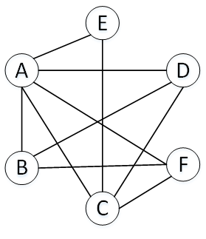
Count: 6
Count: 2
M
F
Count: 2
Count: 3
Count: 3
A
D
E
B
C
F
(b) Graph Aggregation
User | Age | Gender
A | 21 | M
B | 26 | F
C | 30 | F
D | 22 | M
E | 28 | M
F | 23 | F
(a) Mini social network
(c) Graph Window

Slide 4
B
D
H
ID | Type | ID | Type
A | Enzyme | E | Enzyme
B | Cytokine | F | Cytokine
C | Transporter | G | Enzyme
D | Enzyme | H | Transporter
A
F
C
E
G

