Slide 1
ID | Season | Region | Sales | SUM() | AVG()
1 | 1 | West | 5100 | 5100 | 5100
2 | 2 | West | 5200 | 10300 | 5150
3 | 3 | West | 5200 | 15500 | 5166
4 | 4 | West | 4500 | 20000 | 5000
5 | 1 | East | 5000 | 5000 | 5000
6 | 2 | East | 4400 | 9400 | 4700
7 | 3 | East | 4800 | 14200 | 4733
8 | 4 | East | 5100 | 19300 | 4825
Window of Tuple 3
SELECT Season, Region, Sales,
SUM(), AVG(), OVER(PARTITION BY Region ORDER BY Season DESC)
FROM employee;

Slide 2


Neighborhood Analytics
$$𝒩$$
$$ℱ$$
Distance
Graph: Graph Window Queries
Aggregate
Sequence data: k-Sketch Query
Pattern Matching
Comparison
Trajectory: General Co-Movement Pattern Query
Rank

Slide 3
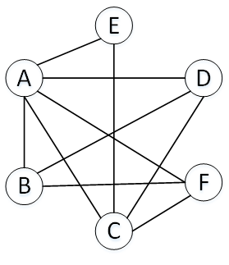
Count: 6
Count: 2
M
F
Count: 2
Count: 3
Count: 3
A
D
E
B
C
F
(b) Graph Aggregation
User | Age | Gender
A | 21 | M
B | 26 | F
C | 30 | F
D | 22 | M
E | 28 | M
F | 23 | F
(a) Mini social network
(c) Graph Window

Slide 4
B
D
H
ID | Type | ID | Type
A | Enzyme | E | Enzyme
B | Cytokine | F | Cytokine
C | Transporter | G | Enzyme
D | Enzyme | H | Transporter
A
F
C
E
G

