Slide 1
 | A | B | C | D | E
A | 1 | 1 | 1 | 1 | 0
B | 0 | 1 | 0 | 0 | 1
C | 1 | 0 | 1 | 1 | 0
D | 1 | 0 | 1 | 1 | 0
E | 0 | 1 | 0 | 1 | 1
W list
A | E | B | D | C
C,D
C
D
B
E
A
Dense Blocks
 | A | C | D | B | E
C | 1 | 1 | 1 | 0 | 0
D | 1 | 1 | 1 | 0 | 0
A | 1 | 1 | 1 | 1 | 0
E | 0 | 0 | 1 | 1 | 1
B | 0 | 0 | 0 | 1 | 1
W list
A | C | D | E | B
A,C,D
E
A
B,E
Dense Blocks

Slide 2
 | A | B | C | D | E
A | 1 | 1 | 1 | 1 | 0
B | 0 | 1 | 0 | 0 | 1
C | 1 | 0 | 1 | 1 | 0
D | 1 | 0 | 1 | 1 | 0
E | 0 | 1 | 0 | 1 | 1
 | A | C | D | B | E
A | 1 | 1 | 1 | 1 | 0
E | 0 | 0 | 1 | 1 | 1
B | 0 | 0 | 0 | 1 | 1
C | 1 | 1 | 1 | 0 | 0
D | 1 | 1 | 1 | 0 | 0
 | A | B | C | D | E
A | 1 | 1 | 1 | 1 | 0
B | 0 | 1 | 0 | 0 | 1
C | 1 | 0 | 1 | 1 | 0
D | 1 | 0 | 1 | 1 | 0
E | 0 | 1 | 0 | 1 | 1

Slide 3
W list
A | C | D | E | B
A | 21
B | 26
C | 30
D | 22
E | 28
W list
A | E | B | D | C
A,C,D
E
A
B,E
Dense Blocks
73,3
22,1
26,1
28,1
21,1
54,2
W list
A | C | D | E | B
A | 24.3
B | 25
C | 24.3
D | 25.25
E | 27
73,3
28,1
21,1
54,2
Partial Aggregates

Slide 4
ID | Department | Salary | Rank
8 | develop | 6000 | 1
10 | develop | 5200 | 2
11 | develop | 5200 | 2
9 | develop | 4500 | 4
7 | develop | 4200 | 5
1 | sales | 5000 | 1
4 | sales | 4800 | 2
3 | sales | 4800 | 2
SELECT ID, Department, Salary,
rank() OVER (PARTITION BY Department
ORDER BY salary DESC)
FROM employee;

Slide 5
User | Age | Gender | Salary | Experience
A | 21 | M | 2,000 | 2
B | 26 | F | 2,500 | 5
C | 30 | M | 4,000 | 10
D | 22 | F | 2,300 | 3
E | 28 | M | 3,200 | 8
F | 23 | M | 2,700 | 4
G | 31 | F | 4,000 | 12
H | 27 | F | 3,000 | 7

Slide 6
D
H
A
C
F
I
DB Community
G
B
E
IR community

Slide 7
 | A | B | C | D | E
A | 1 | 1 | 1 | 1 | 0
B | 0 | 1 | 0 | 0 | 1
C | 1 | 0 | 1 | 1 | 0
D | 1 | 0 | 1 | 1 | 0
E | 0 | 1 | 0 | 1 | 1
 | A | C | D
A | 1 | 1 | 1
B | 0 | 0 | 0
C | 1 | 1 | 1
D | 1 | 1 | 1
E | 0 | 0 | 1
 | E | B
A | 0 | 1
B | 1 | 1
C | 0 | 0
D | 0 | 0
E | 1 | 1
A | C | D | E | B
 | A | C | D
E | 0 | 0 | 1
A,C,D | 1 | 1 | 1
 | E | B
A | 0 | 1
B,E | 1 | 1
A,C,D
E
A
B,E
Dense Blocks

Slide 8
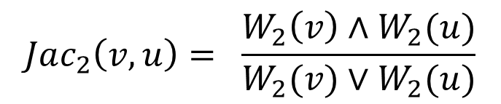
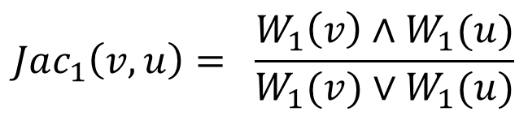
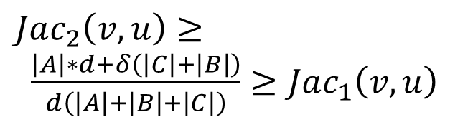
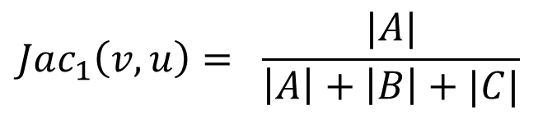
$$Jac_{1}\left(v,u\right)= \frac{W_{1}\left(v\right)∧W_{1}(u)}{W_{1}(v)∨W_{1}(u)}$$
$$Jac_{1}\left(v,u\right)= \frac{|A|}{\left|A\right|+\left|B\right|+|C|}$$
$$Jac_{2}\left(v,u\right)= \frac{W_{2}\left(v\right)∧W_{2}(u)}{W_{2}(v)∨W_{2}(u)}$$
$Jac_{2}\left(v,u\right)≥ \frac{\left|A\right|∗d+δ\left(\left|C\right|+\left|B\right|\right)}{d\left(\left|A\right|+\left|B\right|+\left|C\right|\right)}≥Jac_{1}\left(v,u\right)$
|A| > |B| +|C|
C
A
B

Slide 9
 | A | B | C | D | H | E | F | G
A | 1 | 1 | 1 | 1 | 1 | 1 | 1 | 1
B | 0 | 1 | 0 | 1 | 1 | 1 | 1 | 1
C | 0 | 0 | 1 | 1 | 1 | 1 | 1 | 1
D | 0 | 0 | 0 | 1 | 1 | 1 | 1 | 1
H | 0 | 0 | 0 | 0 | 1 | 0 | 0 | 1
E | 0 | 0 | 0 | 0 | 0 | 1 | 1 | 1
F | 0 | 0 | 0 | 0 | 0 | 0 | 1 | 1
G | 0 | 0 | 0 | 0 | 0 | 0 | 0 | 1
A | B | C | D | E | F | G | H
A
B
C
H
E
G
E,F
A,B,C,D
 | A | B | D | H | E | F | G | C
A | 1 | 1 | 1 | 1 | 1 | 1 | 1 | 1
B | 0 | 1 | 1 | 1 | 1 | 1 | 1 | 0
C | 0 | 0 | 1 | 1 | 1 | 1 | 1 | 1
D | 0 | 0 | 1 | 1 | 1 | 1 | 1 | 0
H | 0 | 0 | 0 | 1 | 0 | 0 | 1 | 0
E | 0 | 0 | 0 | 0 | 1 | 1 | 1 | 0
F | 0 | 0 | 0 | 0 | 0 | 1 | 1 | 0
G | 0 | 0 | 0 | 0 | 0 | 0 | 1 | 0

Slide 10
A
A
A
B
D
H
B
C
B
C
C
E
F
G
D
E
D
E
H
F
H
F
G
G

Slide 11
User | Age | Gender | Industry | Posts
A | 21 | M | IT | 12
B | 26 | F | IT | 15
C | 30 | F | Finance | 28
D | 22 | M | Finance | 23
E | 28 | M | Power | 26
F | 23 | F | Power | 14
 | A | B | C | D | E | F
A | 1 | 0 | 0 | 1 | 1 | 1
B | 1 | 1 | 1 | 0 | 0 | 0
C | 0 | 0 | 1 | 1 | 1 | 1
D | 0 | 0 | 0 | 1 | 0 | 0
E | 1 | 1 | 1 | 0 | 1 | 0
F | 1 | 1 | 1 | 0 | 0 | 1

Slide 12
 | A | B | C | D | E | F
A | 1 | 0 | 0 | 1 | 1 | 1
B | 1 | 1 | 1 | 0 | 0 | 0
C | 0 | 0 | 1 | 1 | 1 | 1
D | 0 | 0 | 1 | 1 | 0 | 0
E | 1 | 1 | 1 | 0 | 1 | 0
F | 1 | 1 | 1 | 0 | 0 | 1
 | A | B | C | D | E | F
F | 1 | 1 | 1 | 0 | 0 | 1
E | 1 | 1 | 1 | 0 | 1 | 0
B | 1 | 1 | 1 | 1 | 0 | 0
D | 0 | 0 | 1 | 1 | 0 | 0
C | 0 | 0 | 1 | 1 | 1 | 1
A | 1 | 0 | 0 | 1 | 1 | 1

Slide 13
 | A | B | C | D | E | F
F | 1 | 1 | 1 | 0 | 0 | 1
E | 1 | 1 | 1 | 0 | 1 | 0
B | 1 | 1 | 1 | 1 | 0 | 0
D | 0 | 0 | 1 | 1 | 0 | 0
C | 0 | 0 | 1 | 1 | 1 | 1
A | 1 | 0 | 0 | 1 | 1 | 1
W list
A | B | C | D | E | F
F,E,B
A
C
D
B
E
F
A,C
Dense Blocks

Slide 14
 | A | B | C | D | E | F
A | 1 | 1 | 1 | 1 | 1 | 1
B | 1 | 1 | 0 | 1 | 0 | 1
C | 1 | 0 | 1 | 1 | 1 | 1
D | 1 | 1 | 1 | 1 | 0 | 0
E | 1 | 0 | 1 | 0 | 1 | 0
F | 1 | 1 | 1 | 0 | 0 | 1
 | A | C | B | E | D | F
B | 1 | 0 | 1 | 0 | 1 | 1
D | 1 | 1 | 1 | 0 | 1 | 0
F | 1 | 1 | 1 | 0 | 0 | 1
A | 1 | 1 | 1 | 1 | 1 | 1
C | 1 | 1 | 0 | 1 | 1 | 1
E | 1 | 1 | 0 | 1 | 0 | 0

Slide 15
A | B | C | D | E | F
A | 12
B | 15
C | 28
D | 23
E | 26
F | 14
A,F,D
B
D
E
C,E
F
A,C
A | 118
B | 64
C | 103
D | 78
E | 66
F | 55
A | B | C | D | E | F
49
15
23
26
54
14
40

Slide 16
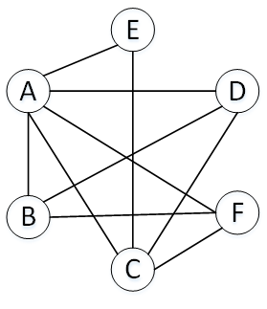
User | Age | Gender | Industry | Posts
A | 21 | M | IT | 12
B | 26 | F | IT | 15
C | 30 | F | Finance | 28
D | 22 | M | Finance | 23
E | 28 | M | Power | 26
F | 23 | F | Power | 14

Slide 17
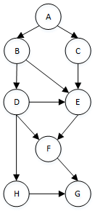
ID | Type
A | Enzyme
B | Cytokine
C | Transporter
D | Enzyme
E | Enzyme
F | Cytokine
G | Enzyme
H | Transporter

Slide 18
 | A | B | C | D | E | F
A | 1 | 1 | 1 | 1 | 1 | 1
B | 1 | 1 | 0 | 1 | 0 | 1
C | 1 | 0 | 1 | 1 | 1 | 1
D | 1 | 1 | 1 | 1 | 0 | 0
E | 1 | 0 | 1 | 0 | 1 | 0
F | 1 | 1 | 1 | 0 | 0 | 1
 | A | C | B | E | D | F
B | 1 | 0 | 1 | 0 | 1 | 1
D | 1 | 1 | 1 | 0 | 1 | 0
F | 1 | 1 | 1 | 0 | 0 | 1
A | 1 | 1 | 1 | 1 | 1 | 1
C | 1 | 1 | 0 | 1 | 1 | 1
E | 1 | 1 | 0 | 1 | 0 | 0

Slide 19
A | B | C | D | E | F
A,F,D
B
D
E
C,E
F
A,C
A | 118
B | 64
C | 103
D | 78
E | 66
F | 55
A | B | C | D | E | F
49
15
23
26
54
14
40

Slide 20
A | B | C | D | E | F
A,F,D
B
D
E
C,E
F
A,C
A | 118
B | 64
C | 103
D | 78
E | 66
F | 55
A | B | C | D | E | F
49
15
23
26
54
14
40

Slide 21
 | A | B | C
A | 1 | 1 | 1
B | 1 | 1 | 0
C | 1 | 0 | 1
D | 1 | 1 | 1
E | 1 | 0 | 1
F | 1 | 1 | 1
 | D | E | F
A | 1 | 1 | 1
B | 1 | 0 | 1
C | 1 | 1 | 1
D | 1 | 0 | 0
E | 0 | 1 | 0
F | 0 | 0 | 1
 | A | B | C
A,D,F | 1 | 1 | 1
B | 1 | 1 | 0
C,E | 1 | 0 | 1
 | D | E | F
A,C | 1 | 1 | 1
B | 1 | 0 | 1
D | 1 | 0 | 0
E | 0 | 1 | 0
F | 0 | 0 | 1
A | B | C | D | E | F
A,F,D
B
D
E
C,E
F
A,C

Slide 22
1
5
2
1
B
A
B
C
A
C
2
3
4
5
3
6
6
4
7

Slide 23
u
u
B
B
A
A
s
s
t
r
t
r
a
a
v
v

Slide 24
u
u
B
A
B
A
s
s
t
t
r
r
a
a
v
v

