Slide 1
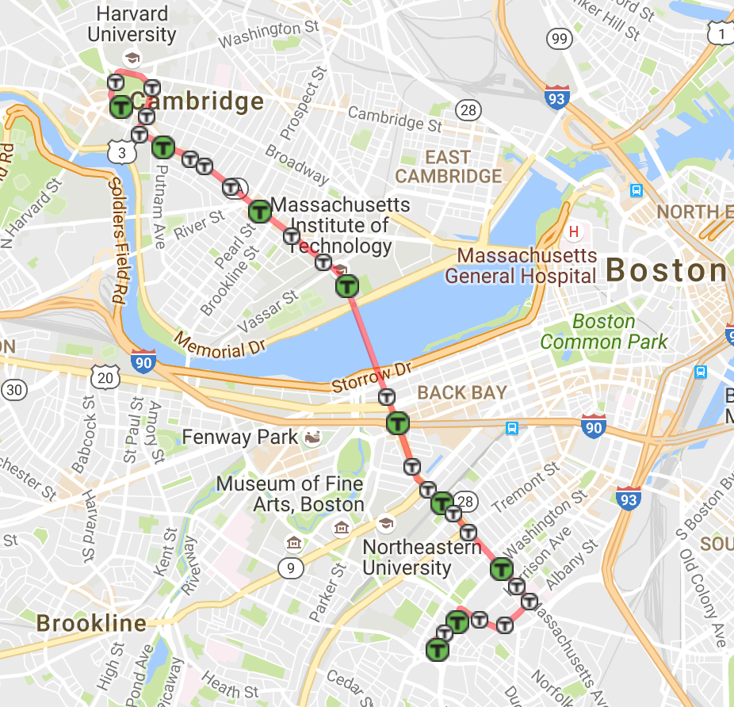
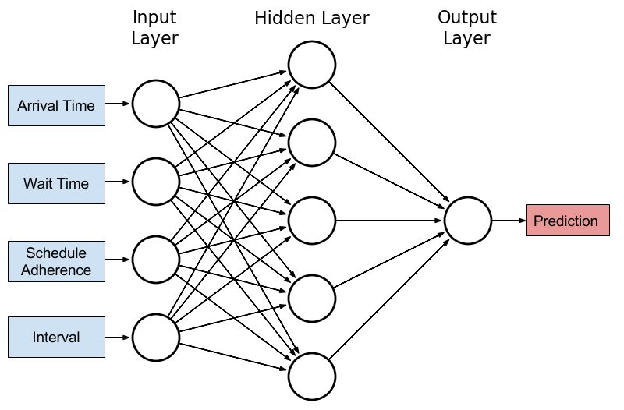
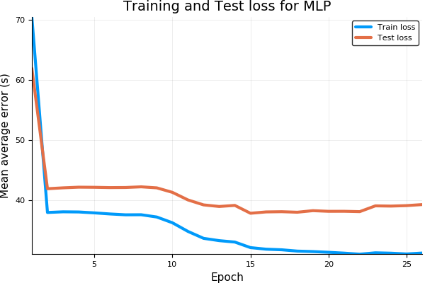


Neural Bus Networks
Cooper Sloan Supervisor: Alan Edelman CSAIL
PROBLEM
METHODS
No one likes waiting for the bus
Traffic is inherently stochastic and difficult to predict
Luckily, we can use neural networks to predict bus bus arrival times¹
This research uses Boston bus data to to predict bus arrival times to decrease passenger wait times
Input features:
Travel time (between stops)
Dwell time (time spent at stops)
Schedule adherence
Traffic condition
Time of day
Day of week
Bus route 1 through Boston and Cambridge
RESULTS
Multilayer Perceptron Architecture
The plot shows the average error in predictions for a multi layer perceptron model
The model produces test accuracy within ~40 seconds of the actual arrival time
Compared with a CNN architecture, the MLP produces lower test loss
CONCLUSIONS
Although traffic networks are difficult to model, large amounts of data and large models can provide passengers with valuable predictions of arrival times
These predictions can the be used to reduce wait times for passengers and improve network efficiency
Further work includes incorporating more data sources to better model traffic conditions, and using more complex models
REFERENCES
[1] Jeong, Ranhee, and Laurence R. Rilett. "Bus arrival time prediction using artificial neural network model." Intelligent Transportation Systems, 2004. Proceedings. The 7th International IEEE Conference on. IEEE, 2004.
You can also edit the “Master” slide by going to “edit” master
If you want to add a new slide go to the “New Slide” dropdown within the home toolbar and select one of the 5 templates which we have set up

