Slide 1
Progress Report
Paul Ruess
Sept. 21, 2016

Slide 2
Progress Made
USGS rating curves from URL
http://waterdata.usgs.gov/nwisweb/get_ratings?file_type=exsa&site_no={0}
HAND rating curves from netCDF file (from Xing)
Calculated HAND rating curves from netCDF file (from Xing)
Using WetArea, HydraulicRadius, and Slope parameters with a fixed n
Tested with n = 0.05 and is nearly identical to Xing’s rating curves
Manually approximated n-value to match HAND to USGS rating curves

Slide 11
Summary of Results
Average n: 0.265

Slide 12
Next Steps
Automate determination of manning’s roughness for each COMID, given USGS rating curve data.
Compare automated to manual results and adjust accordingly.
Iterate until automation is relatively correct.

Slide 13
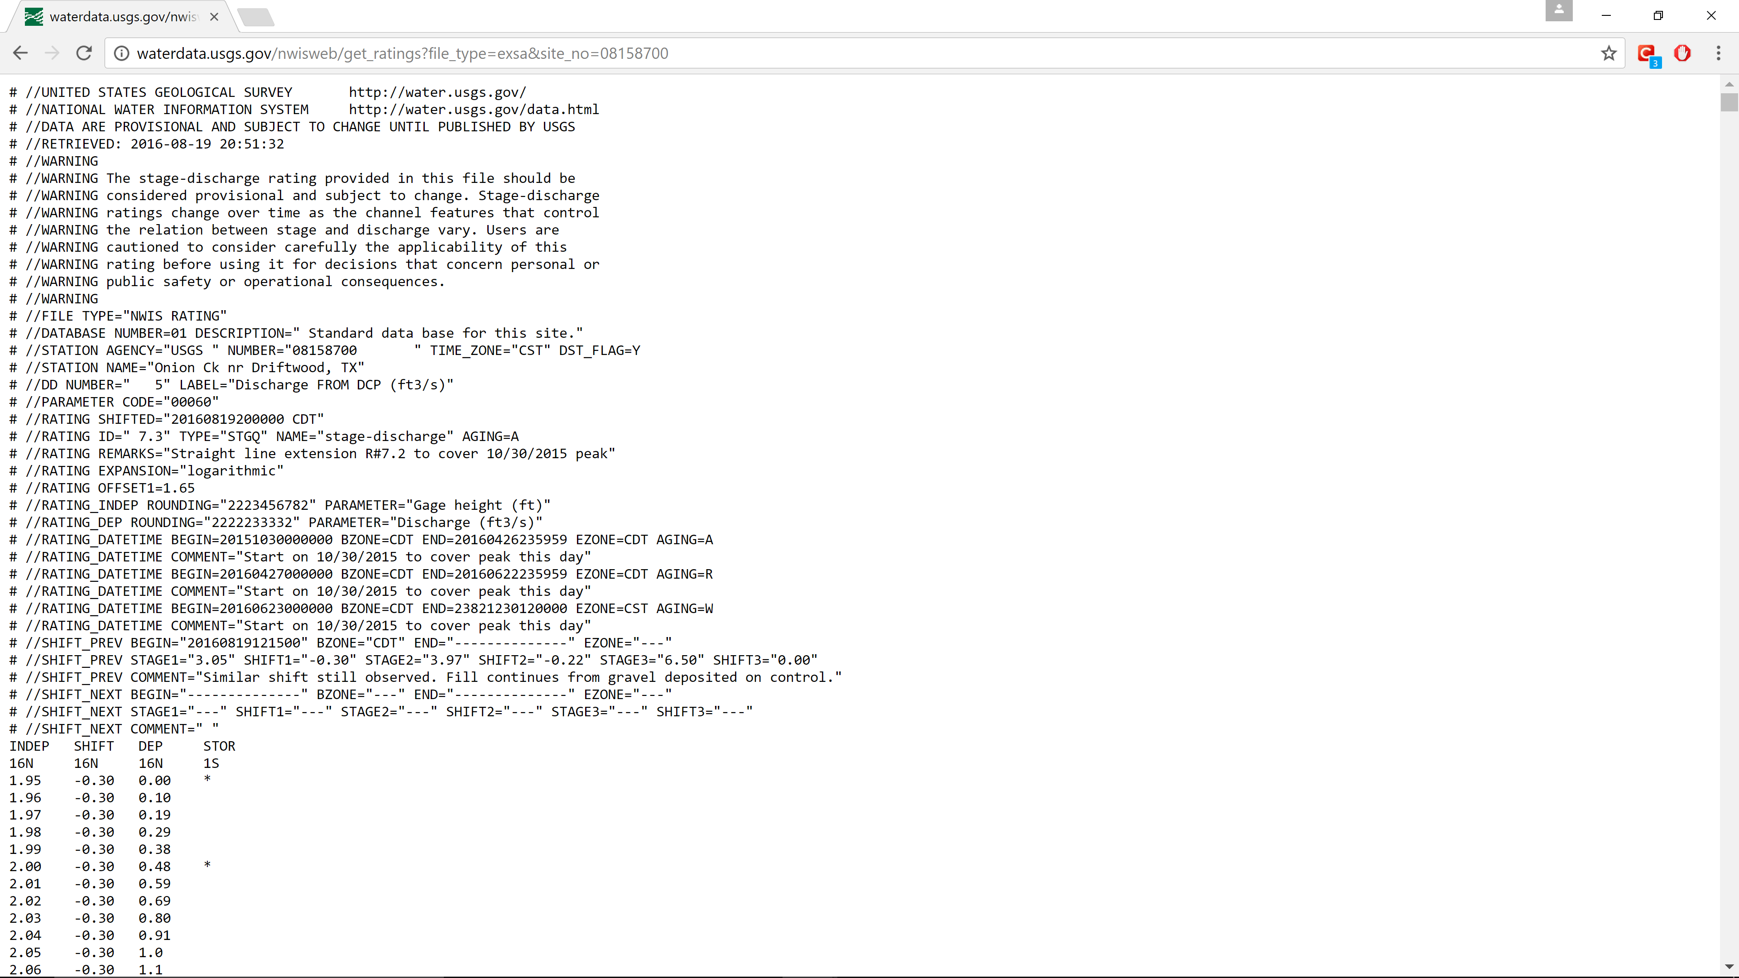
“INDEP” = Height (ft)
“SHIFT” = displacement from actual bottom
( subtract from INDEP to get actual)
“DEP” = Discharge(cfs)

Slide 14
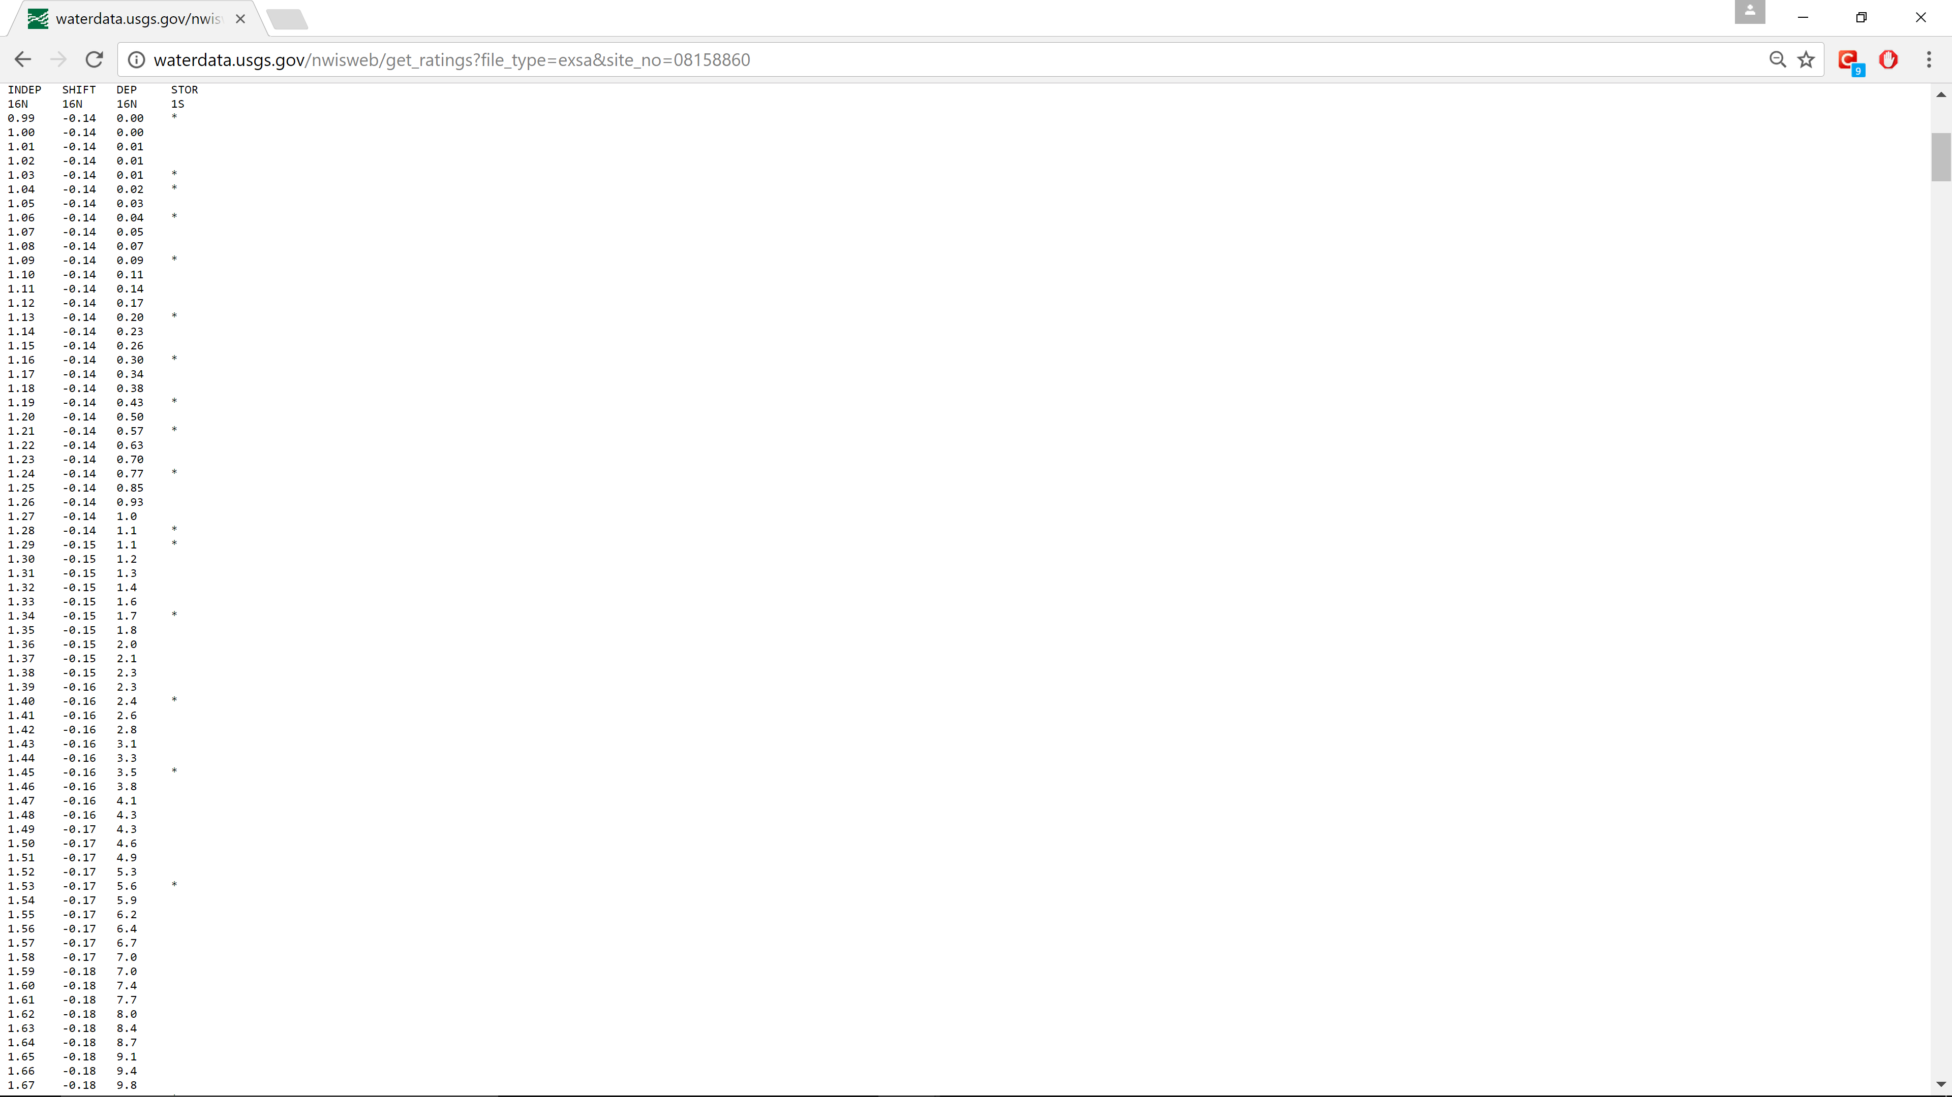
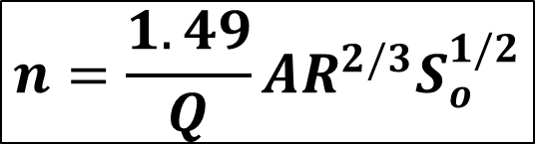
“INDEP” = Height (ft)
For each COMID:
For each height (ft) in HAND netCDF file (0, 1, 2, … 48)
Pull corresponding WetArea, HydraulicRadius, and Slope
Pull corresponding USGS discharge (use USGS rating curve)
Calculate manning’s roughness
Average all roughness values together
Return average manning’s roughness for each COMID
$$n=\frac{1.49}{Q}AR^{2/3}S_{o}^{1/2}$$
“INDEP” = Height (ft)
“DEP” = Discharge(cfs)

Slide 15
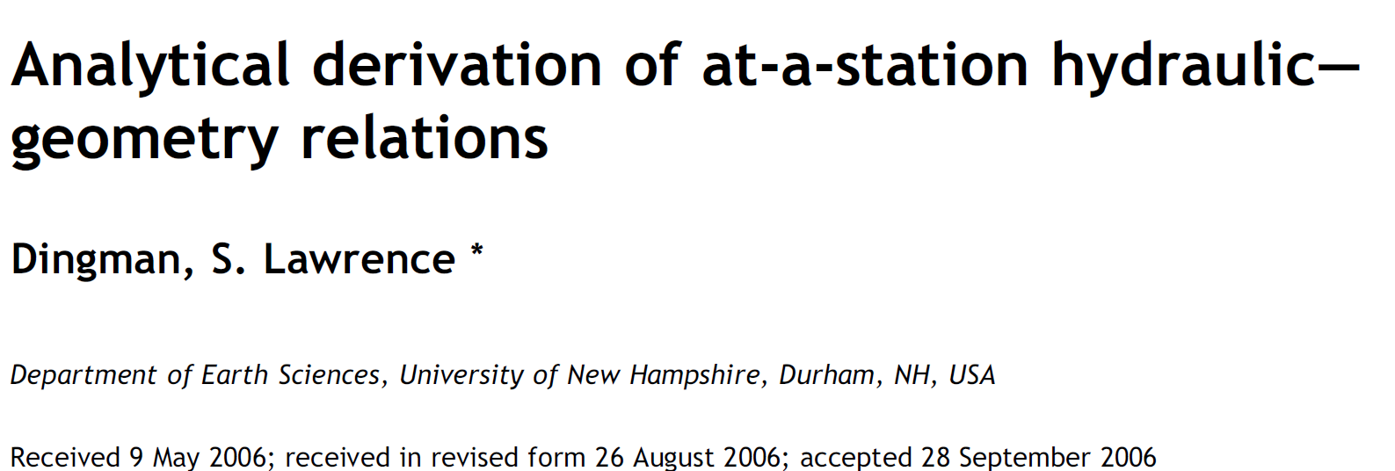
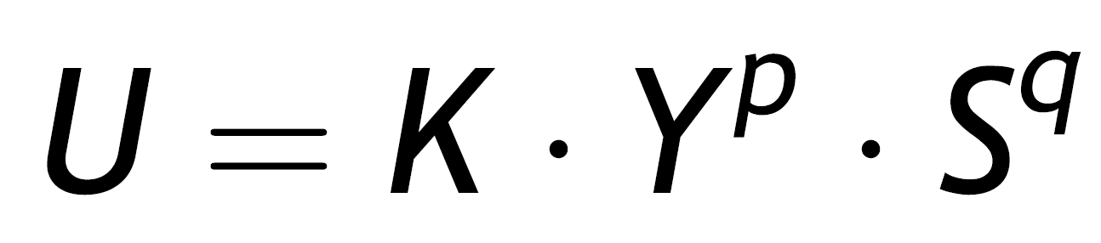
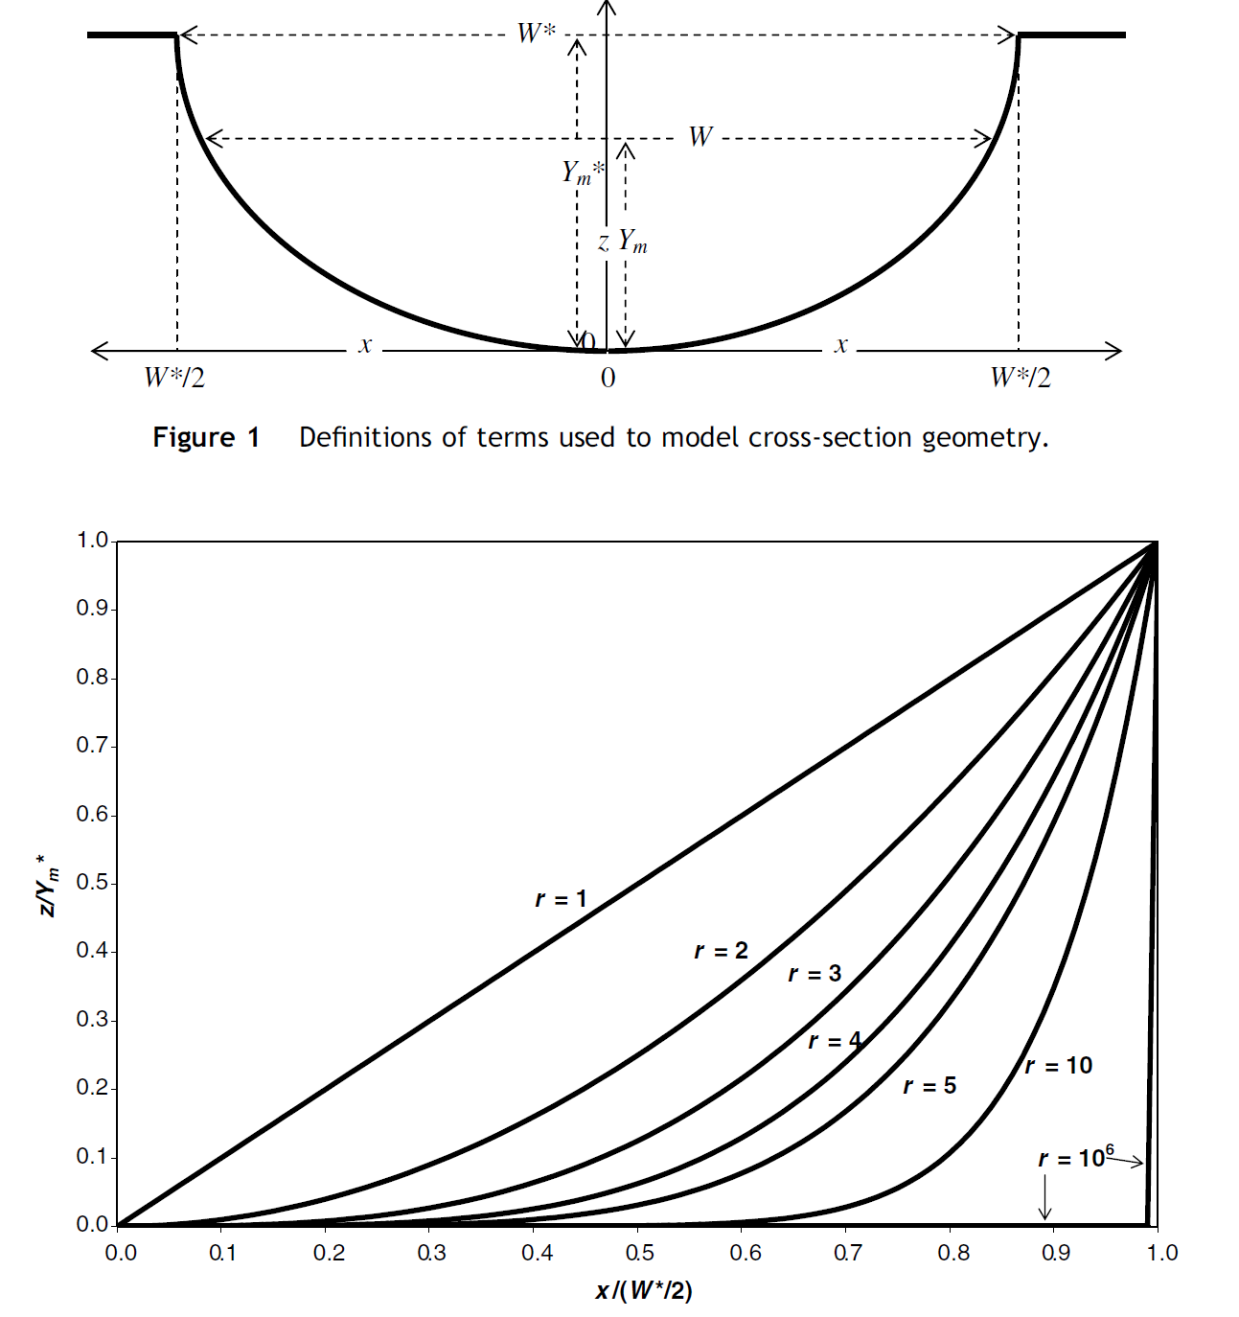
At-a-station Hydraulic-Geometry (AHG)
Use river geometry to determine stream velocity
U = velocity
K = 1 / n , n = manning roughness
Y = average channel depth
S = slope
P = 0.667 (Dingman, 2007)
Q = 0.500 (Dingman, 2007)

Slide 16
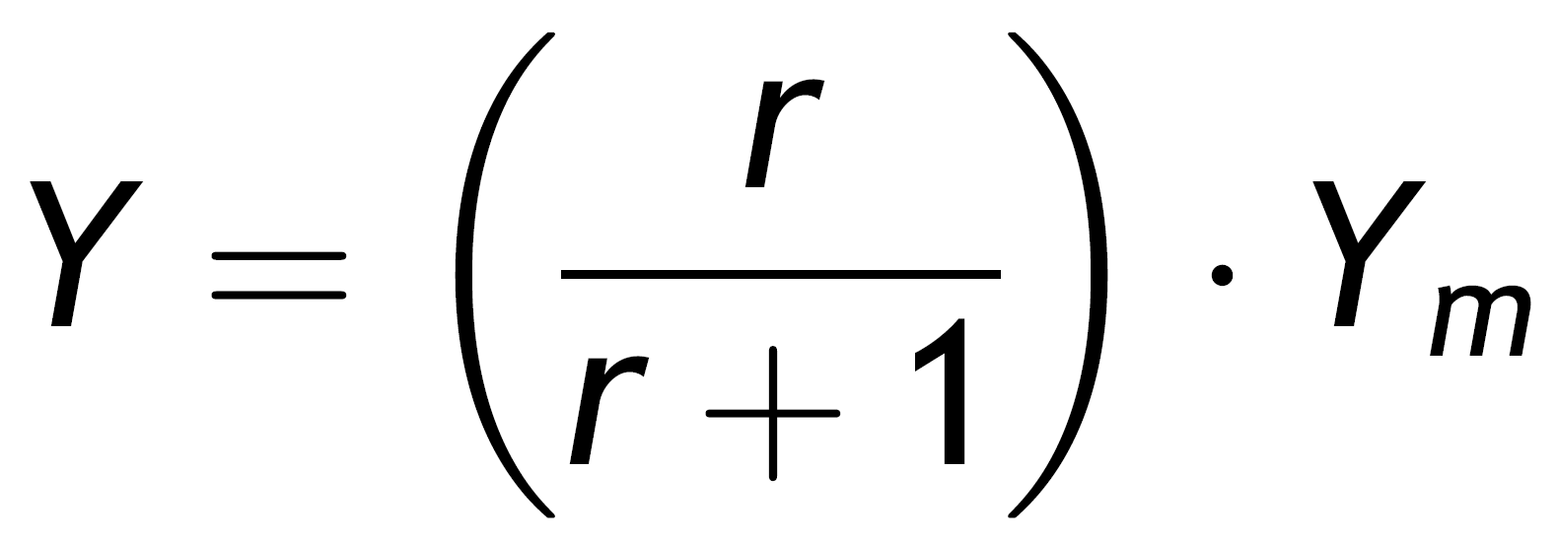
AHG continued
Y = average depth
Ym = maximum depth
r = shape of channel (2 for parabolic)
Given Ym, can compute Y given r

Slide 17
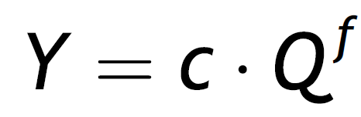
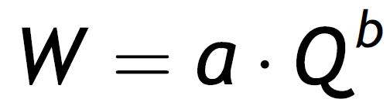
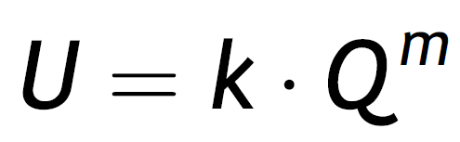
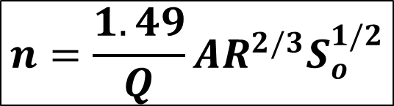
AHG continued
Can then use following relationships to calculate a, b, c, f, k, m
Finally, plug Q into manning’s equation using HAND WetArea, HydraulicRadius, and Slope, and back-calculate roughness.
$$n=\frac{1.49}{Q}AR^{2/3}S_{o}^{1/2}$$

Slide 18
Final Plan
Define machine-learning algorithm to compute manning’s roughness using a fraction of available USGS rating curve data (ie. 90%)
Manually assign roughness to test fraction (ie. 10%)
Apply algorithm to test fraction (ie. 10%)
Validate/verify correctness of algorithm on test fraction (ie. 10%)
Compare automated to manual results and adjust accordingly.
Implement algorithm on remaining 2.7 million reaches

