Slide 1
Masters Thesis Design and Development of Software Agents for Location Privacy-risk estimation
Shashank Sharma
Supervisor: M. Sc. Zohaib Riaz

Slide 2
Which restaurant will you go to?
Where?
Where do you work?
When will you visit the cinema again?
Where will you be at 4 pm today?
Where do you spend your weekends?
Where will you go next?
When?
When will you go to the hospital?
Where do you live?
Which is your favorite mall?
When will you go and visit your aunt?
When do you visit a cafe?

Slide 3

Facts
91% of the Americans have lost control on their private data
Only 9% users are confident that the social media will protect their Private data

Slide 4
Location Input
Global Positioning System GPS
Wi-Fi
Global System for Mobile Communication GSM

Slide 5
Threats
LBA can predict your future movements
Can be on unauthorized servers
Leaked information on web
Examples:
Anonymous Alcoholics Meetings can reveal the patients
Can identify the disease and time of visit based on type of doctor visits

Slide 6
Location Prediction Steps
Location Coordinates
Extract Stay-points
Form States
Time-slotted States
Markov Chain

Slide 7
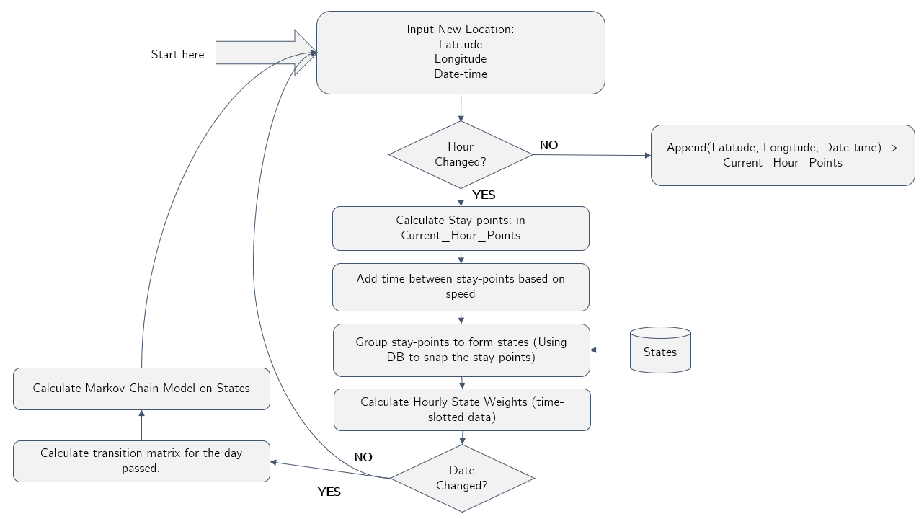
Location Prediction Flowchart

Slide 8
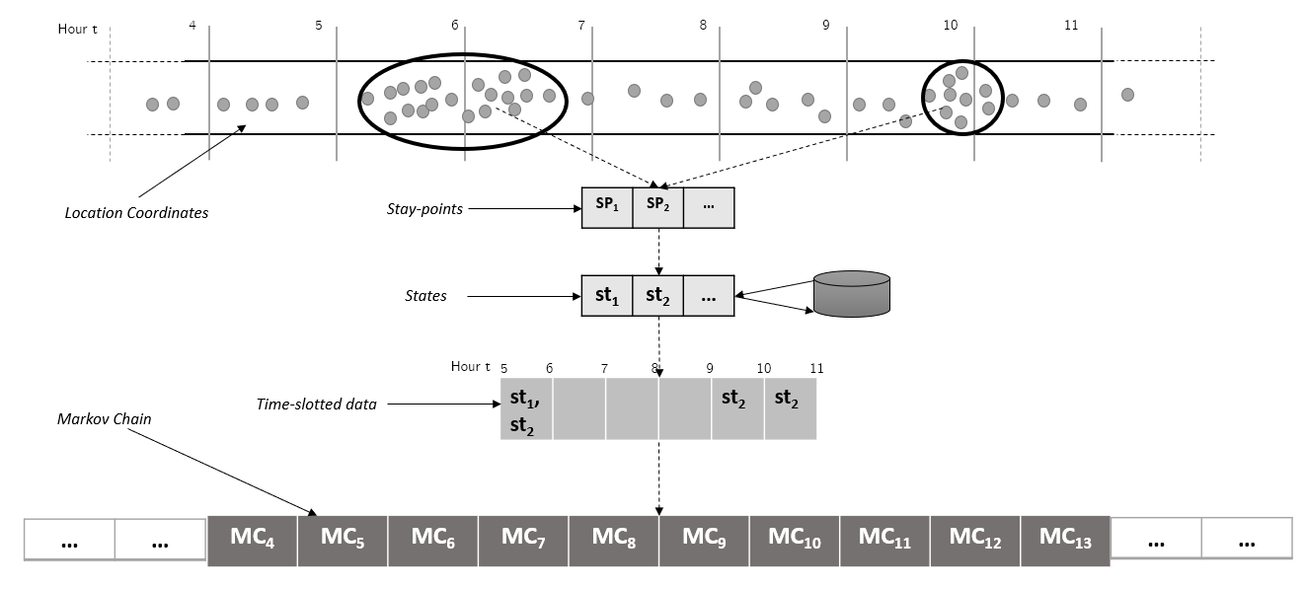
Raw GPS Points to Markov Chain

Slide 9
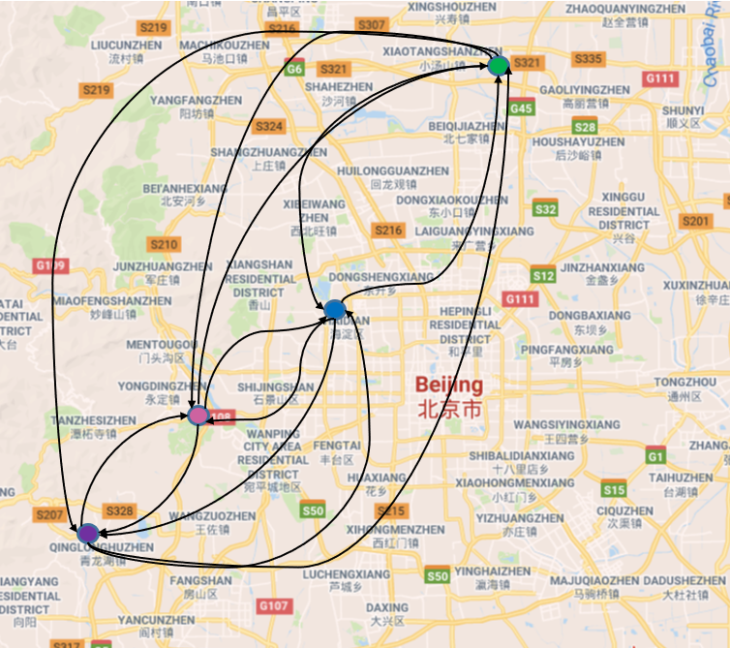
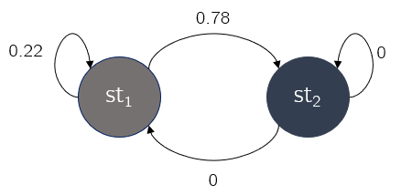
Markov Model

Slide 10
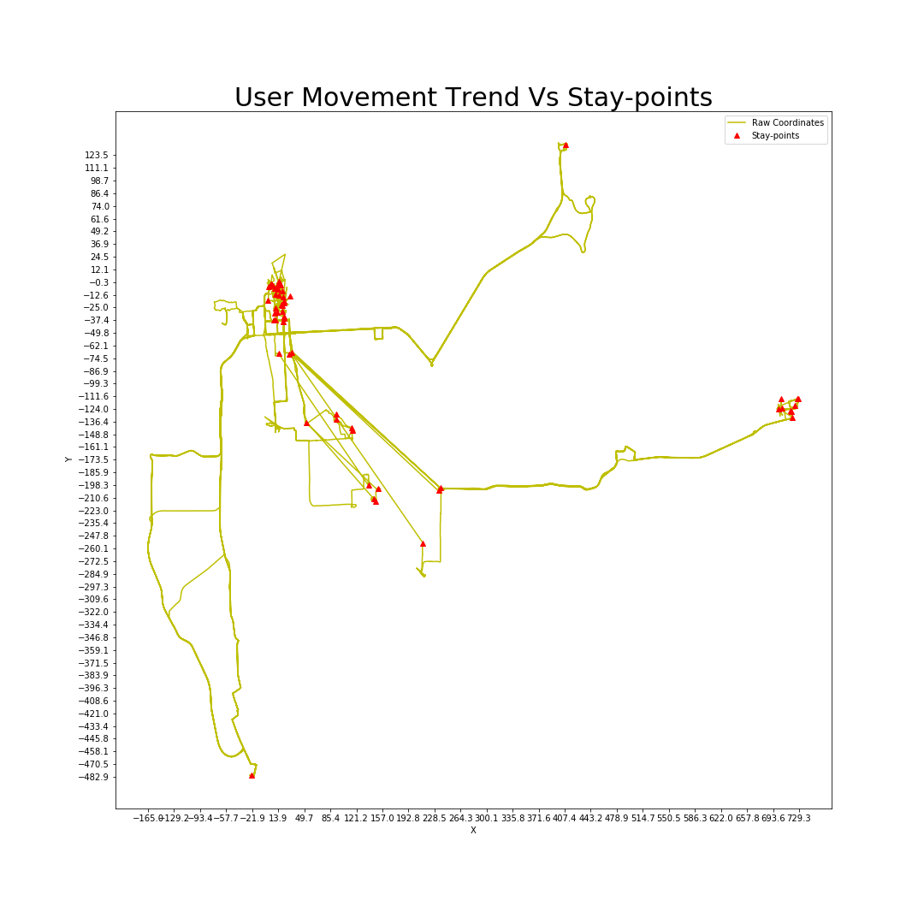
Stay-points

Slide 11
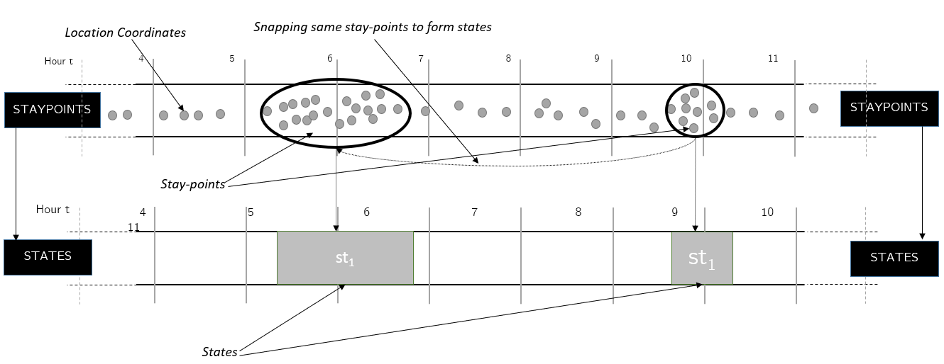
States

Slide 12
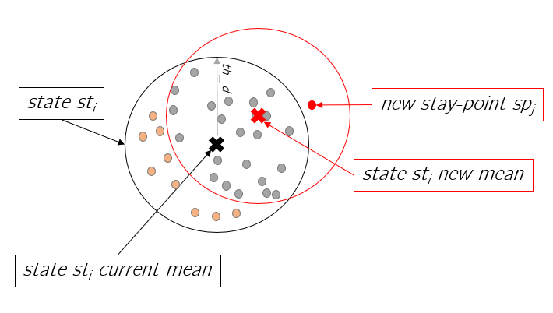
Drifting Problem

Slide 13
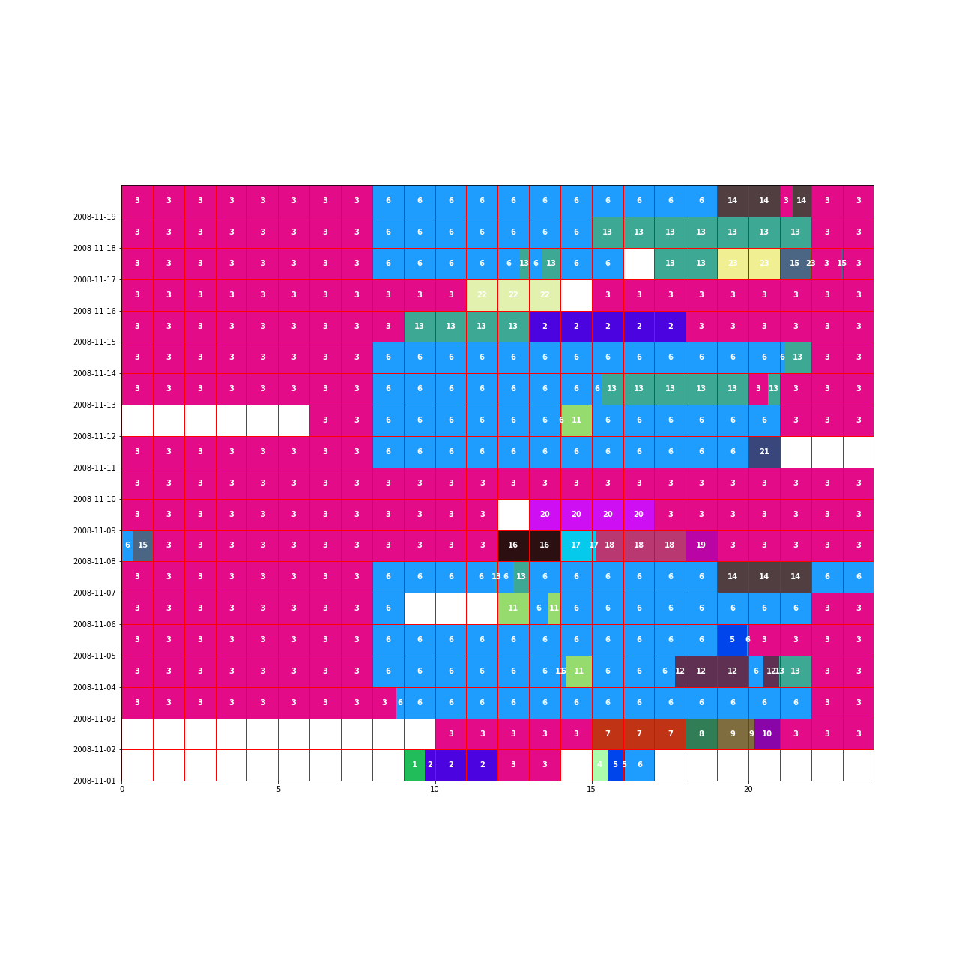
State Time-slot Weight (User 1 (200811))
Weekends

Slide 14
Evaluation: Cosine Similarity

Slide 15
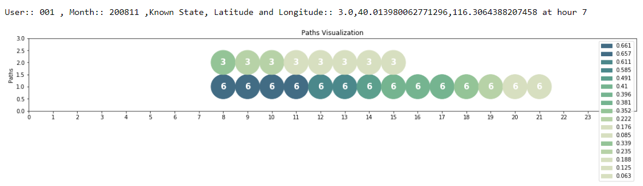
Prediction Path

Slide 16
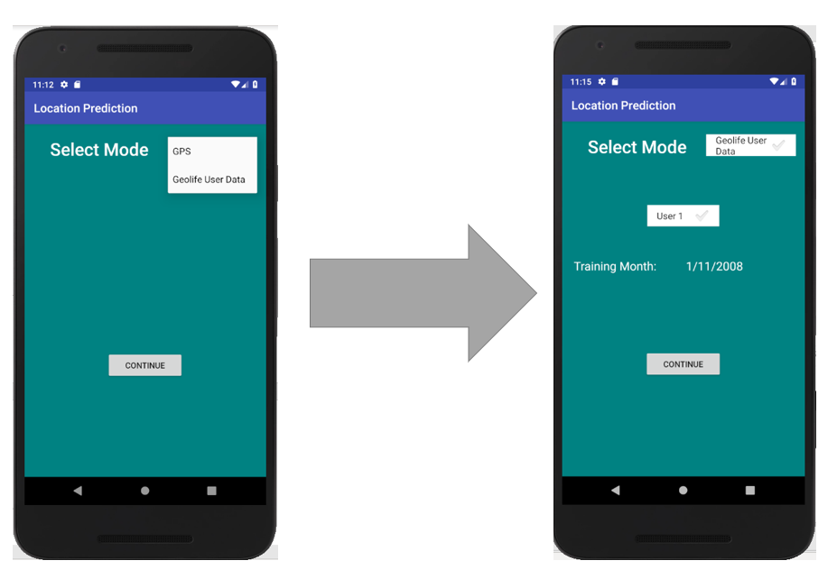
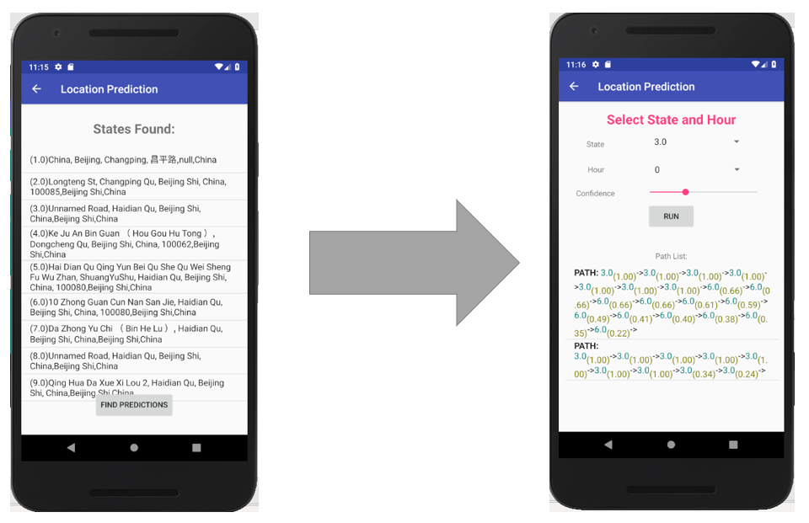
Android Application

