Slide 1
Masters Thesis Design and Development of Software Agents for Location Privacy-risk estimation
Shashank Sharma
Supervisor: M. Sc. Zohaib Riaz

Slide 2
Which restaurant will you go to?
Where?
Where do you work?
When will you visit the cinema again?
Where will you be at 4 pm today?
Where do you spend your weekends?
Where will you go next?
When?
When will you go to the hospital?
Where do you live?
Which is your favorite mall?
When will you go and visit your aunt?
When do you visit a cafe?

Slide 3
Facts
91% of the Americans have lost control on their private data

Slide 4
Threats
LBA can predict your future movements
Can be on unauthorized servers
Leaked information on web

Slide 5
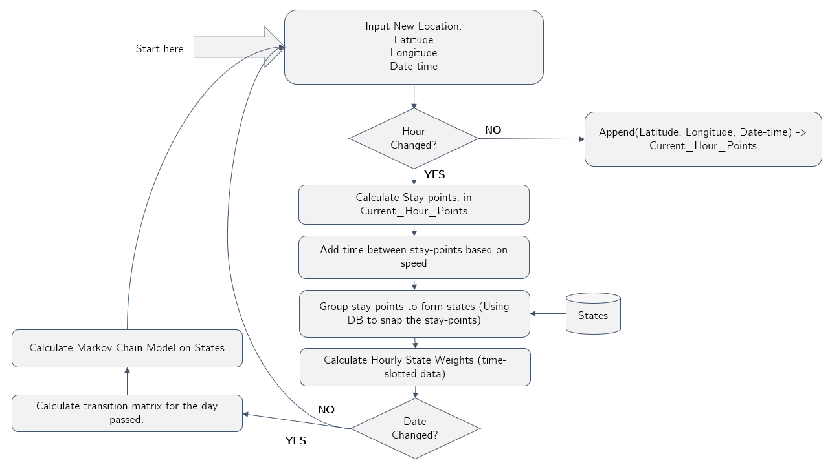
Flowchart

Slide 6
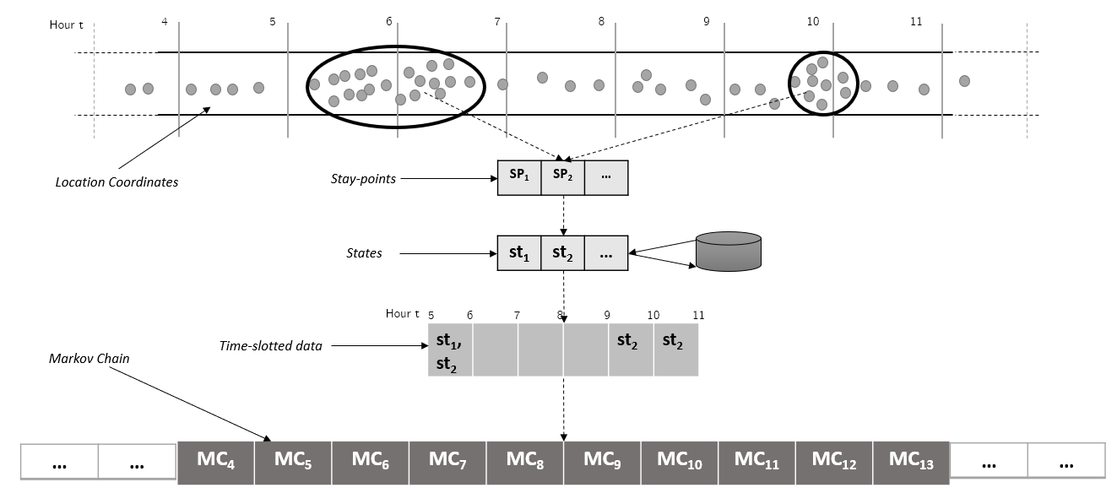
Raw GPS Points to Markov Chain

Slide 7
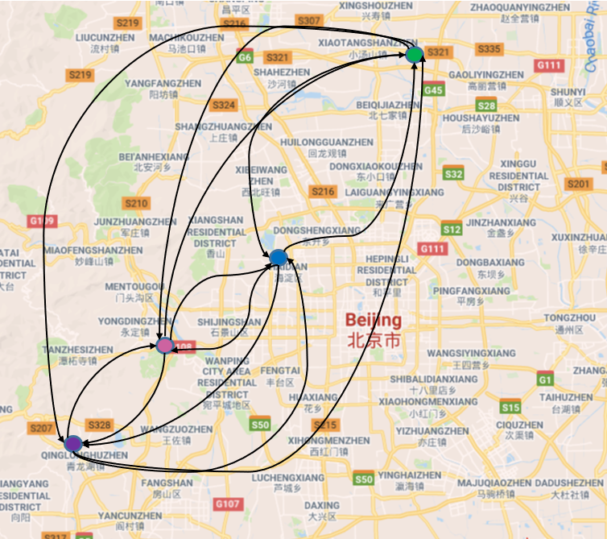
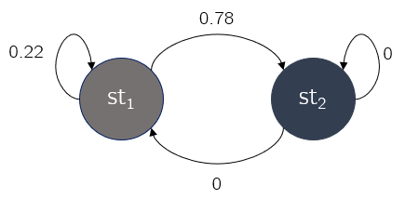
Markov Model

Slide 8
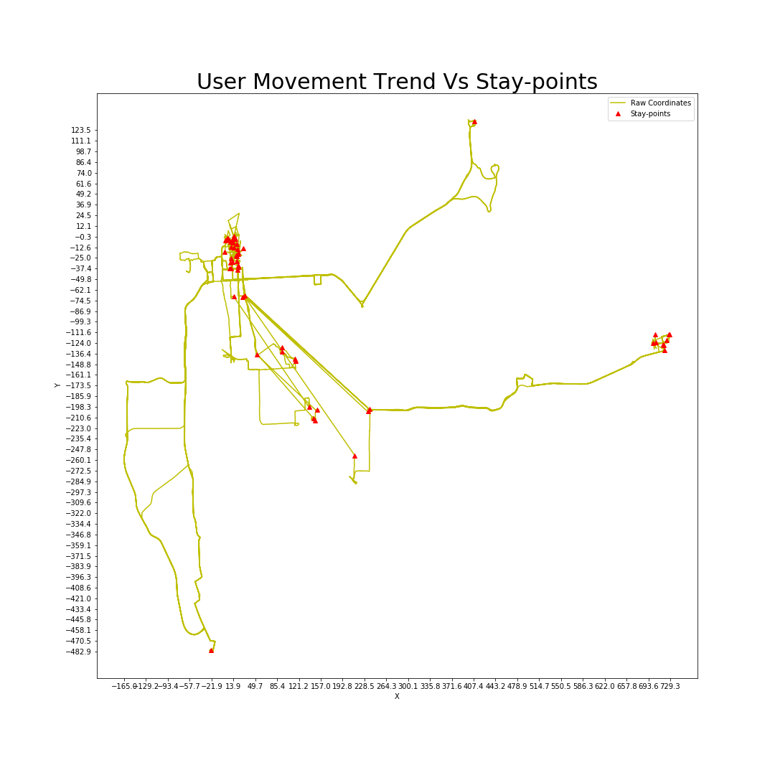
Stay-points

Slide 9
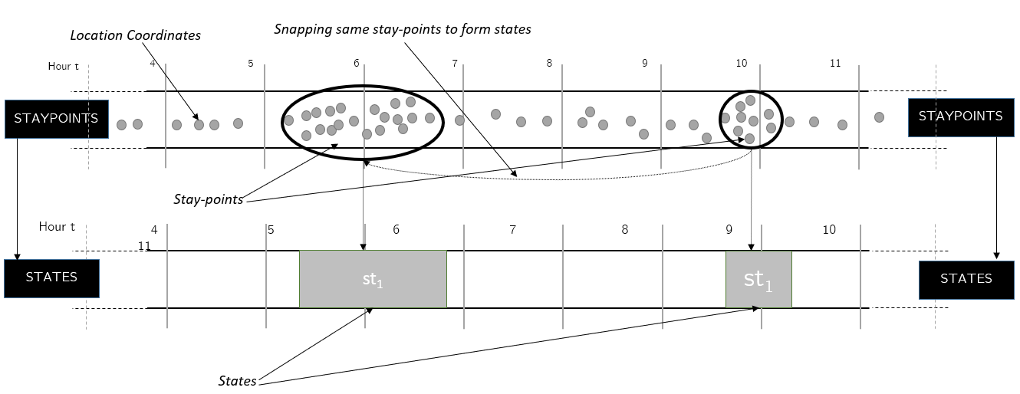
States

Slide 10
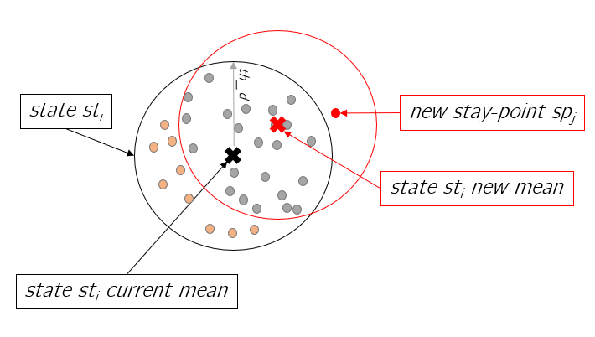
Drifting Problem

Slide 11
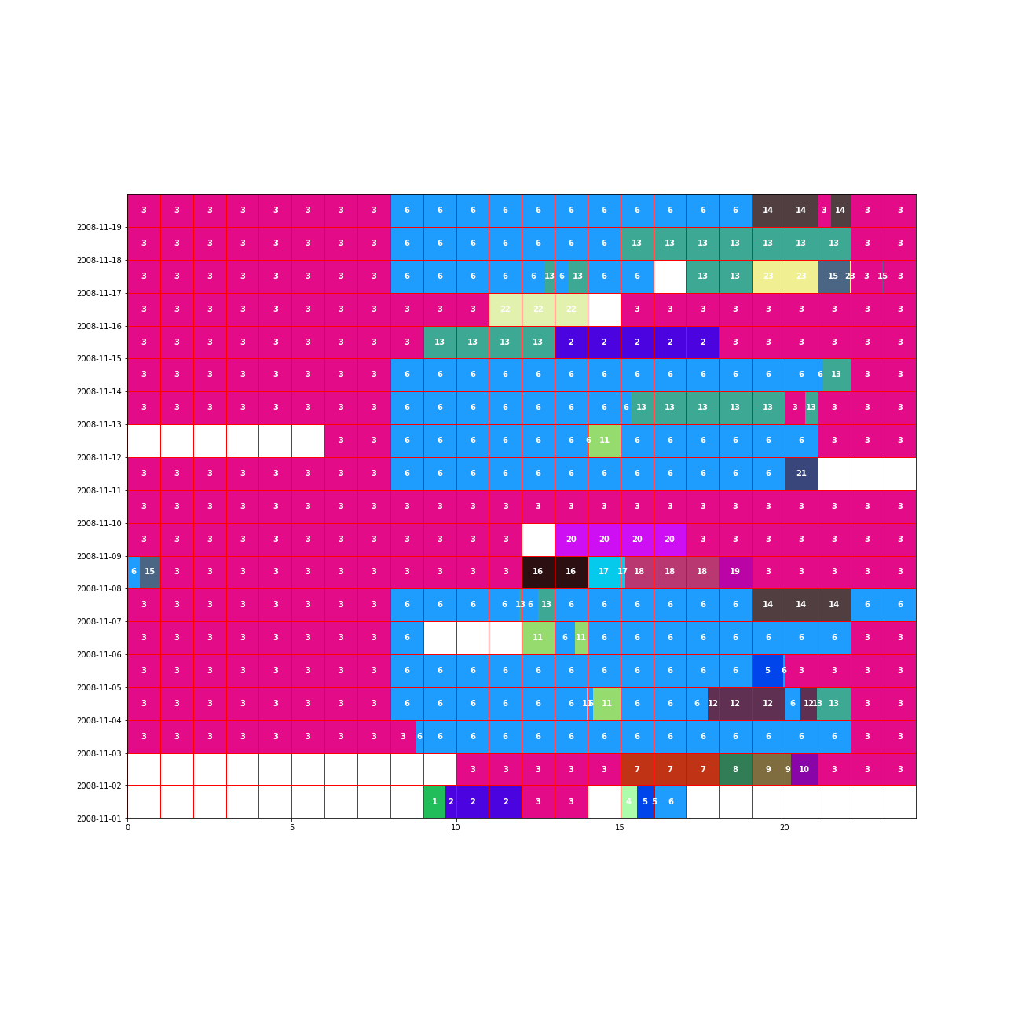
State Time-slot Weight (User 1 (200811))
Weekends

Slide 12
Cosine Similarity

Slide 13
Prediction Path

Slide 14
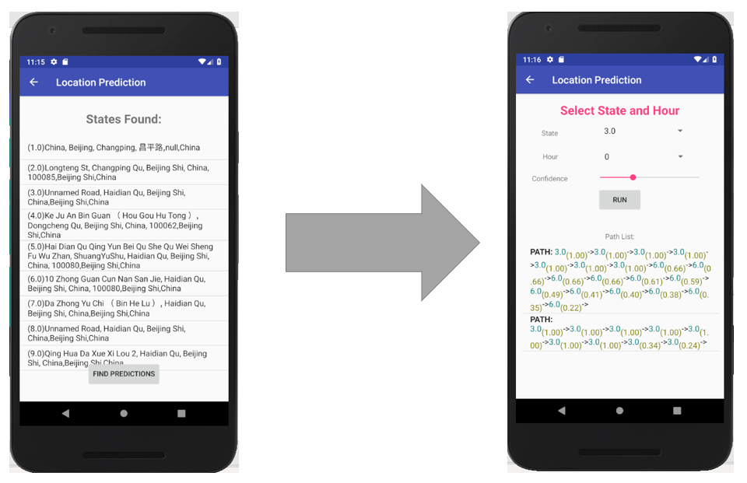
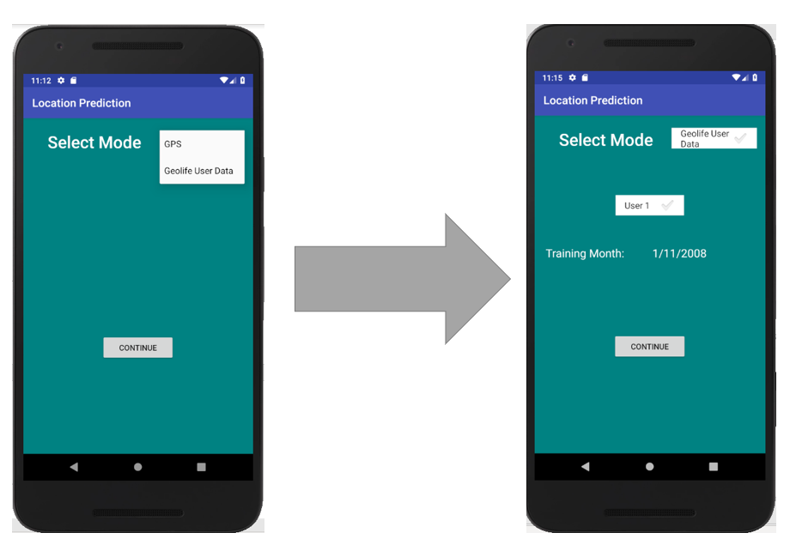
Android Application

