Slide 1
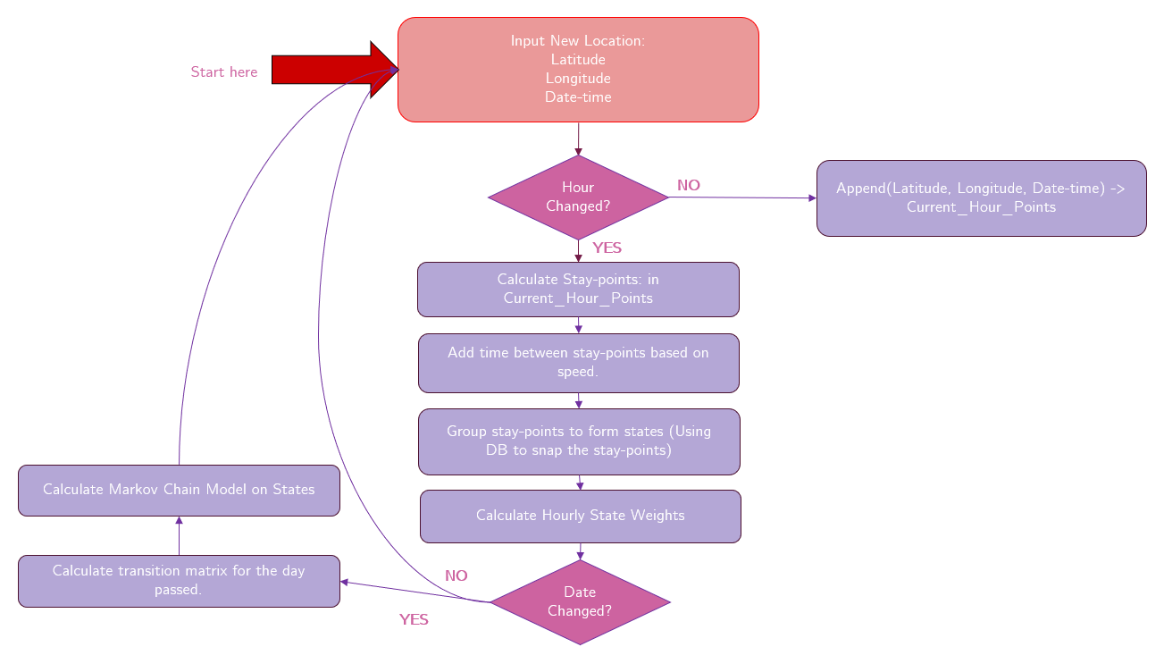

Slide 2
Prediction Parameters:
Total predictions: Count of total predictions made (T_{p})
Correct Predictions: Count of when a prediction and the actual transition matches (P_{c})
Incorrect Predictions: Count of when prediction does not match the actual transition (P_{i})
True Positives: Count of transitions made and predicted. When users moves from A to B and the prediction also suggested that user moves from A to some point (TP)
False Positives: Count of transitions not made but predicted (FP)
False Negatives: Count of transition being made but not detected (FN)
True Negative: Count of transitions not made and not predicted (TN)
Accuracy(%) = P_{c} / T_{p} * 100
True Positive Rate(%) = TP/(TP+FN) * 100
False Positive Rate(%) = FP/(FP+TN) * 100
Accuracy Positives(%) = (TP+TN)/T_{p} * 100
Positive Predictive Value = TP/(TP+FP) * 100
False Discovery Rate(%) = FP/(TP+FP) * 100

Slide 3
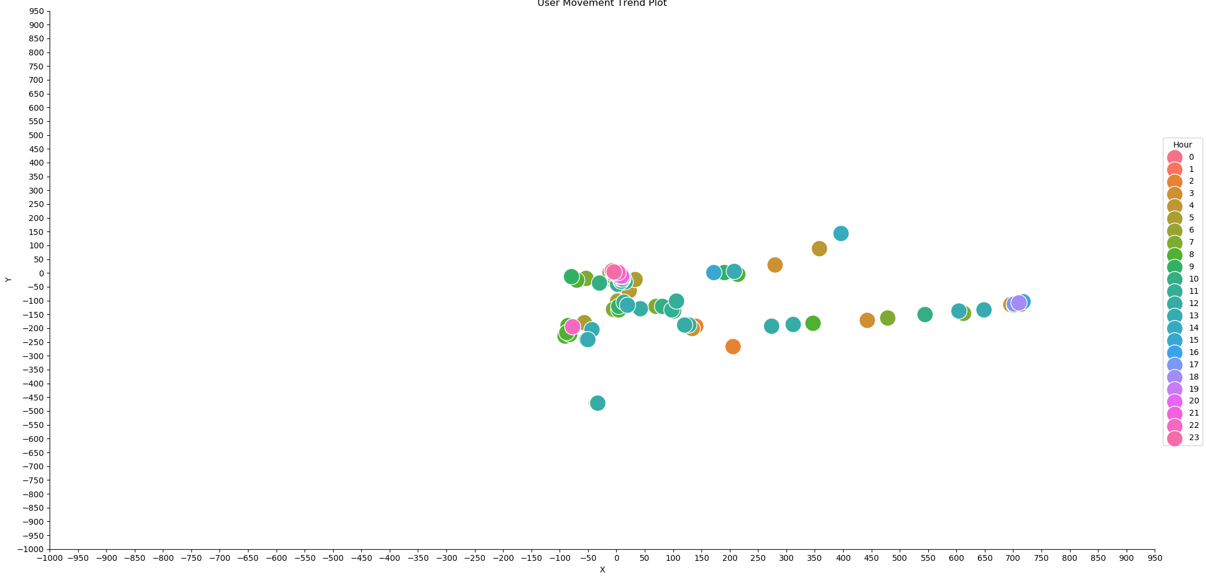
Results Example
User 000 raw data movements for month 200904

Slide 4
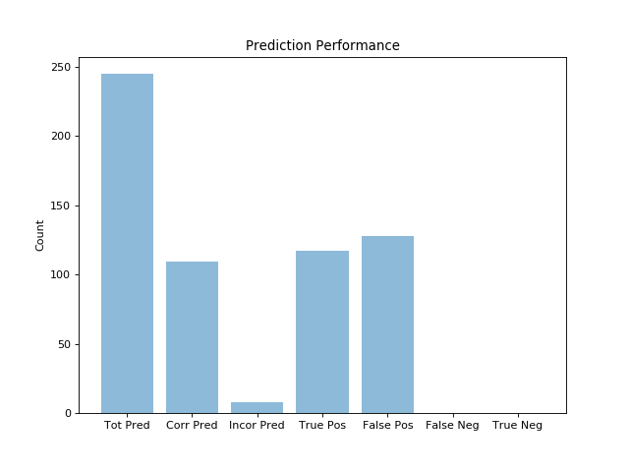
Predictions

Slide 5
Parameters
Total Predictions: 245
Correct Predictions: 109
Incorrect Predictions: 8
Accuracy%: 44.48979591836735
True Positives: 117
False Positives: 128
False Negatives: 0
True Negatives: 0
True positive rate(Recall)%: 100.0
Accuracy Positives%: 47.755102040816325
Positive predictive value(Precision)%: 47.755102040816325
False discovery rate%: 52.244897959183675

Slide 6
Results for few users

Slide 7
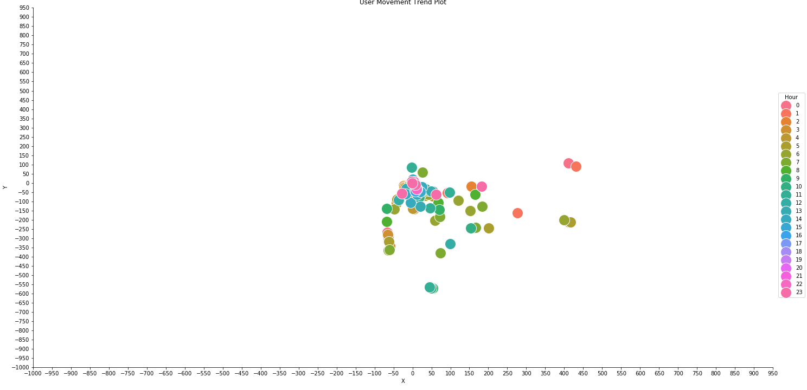
Why user 003 has above average accuracy:

Slide 8
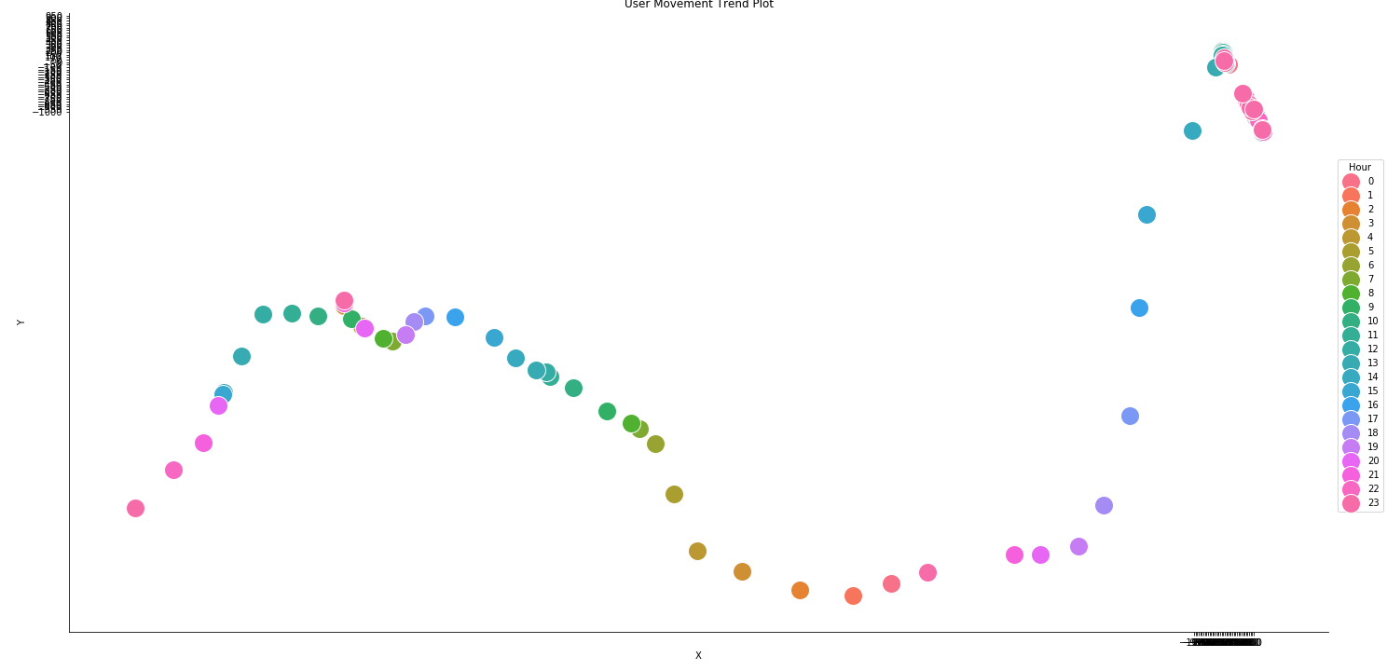
Why user 10 has very low accuracy:

Slide 9
COSINE SIMILARITY:
F‘ = [P_{1(t+1)}´, P_{2(t+1)}´, P_{3(t+1)}´, P_{4(t+1)}´ ….] * P_{x(t)}´
F = [P_{1(t+1)}, P_{2(t+1),} P_{3(t+1),} P_{4(t+1) ….}] * P_{x(t)}
_{Cosine Similarity CS = [} F_{p,} F_{a ]}
_{Where:} F‘ = Predicted Vector
F = Actual Vector
t = current hour
t+1 = next hour
x = current location
P_{1,} P_{2..} = Probabilities of location 1,2..

Slide 10
Similarity Result

Slide 11
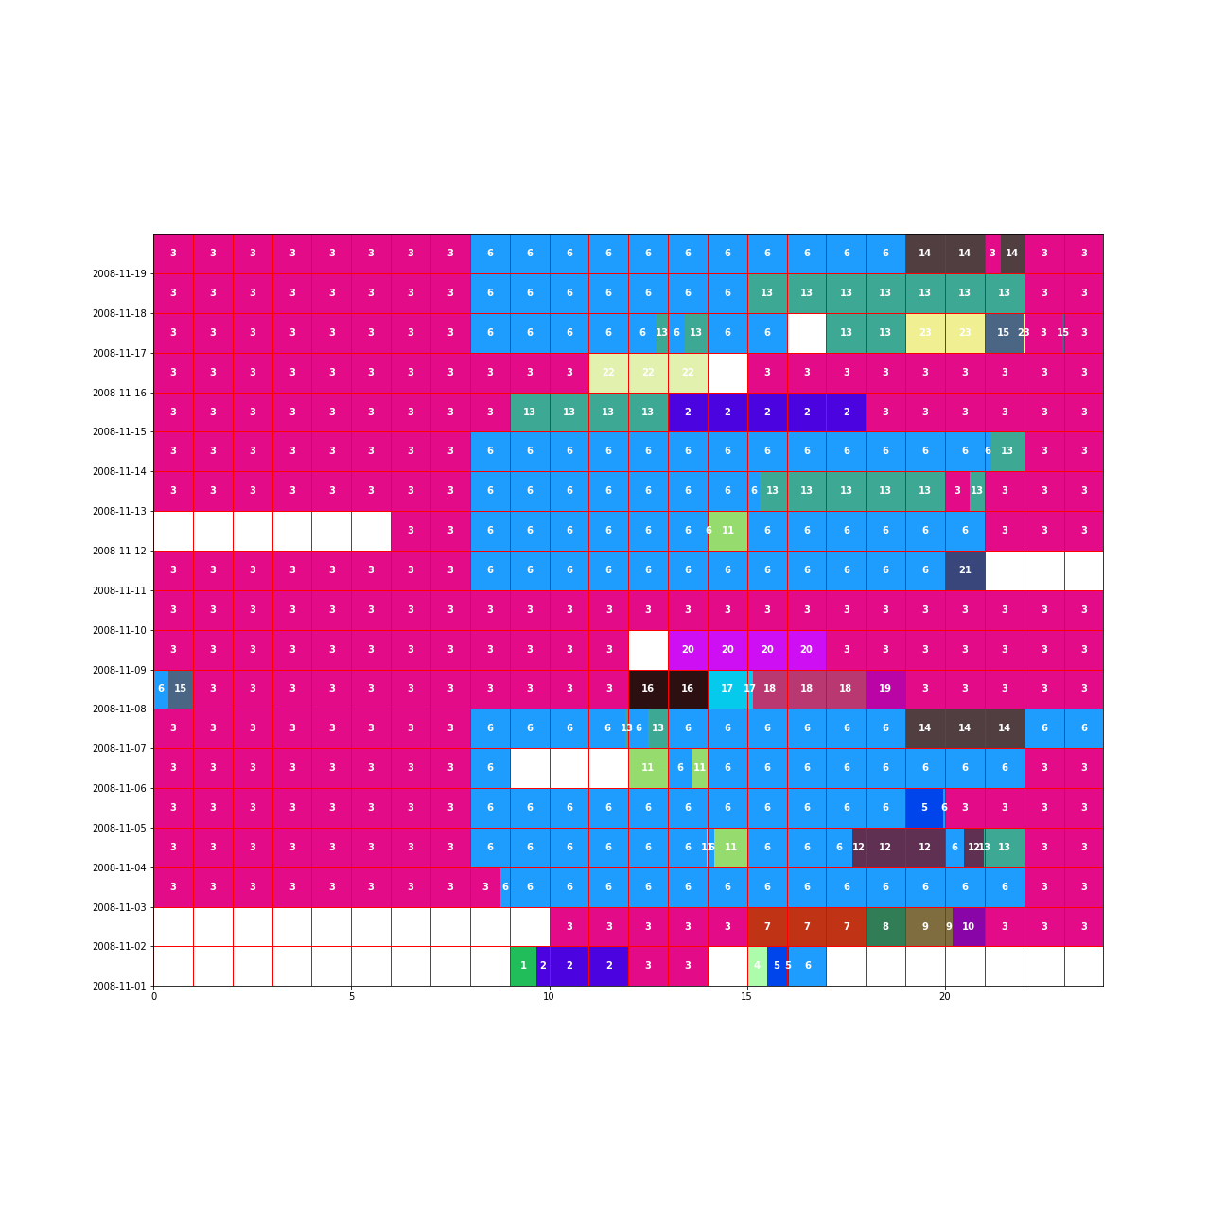
User 1 (200811)
Weekends

Slide 12
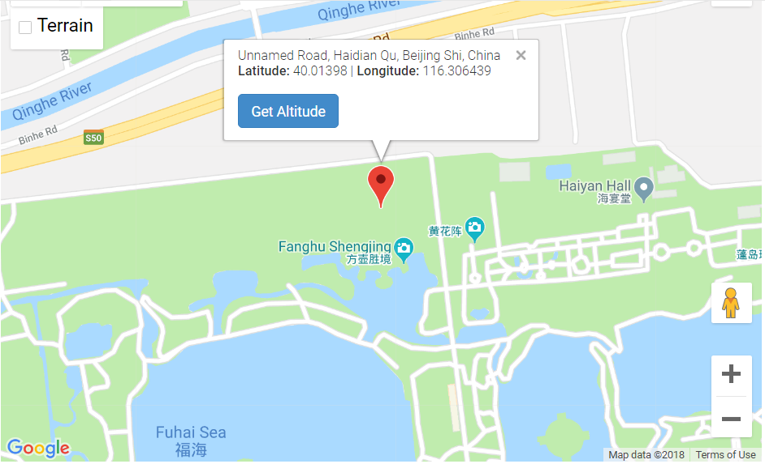
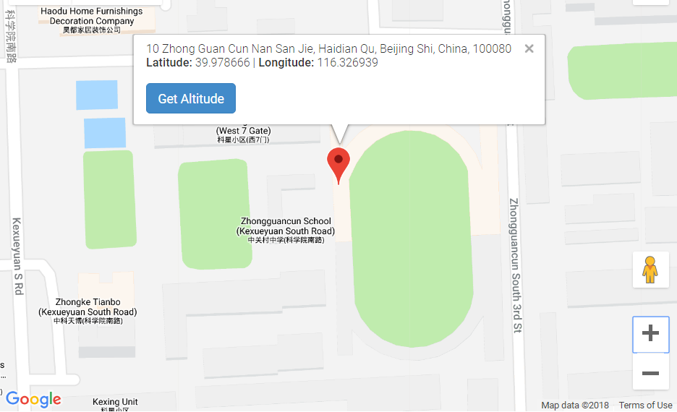
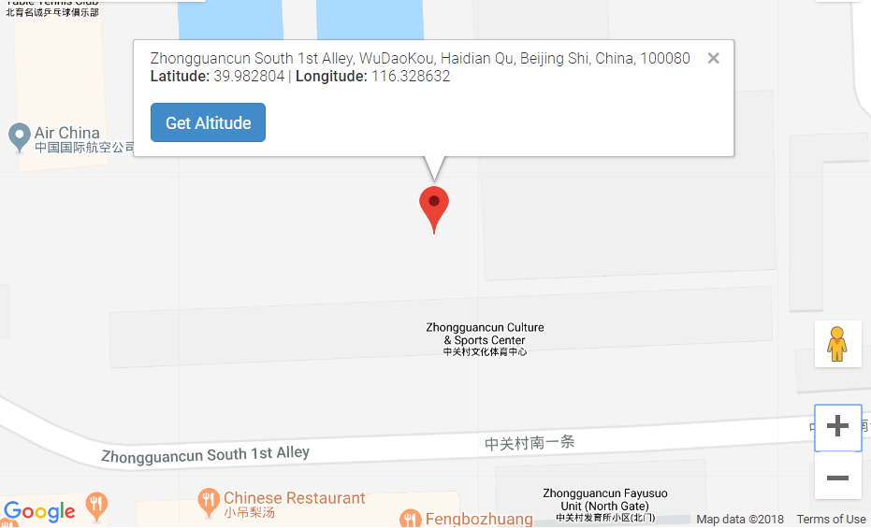
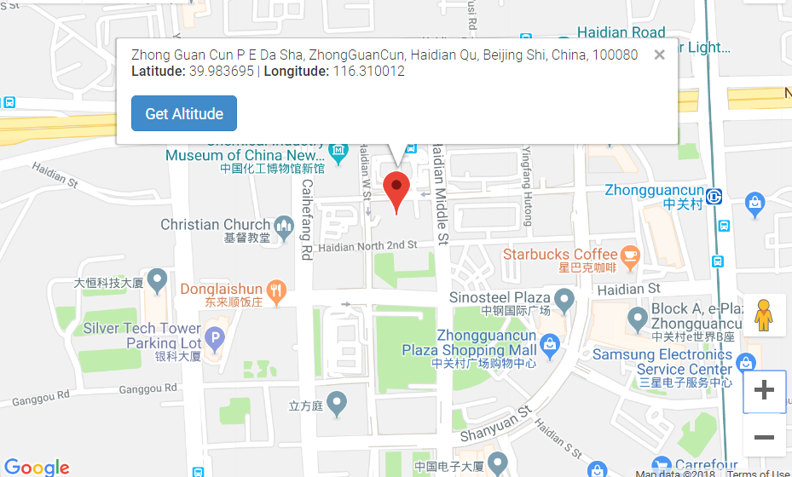
3: HOME
6: WORK
13: CLUB
16: SHOPPING MALLS

Slide 13
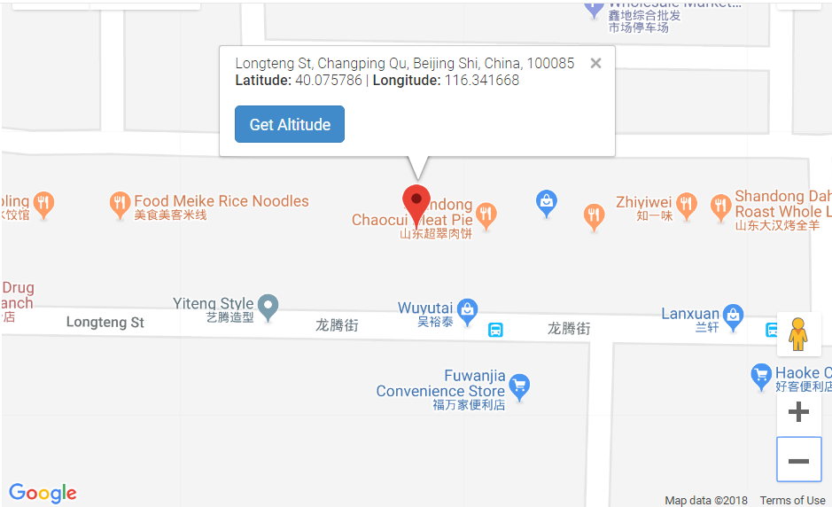
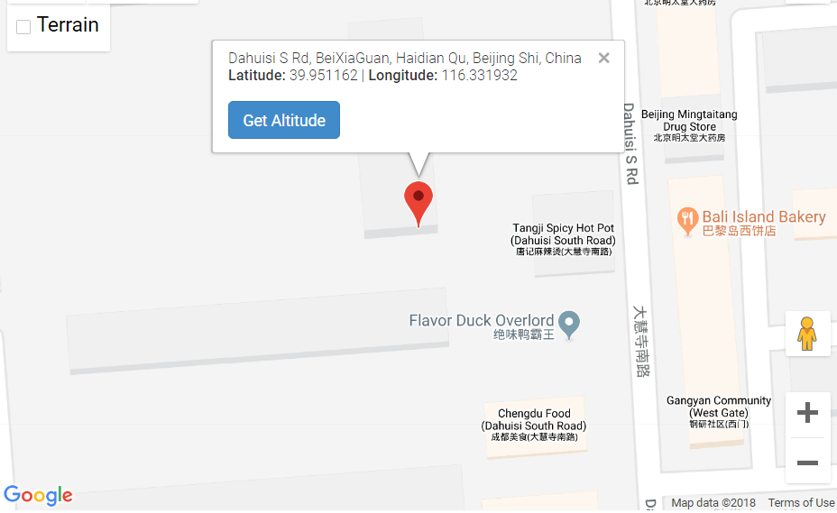
2: RESTAURANT
14. RESTAURANT

Slide 14
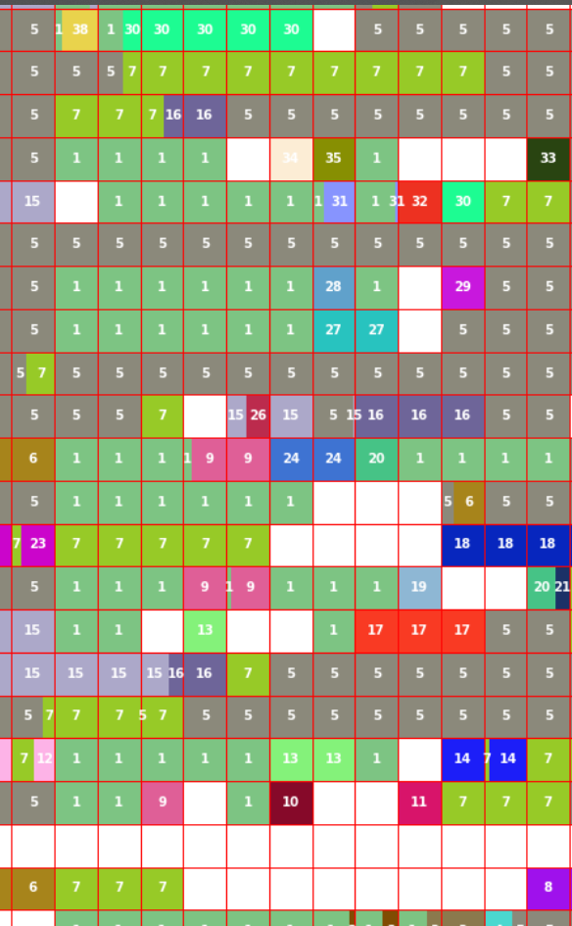
user = "017"
src_path = "C:/Users/12sha/Documents/thesislocation/code_/stay points/v0.7 results"
confidence_thrshld = 0.1 #minimum confidence for path predictions
month = "200906" #model to be used for path predictions
d_thrhld = 10
hour = 10#
Why from 7 to 5
Count how many times from 7-5 in next hour

Slide 15
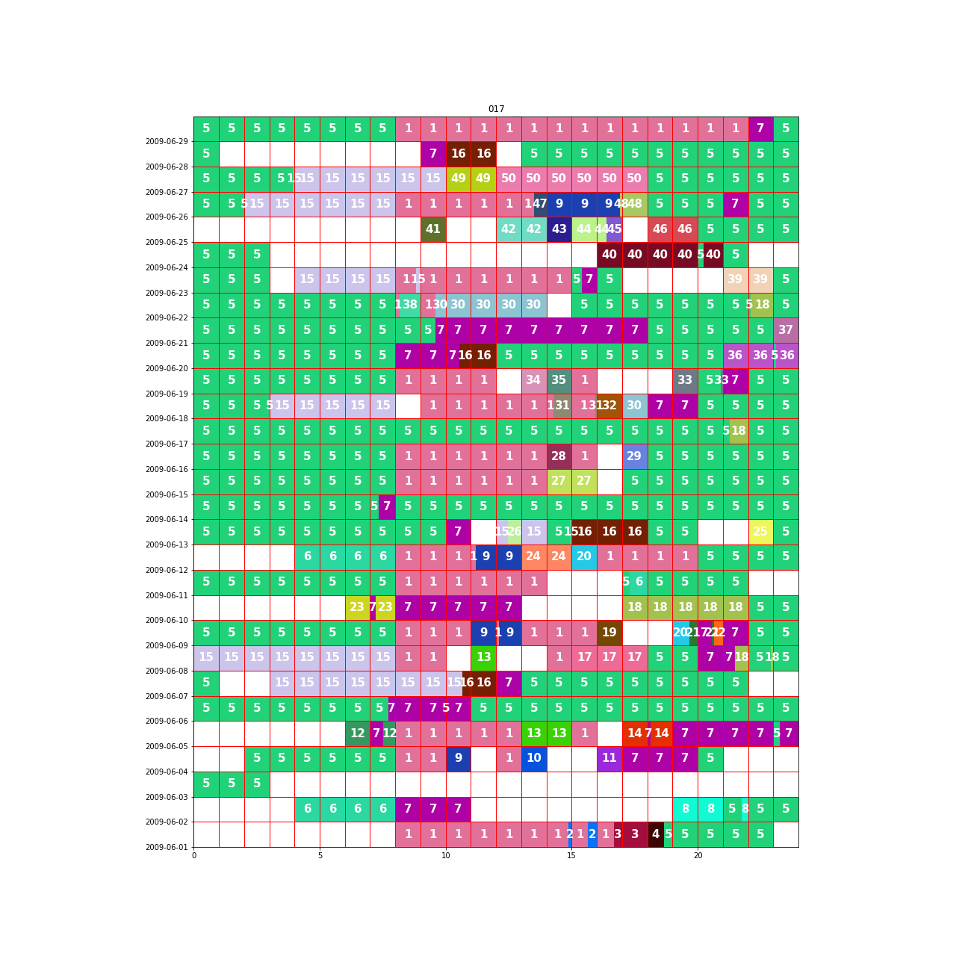
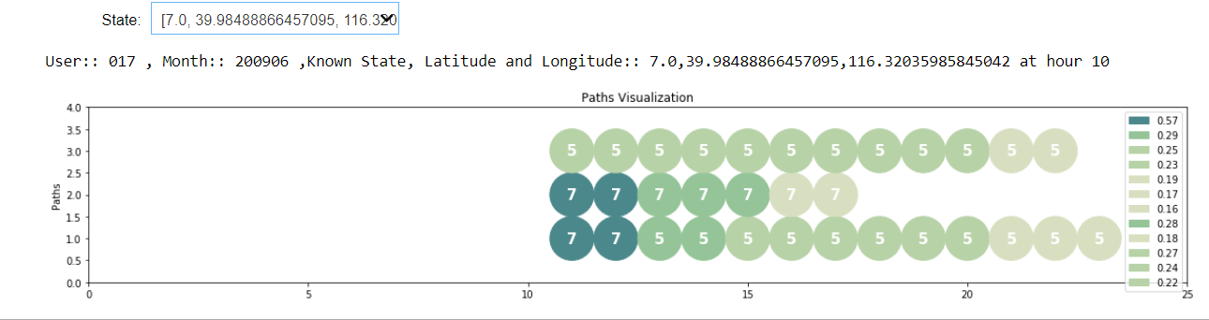

Slide 16
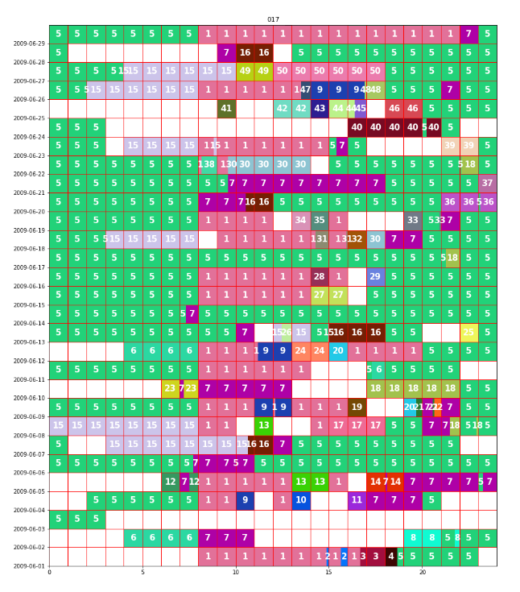

Slide 17
Motivation
Existing work
Contributions
10-15 slides

Slide 18
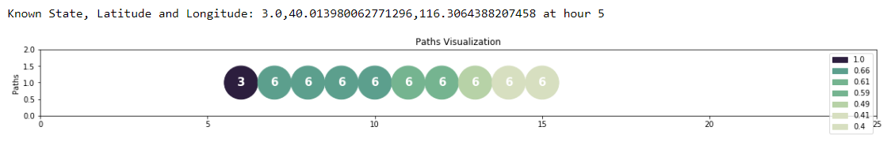
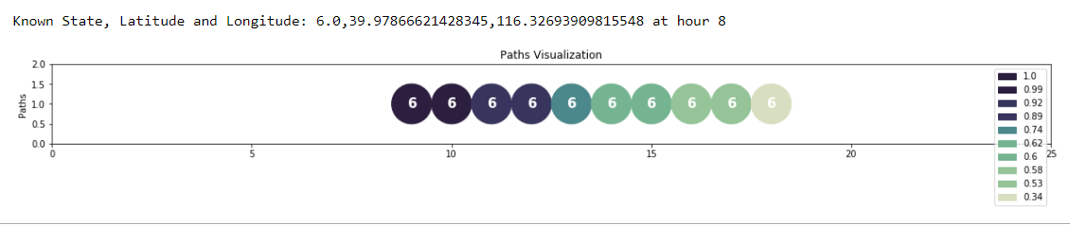
Path Prediction
The known state is „Home“ at 5 am
The path with 40% or more confidence can predicted as below
The known state is „Work“ at 8 am
The path with 40% or more confidence can predicted as below

Slide 19
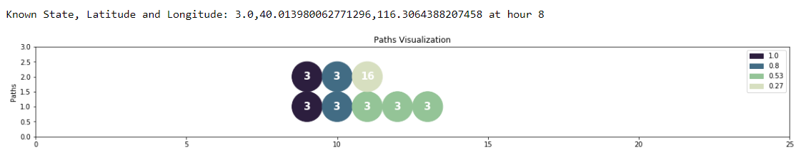
Path Prediction
The known state is „Home“ at 8 am
The path with 40% or more confidence can predicted as below
3: HOME
16: SHOPPING MALLS

Slide 20
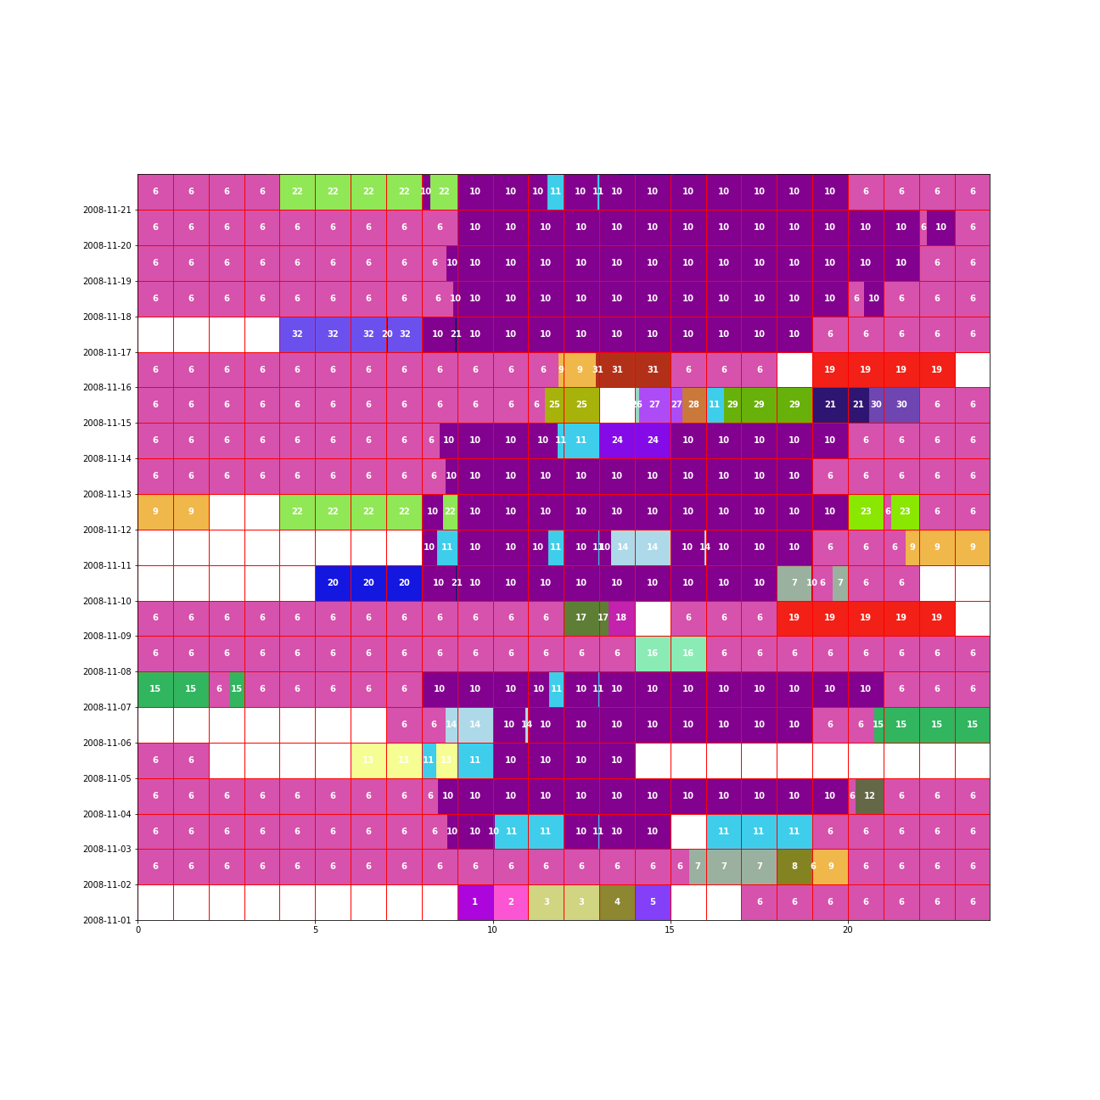
User 2 (200811)

Slide 21
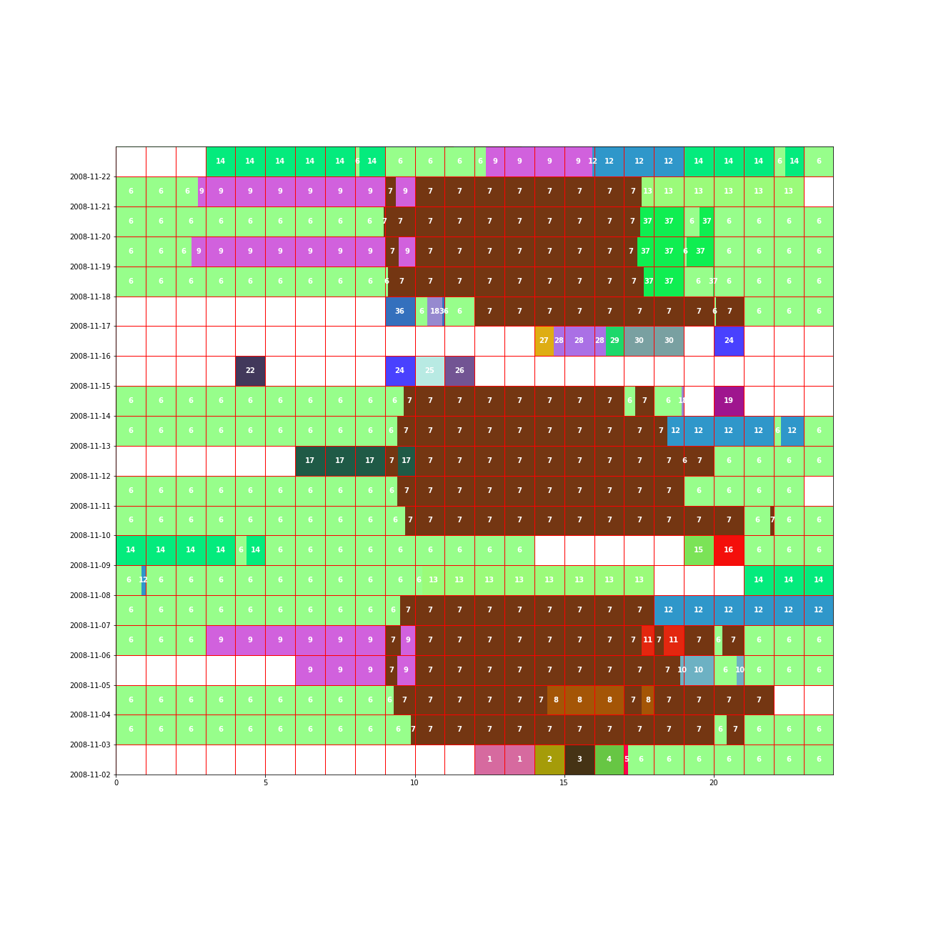
User 12 (200811)

Slide 22
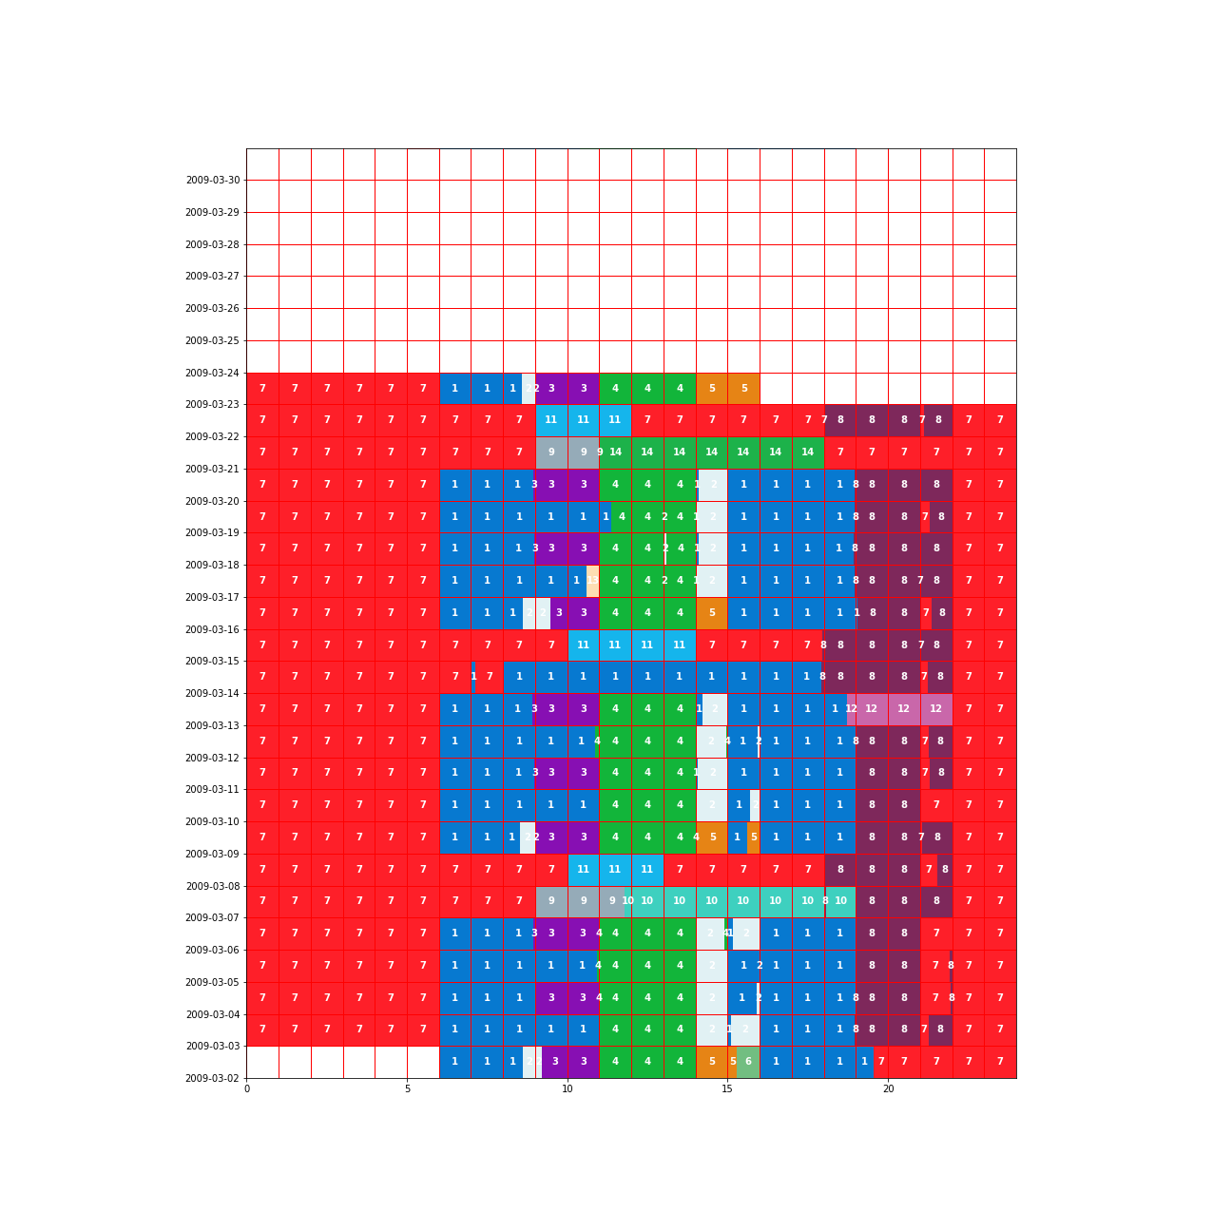
User 35 (200903)

