Slide 1
Masters Thesis Design and Development of Software Agents for Location Privacy-risk estimation
Shashank Sharma
Supervisor: M. Sc. Zohaib Riaz

Slide 2
Which restaurant will you go to?
Where?
Where do you work?
When will you visit the cinema again?
Where will you be at 4 pm today?
Where do you spend your weekends?
Where will you go next?
When?
When will you go to the hospital?
Where do you live?
Which is your favorite mall?
When will you go and visit your aunt?
When do you visit a cafe?

Slide 3
Location Input
Global Positioning System GPS
Wi-Fi
Global System for Mobile Communication GSM

Slide 4
Usefulness
Location recommendations e.g. restaurants, concerts
Personalized advertisements e.g. region based product information
Tracking emergency phone numbers using GSM
Tracking family/friends who could be in danger
Easy to track your public bus, train or flight while waiting
Socially share your interests and place of interests

Slide 5
Threats
LBA can predict your future movements
Can be on unauthorized servers
Leaked information on web
Examples:
1. Anonymous Alcoholics Meetings can reveal the patients.
2. Can identify the disease and time of visit based on type of doctor visits.
3. Can induce criminal activities.

Slide 6

Facts
91% of the Americans have lost control on their private data
Only 9% users are confident that the social media will protect their Private data

Slide 7
Location Prediction Steps
Location Coordinates
Extract Stay-points
Form States
Time-slotted States
Markov Chain

Slide 8

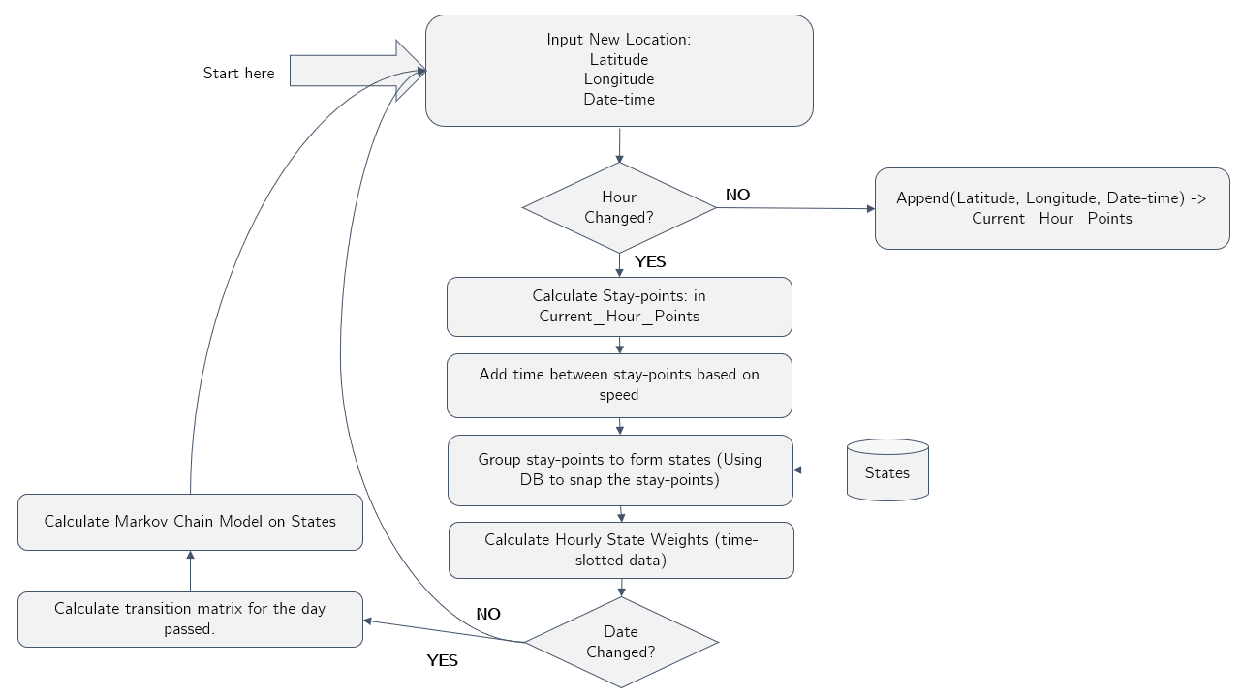
Location Prediction Flowchart

Slide 9
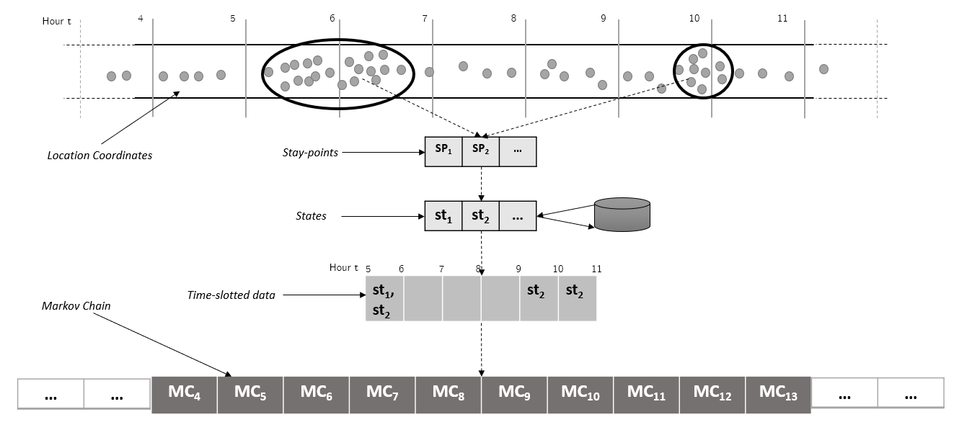
Raw GPS Points to Markov Chain

Slide 10
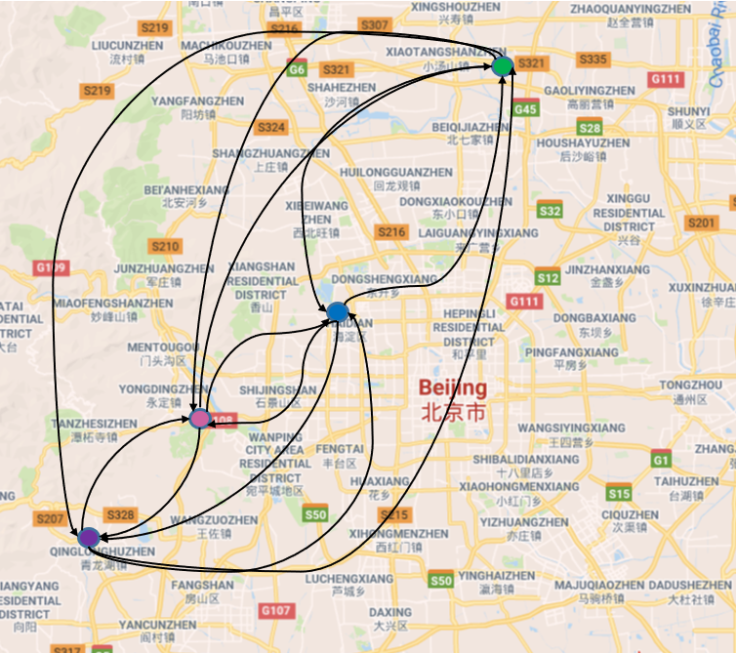
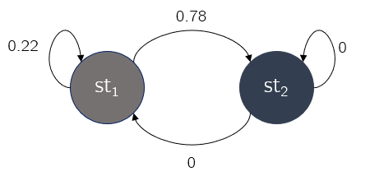
Markov Model

Slide 11
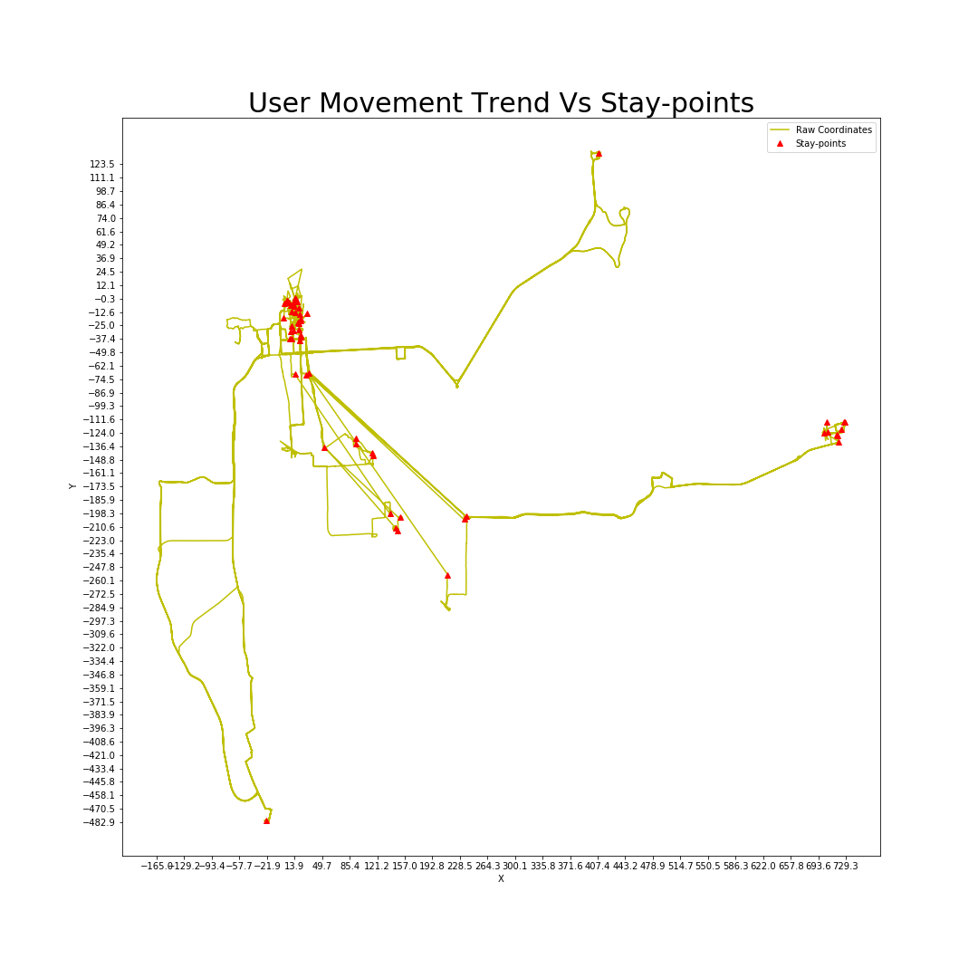
Stay-points

Slide 12
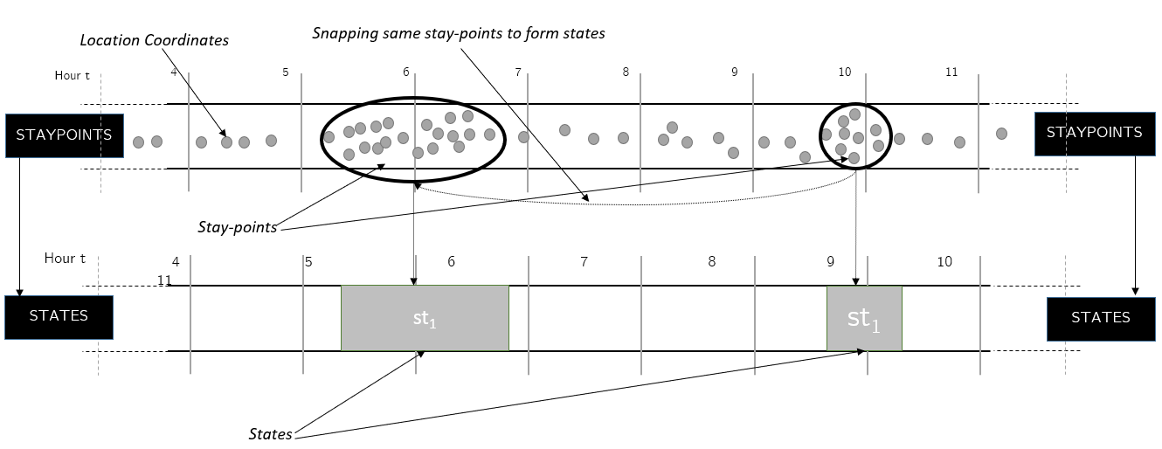
States

Slide 13
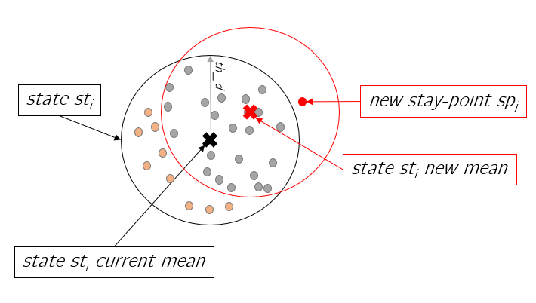
Drifting Problem

Slide 14
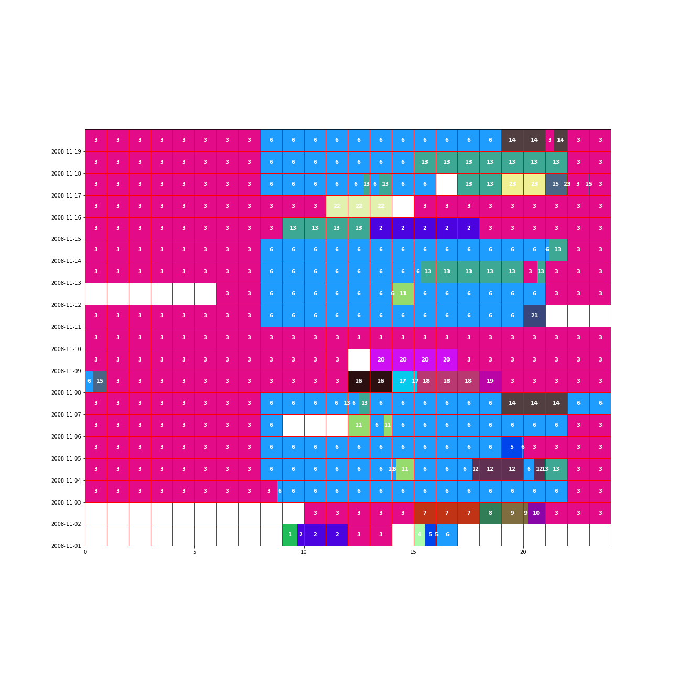
State Time-slot Weight (User 1 (200811))
Weekends

Slide 15
Evaluation: Cosine Similarity

Slide 16
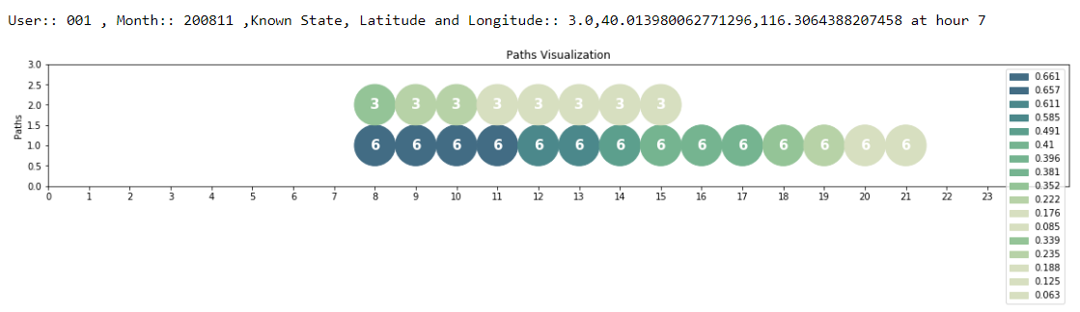
Prediction Path

Slide 17

Survey
Why a survey?
People perceive privacy threats differently
Some remember most of there whereabouts, some forgets few to many places they visited in the past
This can vary with the age of the person

Slide 18

Memory System
Encode
Store
Retrieve
But Markov Chain Model remembers everything.
Is it the right approach to showcase the privacy threat?
Notes:
1. Encode is the first stage. If the Information is never encoded, it will never be remembered.
2. Three types of encoding Visual –what you see, Acoustic – What you hear, Semantic-meaning behind the event for you
3. Memory- Short term memory – where you went to eat dinner last night or Long term memory – where do you work

Slide 19
Adapt Markov Model!
Get the memory-loss factor from survey
Apply this memory loss factor to markov chain

Slide 20
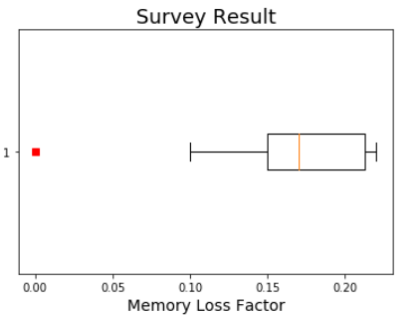
Survey Result
10 Participants
Memory Loss mean = 0.17

Slide 21

Factors to be considered
Humans can add context information in general, e.g.,
One may know that a friend is staying longer at work today as he has a deadline next week
His/her birthday can affect working hours
This information is not available in Markov Chain.
But with the access the mobile data like calendars and chats, this is easy to get!

Slide 22
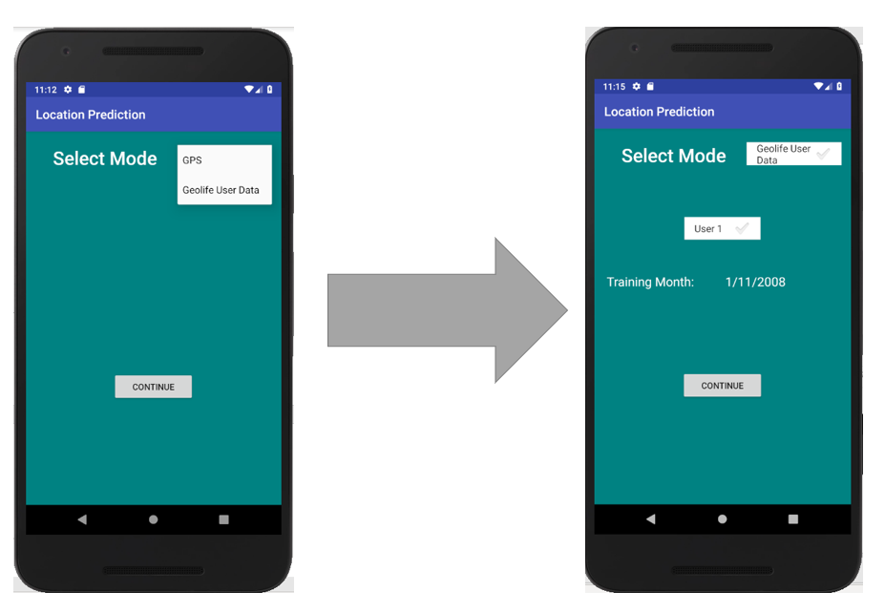
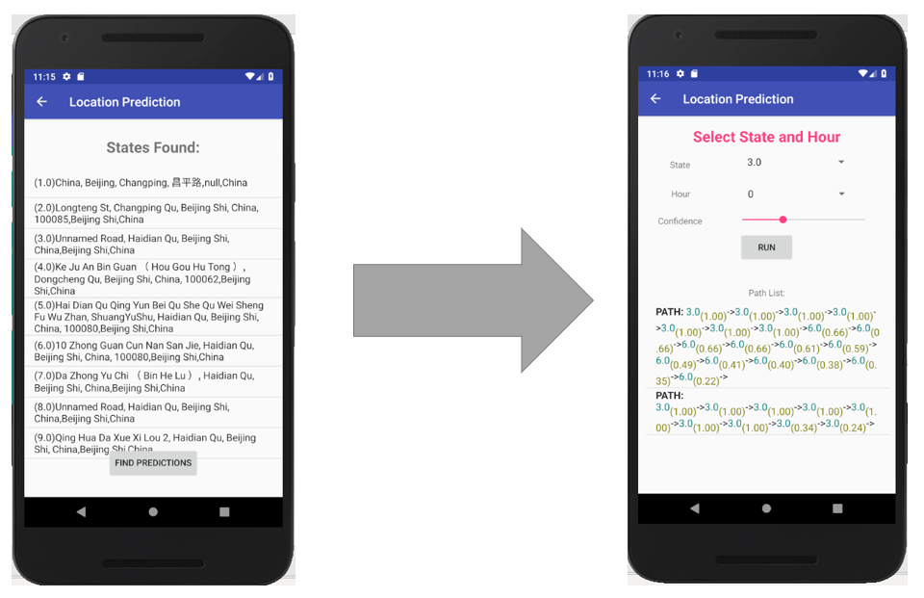
Android Application

Slide 23

Your thoughts?
Shashank Sharma

