Slide 1
Cross-Platform Data Migration with Schema Evolution and LLM-Integrated QA Automation
Sourav Ghosh (M22AIE241)
Indian Institute of Technology Jodhpur

Slide 2
Introduction
Modern data systems demand both scalability and intelligence to support growing data volumes and complex analytical needs.
Key challenges include handling schema evolution, real-time data processing, and achieving efficient cloud-native scalability.
This work focuses on cross-platform data migration, automated schema evolution, and QA automation powered by LLM-enhanced intelligence.
I propose a Hybrid Retrieval-Augmented Generation (RAG) framework capable of reasoning over relational data, performing numerical and quantitative analysis, and delivering precise, contextually grounded answers.

Slide 3
Background of the work
Traditional vs. Modern Data Systems: Traditional pipelines rely on rigid schemas and batch-oriented workflows, whereas modern architectures embrace flexible schemas, continuous ingestion, and real-time analytics.
Dynamic Schema Evolution: Modern platforms support automated schema detection, drift handling, and seamless evolution without breaking downstream consumers.
QA Frameworks & Reliability: Robust quality-assurance mechanisms ensure schema validation, anomaly detection, and proactive error resolution across heterogeneous data sources.
LLM Integration for Intelligence: Large Language Models enable dynamic query generation, contextual reasoning, and actionable insights—bridging human intent with complex relational datasets.

Slide 4
Problem Definition
Cross-platform migration with automated schema mapping.
Schema evolution tracking with version-aware transformations.
LLM-powered QA automation for rule validation, and test-case generation.
Hybrid RAG : LLM-based query generation & inference, enabling both quantitative analytics and natural-language insights directly from relational data.

Slide 5
Architecture
Automated Schema Detection & Alignment:
Intelligent identification of schema drift, column-level mismatches, and structural variations across cross-platform systems.
Real-Time Data Migration with Historical Lineage Tracking:
Continuous synchronization between heterogeneous platforms using CDC, versioned schema history, and audit trails.
LLM-Enhanced QA Automation:
AI-driven test-case generation, anomaly detection, rule-based validation, and natural-language QA for completeness and accuracy.
Hybrid RAG over Relational + Unstructured Data:
Enables LLM-powered SQL generation, query rewriting, cross-table reasoning, and inference over factual + contextual data.

Slide 6
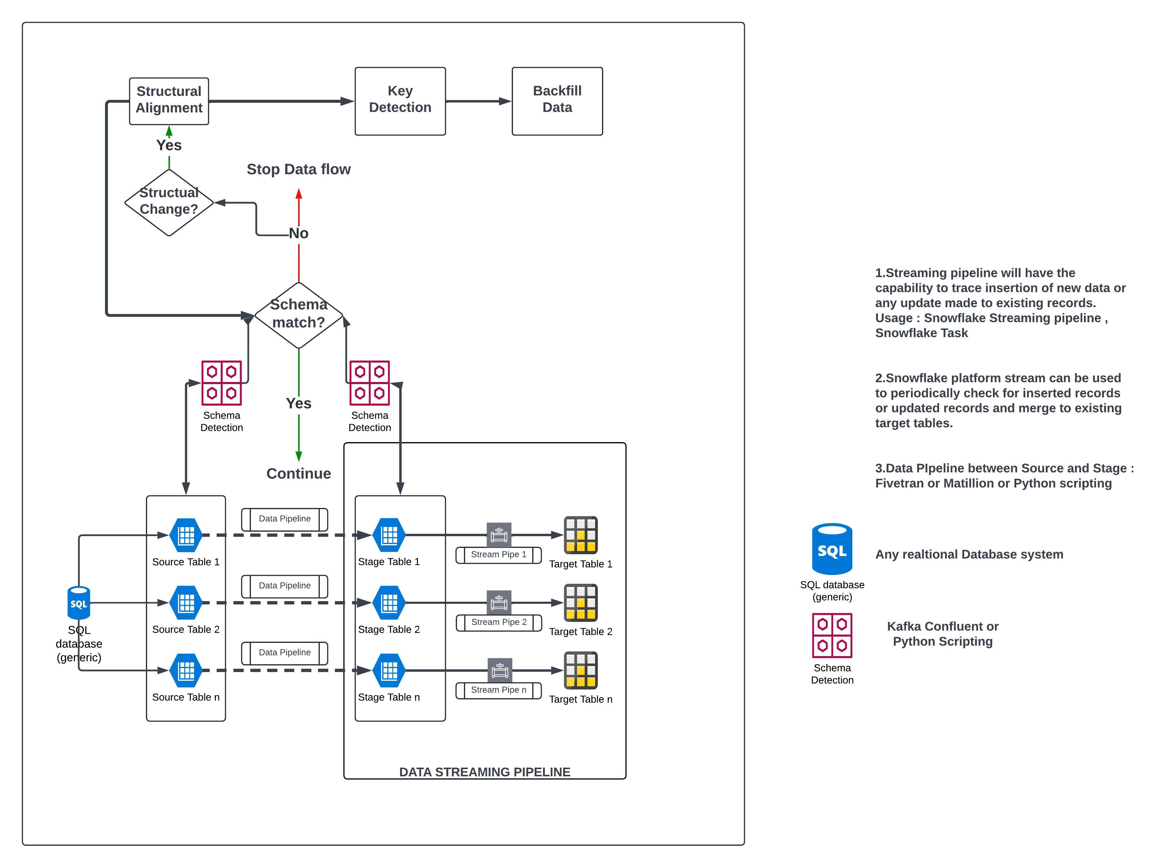
Schema Detection and Evolution

Slide 7
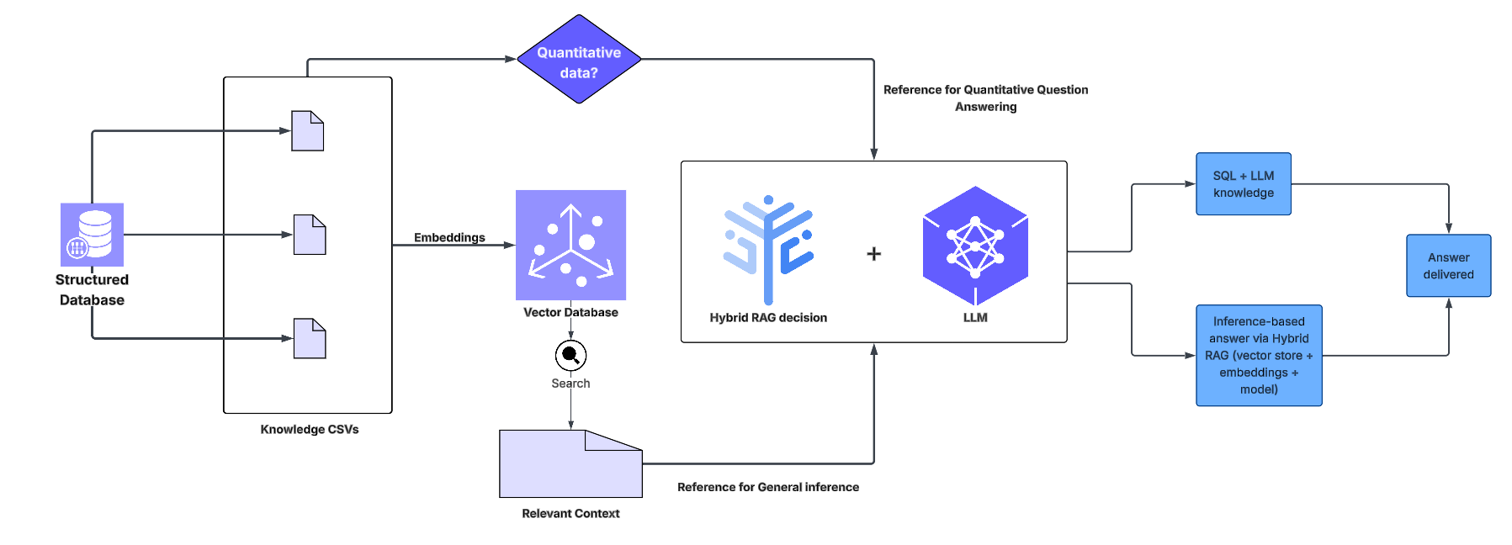
Hybrid RAG System

Slide 8
Hybrid RAG System
User Query: User asks a natural-language business question.
RAG Retrieval: Question is embedded → Chroma returns the most relevant context.
Decision Engine: If the query needs numbers, filters, or aggregation → SQL mode. If it's descriptive or explanatory → RAG mode
SQL Pipeline (Analytical): LLM generates SQL and executes → result is merged with context for a business-friendly answer.
RAG Pipeline (Descriptive): LLM uses retrieved context to produce a clear, natural explanation.
Hybrid Answer: For SQL questions, the system blends SQL output + semantic context + reasoning into one concise, insightful response.

Slide 9
References
https://arxiv.org/abs/2005.11401v4
https://www.researchgate.net/publication/388722115_Advancing_Retrieval-Augmented_Generation_RAG_Innovations_Challenges_and_the_Future_of_AI_Reasoning
https://arxiv.org/html/2408.04948v1
Repository
https://github.com/M22AIE241/MTP
Execution Snippets: https://github.com/M22AIE241/MTP/tree/main/Validate_Execution

Slide 10
Future Scope:
Fine-Tuning a Local SLM on Specific Data: Train a small language model (SLM) locally using knowledge distillation and LoRA to improve SQL generation accuracy, Domain-specific reasoning, Context understanding.
Query Planning & SQL Debugging Agent: Introduce an LLM-powered “SQL Reviewer” that validates, corrects, and optimizes generated SQL before execution.
Multi-Modal RAG Integration: Incorporate PDFs, images, dashboards, and logs into the vector DB for richer business insights beyond CSVs.

