Slide 1
Real-Time Multiple Target Detection in Live Video Streams using CNN-TCN Fusion
Presenting by:
Lohit Ramaraju(M23AID065)

Slide 2
Objective
Propose a novel model integrating SWT, PCA, and CNN-TCN for real-time multiple target detection. The model enhances explainability through Grad-CAM and adapts via a feedback loop, improving detection accuracy in various terrains for identifying friendly, hostile, and alien objects.

Slide 3
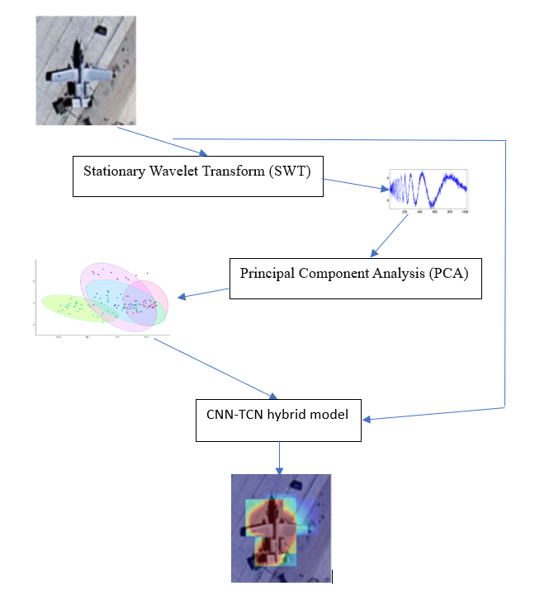
Methodology Overview
Extract individual frames from live video feeds.
Apply Stationary Wavelet Transform (SWT) for feature extraction.
Use Principal Component Analysis (PCA) for dimensionality reduction.
Input PCA output into the CNN-TCN hybrid model.
Identify targets by adding a color spectrum to the classification map.
Explainability Integration: Grad-CAM highlights the areas influencing the model’s predictions, improving transparency.
Adaptive Feedback: Model tuning in real-time based on Grad-CAM insights enhances prediction accuracy dynamically.

Slide 4
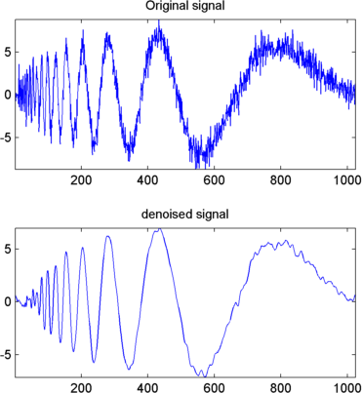

Stationary Wavelet Transform (SWT)
SWT is used to extract meaningful spectral features from video frames. Unlike traditional wavelet transforms, SWT does not down sample the image, which retains more detailed information. This is useful for identifying edges and fine details, crucial for distinguishing targets in complex environments.

Slide 5
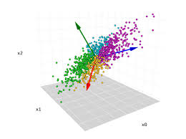
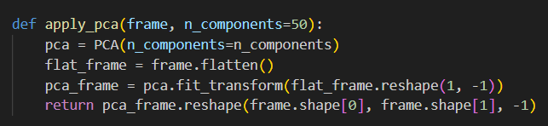
Principal Component Analysis (PCA)
PCA reduces the dimensionality of the SWT data by transforming it into a set of orthogonal components. The first few components capture most of the variance, simplifying the input to our neural network while preserving essential information.

Slide 6
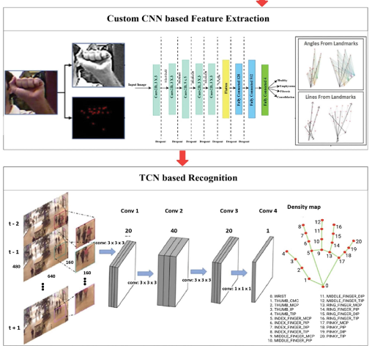
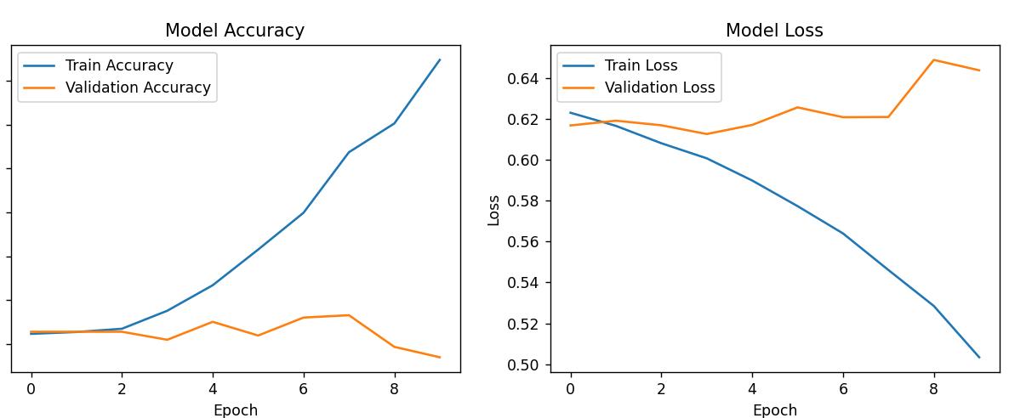
CNN-TCN Fusion Model
As part of innovation and novelty the model’s spatial and temporal feature extraction is complemented by Grad-CAM, which provides real-time explainability, ensuring transparent decision-making and a feedback loop to make the model learn its mistakes and correct them for better detection.
After good research I didn’t find the related works with a closed loop feedback system and I think this inclusion and creating a optimized looping system will make model more reliable and effective.

Slide 7
Comparison and observation
I have experimented with the dataset and target detection with CNN, TCN and the proposing Fusion models.
Before applying the models the dataset was cleaned and restructured.
 | CNN | TCN | Fusion
Accuracy | 77.54 | 69.20 | 84.43
Prediction confidence | 0.76 | 0.71 | 0.91

Slide 8
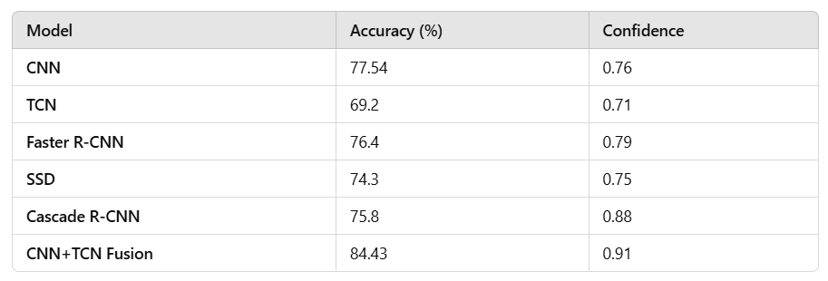
Comparing with some more models with same Dataset
After observing results from other models and individually from cnn and tcn I am sure that we can achieve better results with tcn and cnn fusion method. But Still improvement was required for making this deployable.

Slide 9
Experimentation and Validation
The model is validated on a dataset of over 20,000 images, including military aircraft and various targets. Testing scenarios cover different terrains and operational modes. We aim for high classification and detection accuracy in real-time scenarios.
Grad-CAM helps validate the model's focus in real-time.
Closed loop feedback machine learning approach which we are planning to integrate will make it more effective in deploying use cases.

Slide 10
Results and Discussion
Preliminary research show high classification accuracy across various use cases and scenarios. The combination of SWT and PCA might enhances the model's ability to differentiate targets, especially in complex terrains. Future work will focus on data cleaning and creating model with good output accuracy.
Grad-CAM analysis enhances the model's accuracy by allowing for real-time feedback and tuning, demonstrating improved detection across various terrains.

Slide 11
Novelty and Contributions
Real-Time Explainability with Grad-CAM: Provides visual insights into model decisions by highlighting the key areas of input that influenced the predictions. Enhances transparency and trust in critical applications, such as identifying friendly, hostile, and alien objects.
Adaptive Feedback Loop for Improved Accuracy: Grad-CAM outputs are used to assess model focus, feeding back into the model to dynamically adjust learning parameters. This feedback mechanism enables the model to self-correct and improve its predictions in real-time, simulating reinforcement learning.
Edge-Ready Optimization: The model is optimized for deployment on edge devices like Raspberry Pi, using techniques such as quantization and model pruning to reduce computational complexity while maintaining high performance. Designed to operate efficiently in diverse terrains and operational modes, making it suitable for real-time target detection in various environments.
Hybrid CNN-TCN Architecture: The integration of CNN for spatial feature extraction and TCN for temporal dependencies ensures enhanced accuracy in detecting multiple targets across varying terrains and scenarios

Slide 12
Conclusion
This project will demonstrate the effectiveness of combining SWT, PCA, and a CNN-TCN hybrid model for real-time multiple target detection in live video streams. The model will be optimized for deployment as a attachment on resource-constrained devices, with significant potential for various applications.
The project introduces real-time explainability through Grad-CAM and an adaptive feedback loop, improving accuracy in multiple scenarios. The model is optimized for edge devices like Raspberry Pi, making it ideal for resource-constrained environments.

Slide 13
References
https://www.scienceopen.com/hosted-document?doi=10.57197/JDR-2024-0034
https://www.kaggle.com/code/crsuthikshnkumar/ml-based-aircraft-detection-classification-crsk#References
https://www.kaggle.com/code/dannyrashd/military-aircraft-image-classification-tensorflow
https://www.kaggle.com/code/eisgandar/classification-of-military-aircrafts/notebook
https://ieeexplore.ieee.org/document/8370896
https://link.springer.com/article/10.1007/s00521-021-06391-y
https://link.springer.com/article/10.1007/s11042-018-6467-6
https://ar5iv.labs.arxiv.org/html/1611.05267
https://link.springer.com/article/10.1007/s12555-024-0089-8
https://bmcmedinformdecismak.biomedcentral.com/articles/10.1186/s12911-021-01687-4

Slide 14
Thank you

