Slide 1
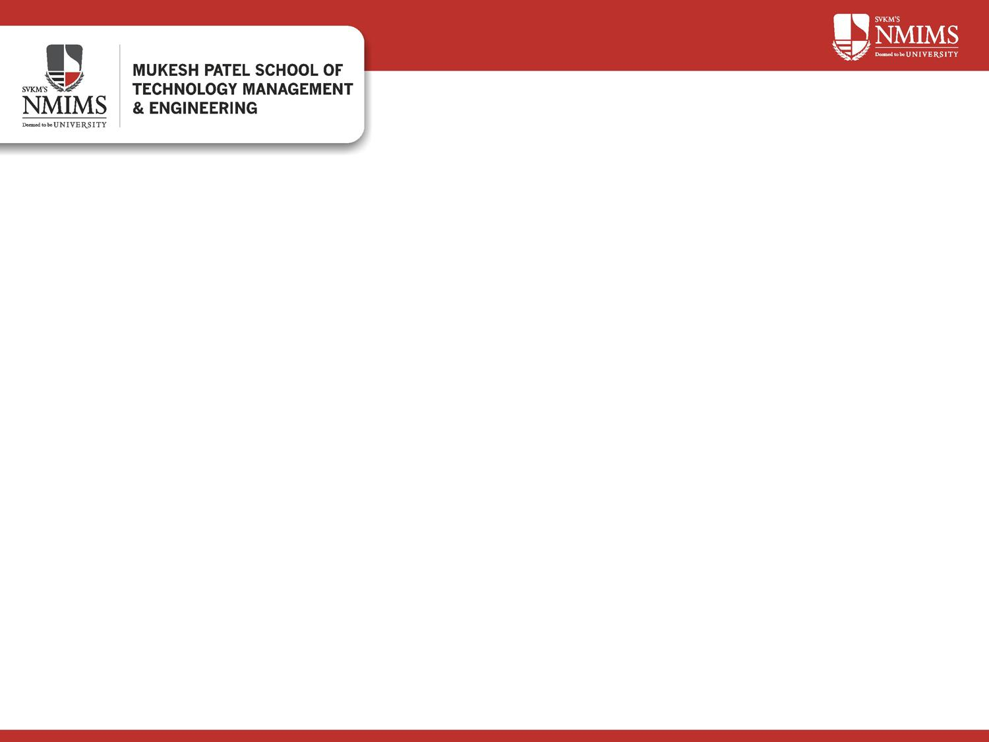
Grahak Gyaan
Spending Analysis & Strategy Recommendation using ML & Game Theory
Team: Mehi Manswa Bhagat (A216) | Dipanshu Yadav (C264)
Subject: Machine Learning | Semester IV (A.Y. 2025–26)
Question: which customers need a discount, and who will buy anyway?
Dataset: Mall_Customers.csv – 200 records, 5 fields | April 2026
Begin ›

Slide 2









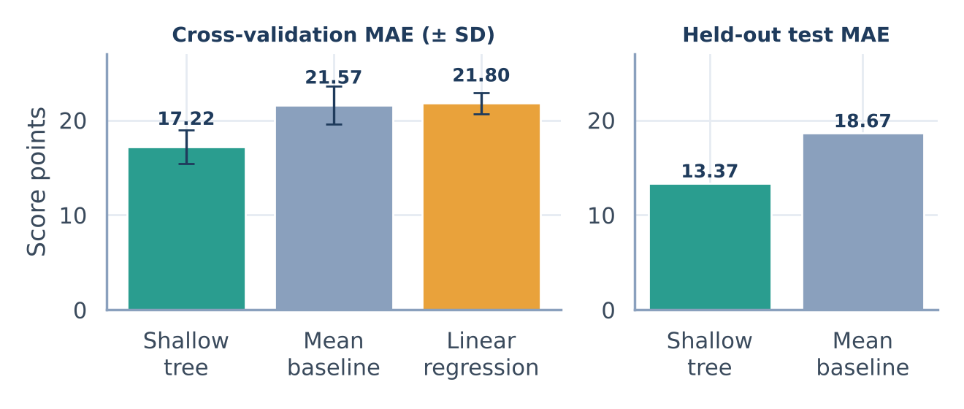
Slide 2 of 6
Idea and Solution Overview
The problem: blanket discounts also go to customers who would buy at full price anyway. Who really needs an offer?
1 Mall data
2 Check & prepare
3 Predict & segment
4 Decide
5 Explore
200 customers: gender, age, annual income, spending score
No missing values; encode gender; flag outliers
Score regression, Low / Medium / High bands, K-means groups
Payoff matrix: Discount or No Discount for each band
Streamlit dashboard: filters, compare groups, CSV export
Click any step to jump to its details.
Customers by spending band
What the mall gets
A band for every customer
Low 59 · Medium 87 · High 54
A suggested action per band
54 High: no discount · 146 others: discount
A no-code dashboard
Filter, compare groups, export a list
Honest limits
Payoffs assumed; K-means is exploratory
‹ Prev
Next ›

Slide 3










Slide 3 of 6
Technical Approach
TECHNOLOGY STACK
Data
Validate
Prepare
Split
Python
analysis code
Mall_Customers.csv, 200 rows × 5 fields
Missing values, duplicates, ID and range checks: all clear
One-hot Gender, scaling inside pipelines, IQR outlier flags (kept)
20% held out (40 customers); 5-fold CV on the other 160
Pandas
data checks, prep
Regression
Classification
K-means
scikit-learn
models, metrics
Mean baseline · Linear · Depth-3 tree. Scored by MAE, RMSE, R²
Baseline · Depth-3 tree on score bands. Accuracy, macro F1
k = 2–6 on scaled age, income, score. Silhouette, 10-seed ARI
Matplotlib · Seaborn
charts
Streamlit
dashboard
Evaluate on held-out customers, against baselines, with cross-validation
Strategy
Dashboard
Jupyter
notebook
Payoff matrix: High → No Discount, Low and Medium → Discount
Streamlit: At a glance · Compare groups · Customer list, CSV export
‹ Prev
Next ›

Slide 4
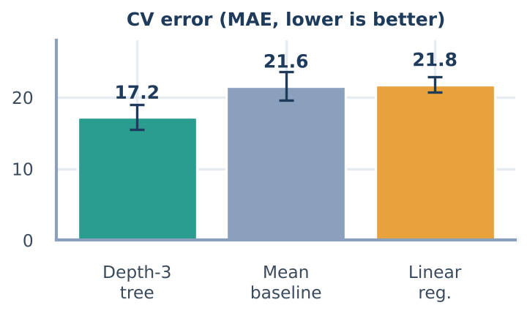
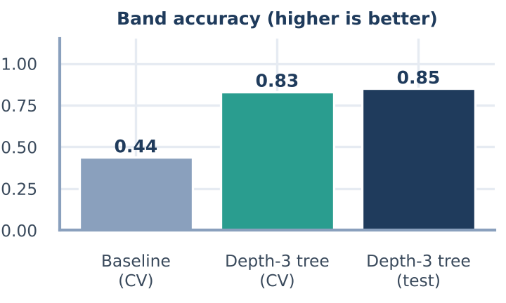
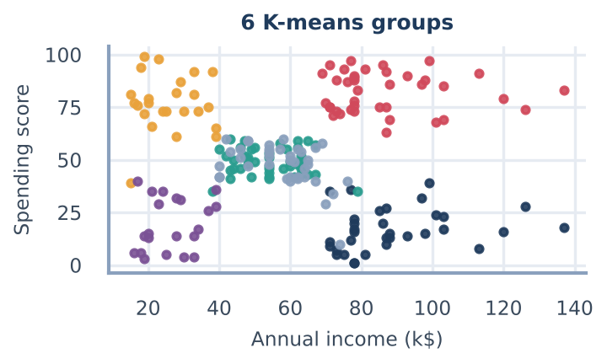
Slide 4 of 6
Results at a Glance
Regression
Classification
K-means
MAE 17.2 vs 21.6
85% accuracy
k = 6 groups
depth-3 tree vs mean baseline (5-fold CV)
held-out customers, macro F1 0.84
silhouette 0.427, refit stability ARI 0.999
• Held-out test: MAE 13.37, R² 0.15
• Linear regression (21.8) did no better than the mean
• CV accuracy 0.83 vs 0.44 for the baseline
• High: recall 1.00, precision 0.65
• Stable but exploratory groups
• Silhouette shows separation, not usefulness
First run (single split, full-depth tree): 80% accuracy; regression R² −0.49 (tree), 0.08 (linear). Full tables are in the report, Section 4.
‹ Prev
Next ›

Slide 5



Slide 5 of 6
Strategy, Feasibility and Viability
GAME-THEORY DECISION
RISK / CHALLENGE
STRATEGY / SOLUTION
Customer band (classifier)
Small sample: 200 customers, 40 in the test set
5-fold cross-validation, baselines, ± SD reported
High spenders · n = 54
Low + Medium · n = 146
Score bands are hand-set cutoffs
Classifier only approximates them; K-means as a comparison
No Discount
Discount
Payoff values are fixed constants
Labelled as assumed; replace with real campaign data
accepts +80 | rejects 0
accepts +50 | rejects −10
Payoffs are fixed, not measured
The payoff values are fixed in the code; the dataset has no campaign data.
Illustrative actions: Low = engage & grow, Medium = build loyalty, High = reward & retain.
No transactions or campaign data
Collect offers, acceptance, cost and margin
FUTURE SCOPE Replace assumed payoffs with real campaign data · randomized holdout group · test models and groups on new data
‹ Prev
Next ›

Slide 6
Slide 6 of 6
Research and References
OPEN RESEARCH (click a title to open the paper)
FOUNDATIONS
Mall segmentation with K-Means (Elbow Method)
Yuliana, Ulya & Jamhuri, 2025 · Jurnal Riset Mahasiswa Matematika
5 clusters by Elbow Method; K-Means compared with GMM, DBSCAN, hierarchical. Ours: k by silhouette, exploratory.
MacQueen (1967)
k-means clustering
Hughes (1994)
RFM and database marketing
Improved K-Means: density peaks, adaptive K
Gong, Lai & Liu, 2026 · Preprints.org (not peer-reviewed)
Outlier filtering and automatic K on 1,500 records. Scores not comparable with ours.
Nash (1950)
equilibrium in games
Ensemble methods for spending-score prediction
Prathiba et al., 2024 · IEEE ICONAT (restricted access)
Reports R² 0.9997 (Random Forest). Abstract only; gap to our R² 0.15 unexplained.
Breiman (2001)
random forests, tree models
Romero & Ventura (2010)
data mining for prediction
Dynamic pricing with customer segmentation
Raju, Narahari & Ravikumar, 2006 · Annals of Operations Research
Q-learning prices for loyal vs price-sensitive customers; alternative to our fixed payoffs.
Mall Customer Segmentation Data
Kaggle / UCI, 200 records
Full discussion: report, Section 2 and References.
‹ Prev

