Slide 1

Grahak
Gyaan
An Exploratory Analysis and Model Comparison
Team: Mehi Manswa Bhagat (A216) | Dipanshu Yadav (C264)
Subject: Machine Learning | Semester IV (A.Y. 2025–26)
Dataset: Mall_Customers.csv – 200 records, 5 fields | April 2026

Slide 2
Slide 2 of 15
Agenda
01
Dataset Overview
200 records, 5 fields, no missing values
02
Analysis Workflow
Data checks, exploration, model comparisons, and dashboard
03
Regression Results
Compare a baseline, linear regression, and a shallow tree
04
Classification Results
85% test accuracy for the hand-set score bands
05
Campaign Limitations
No response or margin data to estimate discount impact
06
Conclusion & Future Work
Key takeaways and next steps

Slide 3
Slide 3 of 15
Dataset Overview – Mall_Customers.csv
200
5
0
112 / 88
Total Records
Features
Null Values
Female / Male
Feature
Type
Range / Values
CustomerID
Integer
1 – 200
Gender
Categorical
Male (88), Female (112)
Age
Integer
18 – 70 yrs (mean: 38.85)
Annual Income (k$)
Float
15 – 137 (mean: 60.56k)
Spending Score (1-100)
Integer
1 – 99 (mean: 50.2)

Slide 4
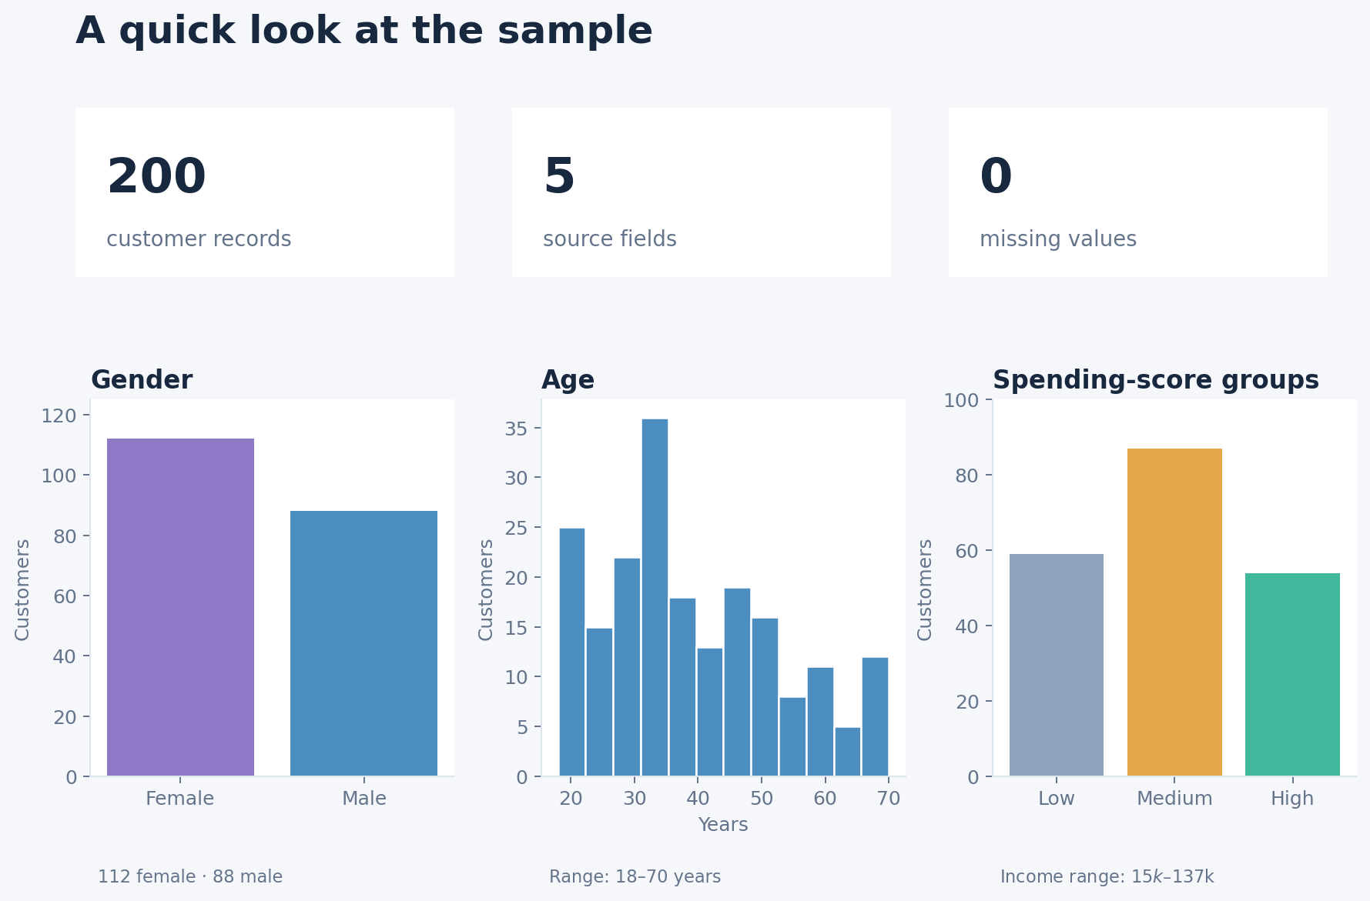
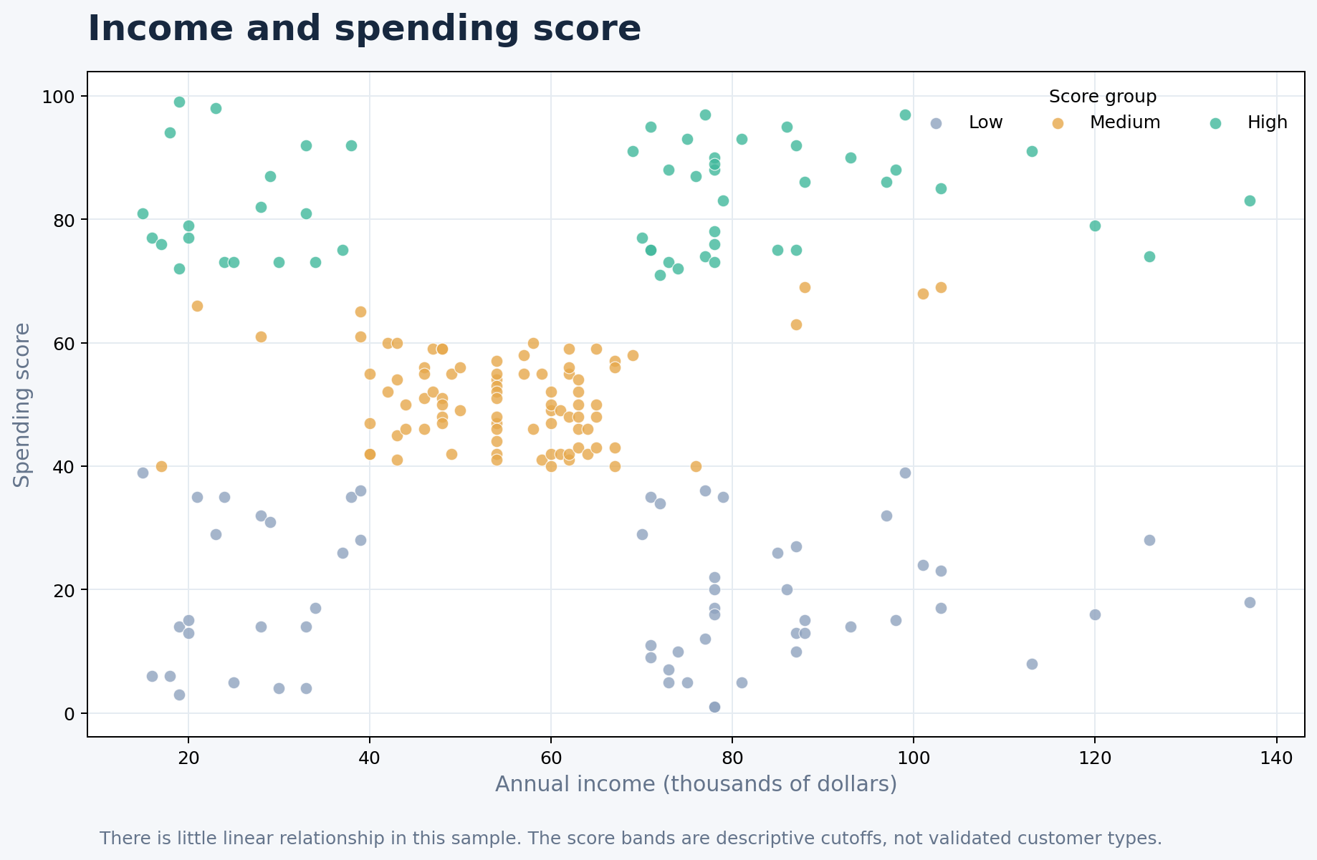
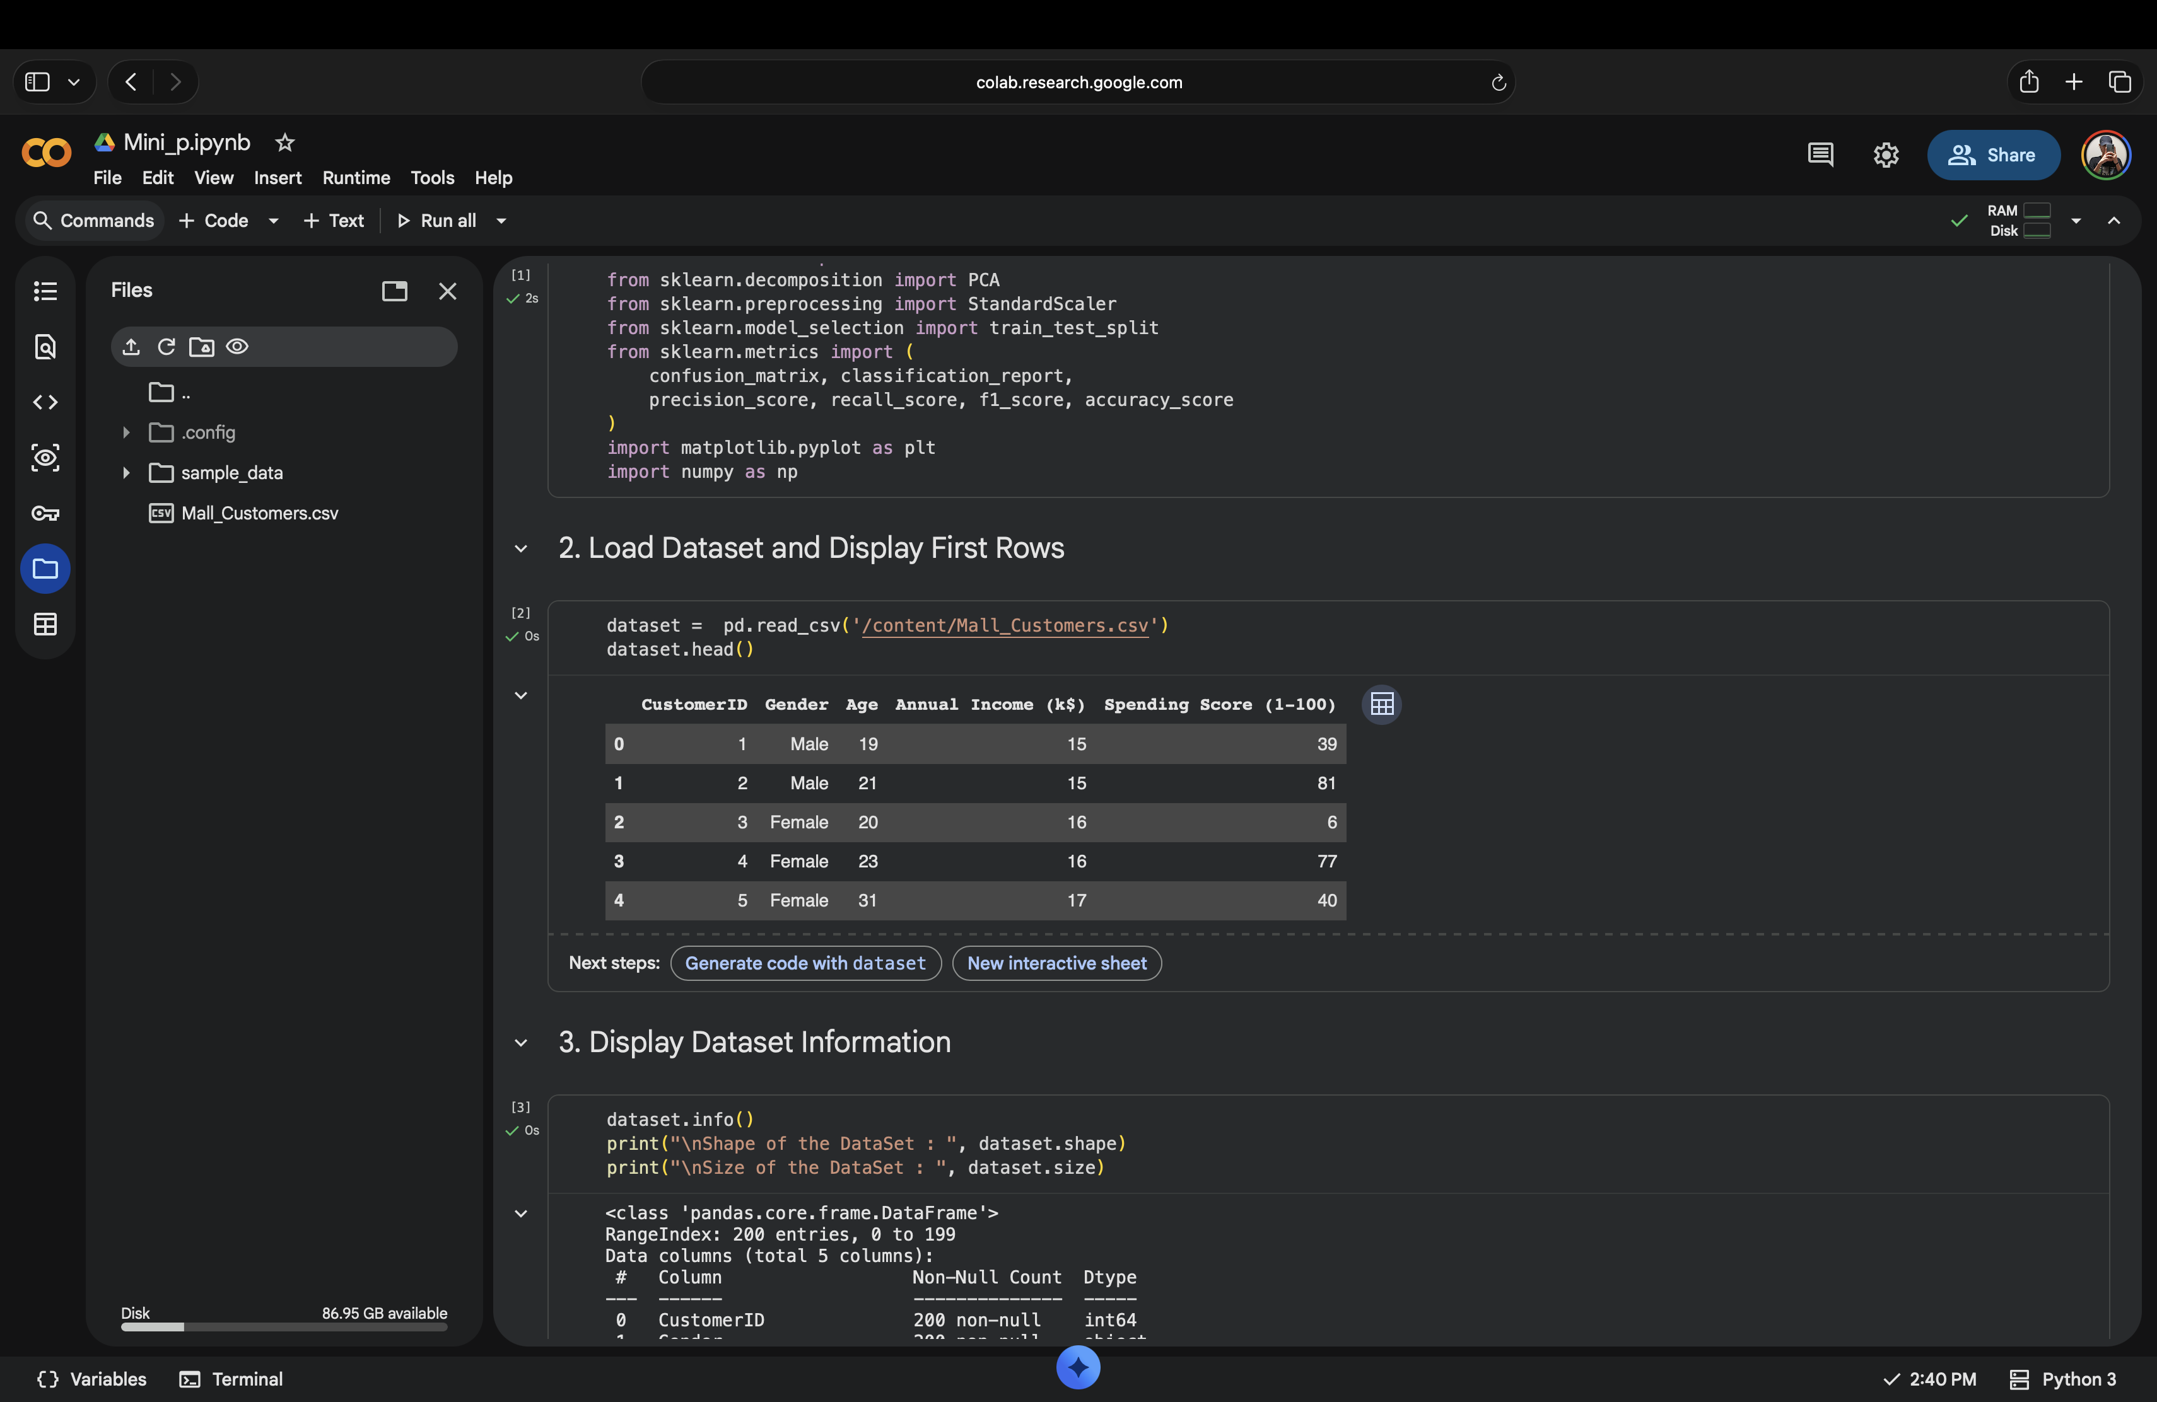
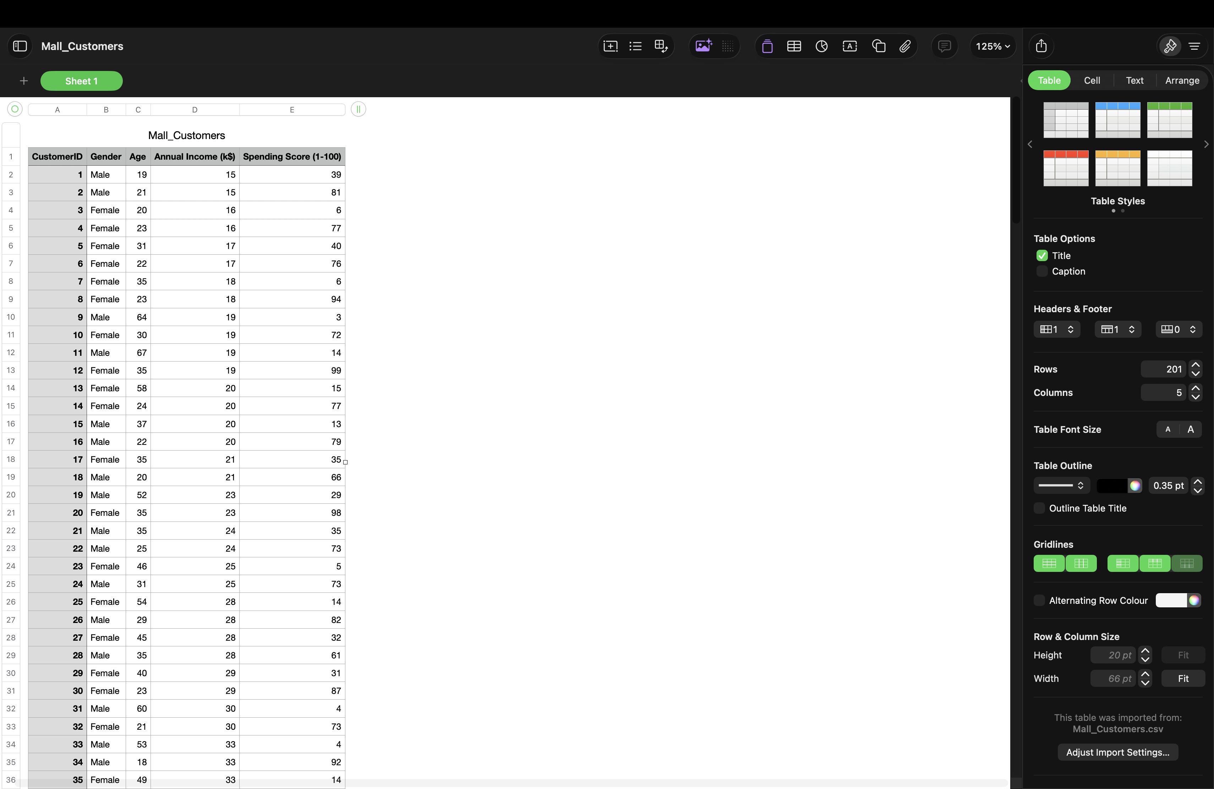
A closer look at the data
Slide 4 of 15
A few useful patterns from the 200 customer records

Slide 5
Analysis Workflow
Slide 5 of 15
How the analysis moves from the source file to the dashboard
Step 1: CSV Input
Step 2: Pre-Process
Step 3: Models
Step 4: Output
Step 5: Dashboard
Mall_Customers.csv
200 rows | 5 source fields | no missing values
One-hot encode gender
Exclude customer ID from models
Use score bands for classification
Mean baseline, linear regression, and shallow tree
Score-band decision tree
Exploratory K-means clustering
Score estimates and bands
Exploratory cluster profiles
Charts and filtered customer records
Local Streamlit dashboard
Interactive filters and charts
Search and CSV export
→ The notebook evaluates models; the dashboard helps explore the records.
Tools used:
Python and Pandas
Scikit-learn
Matplotlib and Seaborn
Streamlit
Models and methods:
Linear regression
Decision trees
K-means clustering
No payoff model
How models are checked:
Cross-validation and holdout
MAE, R², accuracy, macro F1
Silhouette and stability checks
A small analysis project for presentation; not a live customer or marketing system.

Slide 6
Slide 6 of 15
Regression Results
Model
CV MAE
Test MAE
Test RMSE
Test R²
Notes
Shallow Decision Tree
17.22
13.37
20.50
0.148
Selected by CV
Mean Baseline
21.57
18.67
23.56
−0.126
Reference point
The tree performed better than the mean baseline in this split. Results are exploratory, based on a small sample, and do not establish future accuracy. | MAE and RMSE are in spending-score points.

Slide 7
Regression model comparison

Slide 8
Slide 8 of 15
Spending-Score Groups
59
87
54
Low (1–39)
29.5% of records
Medium (40–69)
43.5% of records
High (70–99)
27.0% of records
Score bands used in this analysis
Low: Score below 40 — 59 customers
Medium: Score 40–69 — 87 customers
High: Score 70 or above — 54 customers
Income and spending score show little linear relationship in this sample. That does not tell us what drives spending.
The dashboard lets you explore the records by income, score group, age, and gender.

Slide 10
Slide 10 of 15
Decision Tree Classifier – Test Results
Class
Precision
Recall
F1 score
Support
High
0.65
1.00
0.79
11
Low
1.00
0.67
0.80
12
Medium
1.00
0.88
0.94
17
Weighted Avg
0.90
0.85
0.85
40
The score-band tree reached 85% accuracy and a 0.841 macro F1 score on 40 held-out records. The class-level figures vary, and the labels come from hand-set score cutoffs rather than future customer behavior.
85%
Test accuracy

Slide 12
Slide 12 of 15
What a Campaign Study Would Need
Information needed
What it would show
Available here?
Why it matters
Offer response
Exposure and acceptance
No
Measures response
Costs and margins
Offer cost and margins
No
Shows profitability
Current dataset
No offer or response history
No cost or margin information
Campaign impact cannot be estimated
A useful follow-up
Track offers and responses
Include costs and sales outcomes
Compare with a fair control group

Slide 13
Slide 13 of 15
Key Findings and Next Steps
The tree beat the mean baseline in this split. Results are exploratory, not a forecast.
85% accuracy and 0.841 macro F1 on held-out data. Labels use hand-set cutoffs.
No response, cost, or margin data, so discount profitability cannot be estimated.
A local Streamlit app for exploring filters and customer records—not a live deployment.
Next steps: Use a larger, representative dataset • Add transaction and campaign outcomes • Validate on new data • Test ideas with a fair comparison

Slide 14
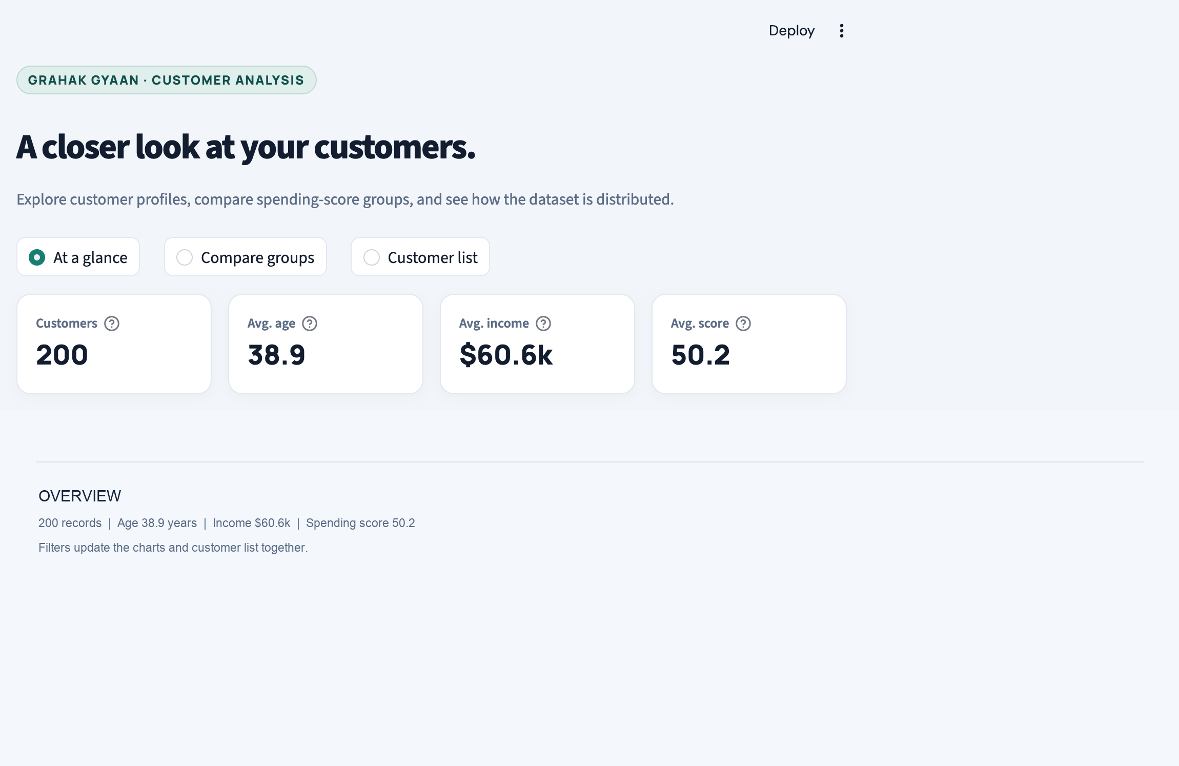
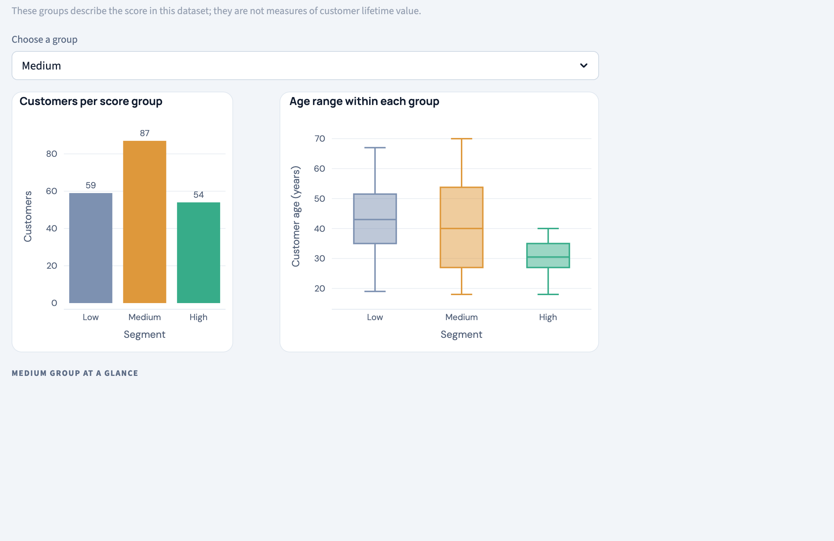
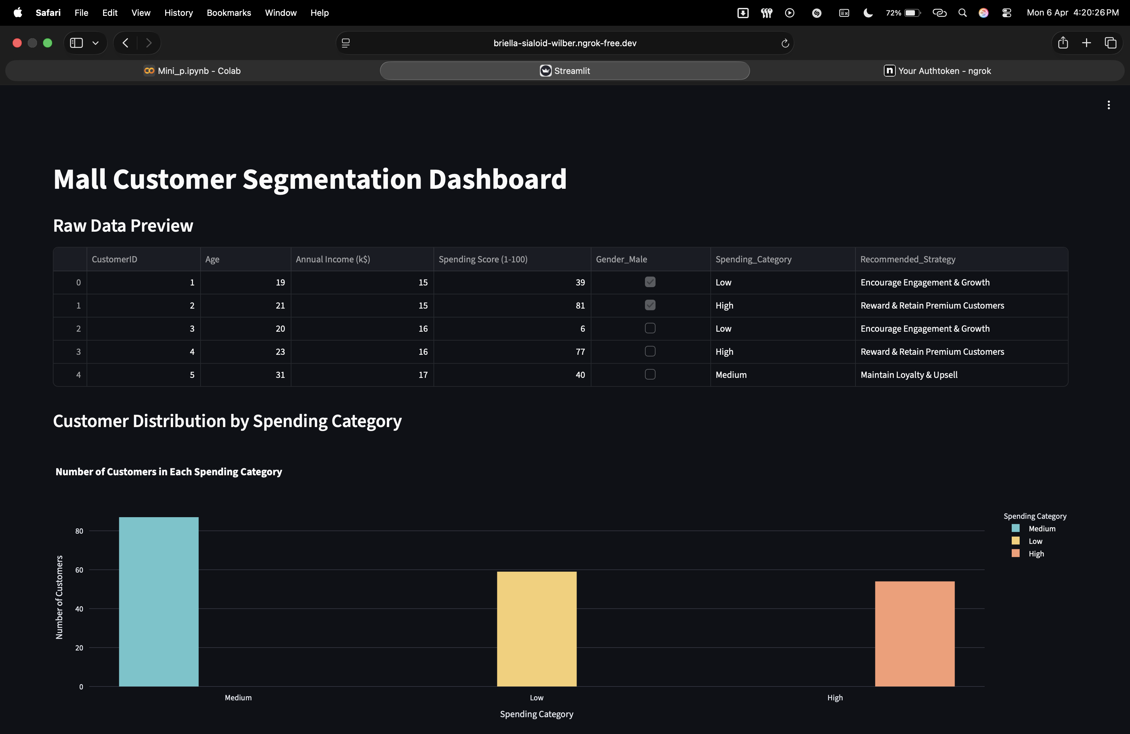
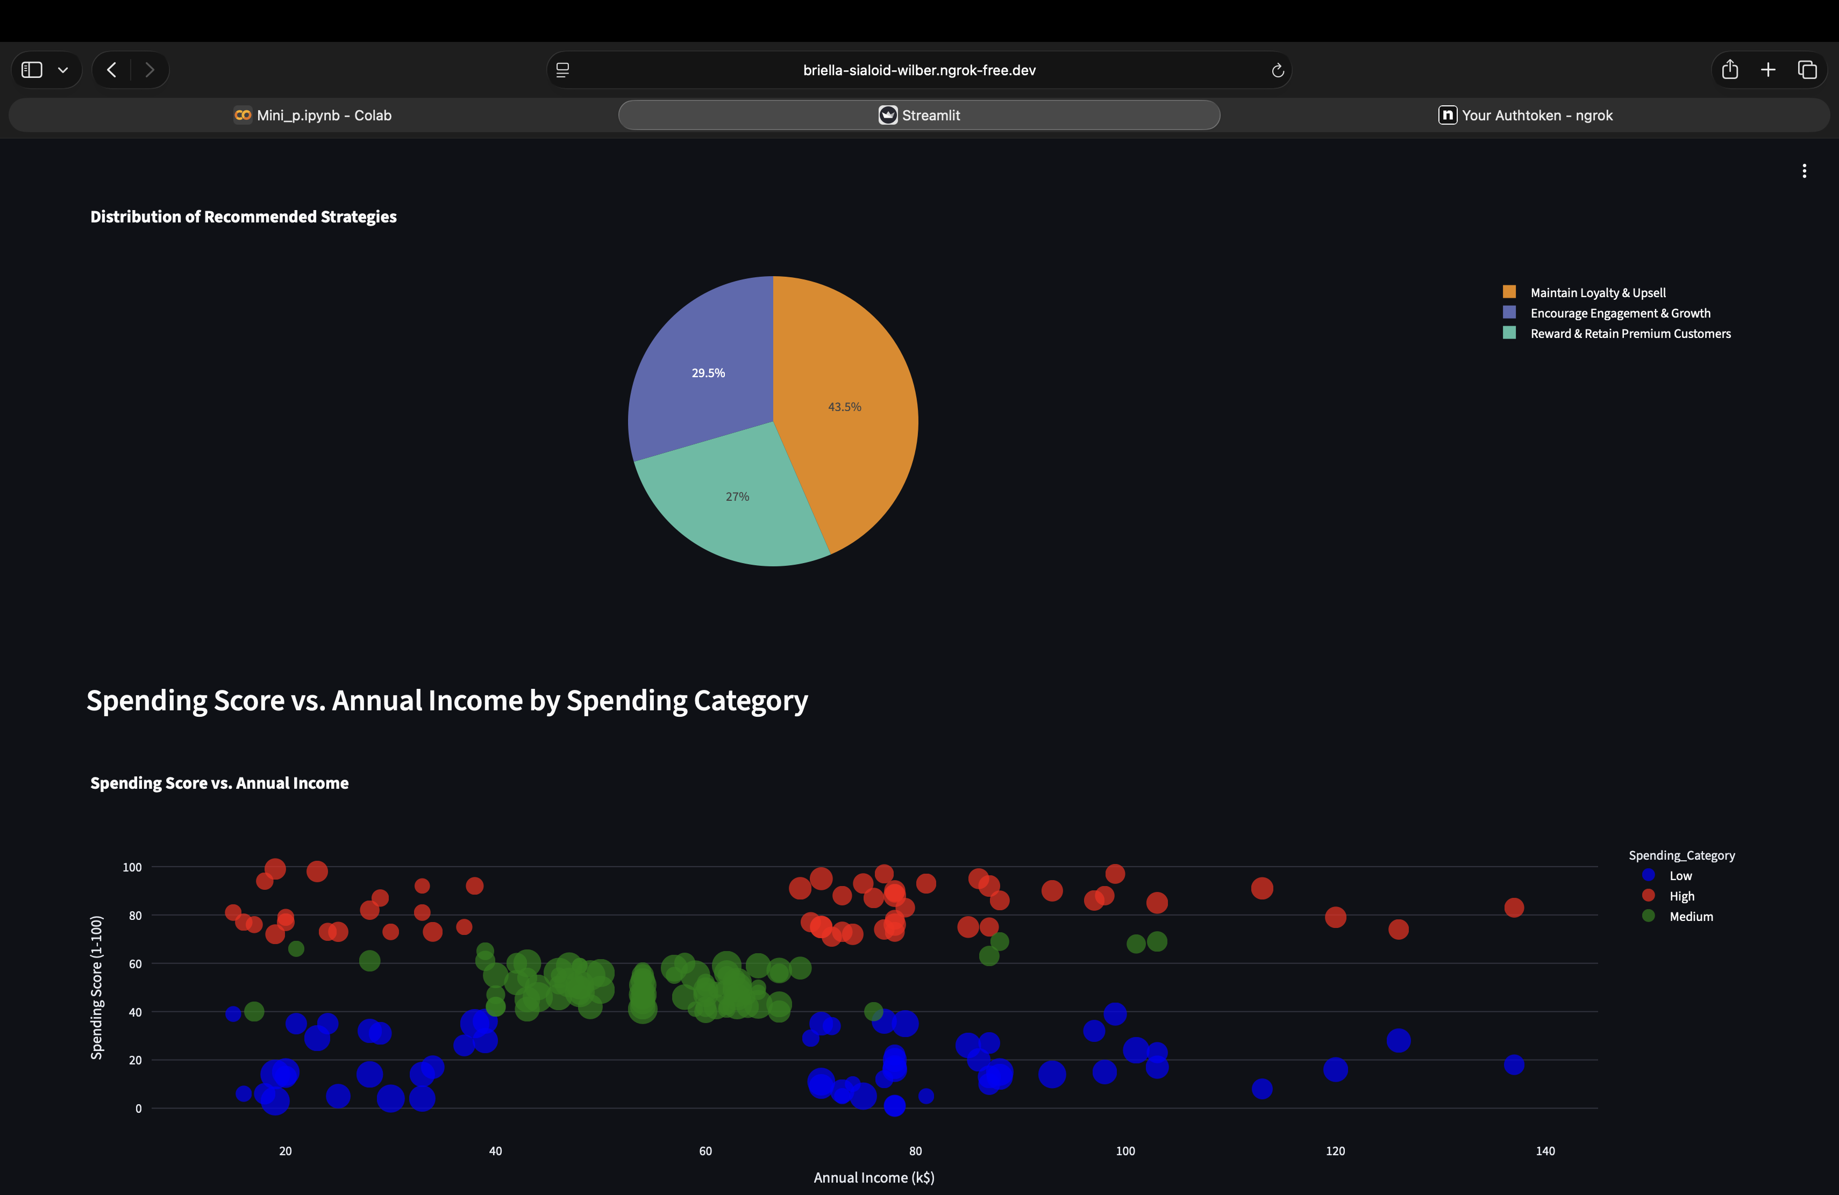
Explore the data interactively
Dashboard
Slide 14 of 15
AT A GLANCE
COMPARE GROUPS

Slide 15
Thank You
Questions & Discussion
Mehi Manswa Bhagat (A216) | Dipanshu Yadav (C264)
GitHub: https://github.com/M270706/Mall-Customer-Spending-Analysis-Strategy-Recommendation | April 2026

