Slide 1
Amit Graduation Project
Glove for Deaf
Mayar Magdy Morkos

Slide 2
Objective
The main objective of this project is to understand the communication between microcontroller and LCD in response to sensors’ readings.

Slide 3
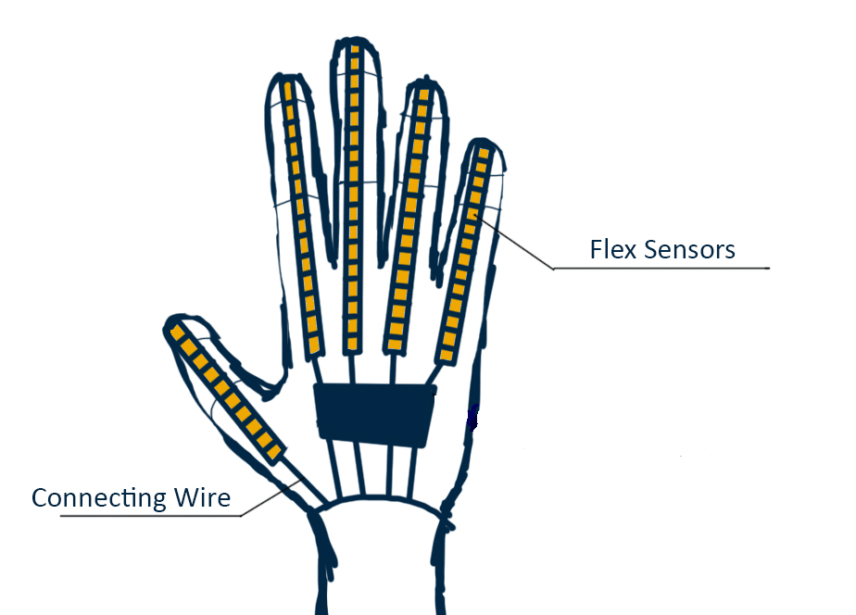
Method
In each finger ,there is a flex sensor which is used to get readings represent finger movements then convert to certain logic to display the corresponding word to those movements in the LCD.

Slide 4
Sequence
4
LCD display
1
Getting sensors readings for conversion
3
Decision making
2
Mapping values

Slide 5
Big concept
How to get sensors’ readings?

Slide 6

Switching ADC channel

Slide 7
Mapping values
Flat
Represented as 4v which means setting potentiometer range
(%100🠚%80)
90〫Bend
Represented as 2v which means setting potentiometer range
(%60🠚%40)
45〫Bend
Represented as 3v which means setting potentiometer range
(%80🠚%60)

Slide 8
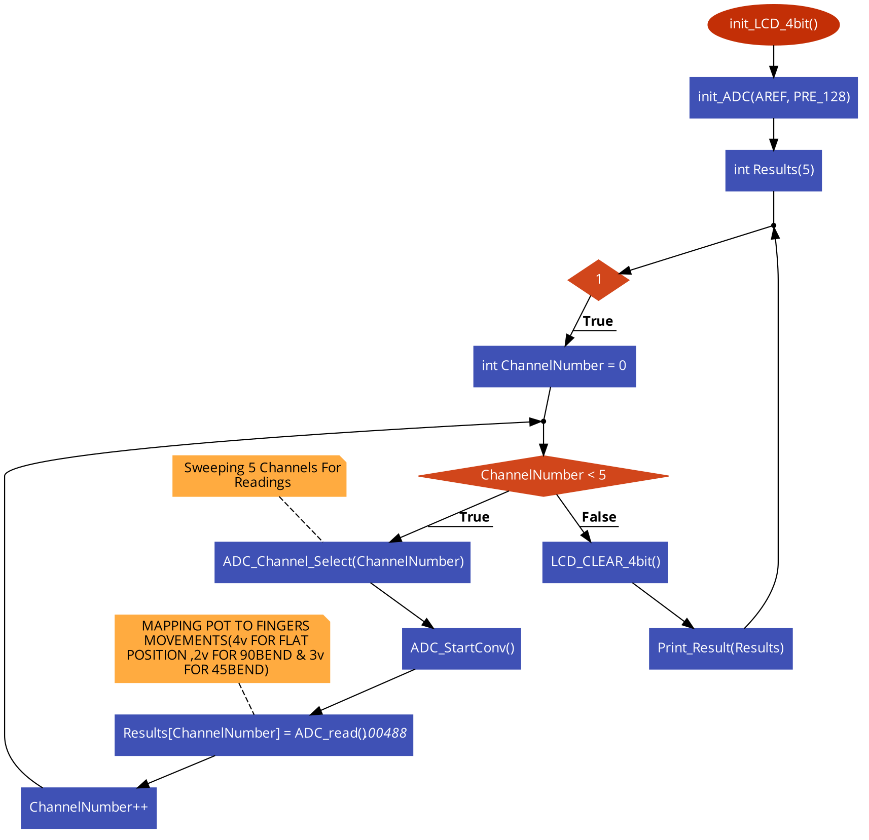
Flowchart

Slide 9
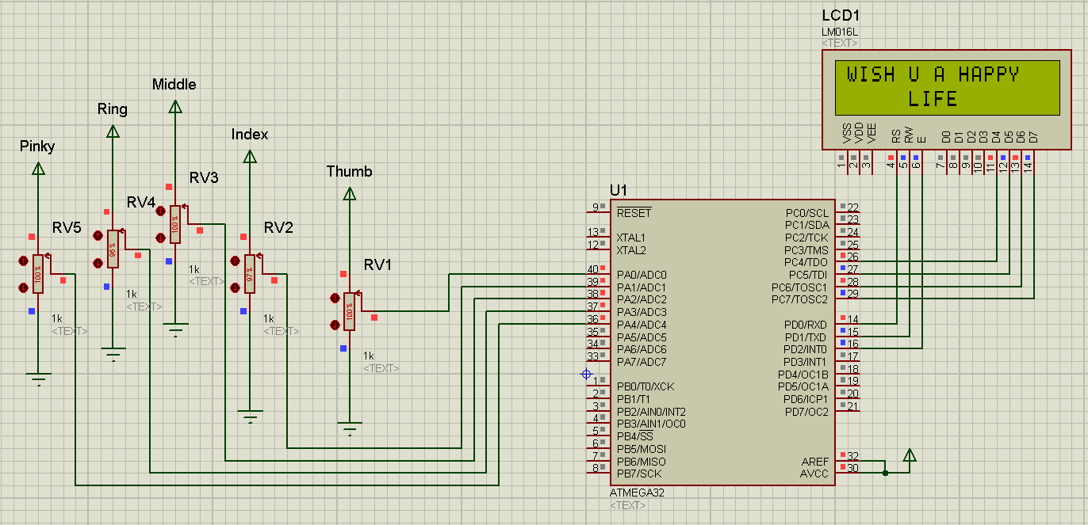
Project Simulation

Slide 10
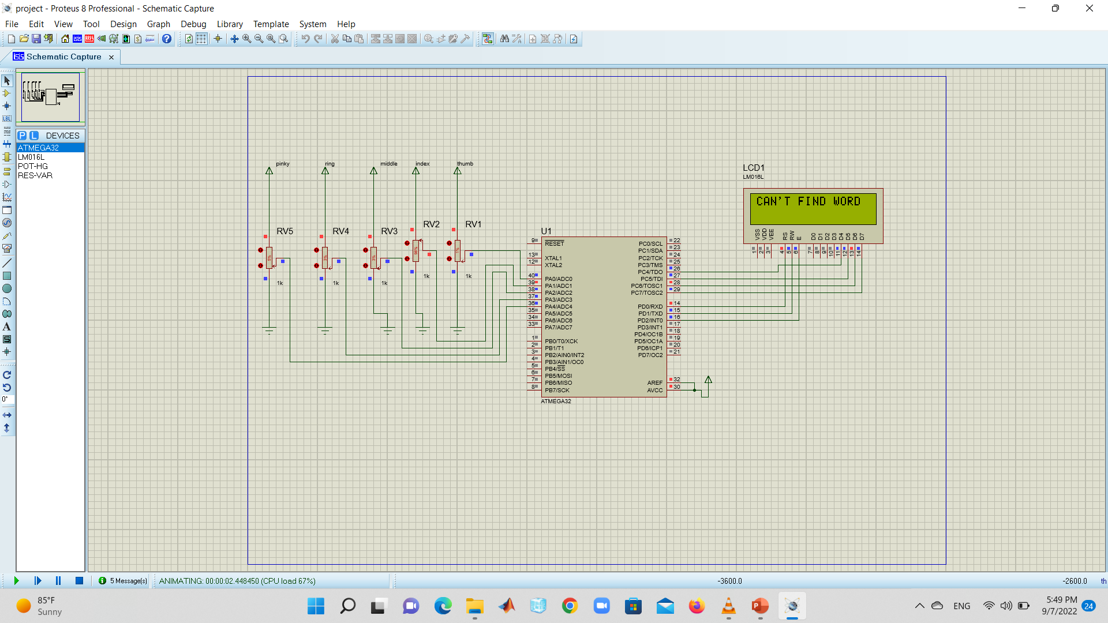
Project Simulation

Slide 11
Thanks!

