Slide 1
Simulation Database
Basketball Reference
CS GY- 6083
Principle of Database Systems
-
Final Project
Tianlang (Harris) Gu: tg1529@nyu.edu
Jason Lai: jl9338@nyu.edu

Slide 2
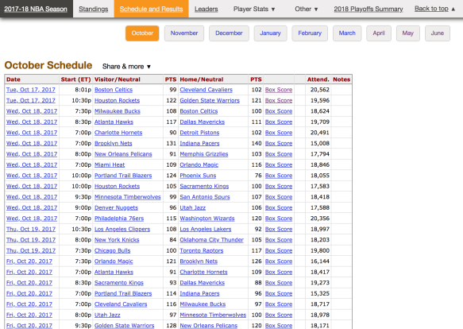
Introduction
What is Basketball Reference?
A website that focuses on providing complete and thorough data on the NBA (National Basketball Association)
Users can look up relevant statistics on almost every aspect of the professional basketball league
Player stats (height, weight, shooting %..etc)
Team stats (coach, arena)
Game stats (home/away team, performance, fouls)
Left image is the interface for the official basketball reference site

Slide 3
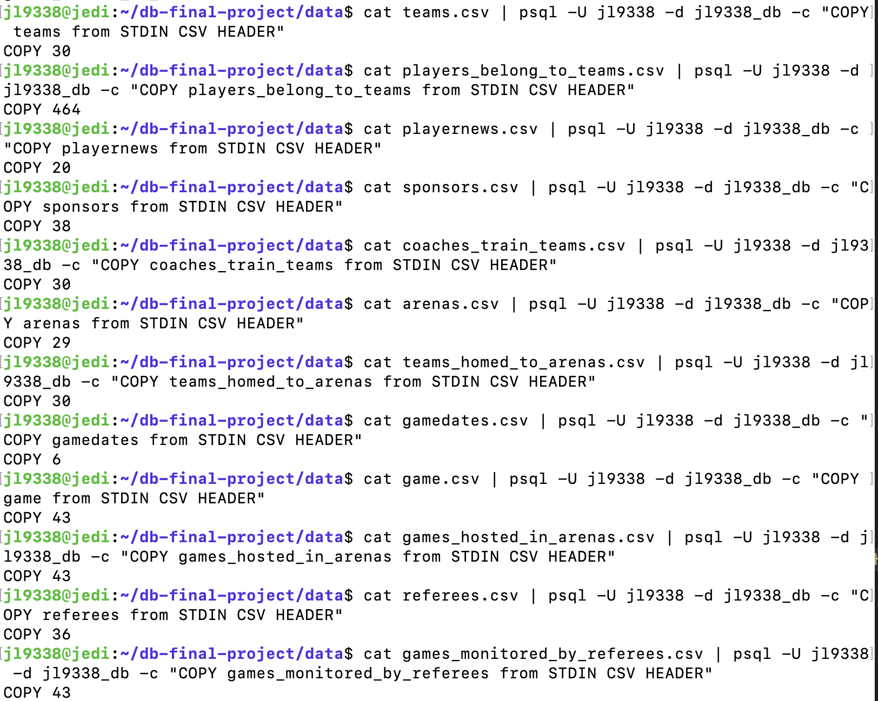
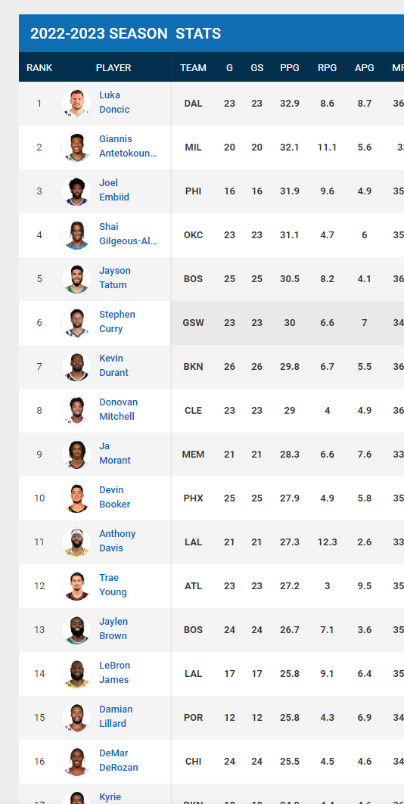
Our Mock Database
Where did we get our data?
We created a database that simulates most of the key functions of basketball references
Allowing users to look up data on each player and their performance (position, effective field goal) as well as teams (arena, location)
Users can also look up games played in the first two months of 2022 season, as well as relevant news regarding their favourite player
We gathered most of our data from the NBA official website, and the official basketball references site
Downloaded and transformed data into 12 CSV files, and loaded them into our database using the psql copy command

Slide 4
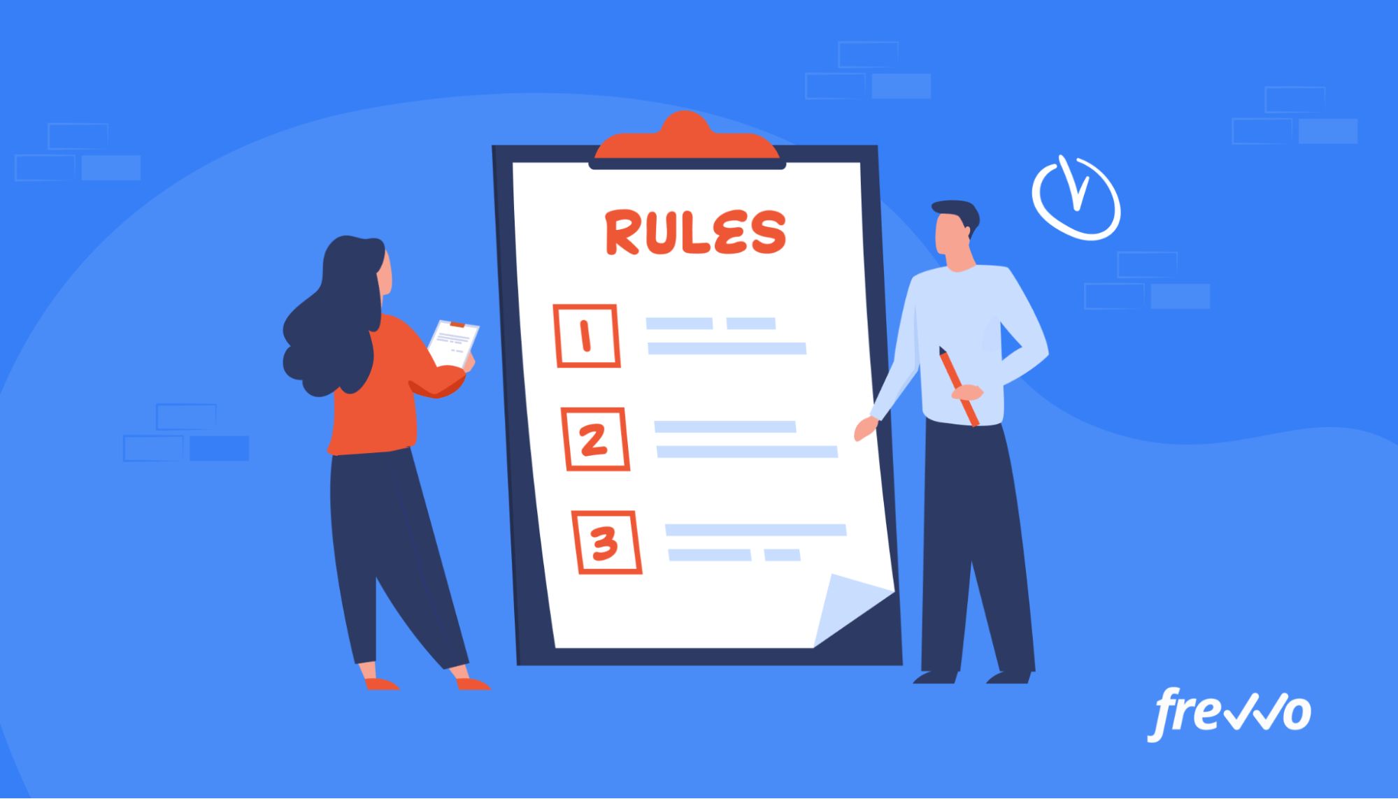
Business Rules
Players are identified by a pid. All players have a name, age, playing position (position), and a team they belong to (tid). Not every player has an effective field goal percentage (efg) statistics. No two players have the same combination of name, age, and position.
Player news is identified by a title and a pid. All player news have a title and a link. No two player news have the same combination of title and link.
Teams are identified by a tid. All teams have a name and a homeCity. No two teams have the same name.
Coaches (all of them are head coaches) are identified by a cid. All coaches have a coachName, the team they coach for (tid), and the date they began coaching (startDate). No two coaches coach for the same team. No two coaches have the same combination of coachName and tid.
Arenas are identified by an aid. All arenas have a name and a location. No two arenas have the same name.
Sponsors are identified by a sid and a tid. All sponsors have a name. No two sponsors have the same name.
GameDates are identified by a gameDate.

Slide 5
Business Rules (Continued)
Referees are identified by a rid. All referees have a name and a yoe (years of experience in officiating basketball games).
Each team has at least one player and at most 15 players. Each player belongs to exactly one team. Each team is coached by exactly one head coach and each head coach trains exactly one team. Each team resides in exactly one arena. Each arena is homed to at least one team and at most two teams.
Sponsors sponsor teams, and are only included in our database if the team they sponsor is in the database. Each sponsor sponsors exactly one team. Each team can be sponsored by any number of sponsors.
Player news is generated by players, and is only included in our database if the relevant player is recorded in the database. Each player news refers to exactly one player. Each player can have any number of player news.
Each game is played by exactly two teams and has exactly one game date. No two games have the same two participating teams and game date. Each game is monitored by exactly one official referee and is hosted in exactly one arena. Each referee can monitor any number of games. Each arena can host at most two games in one day. However, each arena can host multiple games throughout the seasons.

Slide 6
Entity Sets & Cluster
Players (pid: integer, name: string, age: integer, position: string, tid: integer, efg: decimal)
Teams (tid: integer, name: string, homeCity: string)
Coaches (cid: integer, tid: integer, coachName: string, startDate: date)
Arenas (aid: integer, name: string, location: string)
PlayerNews (title: string, pid: integer, link: string)
Sponsors (sid: integer, tid: integer, name: string)
GameDates (gameDate: date)
Referees (rid: integer, name: string, yoe: integer)
Game (winnerTeamId: integer, loserTeamId: integer, gameDate: date)

Slide 7
Relationship Sets
Players_belong_to_teams: consists of entities Players and Teams, and relationship belong_to
Coaches_train_teams: consists of entities Coaches and Teams, and relationship coached_by
Teams_homed_to_arenas: consists of entities Teams and Arenas, and relationship homed_to
Games_hosted_in_arenas: consists of entity cluster Game and entity Arenas, and relationship hosted_in
Games_monitored_by_referees: consists of entity cluster Game and entity Referees, and relationship monitored_by

Slide 8
Identifying Relationship Sets
Sponsors: consists of identifying owner entity Teams and weak entity Sponsors, and relationship sponsored_by
PlayerNews: consists of identifying owner entity Players and weak entity PlayerNews, and relationship has

Slide 9
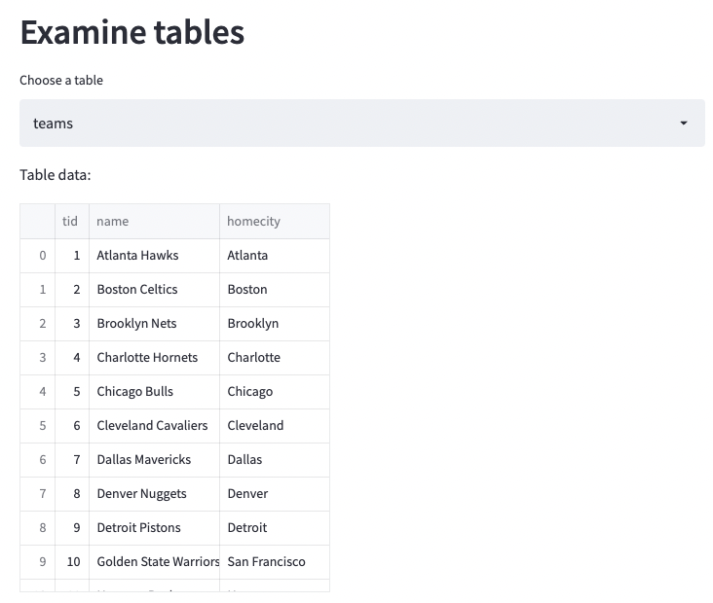
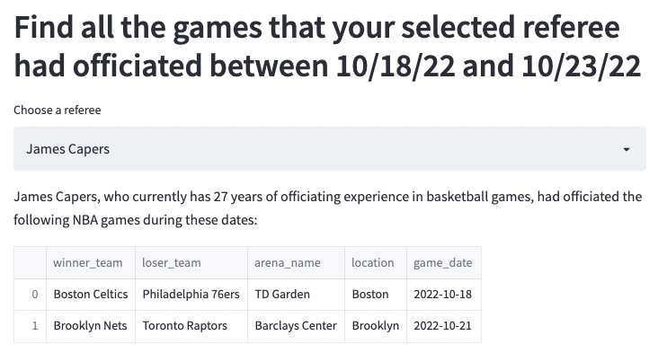
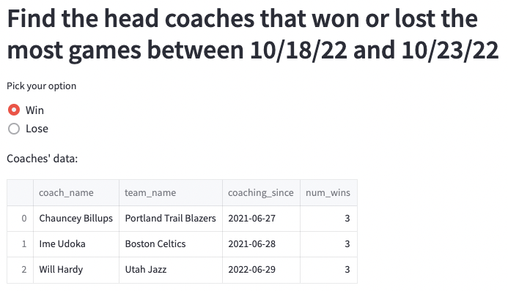
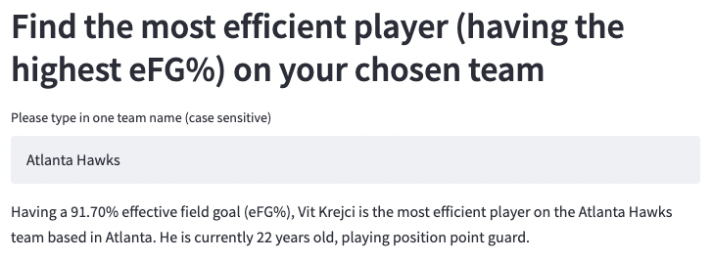
What can users do on our website? (Possible Interactions)
Find the most efficient player on a team (one with the highest effective field goal%)
Users can type in a team name (case sensitive) in the text input box
An error message will be displayed if the team name is not found
Find all the games a selected referee participated in
Dropdown menu with all the referee names
Find the head coaches that won/lost the most games
Pick the best/worst coach in a period of two months!
A radio button with win/lose condition

Slide 10
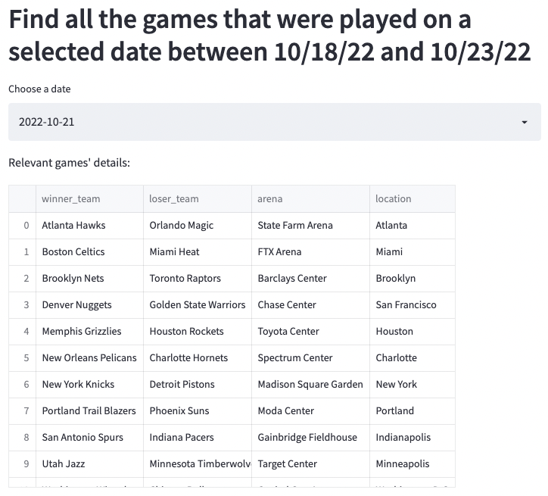
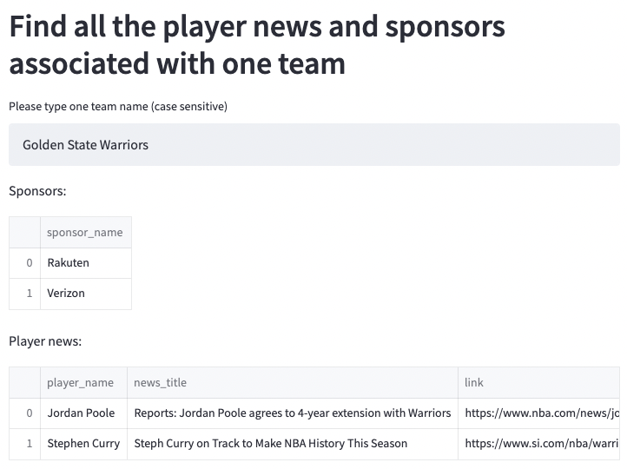
What can users do on our website? (Continued)
Find all the games that were played on a selected date
A drop down menu with all the possible dates
Find the player news and sponsors associated with their favorite team
Similar to interaction #1, users get to type their team in a text input box
An error message will be displayed if the team is not found

Slide 11
Thank you!

