Slide 1
A ConvNet for the 2020s
Published as a conference paper at CVPR 2022
计算机与人工智能学院 计算机技术
汇报：徐俊鹏
指导：董敏

Slide 2
目录
contents
01
02
03
04
介绍
方法
实验
结论
INTRODUCTION
METHOD
EXPERIMENTS
CONCLUSION

Slide 3
01
介绍
INTRODUCTION

Slide 4
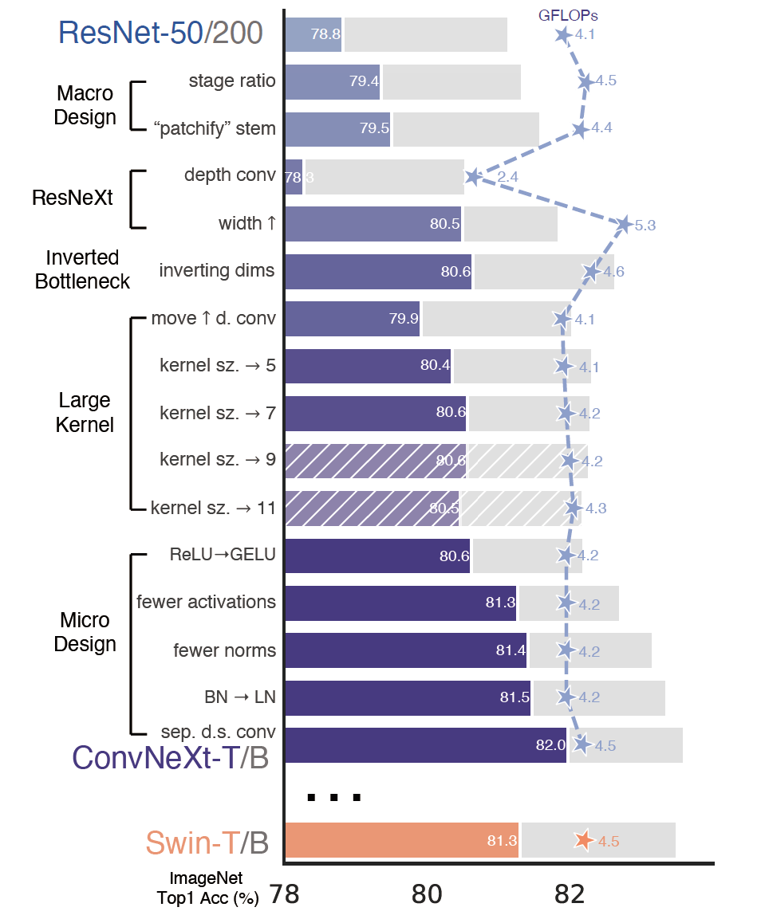
INTRODUCTION
Baseline：ResNet-50
Macro structure design
Depthwise seperable convolution
Inverted bottleneck
Large kerner size
Micro structure design
ConvNeXt-XL pretrained in ImageNet-22k
Fine-tuning ImageNet，the accuracy is 87.8%.

Slide 5
02
方法
METHOD

Slide 6
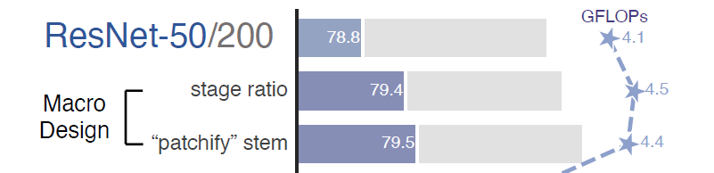
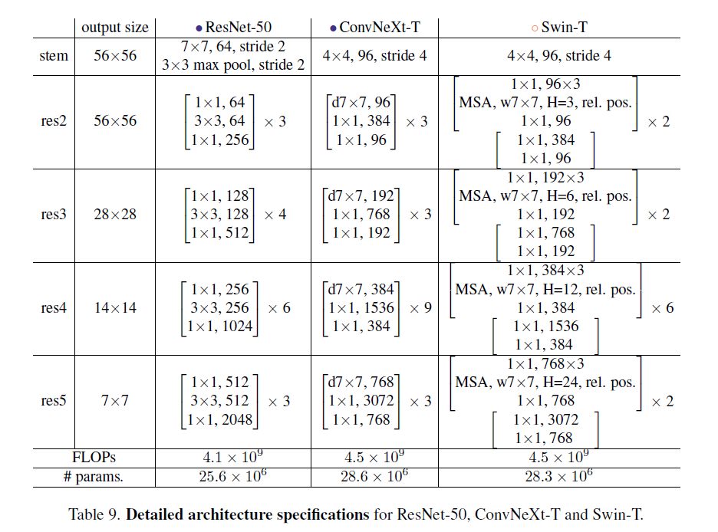
METHOD
Macro structure design
Stage Ratio（1,1,3,1）
Patchify Stem
ResNet：
Conv2d k=7,s=2
→ MaxPool k=7,s=2
ResNeXt：
Conv2d k=4,s=4

Slide 7
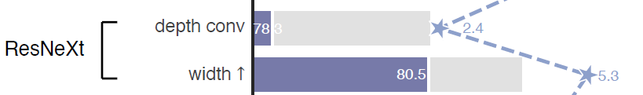
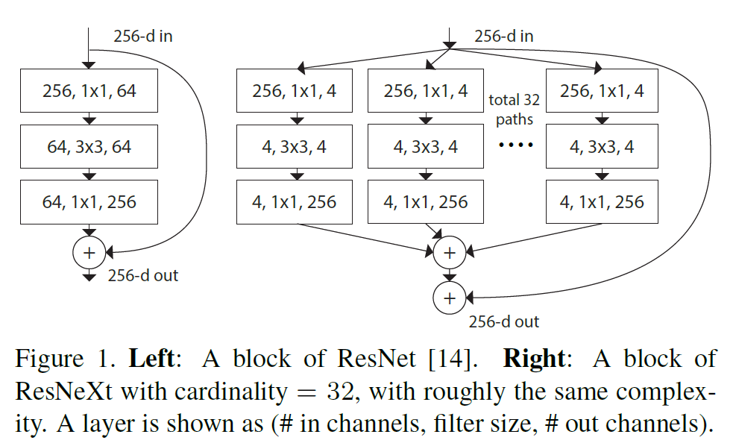
METHOD
Depthwise seperable convolution
Depth conv
Width
ResNet -> 64
ConvNeXt -> 96

Slide 8
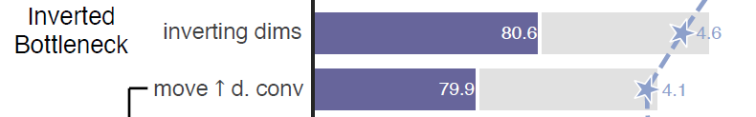
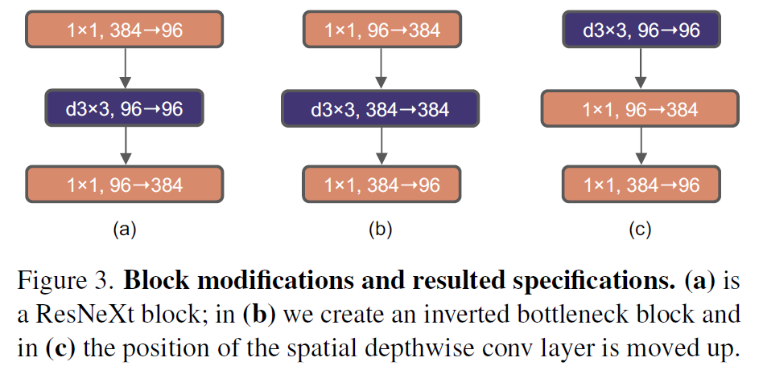
METHOD
Inverted bottleneck
ResNet： bottleneck
ResNeXt：Inverted bottleneck
Move DW over Conv

Slide 9
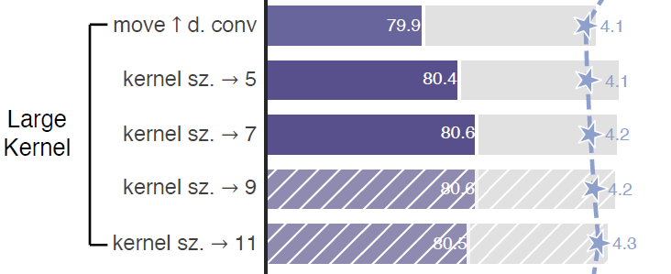
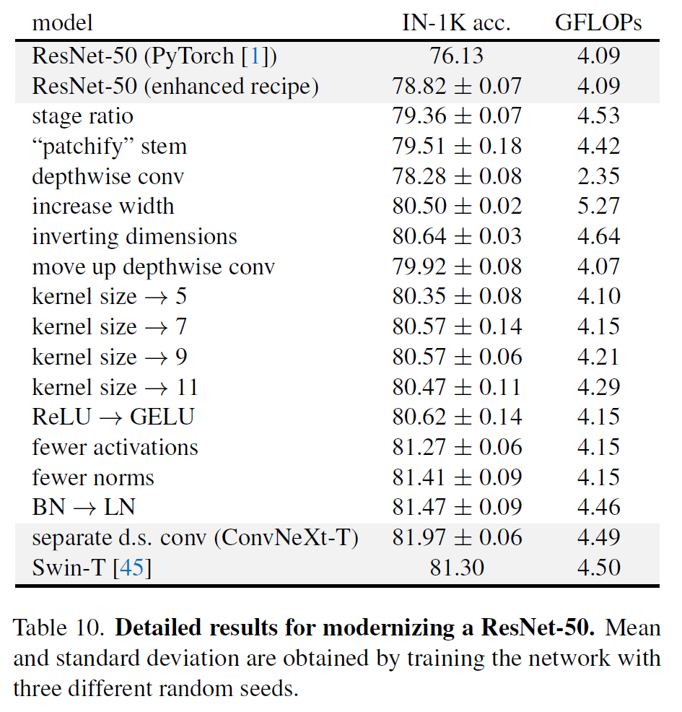
METHOD
Large kerner size
kerner size：7x7

Slide 10
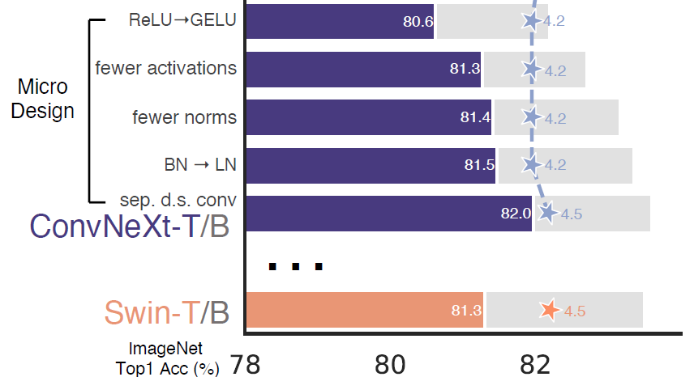
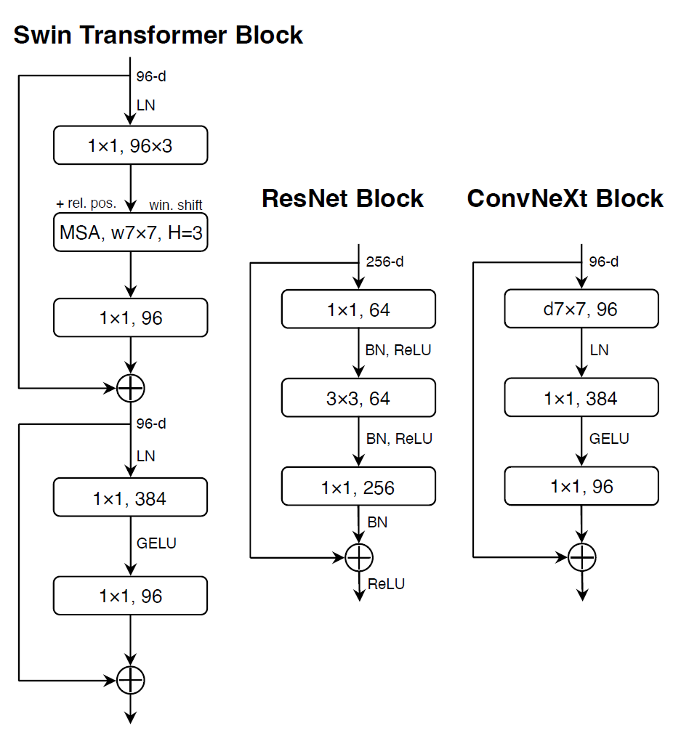
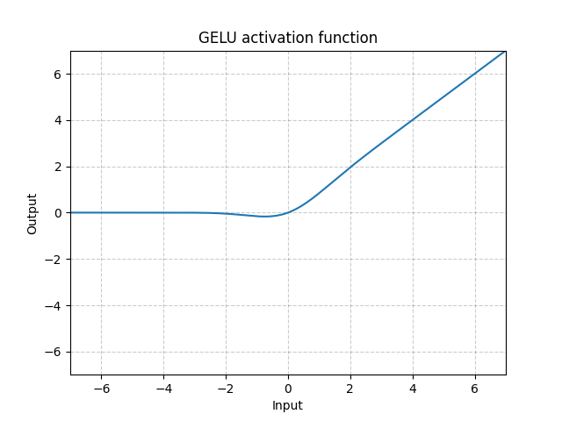
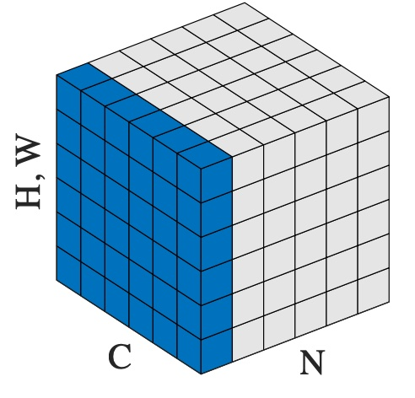
METHOD
Micro structure design
ReLU replaced by GELU.
Use fewer activation.
Use fewer norms.
BN replaced by LN.
Separate downsampling layers.

Slide 11
03
实验
EXPERIMENTS

Slide 12
EXPERIMENTS
ConvNeXt的几个大小不同的模型：
ConvNeXt-T: C = (96, 192, 384, 768), B = (3, 3, 9, 3)
ConvNeXt-S: C = (96, 192, 384, 768), B = (3, 3, 27, 3)
ConvNeXt-B: C = (128, 256, 512, 1024), B = (3, 3, 27, 3)
ConvNeXt-L: C = (192, 384, 768, 1536), B = (3, 3, 27, 3)
ConvNeXt-XL: C = (256, 512, 1024, 2048), B = (3, 3, 27, 3)
其中C代表4个stage中输入的Channel数，B代表每个stage重复堆叠block的次数。
ConvNeXt-T C:\Users\xujun\Desktop\ConvNeXt.png

Slide 13
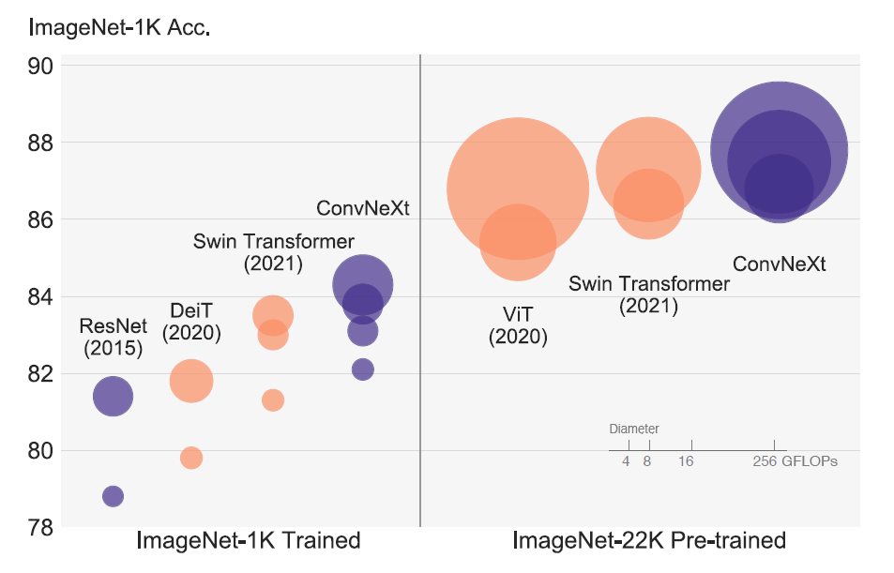
EXPERIMENTS

Slide 14
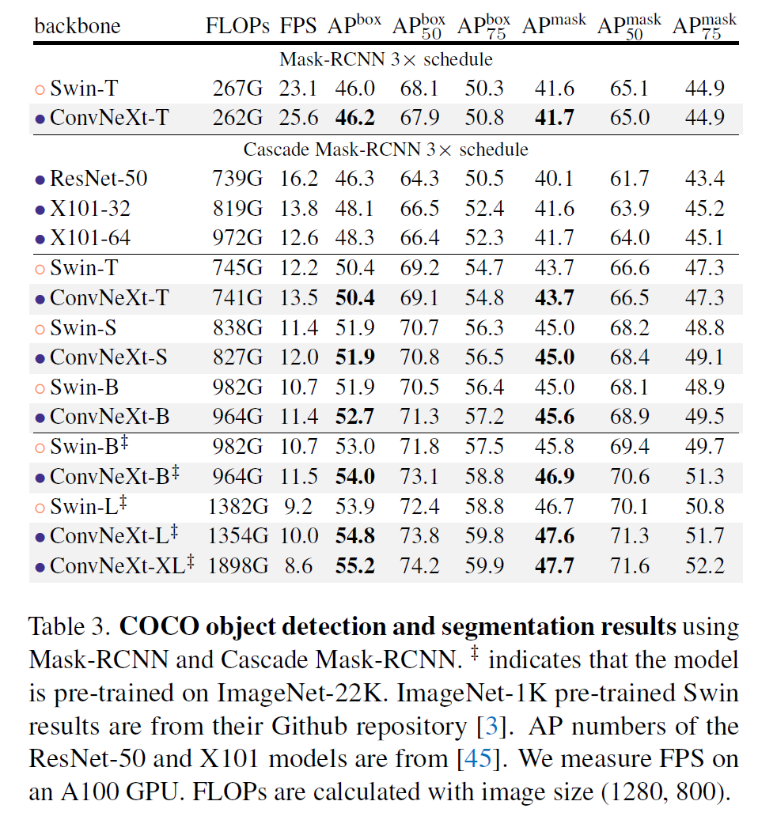
EXPERIMENTS

Slide 15
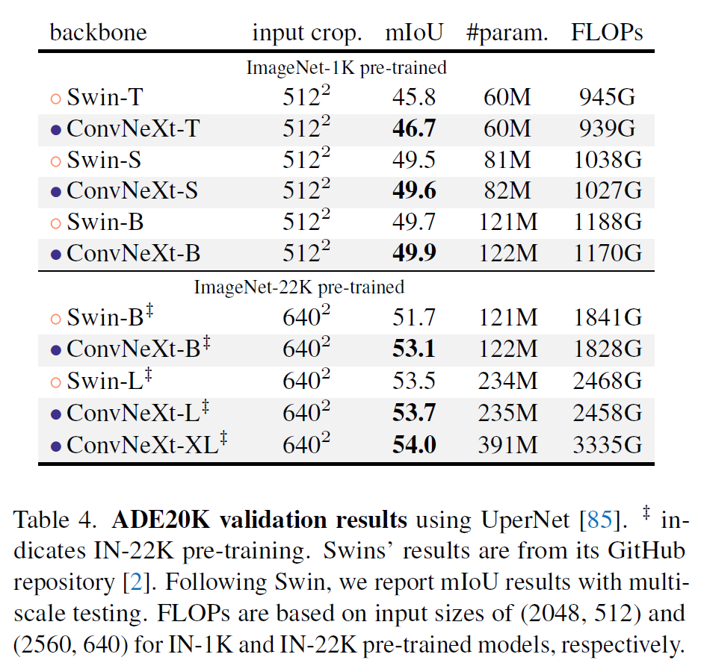
EXPERIMENTS

Slide 16
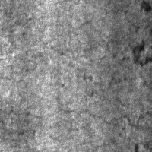
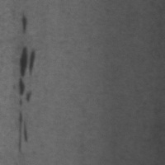
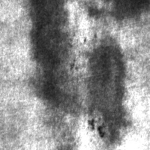
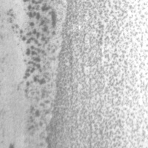
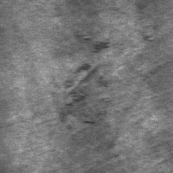
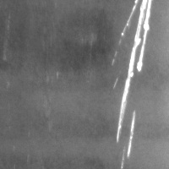
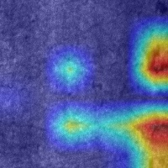
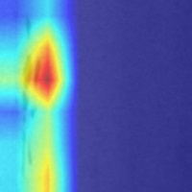
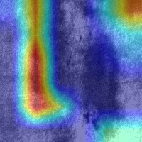
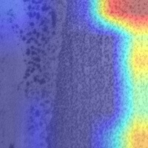
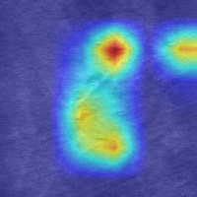
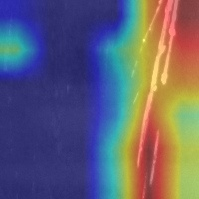
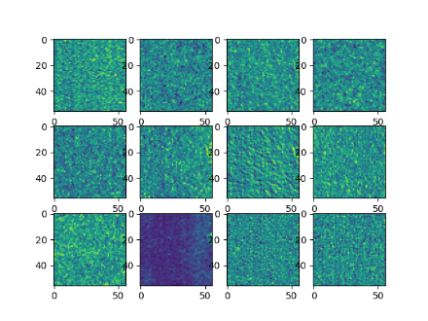
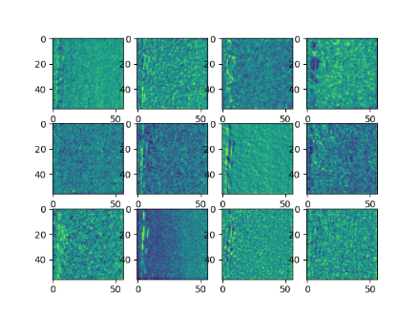
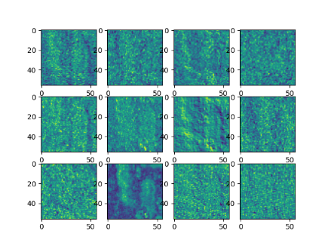
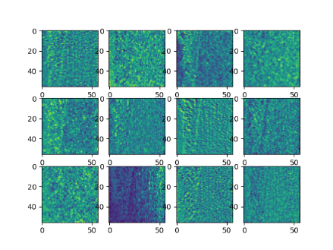
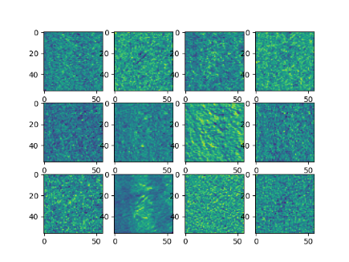
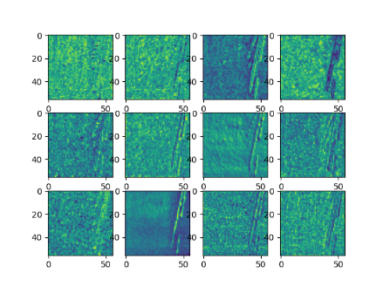
EXPERIMENTS
原图、热力图、特征图

Slide 17
04
结论
CONCLUSION

Slide 18
CONCLUSION
CV
NLP
Transformer
creative idea
concept
delivery
Research
design
Start
Finish？？？？？
？
Convolution
Recurrent

Slide 19
CONCLUSION
We hope that the new results reported in this study will challenge several widely held views and prompt people to rethink the importance of convolution in computer vision.

Slide 20
感谢各位老师同学的指导
Thank you all teachers and students for your guidance
计算机与人工智能学院 计算机技术
汇报：徐俊鹏
指导：董敏

