Slide 1



Rawad
Digital Egypt Pioneers
ITC
Information Technology Institute
Graduation Project
A managed platform that takes a client’s digital project from first request to reviewed delivery.
Mohamed Tawfik
Menna Reda
Abdelrahman Khaled
Merna Abdelfattah
Nahed Magdy
Full Stack
Full Stack
Full Stack
Full Stack
Full Stack
Notes:
Welcome. Introduce the team and the idea in one sentence: Al-Alamia is a managed outsourcing platform.

Slide 2
Open marketplaces hand the hard work to both sides
Business owners and freelancers each carry a burden the platform should carry.
1
2
3
Business owners
Freelancers
The platform
Can’t judge freelancer quality, manage deadlines or review a delivery. They just want the result.
Lose time hunting for work, negotiating and chasing payment instead of doing the work.
Usually only a directory. Nobody owns quality, so disputes and missed deadlines are normal.

Slide 3
Al-Alamia sits in the middle and owns the outcome
Clients never negotiate with freelancers. The platform reviews, prices, assigns and checks every delivery.
Client requests
Admin reviews
Split into tasks
Offers go out
Work and delivery
Admin review
Ledger
▸
▸
▸
▸
▸
▸
Project + services
Pricing, optional meeting
Track, skills, deadline
First valid accept wins
Files and links
Accept, revise, reject
Earning or deduction
Pre-approved freelancers only
One task, one freelancer at a time
Every delivery reviewed before the client sees it

Slide 4


Three roles, one workflow
The admin is a role in Identity, not a separate table.
Client
Freelancer
Admin
Creates a project, picks services, writes customizations, books a meeting if needed, and follows progress and support.
Chooses a track, adds work samples, waits for approval. Then receives offers, delivers, and follows earnings.
Approves freelancers, prices requests, creates tasks, reviews deliveries and applies deductions and blocks.

Slide 5
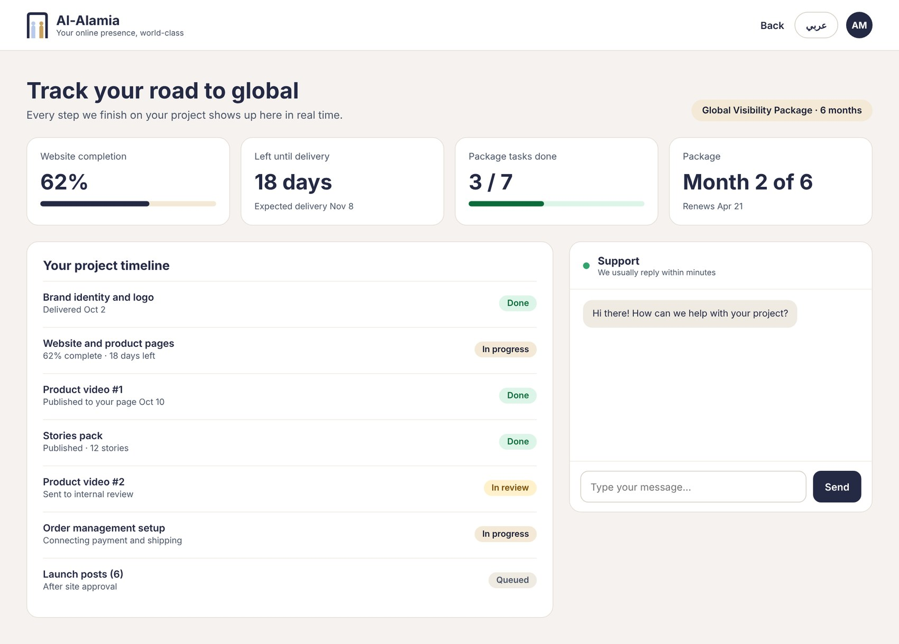
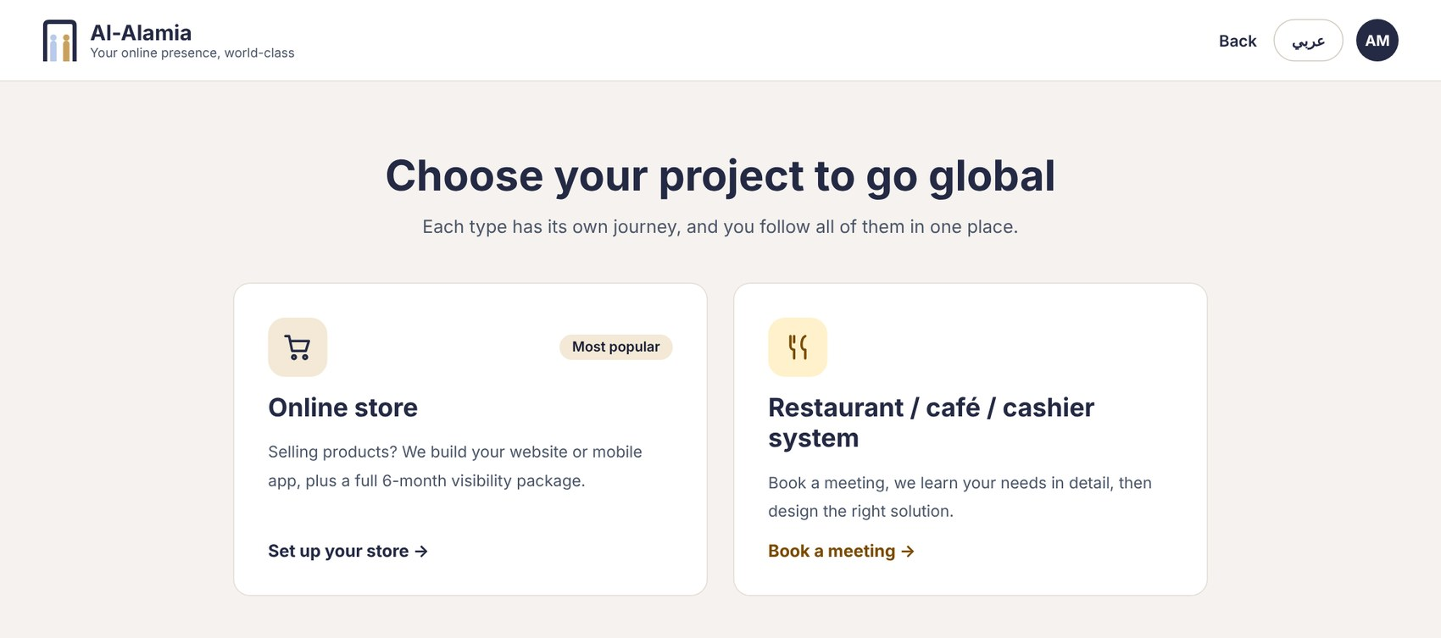
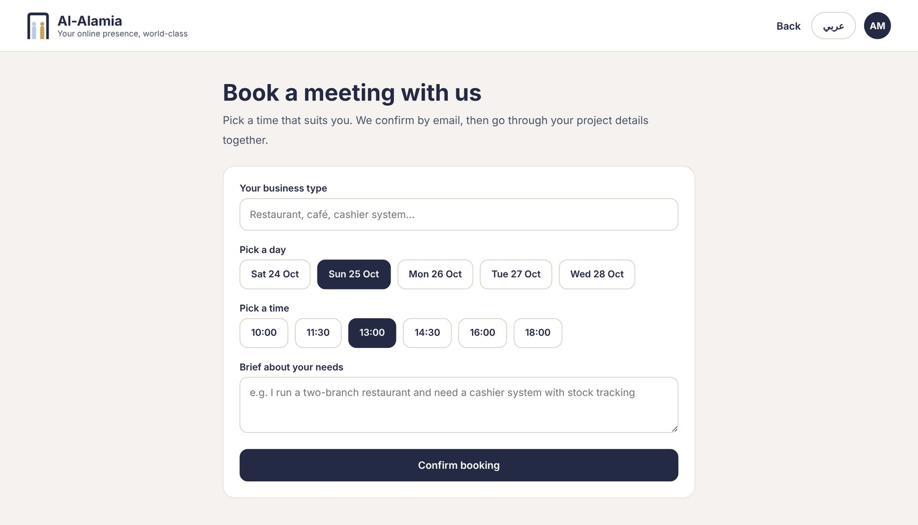
The client sees one screen, not a marketplace
Pick a project type, configure it, book a meeting, track progress.
Choose the project
Track the project and get support
Book a meeting

Slide 6
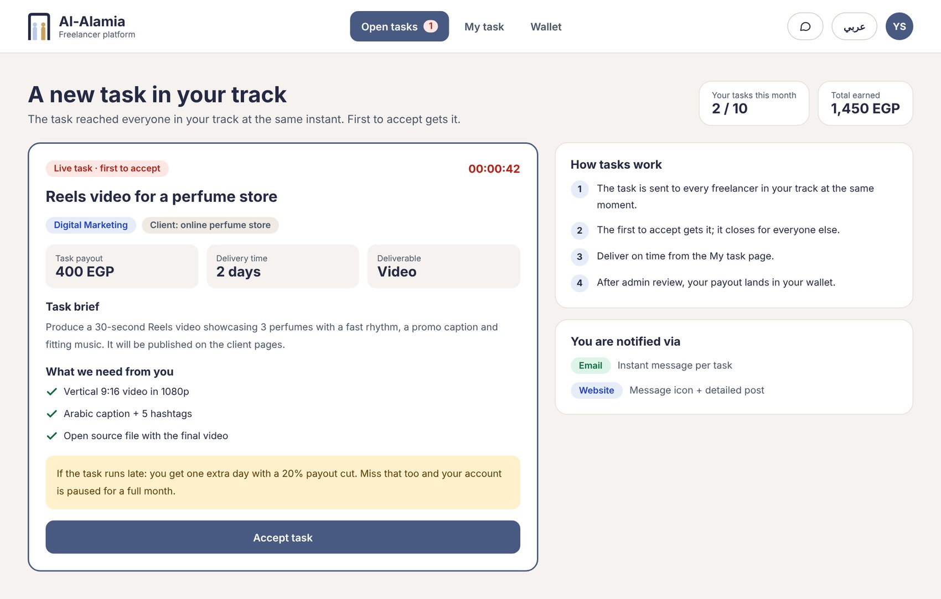
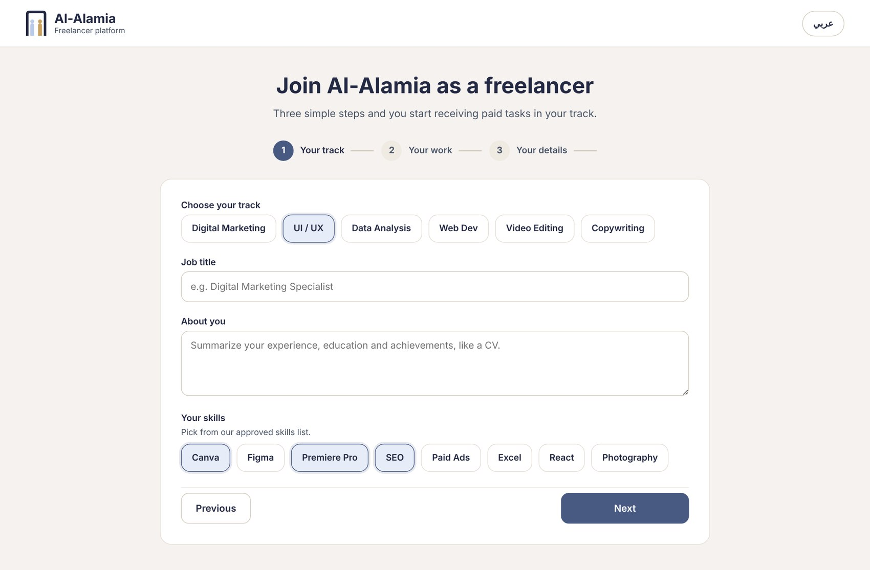
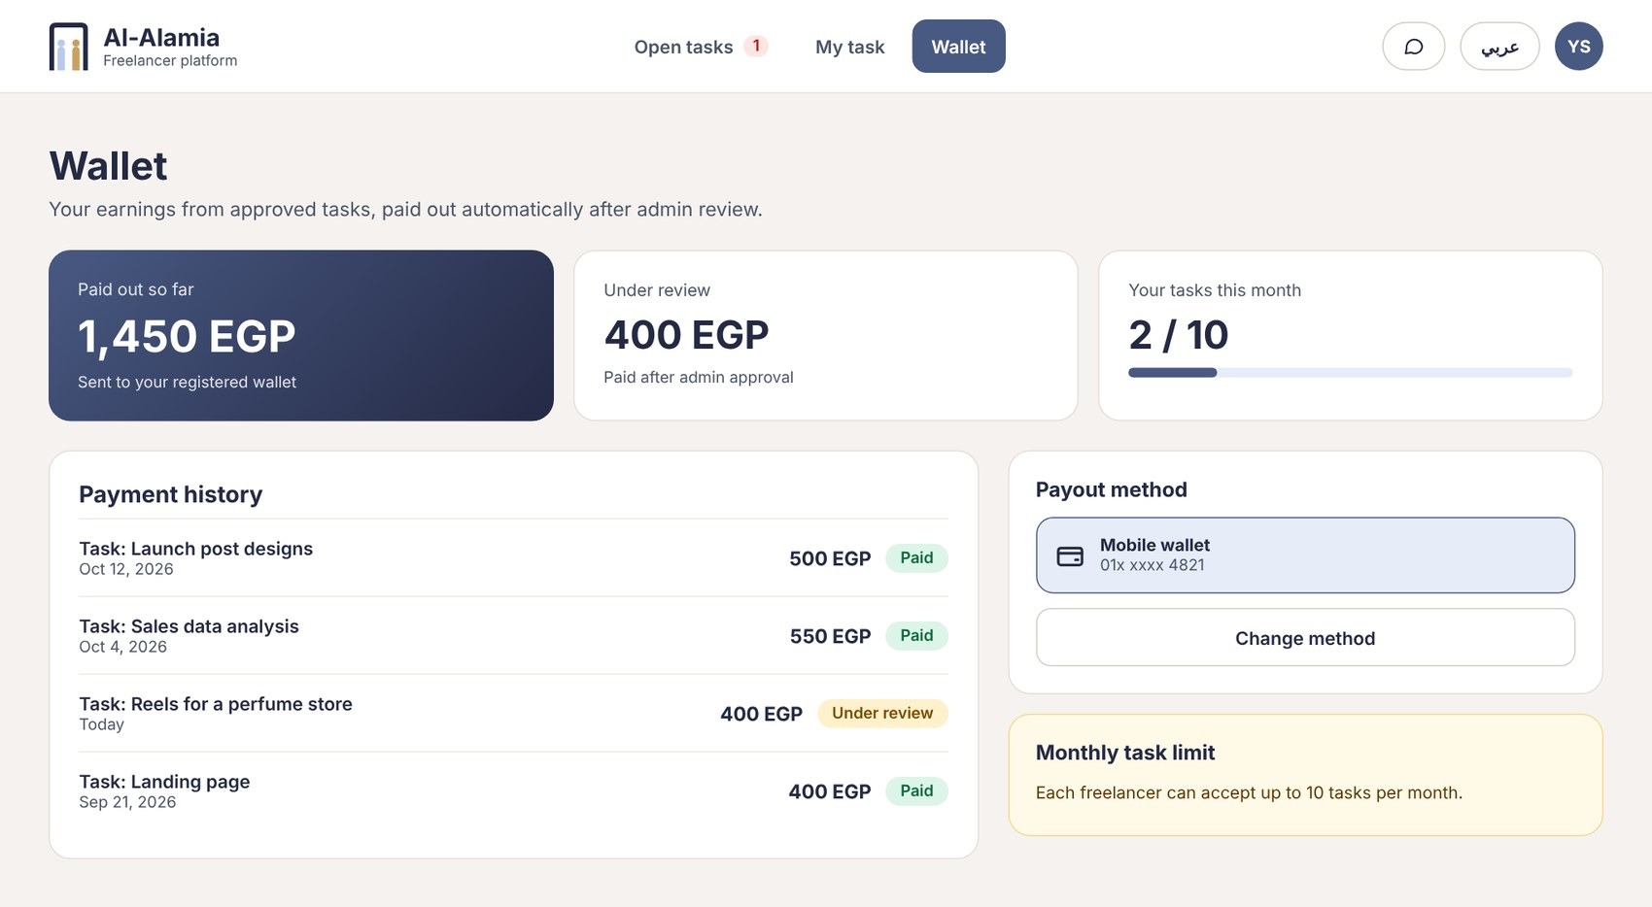
Freelancers get focused offers, not noise
The first valid accept wins; deadlines and deductions are stated up front.
Three-step sign-up
Live task offer: first to accept gets it
Wallet: the ledger

Slide 7
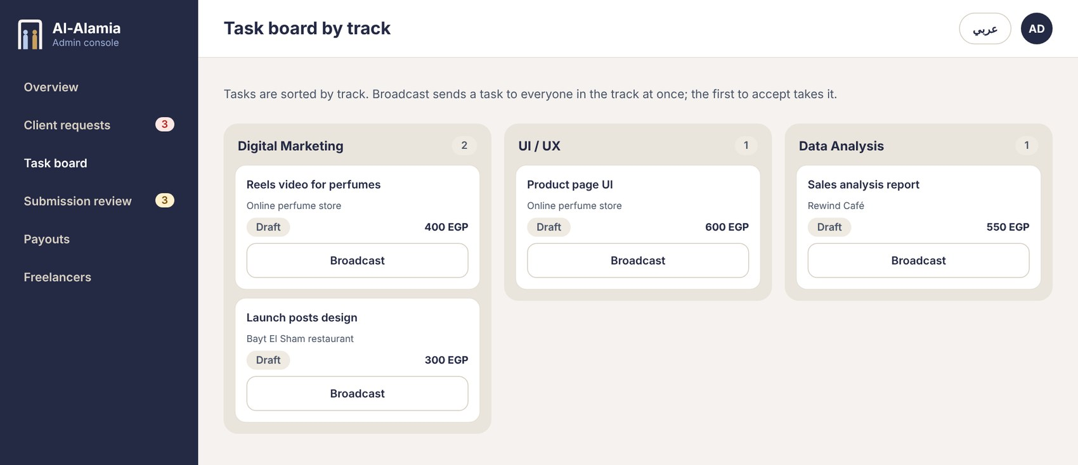
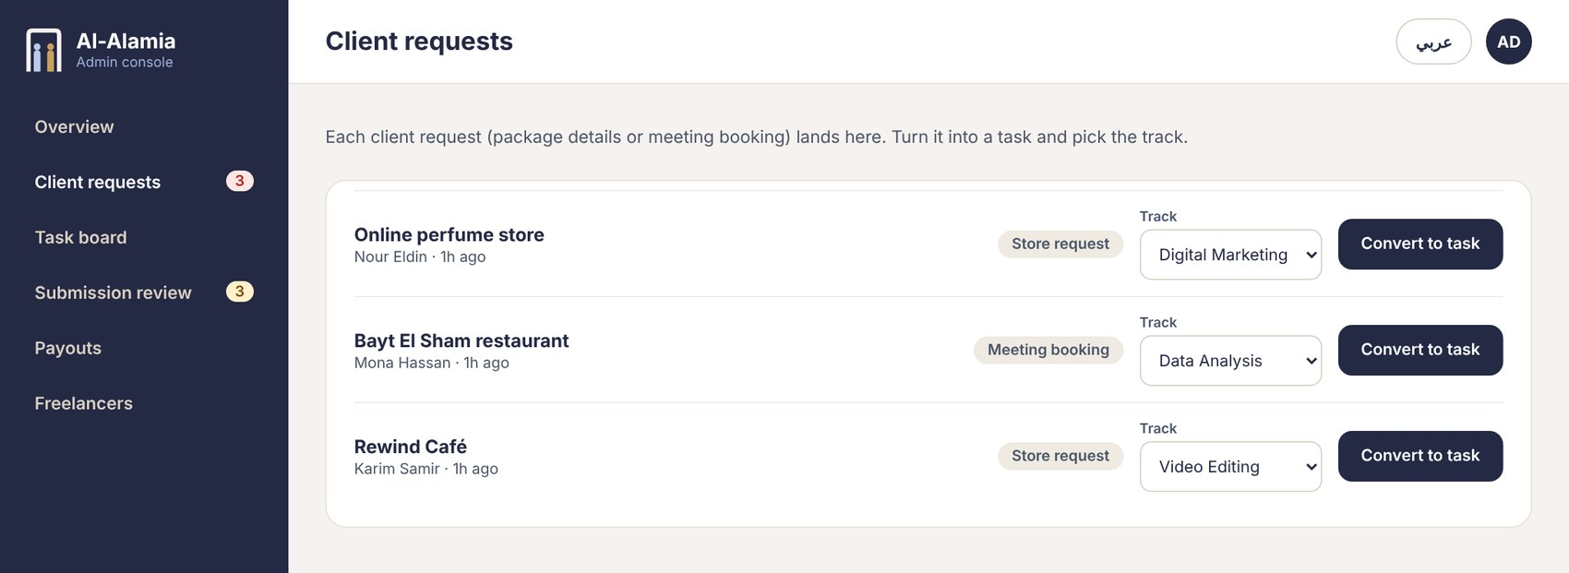
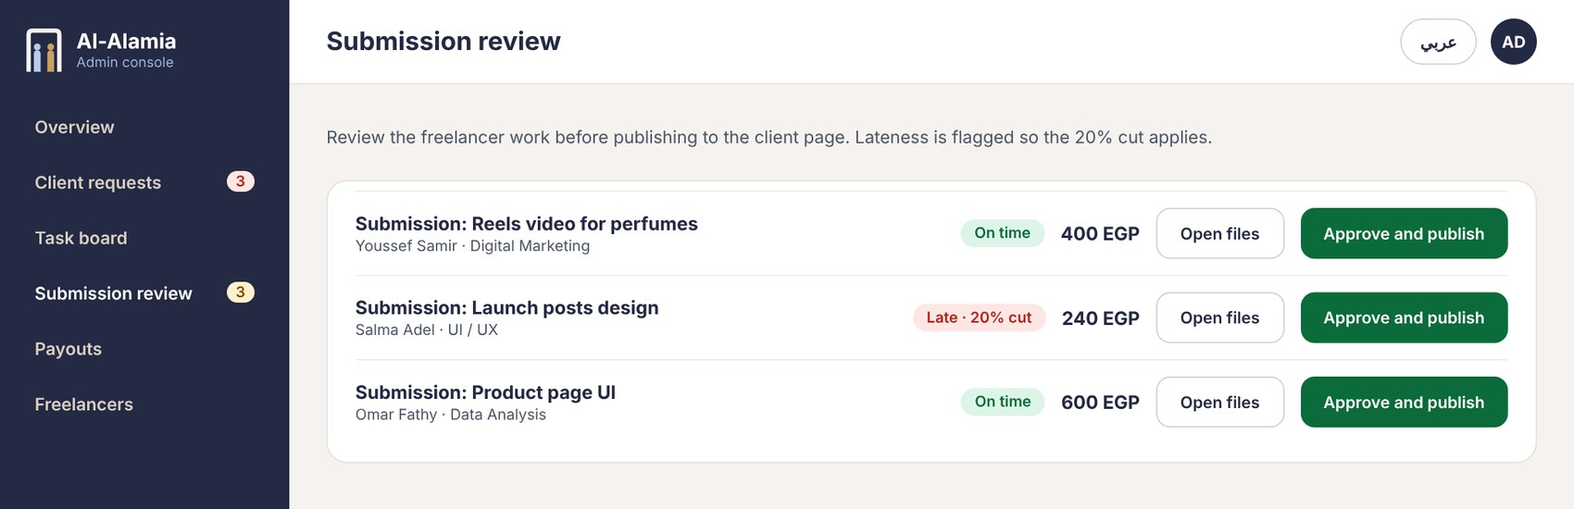
The admin console runs the whole workflow
Requests, task board, submission review and the ledger in one place.
Client requests
Task board by track
Submission review
The Payouts screen shows the ledger only. No real money moves in this version.

Slide 8
The business rules are explicit and configurable
Twenty numbered rules (BR-01 to BR-20). Values come from configuration, not code.
10
20%
30 days
7 days
3
accepted tasks per freelancer per month
deduction for the one extra day, once per task
block if nothing is delivered after the extra day
block for final rejection or withdrawal
images per published portfolio item
A block only stops new offers. Tasks already assigned continue.
A revision stays on the same task with the same freelancer. Ledger only: the platform records money, it does not move it.

Slide 9
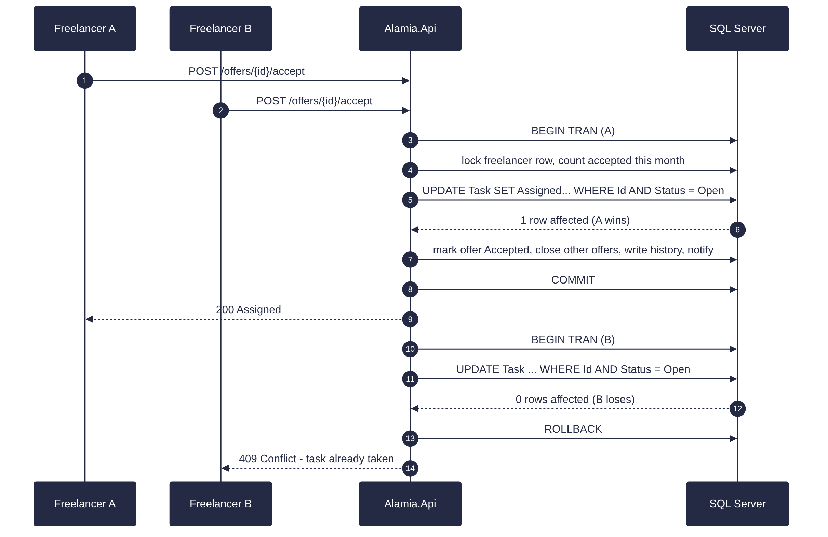
First accept wins, enforced by the database
Fifty parallel requests, exactly one winner.
1
One atomic UPDATE
Task is assigned only if Status = Open and nobody holds it. One row affected means you won.
2
409 for everyone else
The losers get a clear conflict response and the UI rolls back its optimistic update.
3
Proven by a test
50 concurrent requests in CI through Testcontainers: one winner, 49 conflicts.

Slide 10
Clean Architecture in a modular monolith
One deployable unit, clear module boundaries, dependencies point inward.
React SPA
Vite · TypeScript · TanStack Query · react-i18next (RTL/LTR)
Platform
.NET 10 Web API
JWT + rotating refresh tokens
Outbox for e-mail
Deadline monitor job
Keyset pagination
Serilog + correlation id
alealamia.API
Thin controllers · policies · rate limiting · ProblemDetails · OpenAPI
alealamia.Application
Use cases · FluentValidation · DTOs · interfaces · policies
alealamia.Domain
Entities · enums · state rules · no framework dependencies
alealamia.Infrastructure
EF Core 10 + SQL Server · Identity + JWT · files · MailKit · background jobs

Slide 11
40 entities, 12 modules, one database
The ERD was reviewed against the rules. Changes only close gaps; no features were added.
Task.RewardAmount
Base for earnings and the 20% deduction
40
Task.RowVersion
Concurrency token for assignment
AssignedFreelancerProfileId
Consistent foreign-key naming
entities in 12 modules
ProfileImageFileId
One File table, no loose URLs
Identity · Freelancer · Portfolio · Projects · Marketing · Tasks · Delivery · Finance · Files · Support · Notifications · Catalog
Notification.RelatedEntity*
Open the right page from a notification
RefreshToken table
Rotation and revocation, hash only
Unique and filtered indexes
BR-04, BR-08 and BR-14 live here

Slide 12
Quality and performance are measured, not claimed
These are targets we will verify with tools and report honestly at the end.
< 200 ms
< 300 ms
< 250 KB
≥ 90
p95 reads at 100 concurrent users
p95 for accepting a task
first bundle, gzip
Lighthouse performance and accessibility
Unit
xUnit · FluentAssertions · every BR-xx rule
Integration
Testcontainers SQL Server · Respawn · 50-request accept test
Front end
Vitest · Testing Library
End to end
Playwright golden scenario
Load
k6 scenarios
Coverage
≥ 80% Domain and Application

Slide 13
Five and a half weeks, hand-in Saturday 5 December 2026
28 October to 5 December, with a milestone every week and a buffer at the end.
Week 1
Week 2
Week 3
Week 4
Week 5
Buffer
28 Oct – 3 Nov
4 – 10 Nov
11 – 17 Nov
18 – 24 Nov
25 Nov – 1 Dec
2 – 5 Dec
Foundation
Flows
Engine
Rules and money
Polish
Hand-in
Repo, CI, schema, Identity, design system, API contract
Approval, catalog, projects, pricing, task creation, offers
Concurrent accept, monthly cap, delivery and review
Deadline monitor, deductions, blocks, ledger, packages
Performance, E2E tests, accessibility, security review
Code freeze, fixes only, rehearsal, package
Milestones: M1 login for all roles · M2 request to offers · M3 accept engine green · M4 full journey · M5 release candidate

Slide 14
Each member owns a vertical module
Database, API, UI and tests for one area, so responsibility is clear.
MT
MR
AK
MA
NM
Mohamed Tawfik
Menna Reda
Abdelrahman Khaled
Merna Abdelfattah
Nahed Magdy
Tasks
Identity and freelancer
Projects
Delivery and finance
Files, support, notifications
Assignment engine, concurrent accept, task board
Auth, roles, approval, portfolio, blocks
Client journey, pricing, meetings, packages
Review, revisions, deductions, ledger
Secure files, tickets, e-mail outbox

Slide 15
Built to grow, scoped to finish
Future work, deliberately outside this delivery
Real payments
Skill assessment tests
Real-time chat and SignalR
Ratings and ranking
Smart task matching
Analytics and reports
Thank you
Mobile app
Questions are welcome
Mohamed Tawfik · Menna Reda · Abdelrahman Khaled · Merna Abdelfattah · Nahed Magdy

