Slide 1
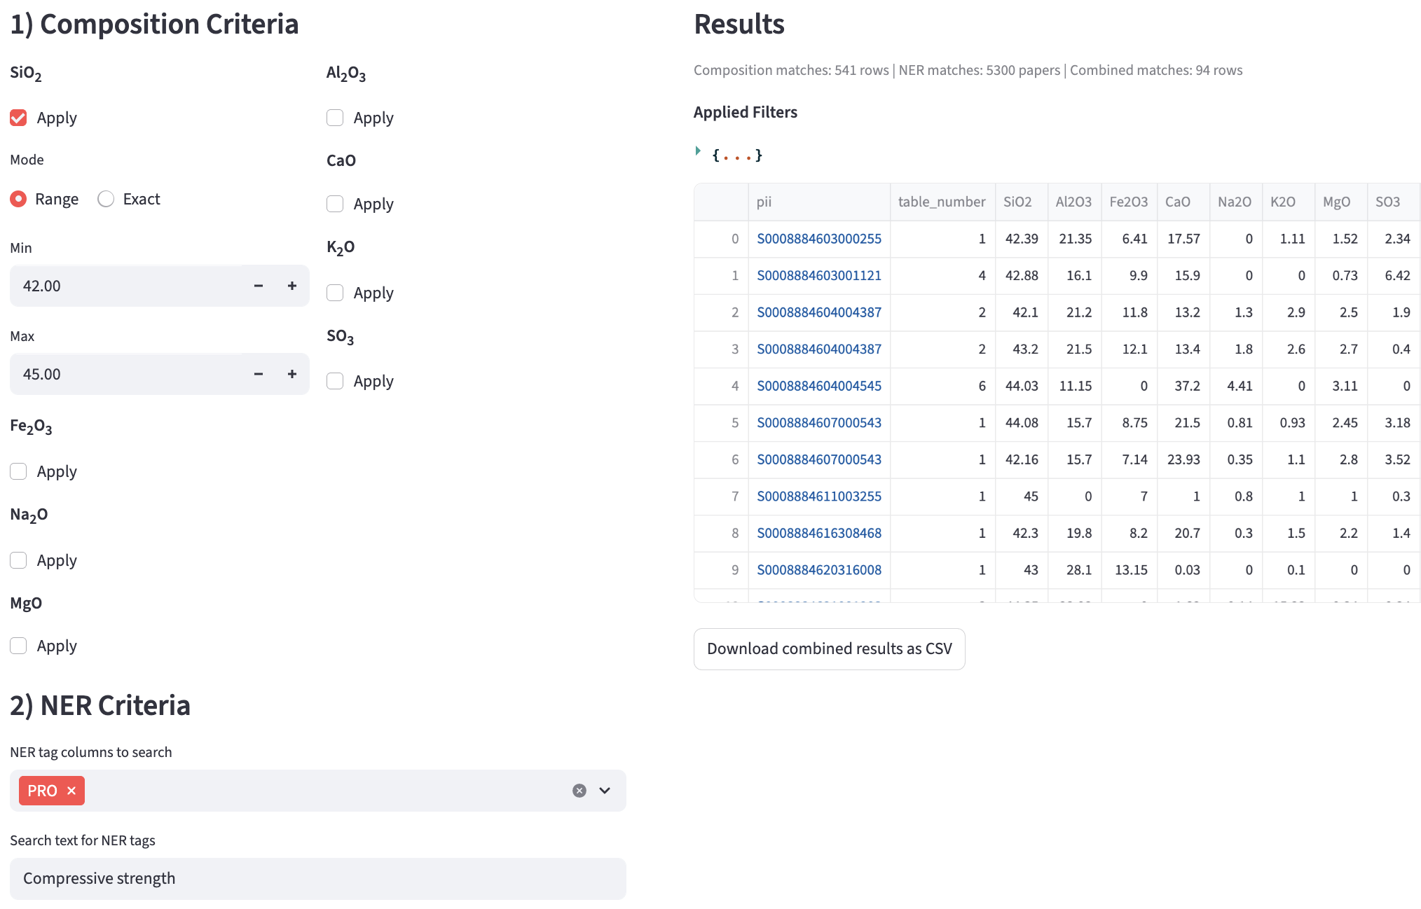
(c)

Slide 2
(a)
(b)

