Slide 1



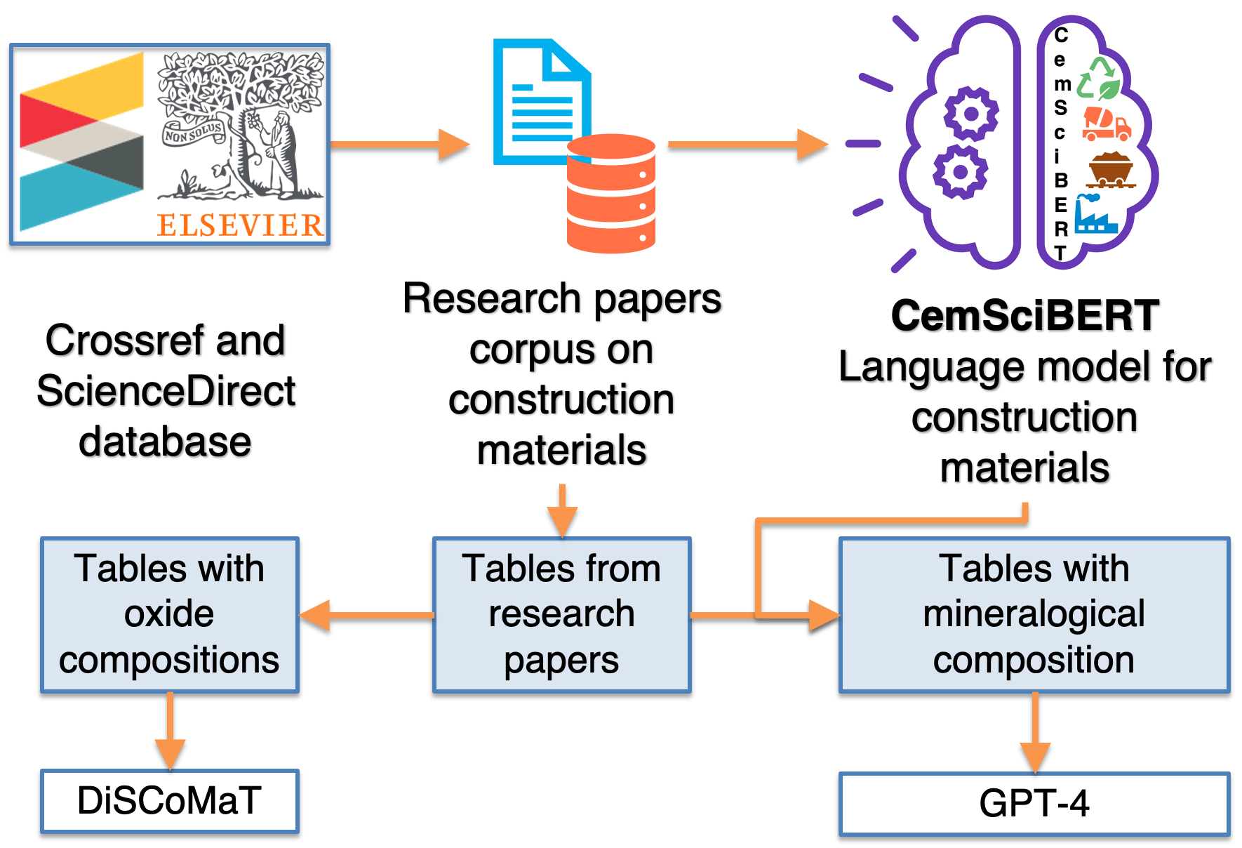
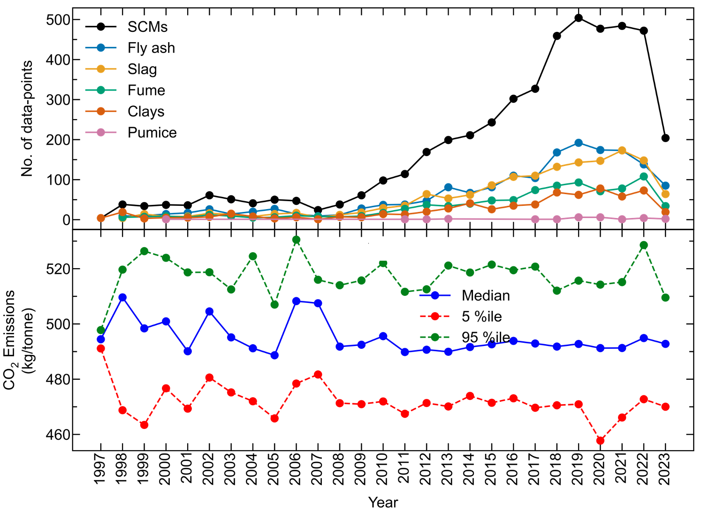
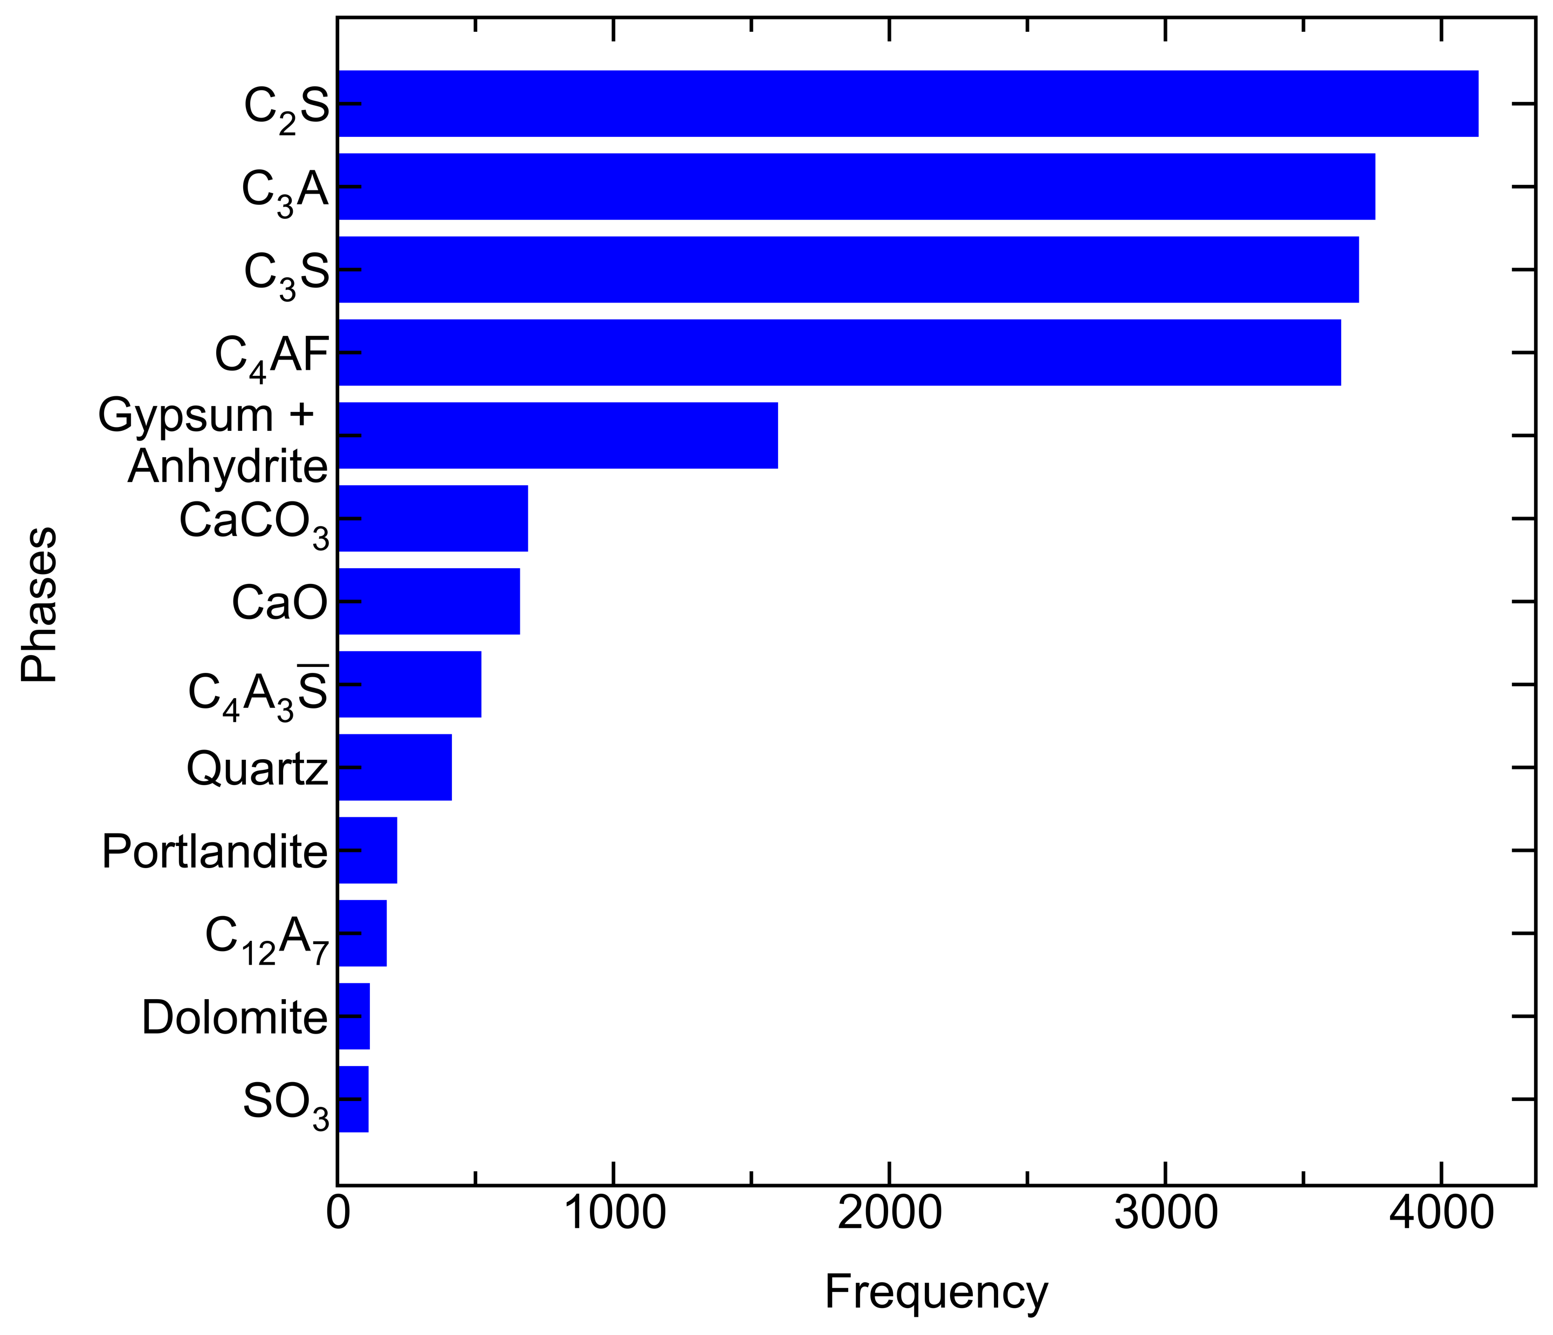
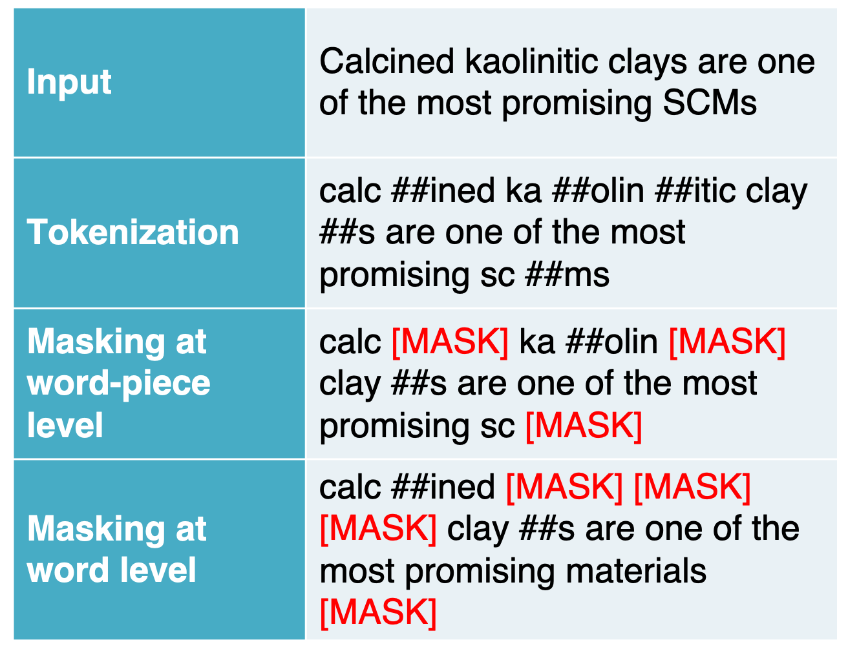
AI DRIVEN INFORMATION EXTRACTION FROM CONSTRUCTION MATERIALS LITERATURE
Mohd Zaki¹, Keshav Bharadwaj Ravi², Jayadeva^{3,4} and N. M. Anoop Krishnan​^{1,4}
¹ Department of Civil Engineering, IIT Delhi
² Department of Civil Engineering, IISc Bengaluru
³ Department of Electrical Engineering, IIT Delhi​
⁴ Yardi School of Artificial Intelligence, IIT Delhi​​
MOTIVATION
Create largest database of construction materials
OUTLINE
CONTRIBUTIONS
Language model (LM) for understanding text of construction materials research papers
Extracted compositions of SCMs and cements from research paper tables
Evaluated CO₂ emissions from cement clinker compositions
INTRODUCTION
Construction material research is important for sustainable development
Choice of the materials depend on applications and locally available resources
Automated information extraction from text requires specialized language model
More than 85% compositions of construction materials are reported in tables
DETAILS OF EXTRACTED INFORMATION
METHODOLOGY
Language model development
# DATASET
Training – 19234 papers (96M tokens)
Validation – 3465 papers (17.2M tokens)
# OBJECTIVE – Masked work prediction
TAKEAWAYS
Domain specific pretraining improves textual understanding of LM
Identified tables of crystalline composition with a recall of 1.0
Extracted ~30k oxide, ~4k mineralogical compositions
Extracted compositions of ~4700 SCMs and ~7400 materials including Portland cement, limestones, and others.
Research interest in SCMs is rising.
CO₂ emissions of cement clinkers has not changes much.
ACKNOWLEDGEMENTS
PMRF
HPC IIT DELHI
REFERENCES
1. Gupta T, Zaki M, Khatsuriya D, Hira K, Krishnan NMA, Mausam. DiSCoMaT: Distantly Supervised Composition Extraction from Tables in Materials Science Articles. In Proceedings of the 61st Annual Meeting of the Association for Computational Linguistics (Volume 1: Long Papers), pages 13465–13483, Toronto, Canada. Association for Computational Linguistics.
2. Gupta T, Zaki M, Krishnan NMA, Mausam. MatSciBERT: A materials domain language model for text mining and information extraction. npj Computational Materials. 2022 May 3;8(1):102.

