Slide 1
Information extraction from tables
Extracted compositions
Annotated dataset of tables with mineralogical composition
GPT-4 for extracting the mineralogical compositions
Mineralogical
Table classifier based on CemSciBERT
Tables with mineralogical composition
6,210
P | R | F1
1.0 | 0.94 | 0.97
Tables from research papers
Oxides
Tables with oxide compositions
Rule based system
26,830
DiSCoMaT
P | R | F1
0.75 | 0.70 | 0.72
Notes:
Sampled 50 tables and identified types of 121 compositions
Total papers ~36,572
Total compositions ~ 35,000
cement = 14,700
slag = 5,950
flyash = 5,250
silica fume = 1750
others include clays, limestone, tailings, mixtures = 6,650

Slide 2


Research papers corpus on construction materials
CemSciBERT
Extracted compositions
Annotated dataset of tables with mineralogical composition
GPT-4 for extracting the mineralogical compositions
Mineralogical
Table classifier based on CemSciBERT
Tables with mineralogical composition
6,210
P | R | F1
1.0 | 0.94 | 0.97
Tables from research papers
Oxides
Tables with oxide compositions
Rule based system
26,830
DiSCoMaT
P | R | F1
0.75 | 0.70 | 0.72

Slide 7
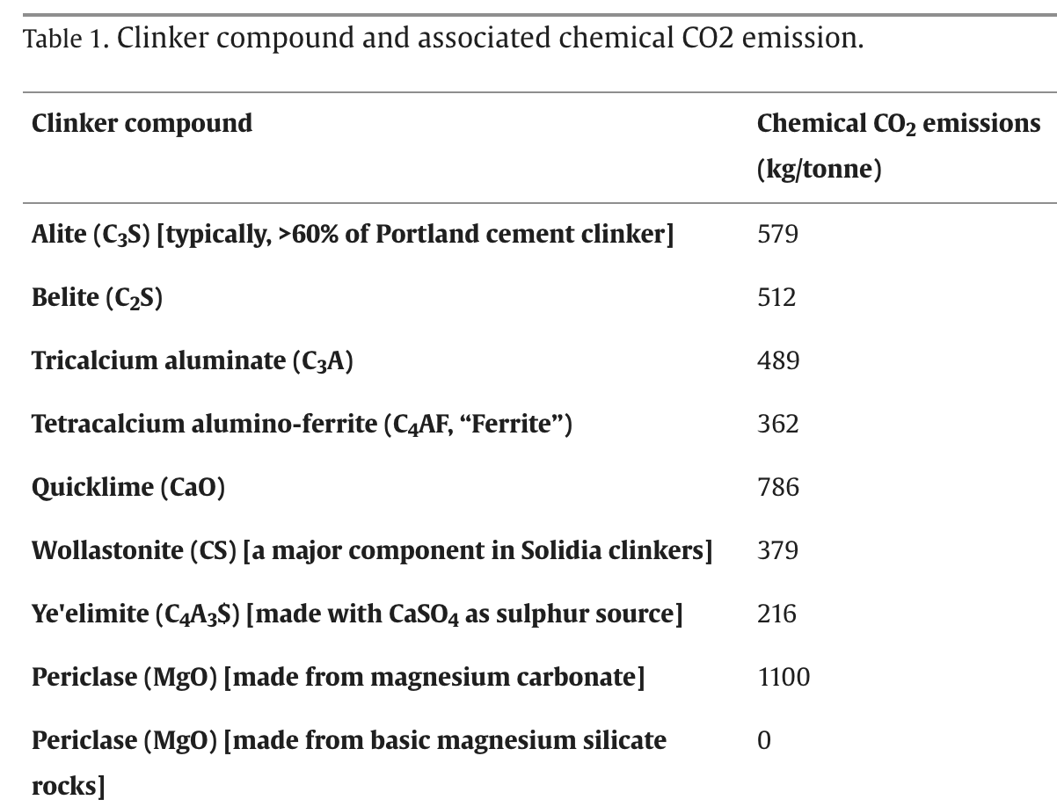
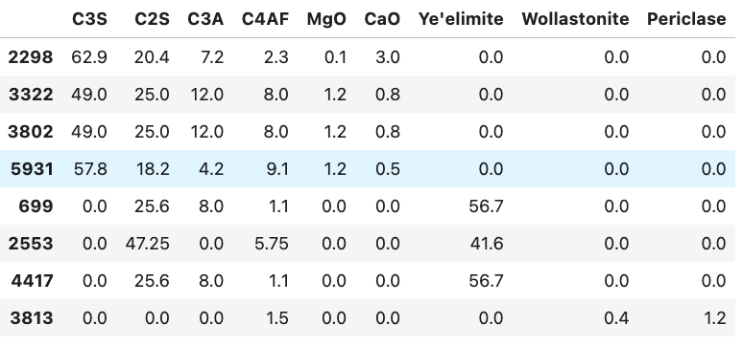
Table 2: wt% of phases in clinkers

