Slide 1





C
e
m
Sc
i
BERT

Slide 2

C
e
m
Sc
i
BERT

Slide 3




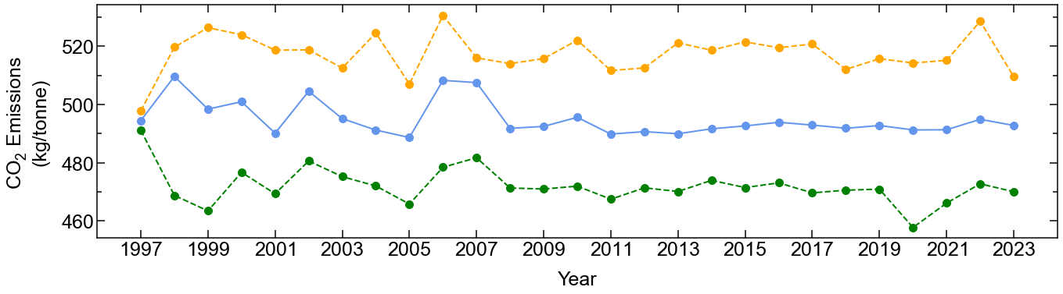
Named entity recognition
Downstream tasks
Table classification
CemCorpus
CemSciBERT
Mineralogical composition tables
Oxide composition tables
CO₂ Emissions
calculation
GPT-4
DiSCoMaT
Cementitious Materials Catalogue

