Slide 1

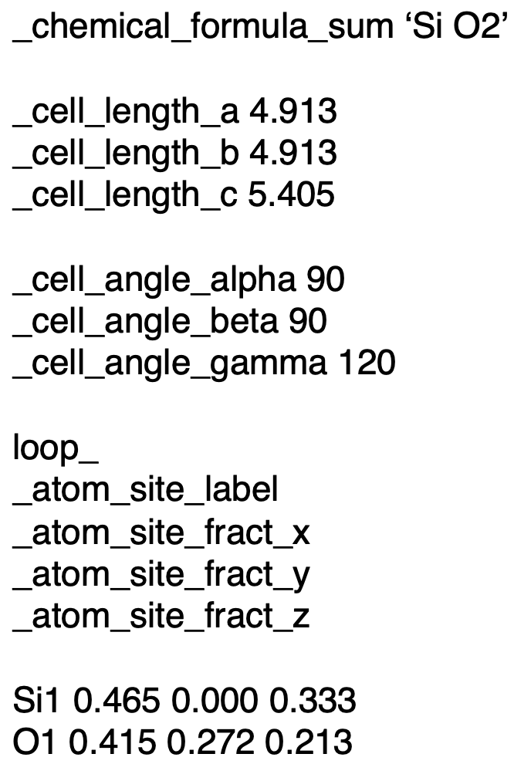








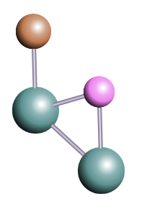
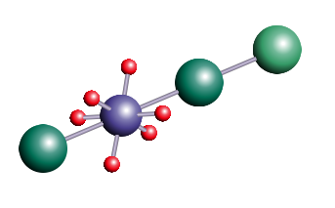
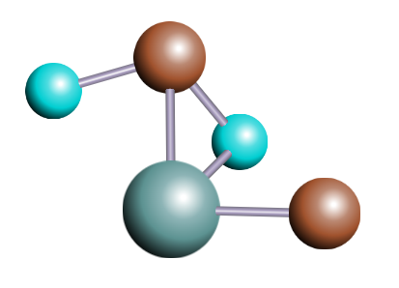
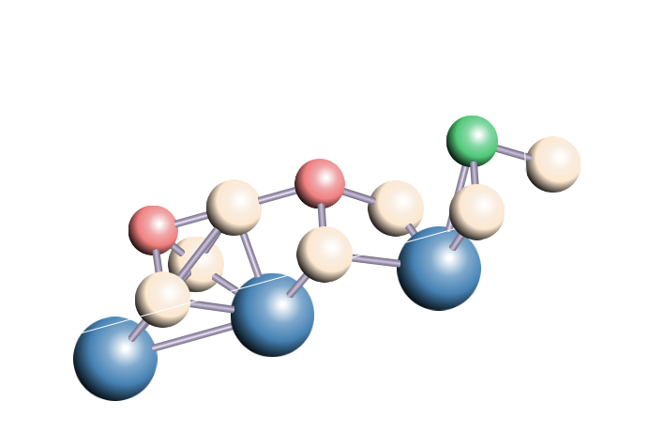

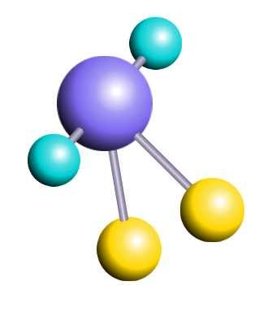
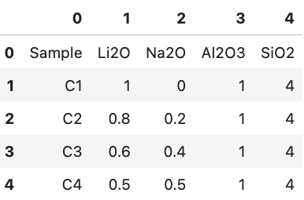
PRETRAINING DATASETS
Peer-reviewed Materials Science Publications
Materials Science Community Discourse
RedPajama :
Subset of original corpus
Crystallographic
Information Files
Finetuning for materials science
Finetuning for materials generation
Understanding CIF files syntax
Learning atoms and their coordinates
Learning co-occurrence of elements
LLaMat-chat
LLaMat-CIF
STRUCTURED INFORMATION EXTRACTION FROM TEXT
Oxidation in ceria infiltrated metal supported SOFCs - A TEM investigation - The oxidation resistance of the Fe–Cr alloy backbone structure of metal supported solid oxide fuel cells is significantly improved when infiltrated with gadolinium doped ceria (CGO) particles.
{‘name’: ‘ceria’,
‘description’: [‘gadolinium doped’, ’particles’],
‘acronym’: ‘CGO’,
‘applications’ : [‘solid oxide fuel cells’]}
INFORMATION EXTRACTION FROM TABLES
{'comp_table': [1], 'composition_row_index': [1, 2, 3, 4], 'chemical_col_index': [1, 2, 3, 4], 'gid_col_index': [0],
'regex_table': [0]}
Generated crystal structures
Materials research co-pilot
Materials structure generator

