Slide 1
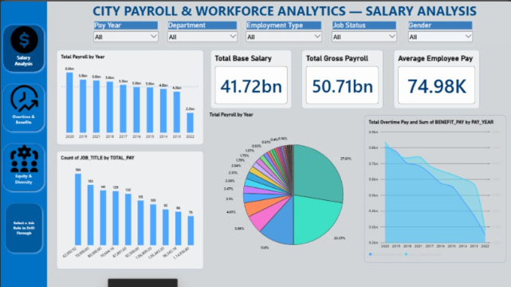
City Payroll & Workforce Analytics
PROJECT PRESENTATION
A Power BI project on salary, overtime & benefits, and equity & diversity
Notes:
Introduce the project: an interactive Power BI report analysing city payroll and workforce data across three dashboards.

Slide 2
Project overview
Goal: turn raw city payroll records into clear, interactive insights
Question 1: where does the payroll money go, and how has it changed?
Question 2: how much do overtime and benefits add to the base pay?
Question 3: is pay equitable across gender and ethnicity?
3
dashboard pages
5
interactive filters
676K
headcount analysed

Slide 3
Approach & tools
1
2
3
4
Collect
Clean & model
Measure
Visualise
City payroll records by year, department and job
Prepare fields: pay, benefits, overtime, gender, ethnicity
Build KPIs and ratios such as overtime % and pay parity
Design 3 linked dashboards with slicers and drill-through
Tool: Microsoft Power BI (charts, DAX measures, slicers, page navigation)

Slide 4
Salary analysis
41.72bn
Total base salary paid
50.71bn
Total gross payroll, ~9bn above base
74.98K
Average employee pay
Payroll peaks at about 6.6bn a year and is concentrated in a few segments.
Notes:
Total payroll by year falls from roughly 6.6bn at its peak to about 2.25bn in the latest year shown (possibly a partial year). The pie shows payroll share is concentrated in a few slices.

Slide 5
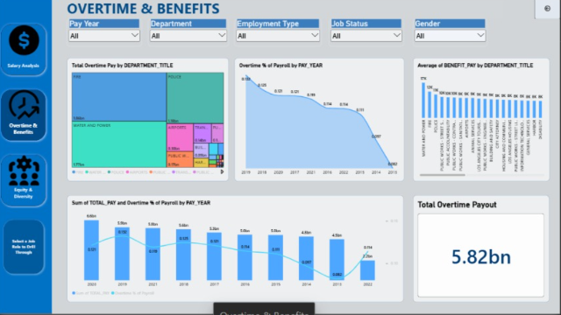
Overtime & benefits
5.82bn
Total overtime payout (~11.5% of gross)
Fire & Police
Largest overtime pay by department
Falling
Overtime share of payroll trends down
Water & Power leads on average benefit pay per employee.

Slide 6
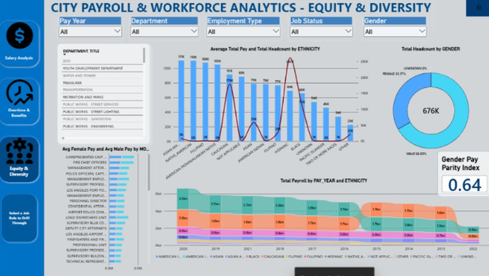
Equity & diversity
676K
Total headcount analysed
~69% / 31%
Male vs female share of headcount
0.64
Gender Pay Parity Index
An index of 0.64 means women's average pay is about 64% of men's.

Slide 7
Key numbers at a glance
41.72bn
50.71bn
74.98K
Total base salary
Total gross payroll
Average employee pay
5.82bn
676K
0.64
Total overtime payout
Total headcount
Gender pay parity index

Slide 8
Conclusions & recommendations
What we found
What to do next
Gross payroll of 50.71bn sits well above base pay of 41.72bn
Overtime is a major cost driver, led by Fire and Police
Women make up about 31% of headcount, with a 0.64 pay parity index
Review overtime policy in the highest-cost departments
Investigate the drivers of the gender pay gap by job and department
Add trend forecasts and refresh the data regularly

Slide 9
Thank you
Questions & discussion

