Slide 1
Register Application
By: Jondn Tryniski, Thomas Hanley, and Joshua Meritt

Slide 2
Basic Overview
The application built is a Register Application.
It allows for the sale of items, from an inventory.
Inventory is created from an XML file and will re-write the XML once the application finishes in order to save the state of the inventory.
The register allows for different users to login and perform actions.
A system for tracking members total amount bought is in place, and provides discounts once certain thresholds are met.

Slide 3
Users
When first opening the application the user must log in with a username and password.
Each user has a role.
Roles allow specific actions to be performed and other users do not have access to those actions.
Users also have sale totals to help track individual performance.
Notes:
When the application is first

Slide 4
Register
Allows for the sale of items.
Allows for the return of items.
Allows for creation of new items to add to the inventory.
Inventory command shows the current inventory.
Daily report shows the total pre-tax for sales.
Daily inventory shows the total of what was sold and returned.
Check price gives the cost of the item.
During sales, if the total of an item drops below two it outputs that more of the item should be ordered.
Notes:
The register functions get called through a runner class, the runner calls the functions based on the user input. For example if the user inputs sale it will start the sale function, return item initiates the return function. There are daily inventory and report functions that allow managers to see how much was sold and the total amount in dollars sold before tax. A function goes through and gets called during each sale to make sure that the item amount doesn’t drop to low otherwise it outputs that the user should order more of what was sold.

Slide 5
Members
Three different levels of membership.
Discounts range from 1%-3%.
Members are saved in an XML file, and have an address and phone number on file.
During a sale members can be found by phone number to apply the discount.

Slide 6
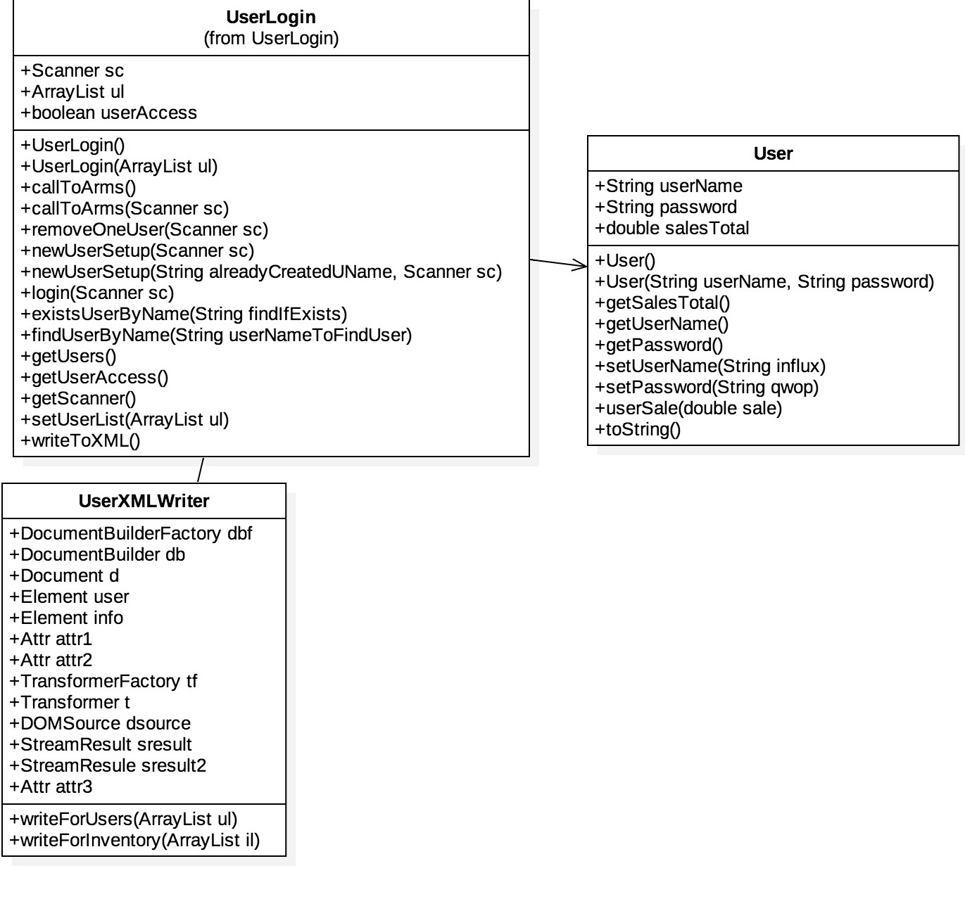
User UML

Slide 7
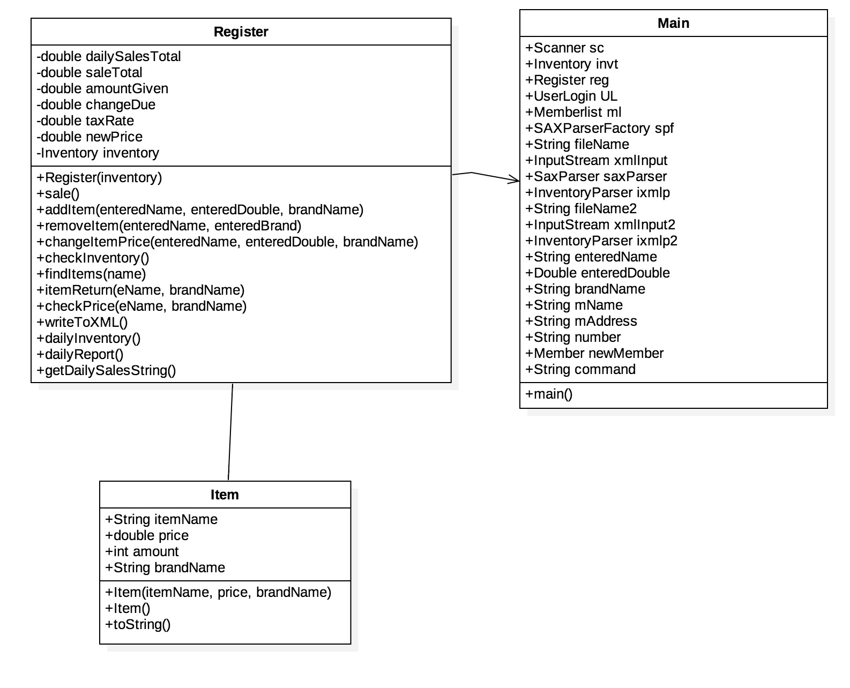
Register UML

Slide 8
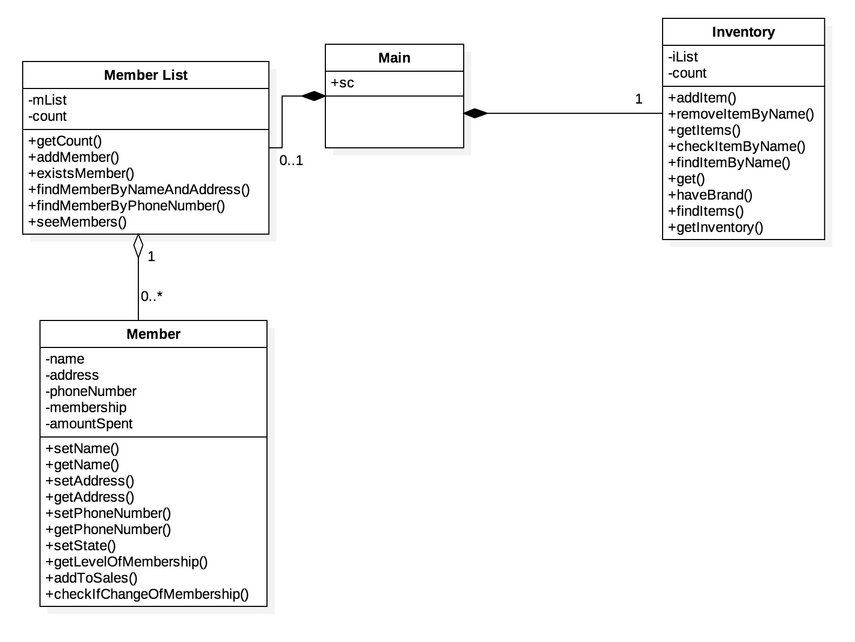
Member UML

