Slide 1
Data Driven Systems Project
Student number : 40487649

Slide 2
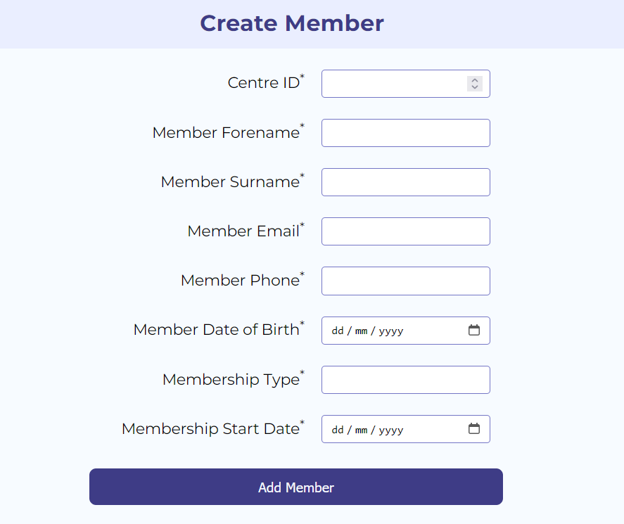
Adding Data (frontend)
Adding a member is simple and quick via our web interface. All inputs are validated and we check for required fields

Slide 3
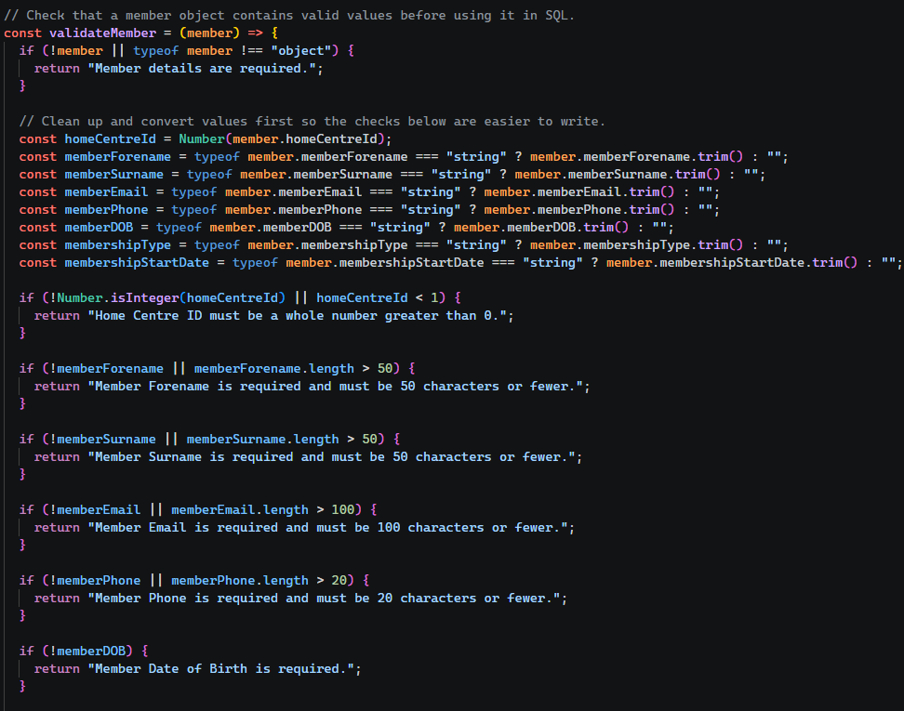
Adding Data (backend)
All inputs have their types validated
Input strings have their length checked and rejected if too large

Slide 4
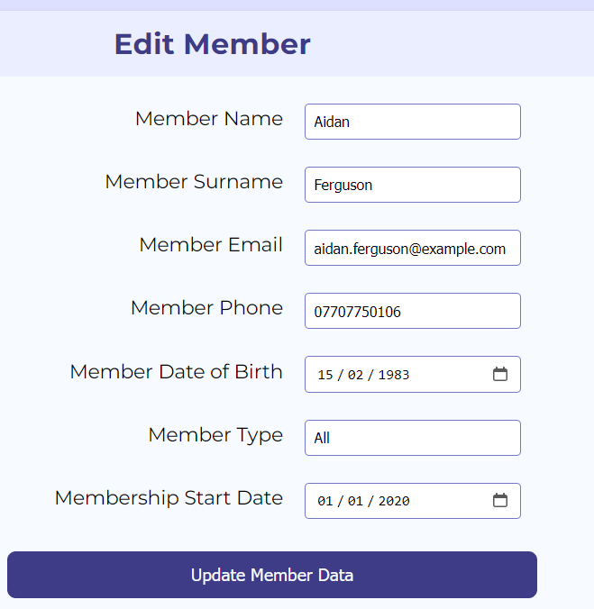
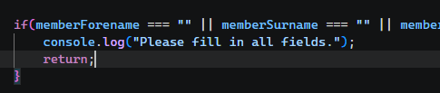
Editing Data
Once again there is a simple form to edit data
All changed data goes through the same validation as new Data

Slide 5
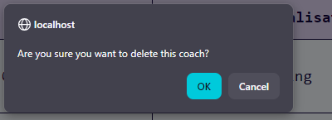
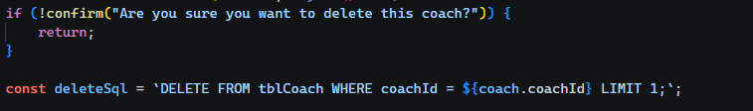
User Feedback
Before any deletions occur, we prompt the user with a confirmation box
Upon any error occurring we produce an error message for the user to assist in fixing it

