Slide 1
Quick reference guide for web elements
Student No. 40479966

Slide 2
Contents
Directory Structure
Landing Page
CRUD Page
Report Page
Report 1
Report 2
Report 3
Parameterised Reporting

Slide 3
Directory structure
Group03/
├── Database/
│ ├── create.sql
│ └── insert.sql
├── Web App/
│ ├── HTML
│ ├── CSS
│ └── JavaScript
├── Database_Technical_Documentation.docx
├── Group_System_Video.mp4
│
├── Work_Breakdown_Table.docx
│
├── StudentID_40483010/
│ ├── 40483010 _Design_Spec.docx
│ ├── 40483010 _reports.sql
│ ├── 40483010 _Web_Reference_PPT.pptx
│ ├── 40483010 _Individual_Video.mp4
│ └── 40483010 _GenAi_Log.docx
├── StudentID_40487649/
│ ├── 40487649 _Design_Spec.docx
│ ├── 40487649 _ reports.sql
│ ├── 40487649 _Web_Reference_PPT.pptx
│ ├── 40487649 _Individual_Video.mp4
│ └── 40487649 _GenAi_Log.docx
└── StudentID_40486524/
├── 40486524 _Design_Spec.docx
├── 40486524 _ reports.sql
├── 40486524 _Web_Reference_PPT.pptx
├── 40486524 _Individual_Video.mp4
└── 40486524 _GenAi_Log.docx
├── StudentID_40479966/
│ ├── 40479966 _Design_Spec.docx
│ ├── 40479966 _ reports.sql
│ ├── 40479966 _Web_Reference_PPT.pptx
│ ├── 40479966 _Individual_Video.mp4
│ └── 40479966 _GenAi_Log.docx
└── StudentID_40479968/
├── 40479969 _Design_Spec.docx
├── 40479969 _ reports.sql
├── 40479969 _Web_Reference_PPT.pptx
├── 40479969 _Individual_Video.mp4
└── 40479969 _GenAi_Log.docx

Slide 4
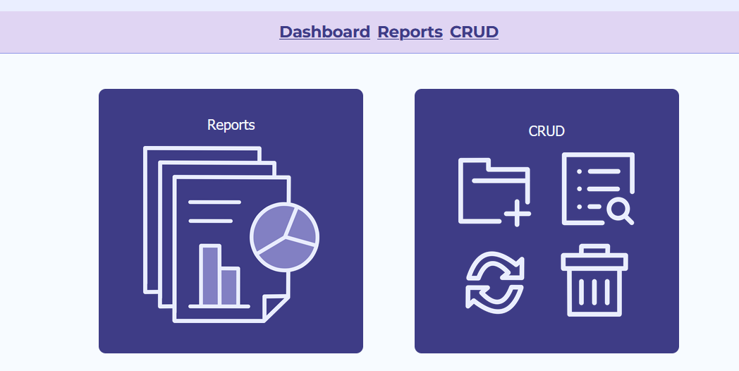
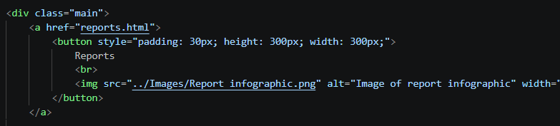
Landing page
Landing page in website (banner cut off)
“..\Data-Driven-2026\Web App\HTML\index.html“
Landing page that sends user to either report page or crud page
Can use buttons or dashboard
HTML of button elements that contains href links to other pages

Slide 5
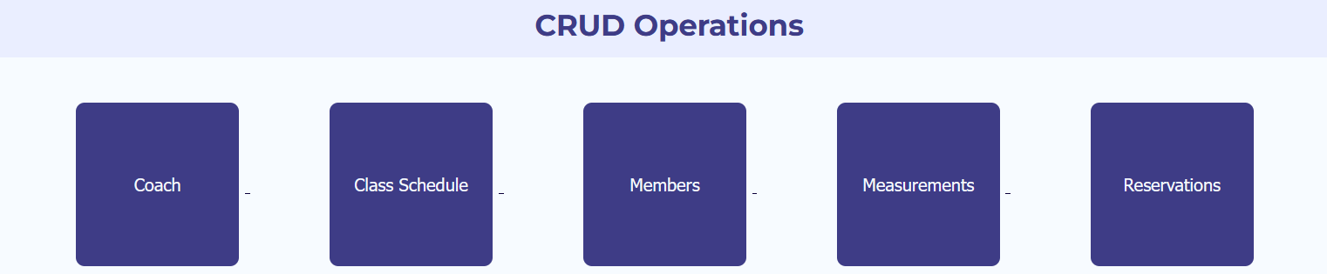
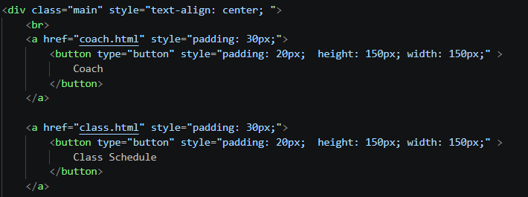
Crud page
Buttons as seen in website
“..\Data-Driven-2026\Web App\HTML\crud.html“
Buttons allowing access to each CRUD using href links
Can also use dashboard which updates when moving to this page
HTML of button elements that contains href links to other pages

Slide 6
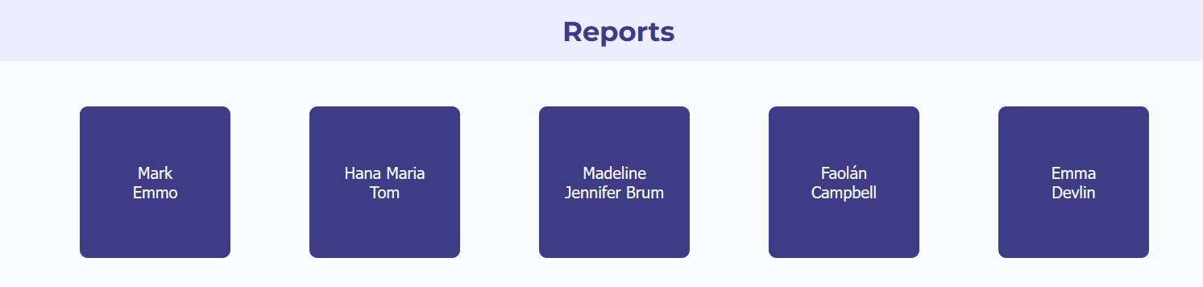
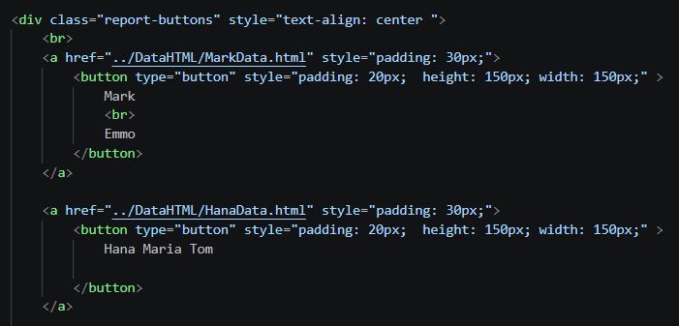
Report page
Buttons as seen in website
“..\Data-Driven-2026\Web App\HTML\report.html“
Buttons allowing access to each report using href links
Can also use dashboard which updates when moving to this page
HTML of button elements that contains href links to other pages

Slide 7
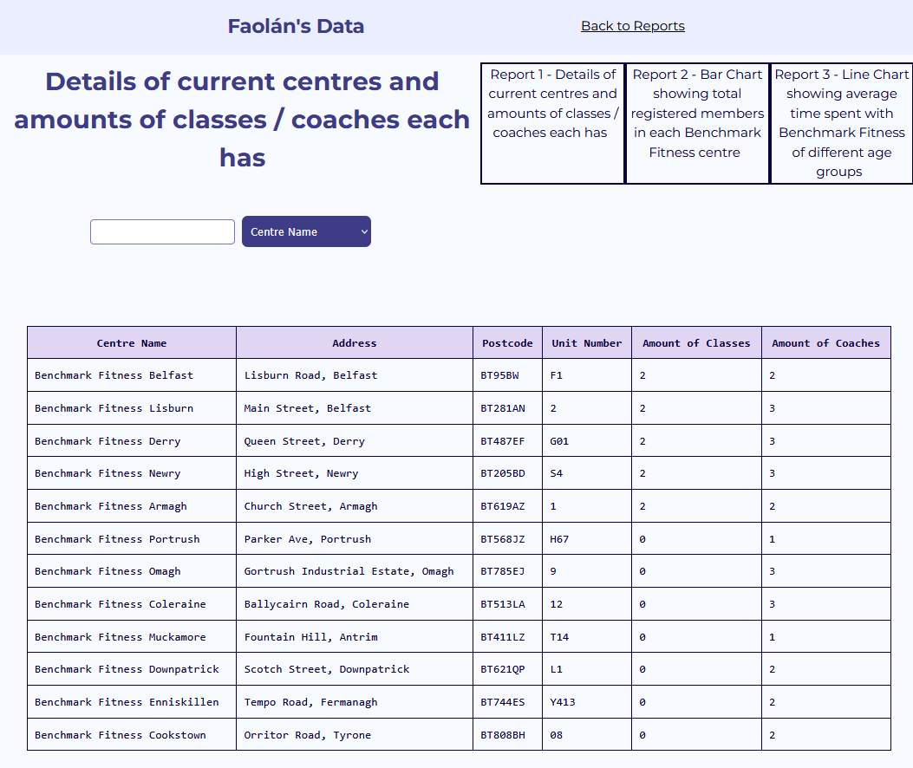
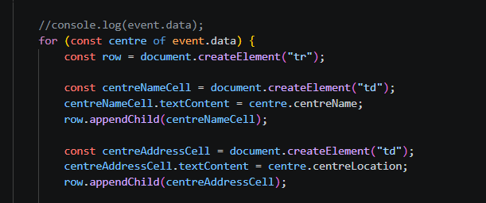
Report 1
…\Data-Driven-2026\Web App\DataHTML\FaolánData.html“
“..\Data-Driven-2026\Web App\JS\ReportJS\faolanReport.js“
Report showing centre details
Can switch between reports using links inside of the boxes
Table generated in the JS file
Table is hidden and revealed by JS event
Consists of report1 function in JS
Table in website
report1() in faolanReport.js

Slide 8
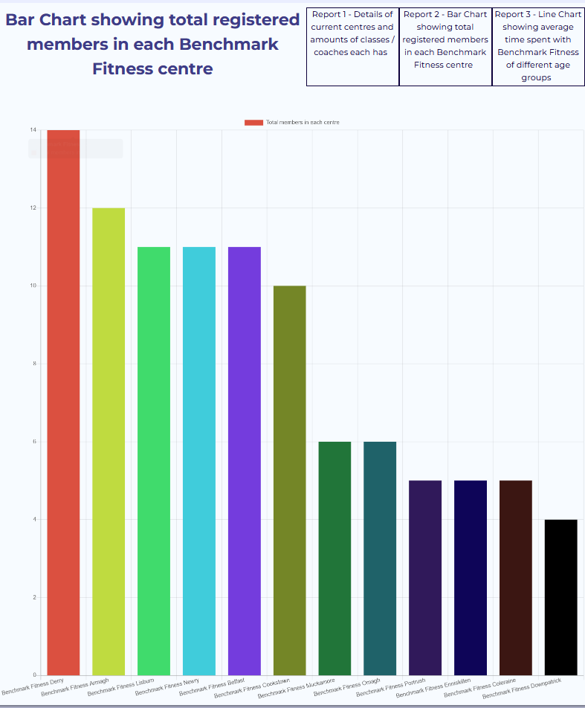
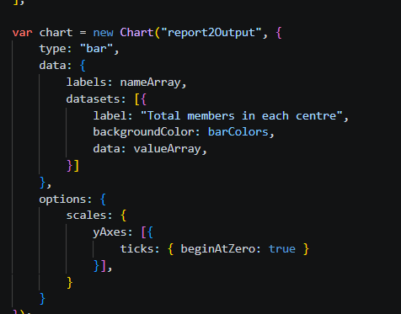
my reports
report2() in faolanReport.js
…\Data-Driven-2026\Web App\DataHTML\FaolánData.html“
“..\Data-Driven-2026\Web App\JS\ReportJS\faolanReport.js“
Bar chart showing total registered members in each centre
Created in faolanReport.js and attached to pre-existing canvas element
Bar chart in website

Slide 9
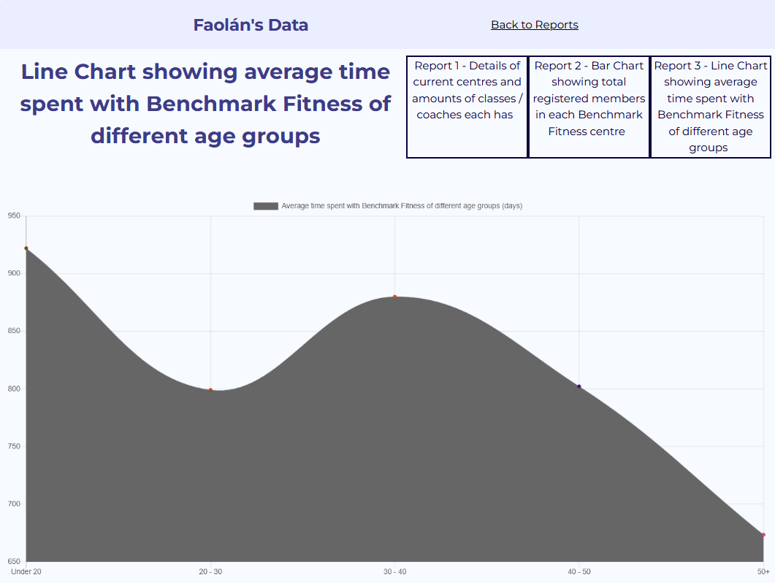
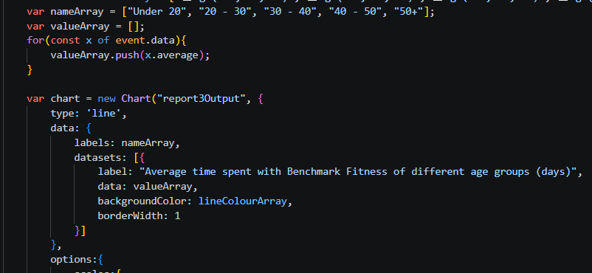
my reports
Line graph in webpage
…\Data-Driven-2026\Web App\DataHTML\FaolánData.html“
“..\Data-Driven-2026\Web App\JS\ReportJS\faolanReport.js“
Line chart created in faolanReport.js and linked to pre-existing HTML canvas element in FaolánData.html
report3() in faolanReport.js

Slide 10
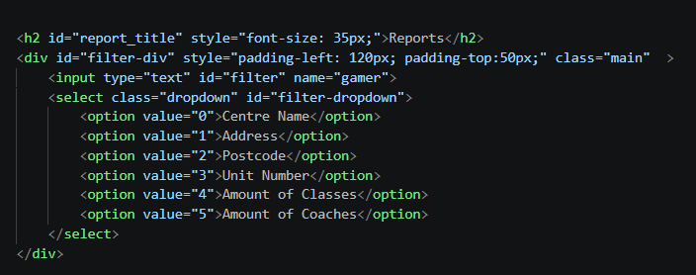
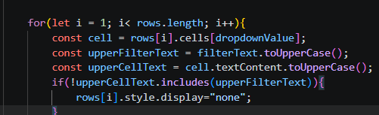
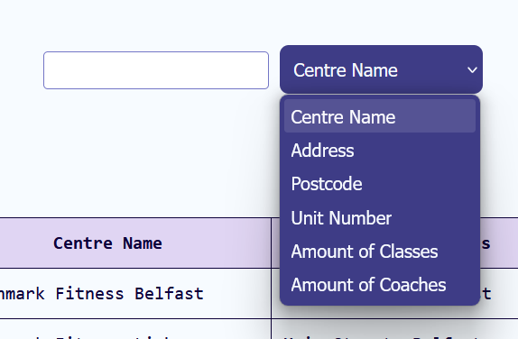
Parameterised Reporting
Dropdown HTML in FaolánData.html
…\Data-Driven-2026\Web App\DataHTML\FaolánData.html“
“..\Data-Driven-2026\Web App\JS\ReportJS\faolanReport.js“
“..\Data-Driven-2026\Web App\JS\ReportJS\filter.js“
Input element that allows users to dynamically filter records based on input
Enables parameterised reporting
Column to filter is chosen with dropdown box
addFilter() in filter.js
Filtering bar in FaolánData.html

