Slide 1
Quick Reference Guide for Web Elements
Student No. 40483710

Slide 2
Contents
Web Feature Locations
CRUD Interactions
Parameterised Reports/Charts
Dynamic Data Retrieval
User Feedback and Confirmations
Error Handling

Slide 3
Directory Structure
Group03/
├── Database/
│ ├── create.sql
│ └── insert.sql
├── Web App/
│ ├── HTML
│ ├── CSS
│ └── JavaScript
├── Database_Technical_Documentation.docx
├── Group_System_Video.mp4
│
├── Work_Breakdown_Table.docx
│
├── StudentID_40483010/
│ ├── 40483010 _Design_Spec.docx
│ ├── 40483010 _reports.sql
│ ├── 40483010 _Web_Reference_PPT.pptx
│ ├── 40483010 _Individual_Video.mp4
│ └── 40483010 _GenAi_Log.docx
├── StudentID_40487649/
│ ├── 40487649 _Design_Spec.docx
│ ├── 40487649 _ reports.sql
│ ├── 40487649 _Web_Reference_PPT.pptx
│ ├── 40487649 _Individual_Video.mp4
│ └── 40487649 _GenAi_Log.docx
└── StudentID_40486524/
├── 40486524 _Design_Spec.docx
├── 40486524 _ reports.sql
├── 40486524 _Web_Reference_PPT.pptx
├── 40486524 _Individual_Video.mp4
└── 40486524 _GenAi_Log.docx
├── StudentID_40479966/
│ ├── 40479966 _Design_Spec.docx
│ ├── 40479966 _ reports.sql
│ ├── 40479966 _Web_Reference_PPT.pptx
│ ├── 40479966 _Individual_Video.mp4
│ └── 40479966 _GenAi_Log.docx
└── StudentID_40479969/
├── 40479969 _Design_Spec.docx
├── 40479969 _ reports.sql
├── 40479969 _Web_Reference_PPT.pptx
├── 40479969 _Individual_Video.mp4
└── 40479969 _GenAi_Log.docx

Slide 4
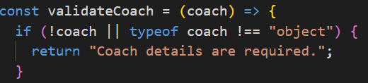
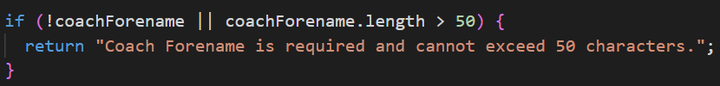

Internal Add
Ex. Adding a coach:
1. Ensure the coach is an object.
Created add capabilities: HTML and JavaScript.
Incorporated client-side validation using ‘type of’ and parameter restraints.
Cleaned and converted values to ensure validation runs smoothly.
2. If a coach is a String object, trim the corresponding field of whitespace.
3. Using binary operators, determine if the parameter is valid.
4. Handle any punctuation that could cause syntax errors.

Slide 5

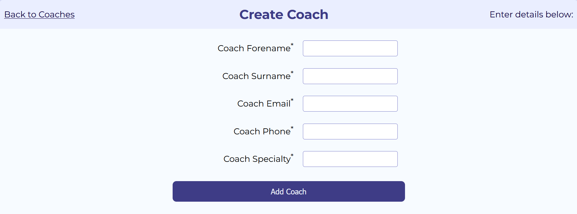
External Add
Ex. Adding a coach:
Add buttons are available for each entity in the system, besides centres, which we decided to keep internal.
Press ‘Add New [entity]’ to add a new entity record to the system:
Formatted using tables and CSS styling.
Visually cued users to indicate whether operations were successful.
Improved user experience with the layout of elements.
A personalised add menu will appear for each specific entity.
Add Restraints: Duplicate records may not be added to the database.

Slide 6
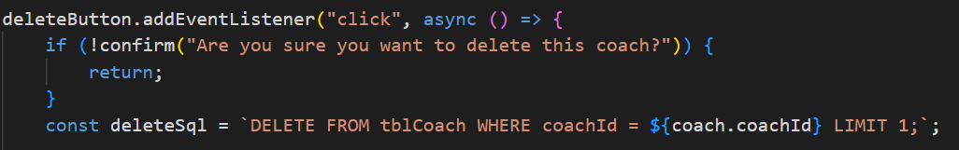
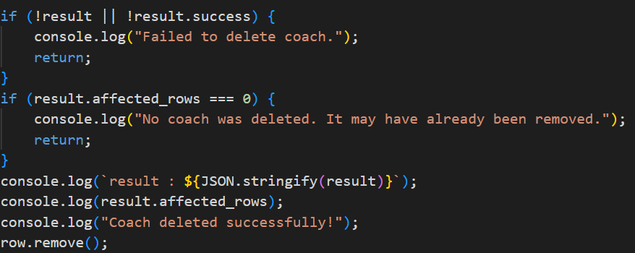
Internal Delete
Ex. Removing a coach:
1. An event listener to ensure the user wants to remove the desired object
Created delete capabilities for each entity row in the database: HTML and JavaScript.
Ensured that only objects without foreign key obstructions can be removed.
2. Await the result and provide feedback to the user to suggest how the operation went.

Slide 7
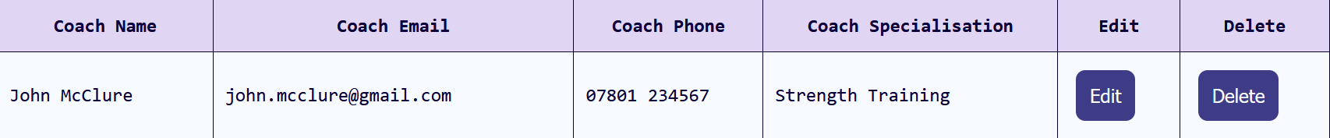
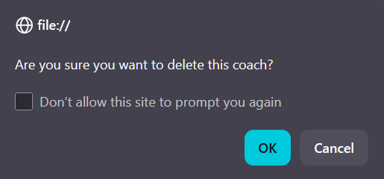
External Delete
Ex. Removing a coach:
Delete buttons are available for every row in the system, besides centres, which we decided to keep internal.
Press ‘Delete’ in the delete column beside the entity’s details to remove an object:
Created a designated row for delete functionalities within each entity’s table.
Confirmation will appear to inform the user that the selected object will be deleted.
Foreign key constraints will prevent certain rows from being deleted.
A personalised confirmation menu will appear for each entity.
Delete Restraints: Foreign key restraints apply.

Slide 8
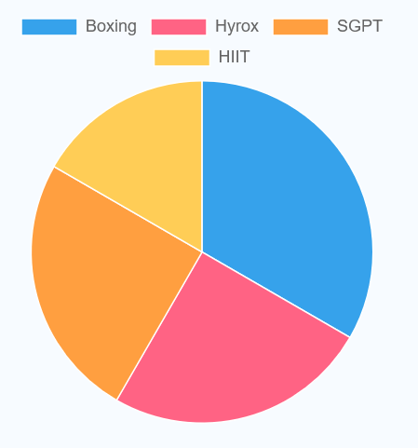
Parameterised Reporting and Charts
-- 1. Query to retrieve the classes with the lowest turnout:
/* This query includes the class category and the number of members reserved.
*/
SELECT
c.className,
SUM(COALESCE(r.memberId IS NOT NULL,0)) AS reservedMembers
FROM tblClass c
LEFT JOIN tblReservation r ON c.classId = r.classId
GROUP BY c.className
ORDER BY reservedMembers DESC;
We contributed individual reports that measure member progress in our fitness centres. These reports are generated using a combination of SCALAR and AGGREGATE functions, JOINs, and the Chart.js library.
For example, this chart identifies members with the greatest difference in muscle mass.
-- These charts visualise our business questions and grant us valuable insights.
-- Monitors the wellbeing of our members, allowing stakeholders to make critical decisions.

Slide 9
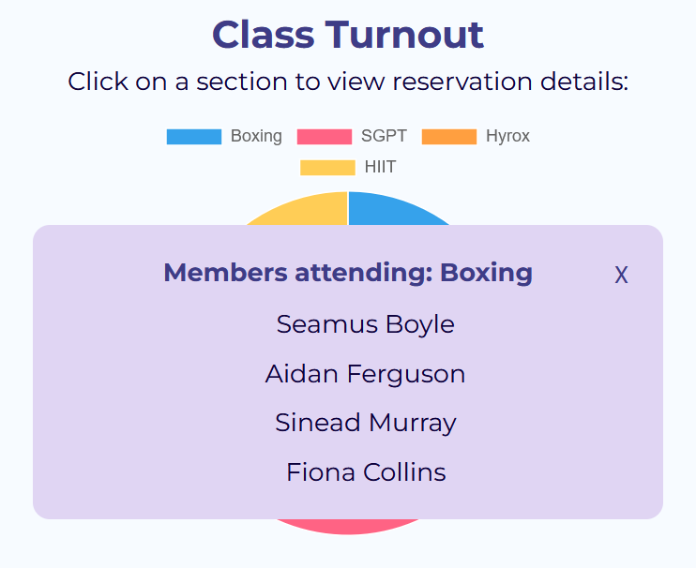
Parameterised Reporting and Charts Cont.
Clicking a section of the pie chart opens a “Member Attendance” modal. It displays all member names assigned to a class category.
After clicking on the “Boxing” section of the chart:
We utilised distinct chart displays to influence the interpretation of statistics.
The pie chart is a visual aid that simplifies management and allows managers to draw comparisons.
Our reports use dynamic interaction, such as clickable items, searching, and dropdowns.

Slide 10
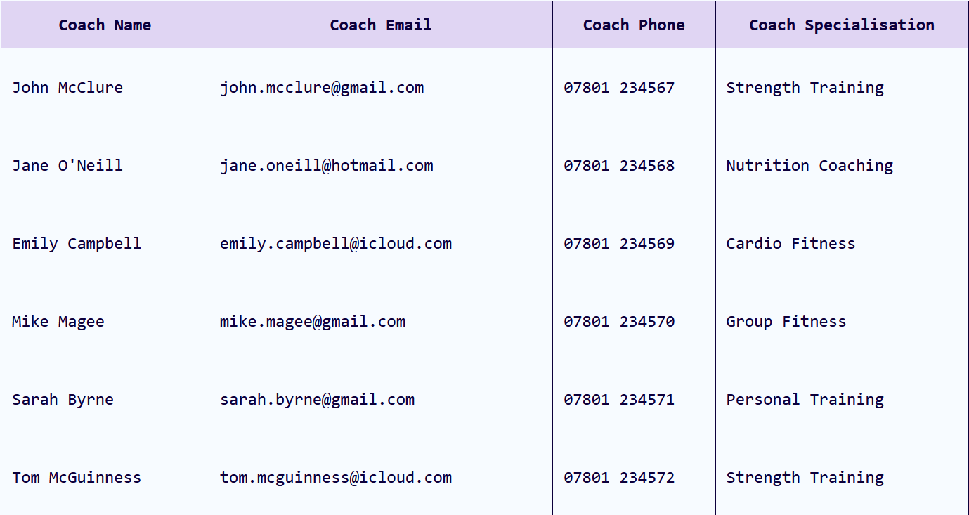
Data Retrieval
-- An example query from our coach table:
SELECT
coachId,
CONCAT(coachForename, ' ', coachSurname) AS coachName,
coachEmail,
coachPhone,
coachSpecialisation
FROM tblCoach;
Used SELECT SQL queries to retrieve data from our local database.
Produced tables that visually help users gain insights from information.
Used functions like CONCAT to simplify searching for specific coaches, coach assignments, members, measurements, and reservations.

Slide 11
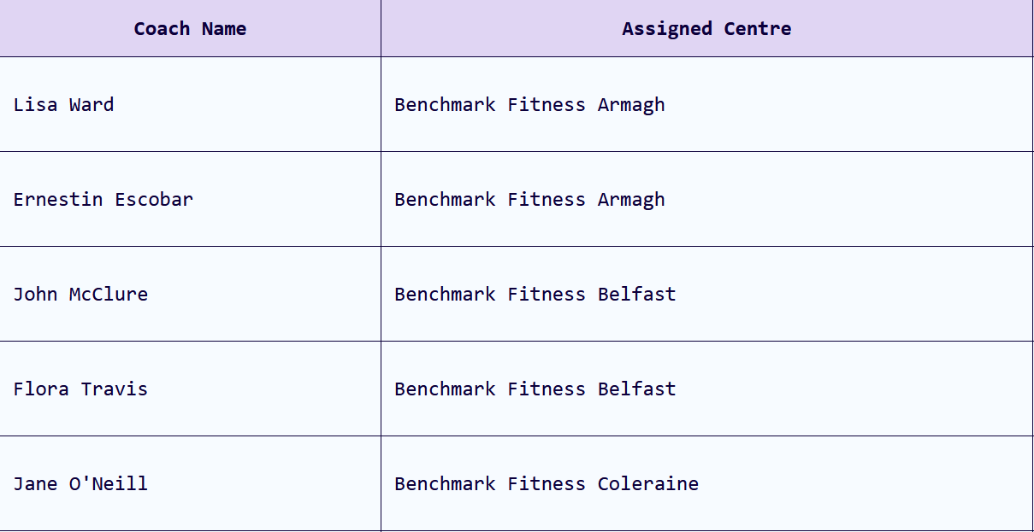
Data Retrieval Cont.
-- An example of how we used an inner join to obtain the names of coaches assigned centres:
SELECT
c.coachId,
ce.centreId,
CONCAT(c.coachForename, ' ', c.coachSurname) AS coachName,
ce.centreName
FROM tblcoachcentre cc
JOIN tblCoach c
ON cc.coachId = c.coachId
JOIN tblCentre ce
ON cc.centreId = ce.centreId;
We used JOINs to link key information from tables using foreign keys.
The IDs that identified key entities allowed us to obtain information from corresponding tables and produce meaningful reports in many of our pages.
For instance, we used an INNER JOIN to retrieve the names of centres that coaches were assigned to using centre IDs:

Slide 12
User Feedback: Validation
-- First, we validate the type of data submitted by the user.
const validateMeasurement = (measurement) => {
if (!measurement || typeof measurement !== "object") {
return "Measurement details are required.";
}
// Clean up and convert values first so the checks below are easier to write.
const memberId = Number(measurement.memberId);
const memberStartWeight = Number(measurement.memberStartWeight);
const memberCurrentWeight = Number(measurement.memberCurrentWeight);
const memberStartMuscleMass = Number(measurement.memberStartMuscleMass);
const memberCurrentMuscleMass = Number(measurement.memberCurrentMuscleMass);
const memberCondition = typeof measurement.memberCondition === "string" ? measurement.memberCondition.trim() : "";
Messages appear after critical operations are performed.
const result = await runQuery(sql);
if (result && result.success) {
showMessage("Coach added successfully!", "success");
form.reset();
return;
}
if (result && result.error) {
showMessage(`Error: ${result.error}`, "error");
} else {
showMessage("Unable to add the record", "error");
}
// Replace single quotes with two single quotes so they are safer inside SQL strings.
// /'/g means "find every single quote in the text" (g = global, so not just the first one).
const escapeSql = (value) => {
return value.replace(/'/g, "''");
}

Slide 13
User Feedback: Add
if (!coachForename || coachForename.length > 50) {
return "Coach Forename is required and cannot exceed 50 characters.";
}
if (!coachSurname || coachSurname.length > 50) {
return "Coach Surname is required and cannot exceed 50 characters.";
}
if (!coachEmail || coachEmail.length > 100) {
return "Coach Email is required and cannot exceed 100 characters.";
}
if (!coachPhone || coachPhone.length > 20) {
return "Coach Phone is required and cannot exceed 20 characters.";
}
if (!coachSpecialisation || coachSpecialisation.length > 100) {
return "Coach Specialisation is required and cannot exceed 100 characters.";
}
return ""; // No problems found.
Performing an ADD operation causes the system validation checks against each field.
Our validation determines whether the success or error messages will appear. For example, if a parameter were too long, an error message would appear. To proceed, the user would have to fix the field.
Checks include length, type, null, and number ranges.

Slide 14
User Feedback: Delete
Provide the user with feedback regarding the query’s outcome. If the query is successful, the row is deleted, and the corresponding table is updated. Otherwise, leave the row and do nothing.
Performing a DELETE operation causes the system to find and remove the object.
const result = await response.json();
if (!result || !result.success) {
console.log("Failed to delete coach.");
errorOutput.textContent = (result.error || "Unknown error");
return;
}
if (result.affected_rows === 0) {
console.log("No coach was deleted. It may have already been removed.");
errorOutput.textContent = "No coach was deleted. It may have already been removed.";
return;
}
console.log(`result : ${JSON.stringify(result)}`);
console.log(result.affected_rows);
row.remove();
console.log("Coach deleted successfully!");
if (!confirm("Are you sure you want to delete this coach?")) {
return;
}
const deleteSql = `DELETE FROM tblCoach WHERE coachId = ${coach.coachId} LIMIT 1;`;
const response = await fetch(url, {
method: "POST",
body: new URLSearchParams({
query: deleteSql
})
});
const result = await response.json();

Slide 15
Error Handling
* These functionalities are present for each entity and fetch request in our database.
We incorporated handlers throughout our code to gracefully handle errors and provide actionable feedback to users.
Here, running a query performs a try-catch statement to handle responses.
This prevents errors from breaking or corrupting the system’s functionality.
const runQuery = async (sql) => {
try {
const url = "http://localhost/dbConnector.php";
const response = await fetch(url, {
method: "POST",
body: new URLSearchParams({ query: sql })
});
if (!response.ok) {
throw new Error(`HTTP Error ${response.status}`);
}
const result = await response.json();
return result;
} catch (error) {
console.log(error.message);
}
}

Slide 16
Thank You
Madeline Brum
mbrum01@qub.ac.uk
40483710

