Slide 1
Quick
Reference Guide
for
Web Elements
Student No. 40486524
Student Name: Hana Maria Tom

Slide 2
Table of Contents
𝟙
Introduction & Contribution
𝟚
Website Structure
𝟛
CRUD Functionality
𝟜
Reporting & Visulisation

Slide 3
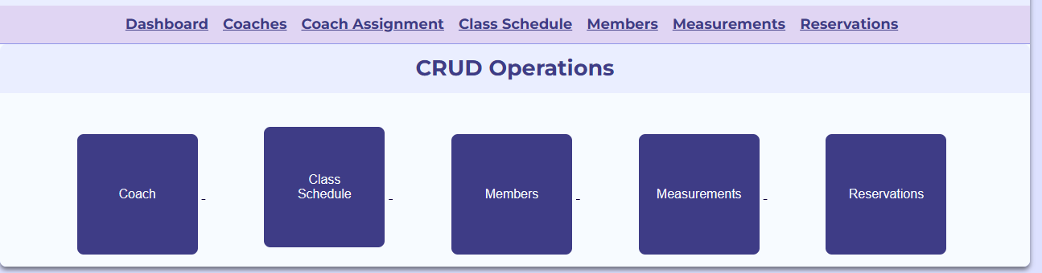
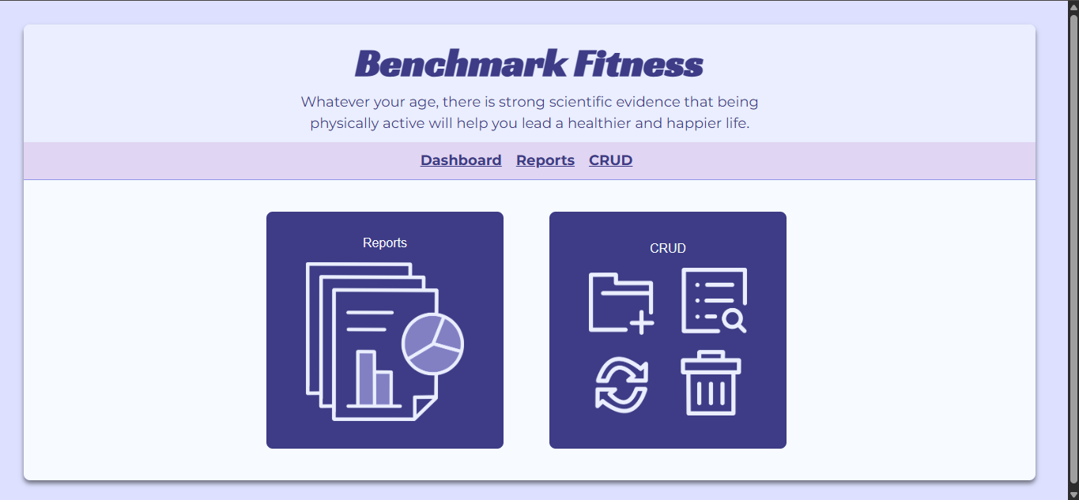
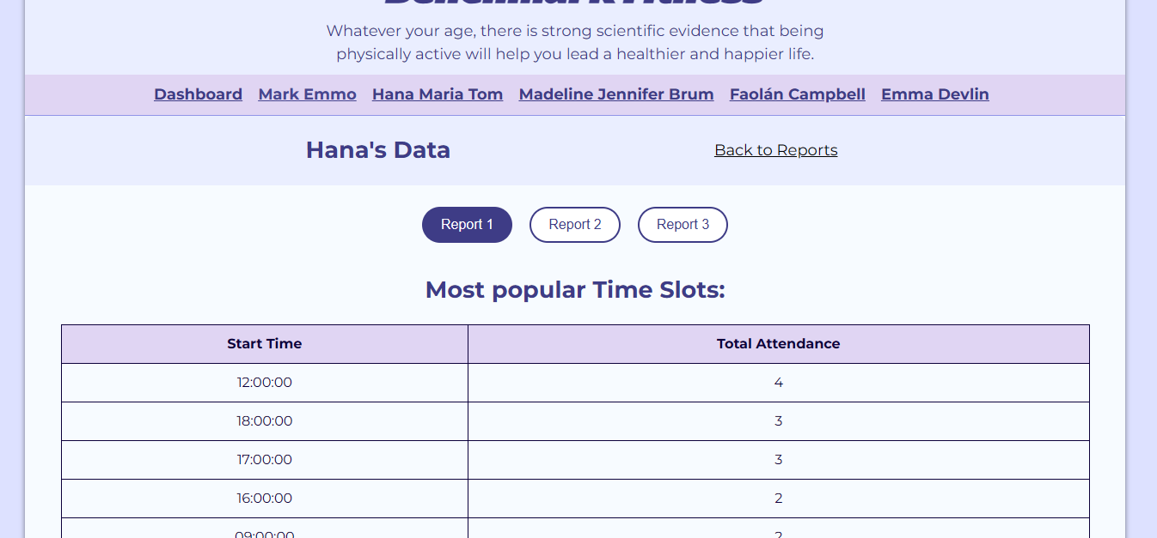
Introduction & Contribution
I contributed to the design and development of the web interface for our database system, focusing on both functionality and presentation. My work supported the overall usability, data integrity, and reporting capabilities of the application.
Implementation of CRUD functionality (Create, Read, Update, Delete)
Development of individual SQL reports
Client-side validation for form inputs
User feedback and confirmation messages
Dynamic data retrieval from the database
Support for reporting and visualisation features
CSS and page layout

Slide 4
Website Structure
The website is organised into separate HTML, CSS, and JavaScript files to support CRUD functionality, reporting, and user interaction across the system.
WEB APP/ │ ├── AddHTML/ │ ├── addClass.html │ ├── addCoach.html │ ├── addCoachCentre.html │ ├── addMeasurement.html │ ├── addMember.html │ └── addReservation.html │ ├── CSS/ │ ├── emmaData.css │ ├── hanaData.css │ ├── markData.css │ ├── style.css │ ├── DataHTML/ │ ├── EmmaData.html │ ├── FaolánData.html │ ├── HanaData.html │ ├── MaddyData.html │ └── MarkData.html │
├── EditHTML/ │ ├── editCentre.html │ ├── editClass.html │ ├── editCoach.html │ ├── editCoachCentre.html │ ├── editMeasurement.html │ ├── editMember.html │ └── editReservation.html │ ├── HTML/ │ ├── class.html │ ├── coach.html │ ├── coachCentre.html │ ├── crud.html │ ├── index.html │ ├── measurement.html │ ├── member.html │ ├── reports.html │ └── reservation.html │ ├── Images/ │
├── JS/ │ ├── AddJS/ │ │ ├── addClassScript.js │ │ ├── addCoach.js │ │ ├── addCoachCentre.js │ │ ├── addMeasurementScript.js │ │ └── addMemberScript.js │ │ │ ├── DefaultJS/ │ │ ├── indexScript.js │ │ ├── measurementScript.js │ │ ├── memberScript.js │ │ └── classScript.js
│ │ ├── coachScript.js │ │ └── coachCentreScript.js │ │ └── reservationScript.js │ │ │ ├── EditJS/ │ │ ├── editCentreScript.js │ │ ├── editClassScript.js │ │ ├── editCoachCentreScript.js │ │ ├── editCoachScript.js
││ │ ├── editMeasurementScript.js │ │ ├── editMemberScript.js │ │ └── editReservationScript.js │ │
└── Reports/ │ ├── emmaFilter.js │ ├── emmaReport.js │ ├── FaolánReport1.js │ ├── filter.js │ ├── hanaReport.js │ ├── maddyReport.js │ └── MarkReport.js

Slide 5
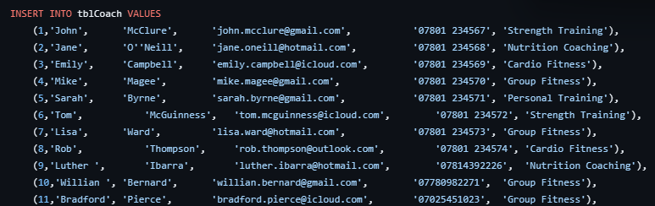
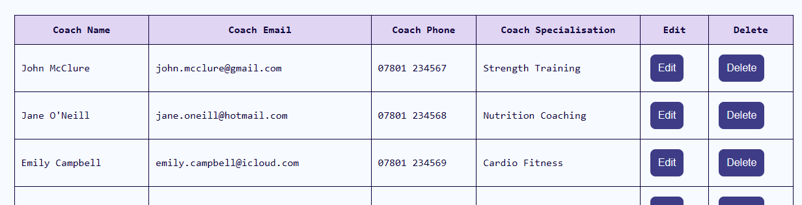
CRUD Functionality
Select queries are used to retrieve and display database records within the CRUD page. JOIN statements combine related tables so all necessary entities and linked information can be shown together.
Insert queries are used within the CRUD page to add new records to the database. User input from web forms is validated before an SQL INSERT statement is executed, ensuring that only accurate and complete data is stored.
SELECT coachId, CONCAT(coachForename, ' ', coachSurname) AS coachName, coachEmail, coachPhone, coachSpecialisation
FROM tblCoach;

Slide 6
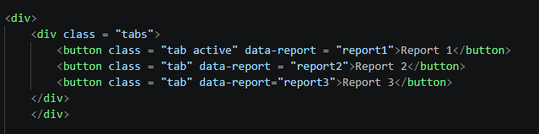
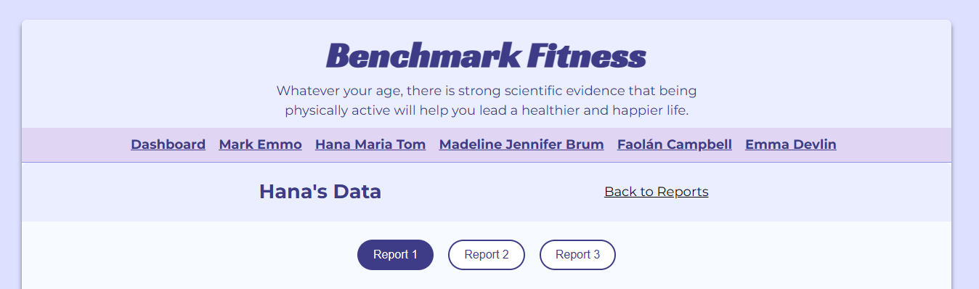

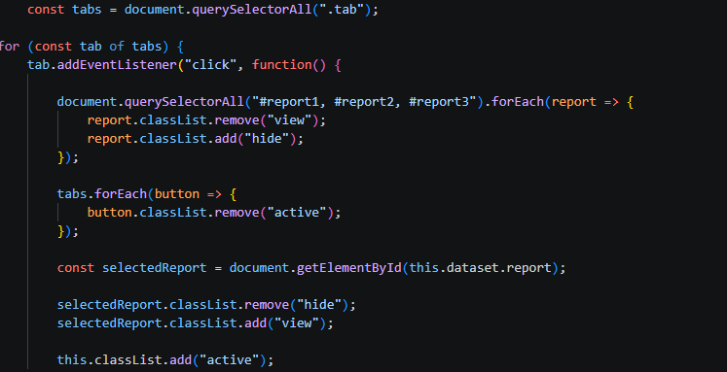
Reporting & Visualisation
Reporting and visualisation features were used to display meaningful
database insights through dynamic reports and charts.
3 reports were created:
Most Popular Time Slots
Member Per Centre
Member Attendance
Easy switching between reports

Slide 7
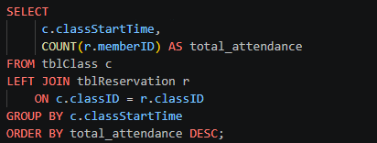
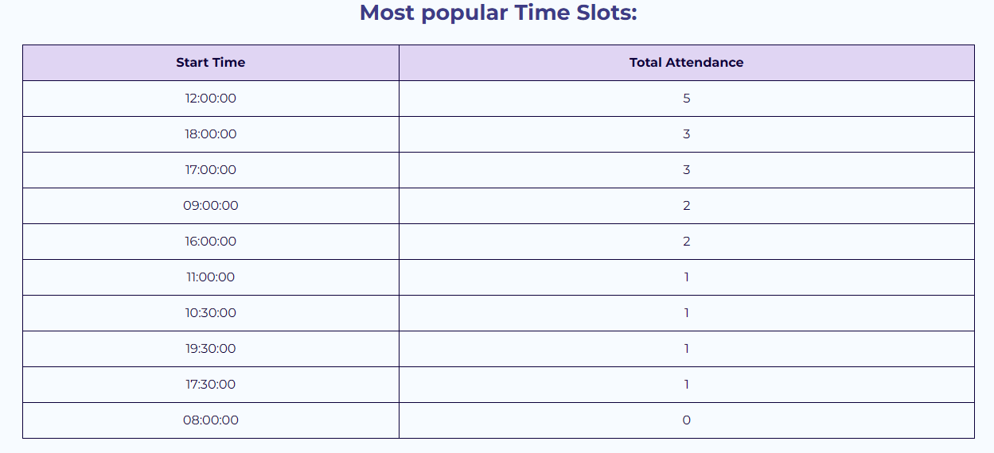
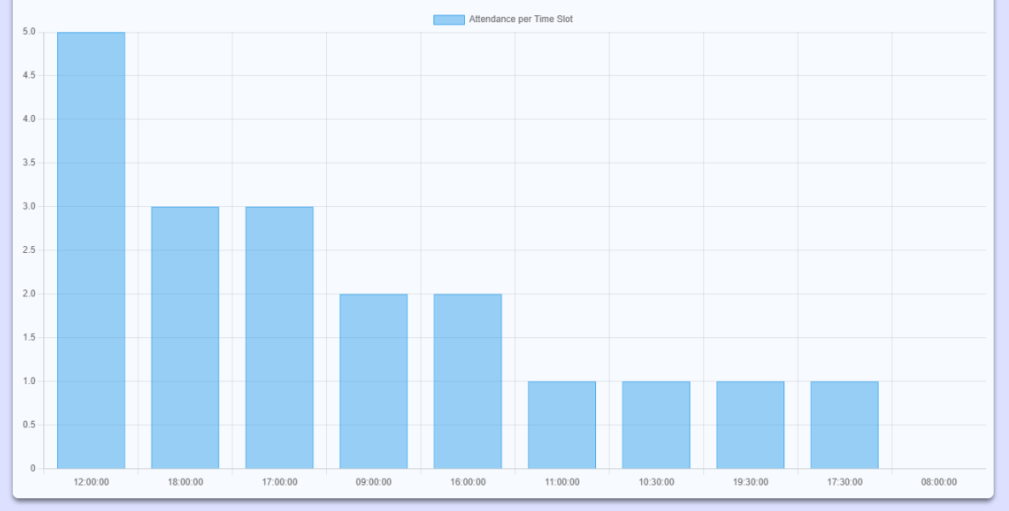

Parameterised Reports
REPORT 1
Most Popular Time Slots
These reports are generated using a combination of SCALAR and AGGREGATE functions, JOINs, and the Chart.js library.
Some reports include charts alongside tables to present data visually and improve understanding of key information.

Slide 8
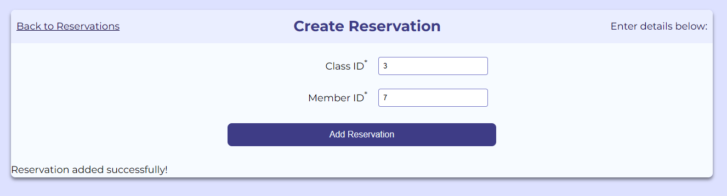


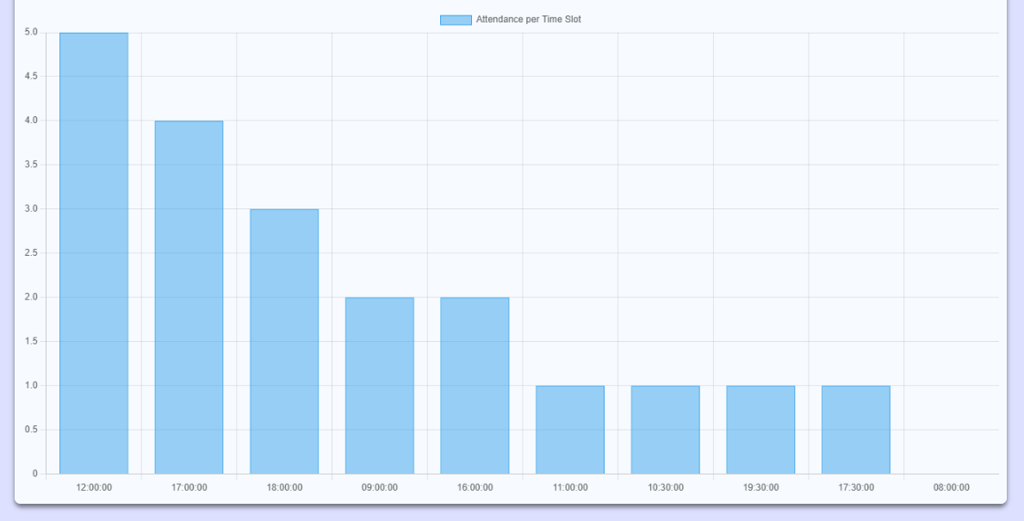
Parameterised Reports
REPORT 1
Most Popular Time Slots
Reports are dynamic, meaning they update automatically based on live database data and selected user inputs or filters.

Slide 9
Thank You

