Slide 1

DATA Analysis / EDA
Project – November 2023
Marita Schmidt – 30. November 2023

Slide 2

The Clients
William Rodriguez and Samuel Davis
University Professor and Doctor of Dental
moving to Seattle for job-related reasons
Searching for 2 Houses

Slide 3
Which Kind of Houses?
City House
Country House
central
condition higher than standart
2 bathrooms minimum
2 bedrooms or more
younger than 15 years or renovated
has to found fast!!
rural environment
non-renovatend
standart Condition
can be found over a year
Budget for both up to $1,5 Million

Slide 4
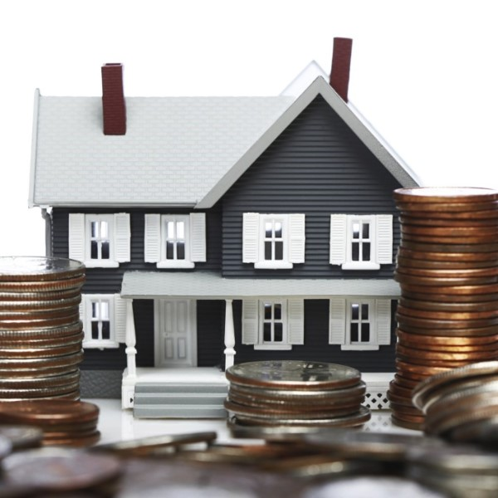
The Dataset
King County Housing Data:
  Home sales in King County
  (Seattle and around)
  21597 Houses
  Period: May 2014 – May 2015

Slide 5
Questions and Hypothesis
Questions
Hypothesis
Where to find?
What Houses?
When to Buy?
The lots in the city are tiny im comparison to the lots of the country houses.
with higher price you will get better conditions
prices go up and down over the year
Let‘s see if these hypothesis can be confirmed!

Slide 6
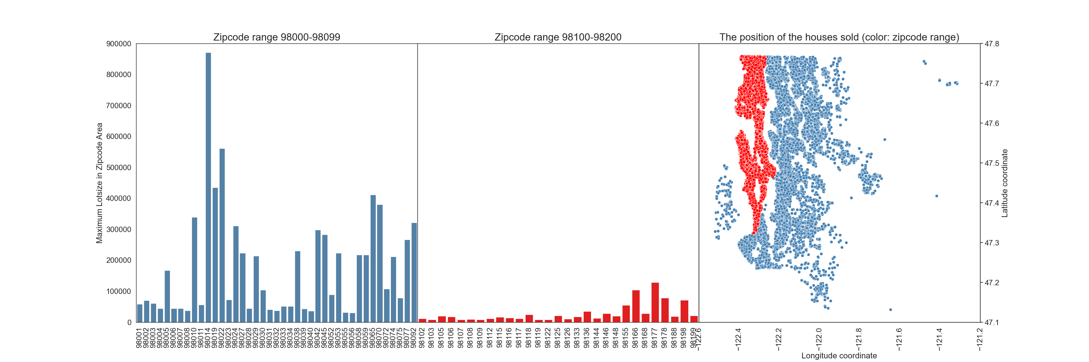
Maximum LOTSIZE of the Neighbarhood in zipcode area
It is very clear to see that the lot sizes in the 2nd half of the zipcodes are much smaller.
If you look at the position of the zipcode, you can see that these areas are also connected.

Slide 7
Conclusion for zipcode area
Due to the correlation of the lotsize and the zipcode-range we can assume to find
  …the city house in the zipcode range 98100-98199
  …the country house in the zipcode range 98000-98099

Slide 8
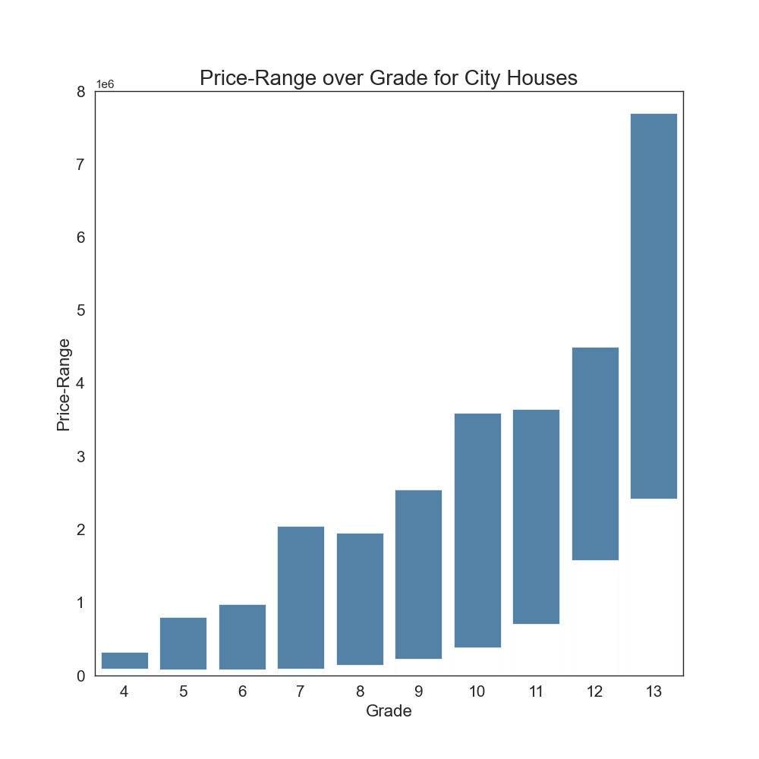
King County Grading System
houses in the data set were rated based on the Kind county grade system
the system represent the construction quality of buildings
the houses in the dataset are rated from 4 to 13
grade 7 and 8 represent the normal standart
the plot shows the price-range of the city houses for each grade
price and rating correlate with each other
low qual.
standart
high qual.

Slide 9
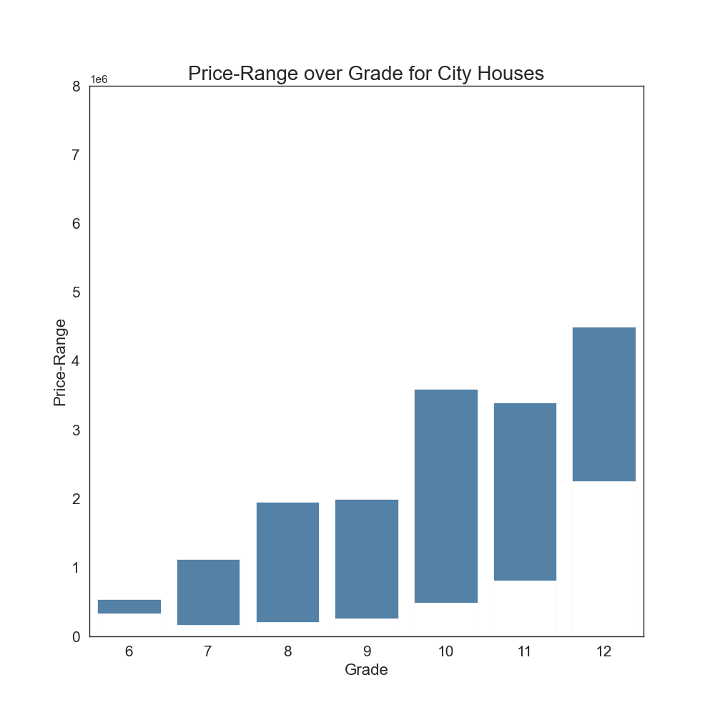
Budget for The City House
filtering the plot data with our specifications:
  2 bathrooms minimum
  2 bedrooms or more
  younger than 15 years or renovated
for condition with higher standart we can choose grades 9 - 11
this fits to our budget up to $1.000.000

Slide 10
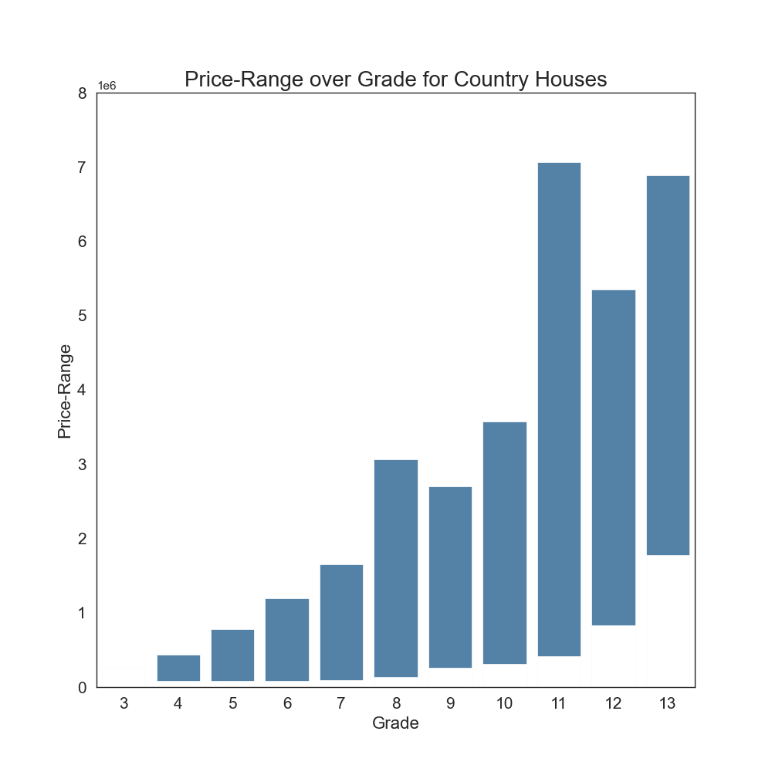
Budget for The Country House
the country house has no specification,
it just has to be non-renovated
with the leftover budget, the clients will have a wide range of grades to choose
(grade 4 – 11)

Slide 11
Conclusion and Suggestions For the Houseprice
The best Budget-range for the city House will be $750.000 – $1.000.000
  the clients can get the higher standart with the grade 9-11
The best Budget for the country house will be up to $500.000
  the clients can choose in the range of grades 4 till 11

Slide 12
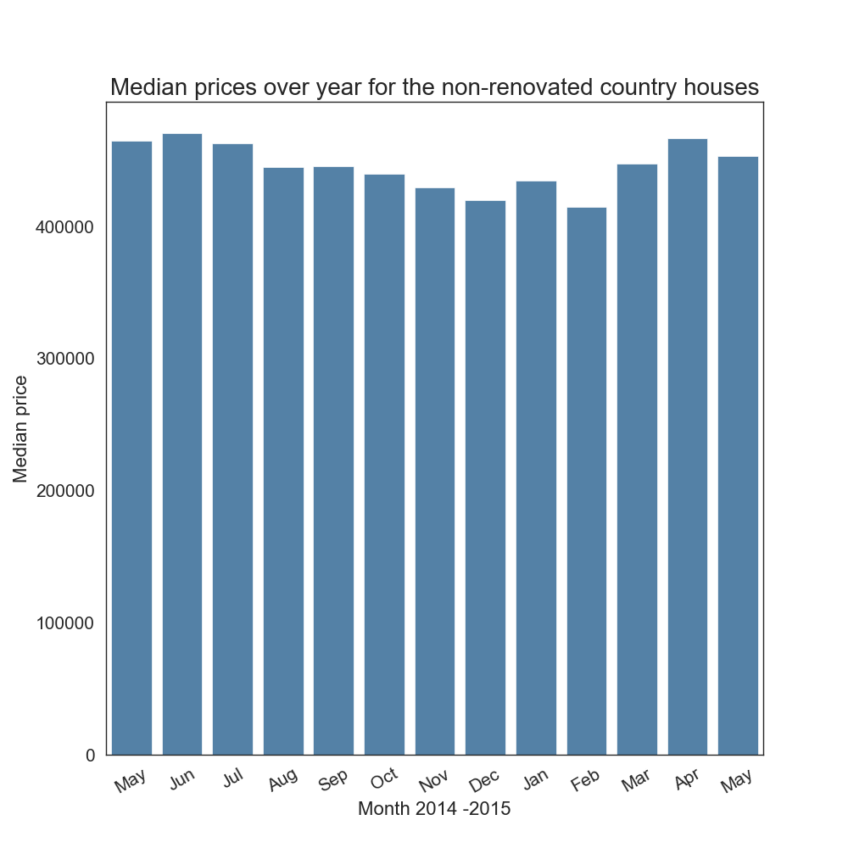
Price over the year
The townhouse has to be bought immediately
But for the country house they have planned a longer period of time for the search
The plot shows the median price for the non-renovated country houses of each month of the data set
It can be seen that the prices of houses which are sold in winter are lower

Slide 13
Conclusion for price over time period
The plot shows, that the prices in winter are lower.
However, it should be noted that the data was only collected for the period of one year.
It is possible that it is like this every year, but this cannot be verified with this data.

Slide 14
Summary
City House
Country House
zipcode range 98100-98199
Budget $750.000 – $1.000.000
Kind county grade system: grade 9 - 11
zipcode range 98000-98099
Budget up to $500.000
Best time to buy is probably winter

