Slide 1
Democracy?
Or dictatorship?

Slide 2

input

Slide 3
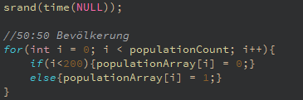
Setup

Slide 4
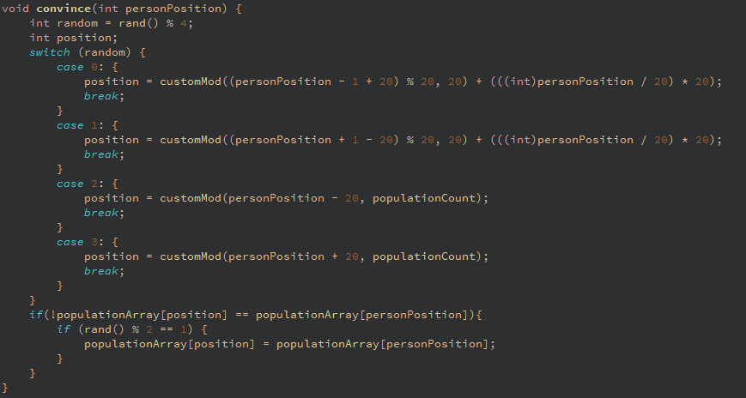
Convince

Slide 5
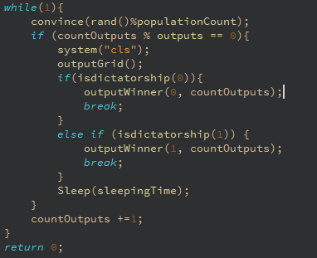
Loop

Slide 6
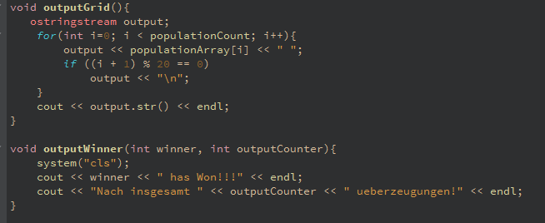
output

Slide 7
Was ich gelernt habe
C++

