Slide 1
RECIPE PREPARATION AGENT
CAPSTONE PROJECT
Presented By:
Student Name – Mohit Bansal
College Name – ITM UNIVERSITY

Slide 2
OUTLINE
Problem Statement
Proposed Solution
System Development Approach (Technology Used)
Algorithm & Deployment
Result (Output Image)
Conclusion
Future Scope
References

Slide 3
Problem Statement
Statement 16.
The Recipe Preparation Agent helps users cook meals using only the ingredients they have on hand. By inputting available groceries, users receive tailored recipe suggestions using a RAG-based AI system. The agent retrieves relevant recipes and generates step-by-step instructions adapted to ingredient limitations. It offers substitutions, cooking tips, and dietary adjustments based on user preferences or restrictions. Designed to reduce food waste and save time, it turns pantry items into practical meal solutions.
This AI assistant makes everyday cooking smarter, simpler, and more sustainable.

Slide 4
Proposed Solution
The proposed system addresses the challenge of helping users cook meals based on the limited ingredients they have on hand. By leveraging IBM Cloud's Watsonx, Granite LLMs, and Agent Lab, the solution uses advanced AI techniques to retrieve and generate custom recipe suggestions while minimizing food waste and optimizing user experience. The solution will consist of the following components:
Data Collection
A dataset of ~13,000 structured recipes by Joseph R. Martinez is uploaded to IBM Cloud Object Storage.
Each recipe contains ingredients, instructions, cuisine tags, and dietary details.
Retrieval Mechanism (RAG-based)
The system uses a Retrieval-Augmented Generation (RAG) approach to fetch relevant recipes based on the user's input ingredients.
Recipes are retrieved using semantic similarity from the stored dataset.
AI-Powered Adaptation using Watsonx Granite Models
The retrieved recipe is passed to IBM’s Granite foundation model to adapt the instructions based on ingredient availability.
Cooking tips and modifications are suggested according to the user's dietary preferences.
Agentic Workflow (Agent Lab)
The entire logic is implemented as an AI agent within Watsonx Agent Lab.
The agent combines retrieval, prompt engineering, and model inference in a single workflow.
Deployment
The AI agent is deployed through Watsonx Runtime and accessed via the Endpoint URL.
This ensures scalability and seamless user interaction.
Evaluation
The system is tested based on user satisfaction, relevance of suggested recipes, and response accuracy.
Future improvements include user feedback integration for recipe quality and personalization tuning.

Slide 5
System Approach
The "System Approach" section outlines the overall strategy and methodology for developing and implementing the Recipe Preparation Agent using IBM Cloud services. The system leverages AI and RAG-based techniques integrated via Agent Lab to deliver customized recipe recommendations. Here's the structure for this section:
System Requirements
IBM Cloud account
Watsonx.ai access with Agent Lab enabled
IBM Granite 8-8-3b-instruct model
IBM Cloud Object Storage (for uploading the recipe dataset)
Recipe Dataset: ~13,000 structured recipes
Libraries & Tools Used
IBM Watsonx Agent Lab (for creating and deploying agents)
Watsonx Runtime (for executing LLMs via endpoint)
IBM Granite LLM APIs (for recipe adaptation and text generation)
Prompt Engineering Techniques (used within agent tools for tailoring outputs)

Slide 6
Algorithm & Deployment
This section outlines the algorithmic foundation and deployment strategy for the Recipe Preparation Agent. The solution utilizes a Retrieval-Augmented Generation (RAG) approach integrated with IBM’s Granite large language models, enabling personalized recipe generation based on user-provided ingredients.
Algorithm Selection:
The system uses a RAG (Retrieval-Augmented Generation) architecture. This approach combines:
Retrieval of relevant recipe documents from a dataset stored in IBM Cloud Object Storage
Generation of custom recipe instructions using the IBM Granite LLM hosted on Watsonx
RAG is chosen for its strength in handling open-ended user queries by grounding generation on reliable, retrieved documents — ideal for cooking scenarios with dynamic ingredients and preferences.
Data Input:
The input to the system includes:
A list of available ingredients entered by the user
Optional preferences such as dietary restrictions or cuisine type
These inputs are passed to the Watsonx agent, which uses them to guide the retrieval and generation process.

Slide 7
Generation Process and Deployment
Generation Process
Retrieved recipes are fed into IBM’s Granite foundation model via the Watsonx Runtime
The model adapts instructions to:
Remove unavailable ingredients
Suggest substitutions
Offer dietary/cooking tips
The generation process is controlled via prompt engineering inside the Agent Lab environment
Deployment
The final AI agent is deployed in Watsonx Agent Lab’s Deployment Service.
This allows easy integration into web interfaces or other client applications
The system supports scalable and real-time interaction
GITHUB LINK
https://github.com/M4ban/IBM-SkillsBuild-Project.git

Slide 8
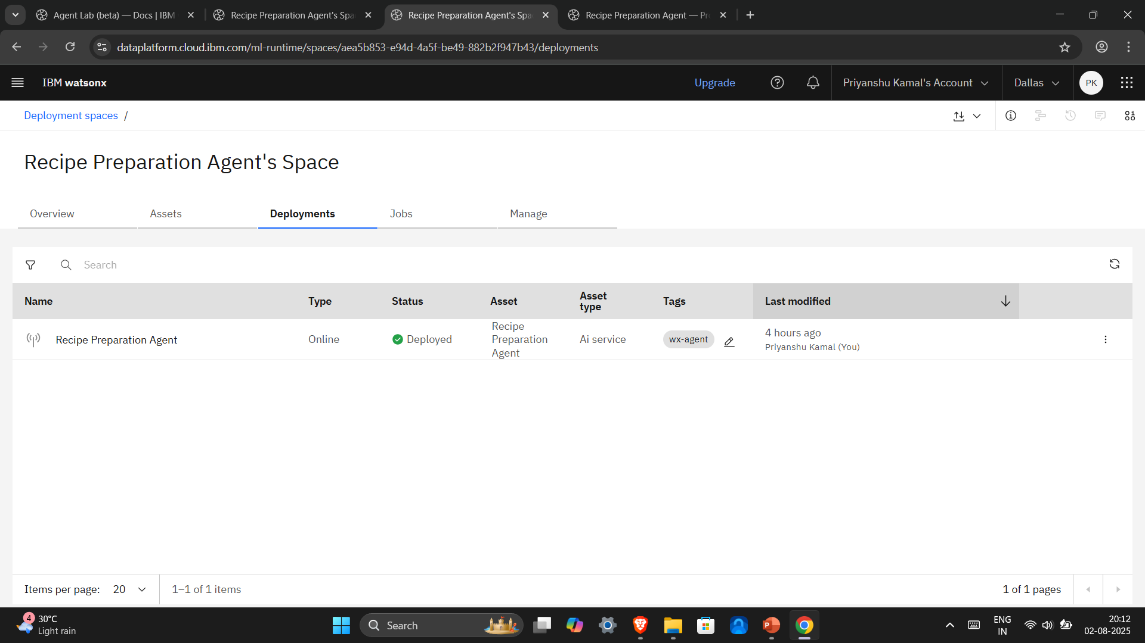
Deployment Proof 01/02
Successfully deployed project.

Slide 9
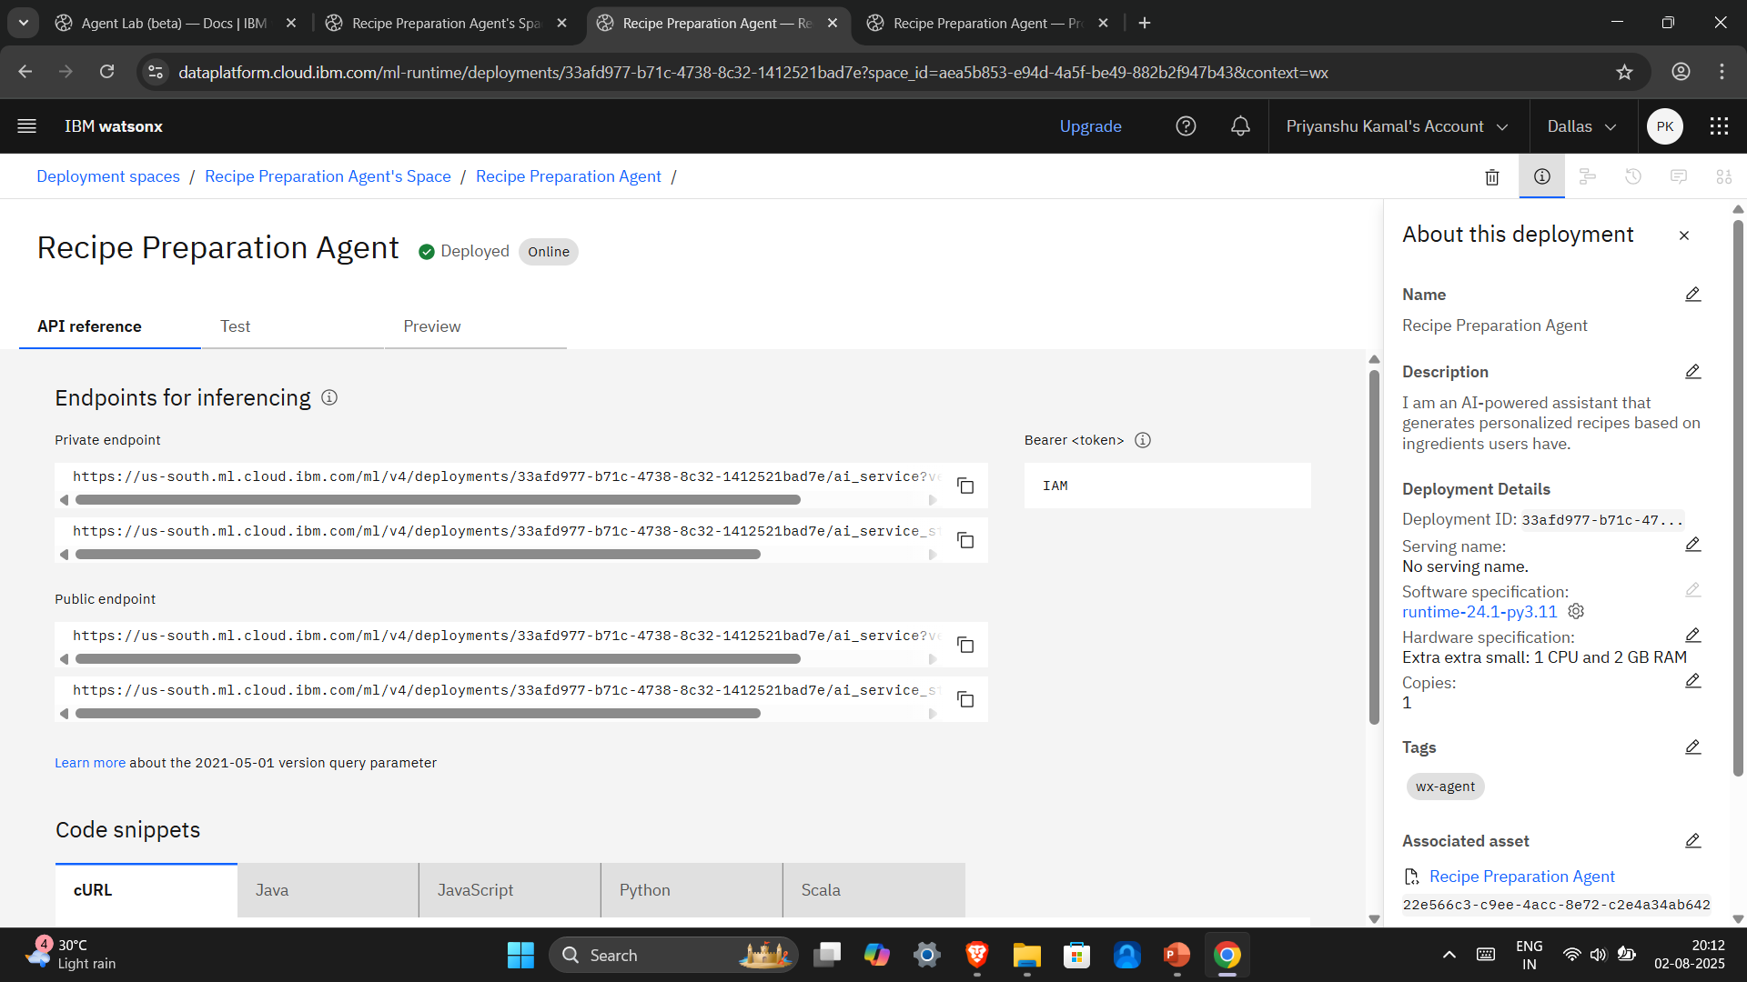
Deployment Proof 02/02

Slide 10
Result
The Recipe Preparation Agent successfully generates personalized recipe instructions tailored to the user's available ingredients and dietary preferences. The system demonstrates effectiveness in retrieving and adapting recipe content using the RAG approach powered by IBM’s Granite foundation model.
Observed Outcomes
The agent retrieves relevant recipes with high semantic match to user-provided ingredients.
IBM Granite LLM accurately adapts instructions, removes unavailable items, and suggests valid substitutions.
Users receive complete, step-by-step cooking instructions tailored to their constraints and preferences.
Examples of Output
Given: “eggs, tomatoes, onions, rice” Output: Tomato Egg Fried Rice with precise steps, suggested substitutions like “use green peas instead of bell peppers”, and tips such as “best served with chutney or yogurt.”
Visuals in forthcoming slides.

Slide 11
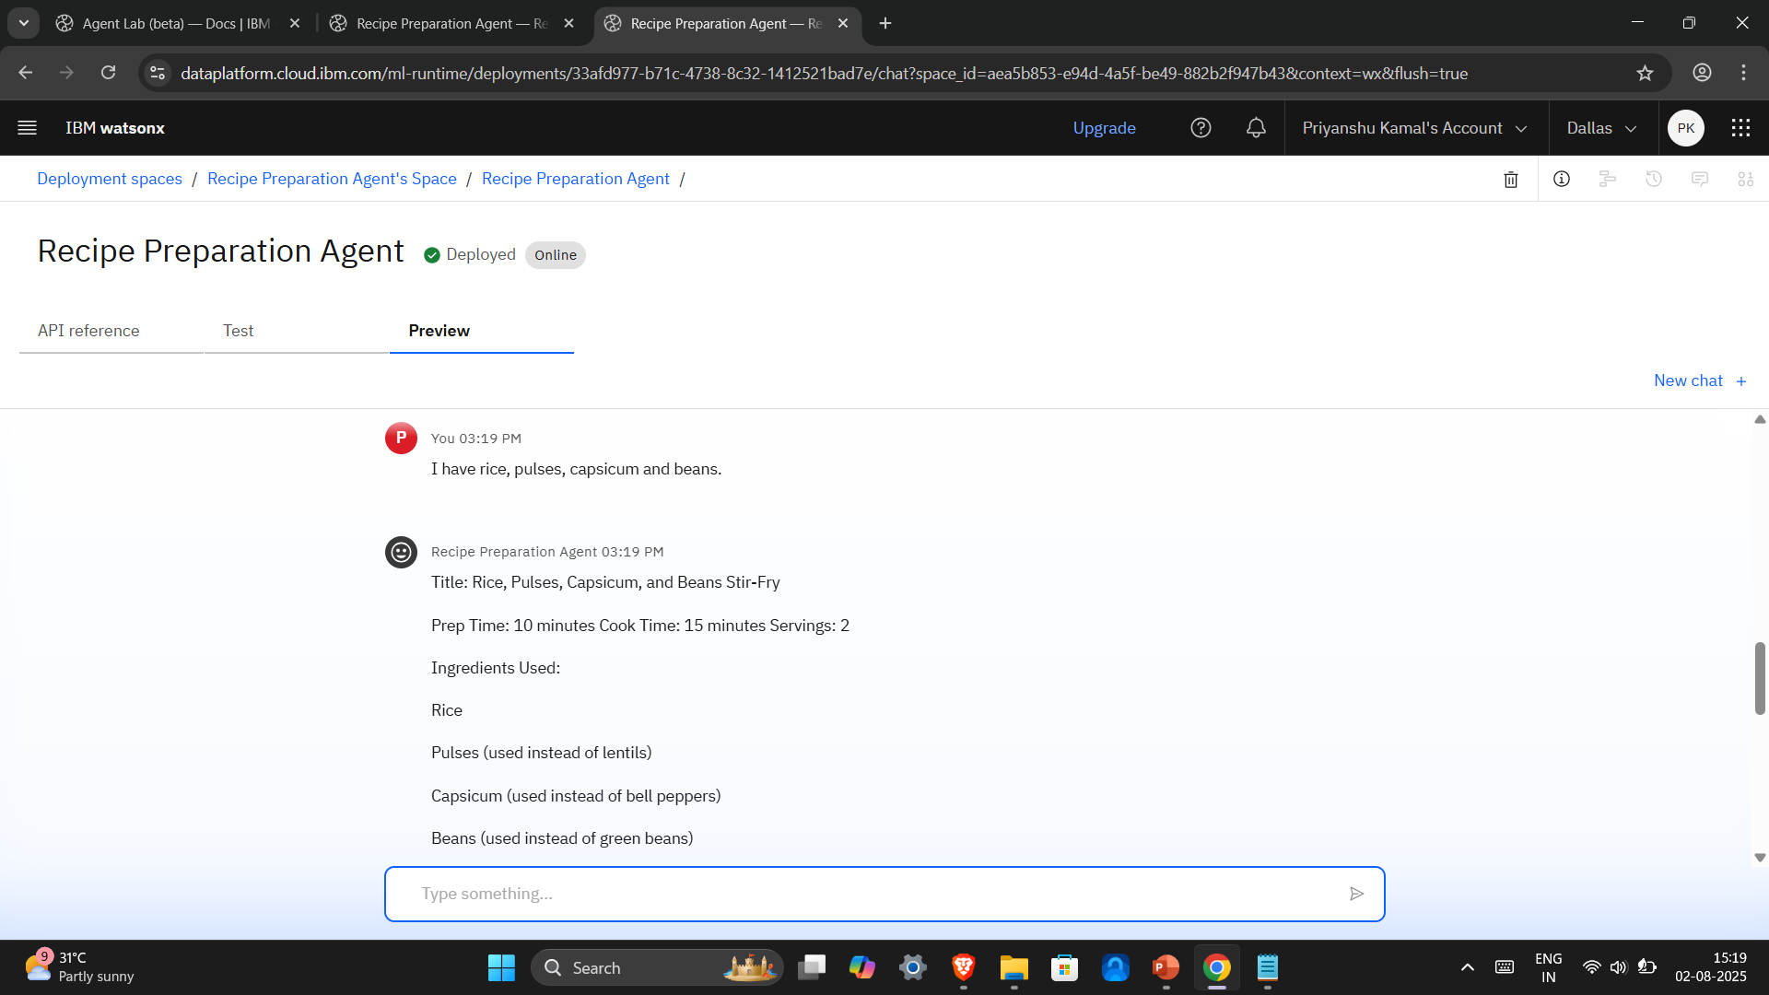
Test Result 01 – 1/3
Input – “I have rice, pulses, capsicum and beans.”

Slide 12
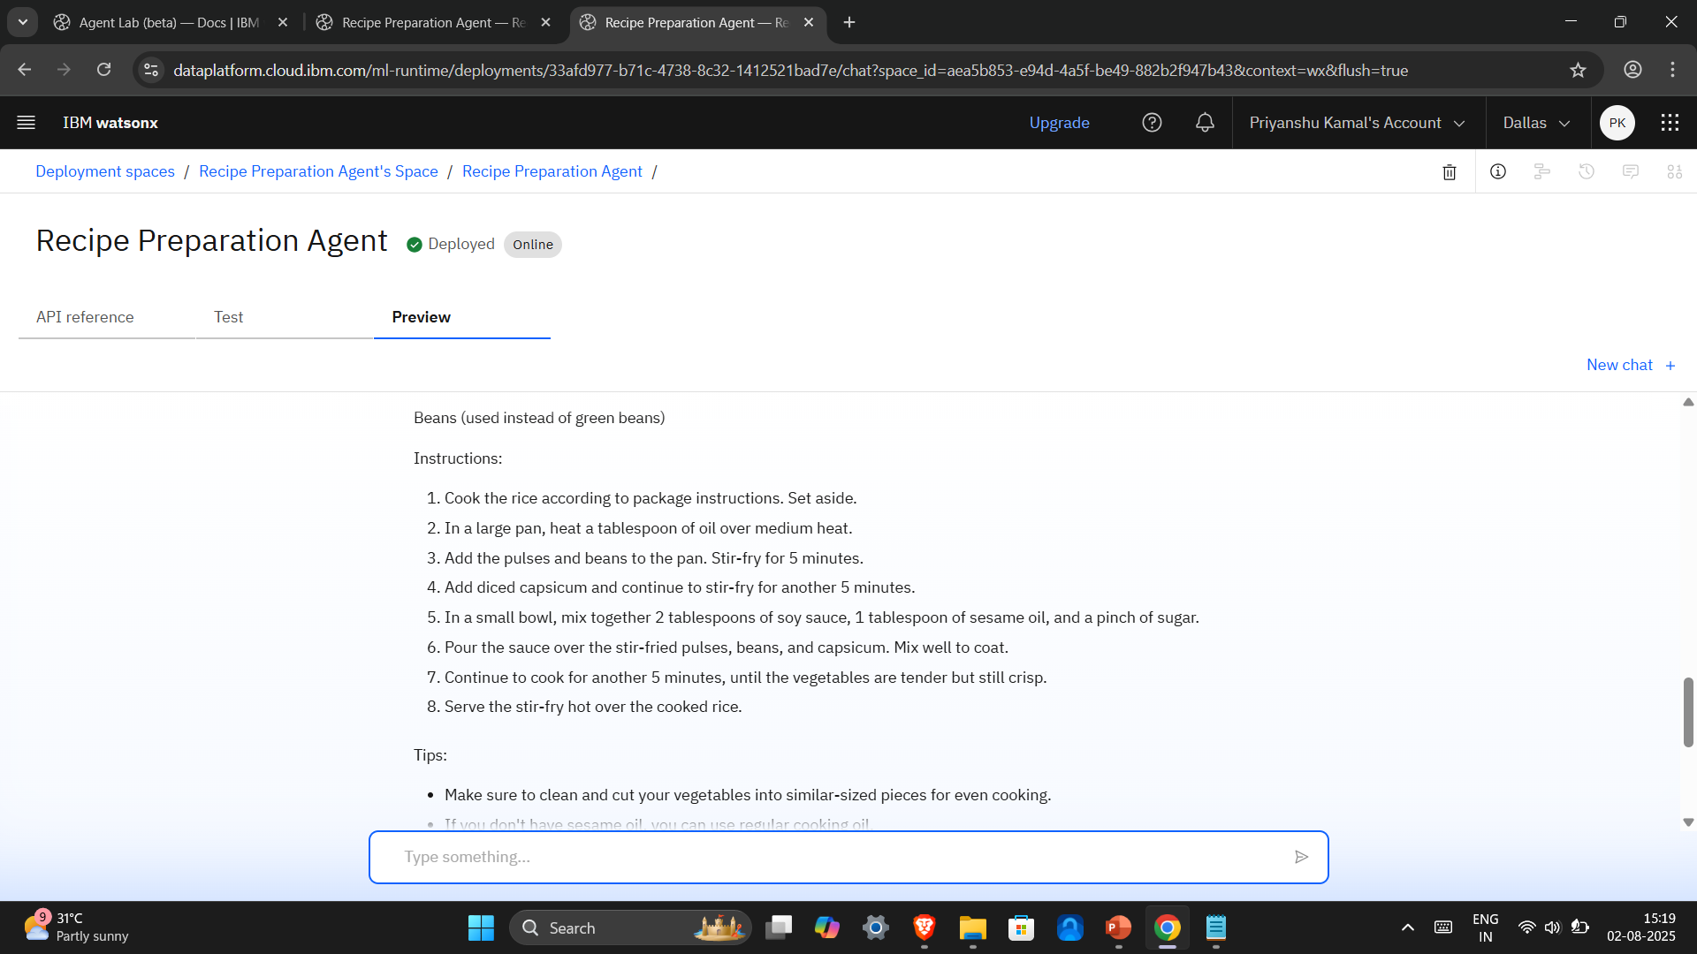
Test Result 01 – 2/3

Slide 13
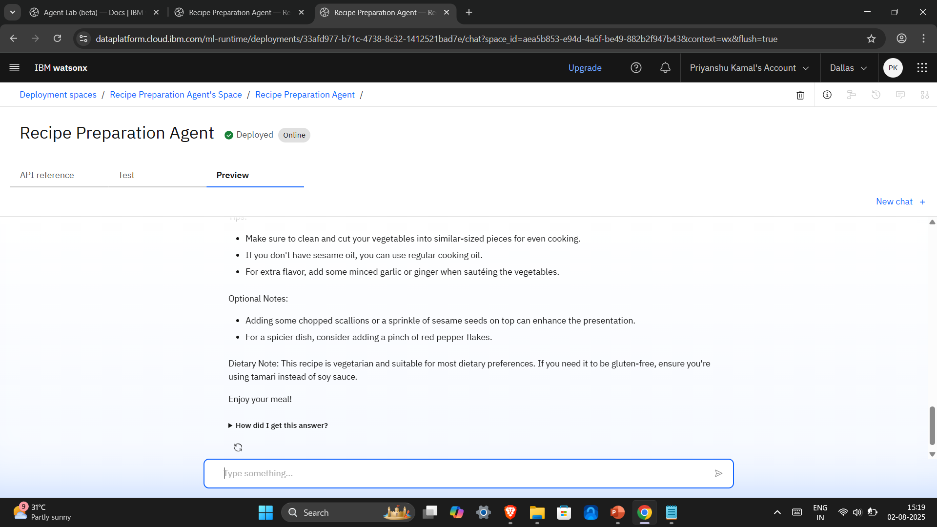
Test Result 01 – 3/3

Slide 14
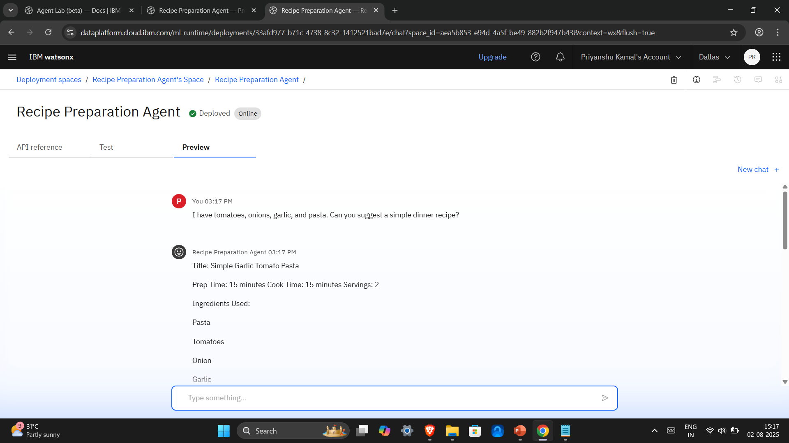
Test Result 02 – 1/3
Input – “I have tomatoes, onions, garlic, and pasta. Can you suggest a simple dinner recipe.”

Slide 15
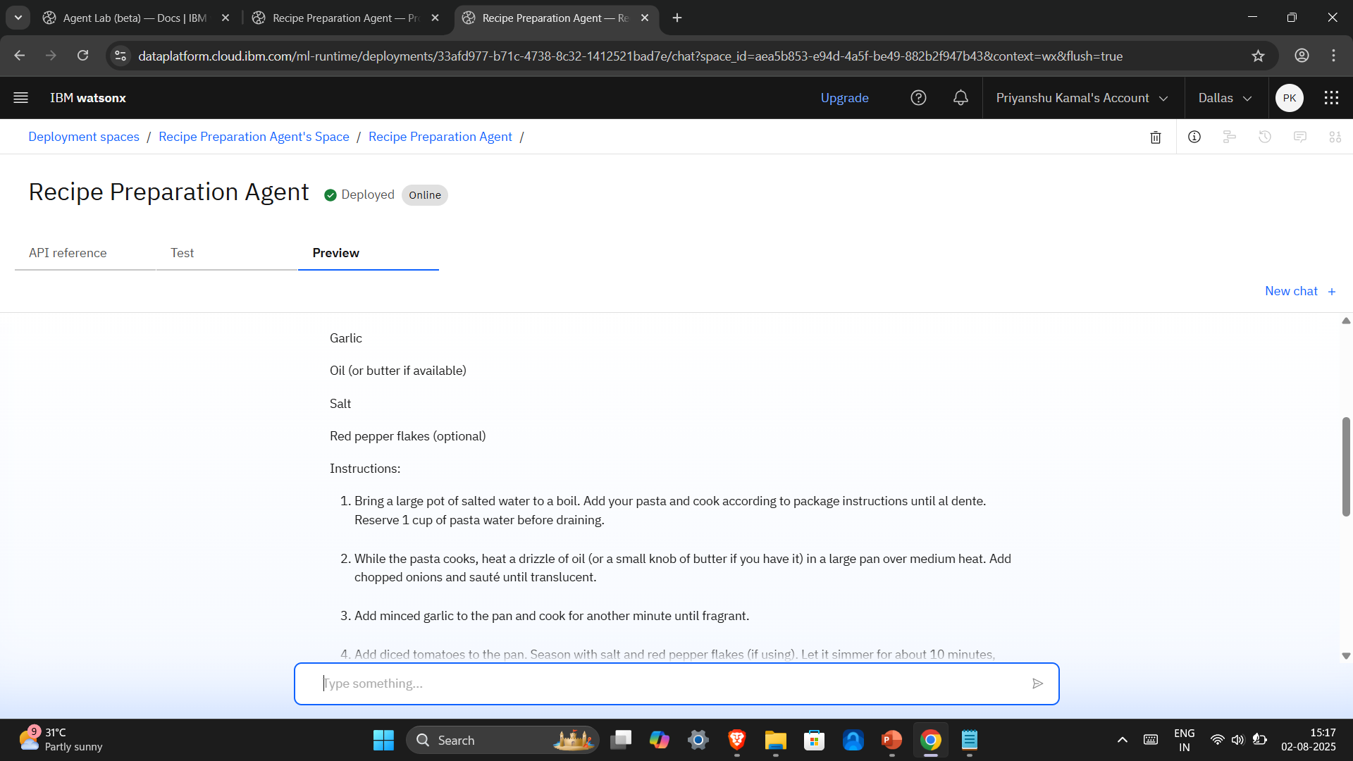
Test Result 02 – 2/3

Slide 16
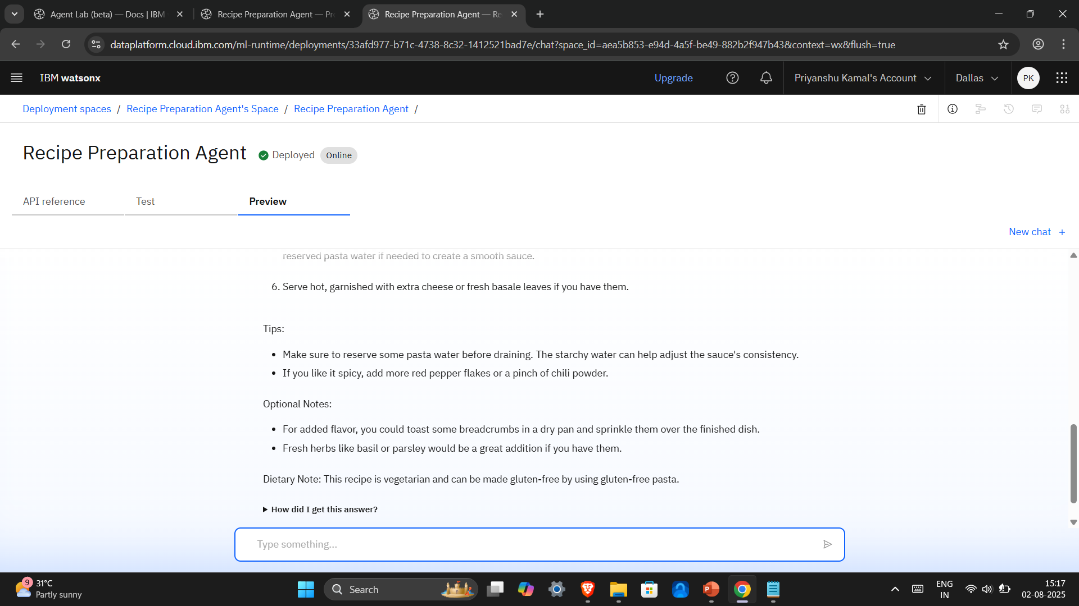
Test Result 02 – 3/3

Slide 17
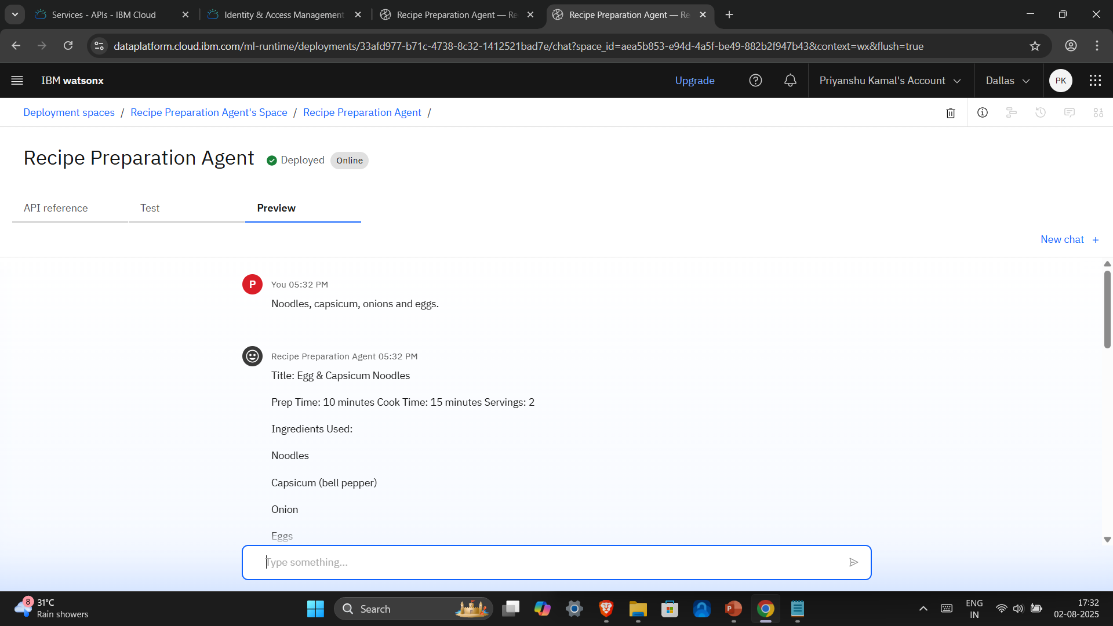
Test Result 03 – 1/4
Input – “Noodles, capsicum, onions and eggs.”

Slide 18
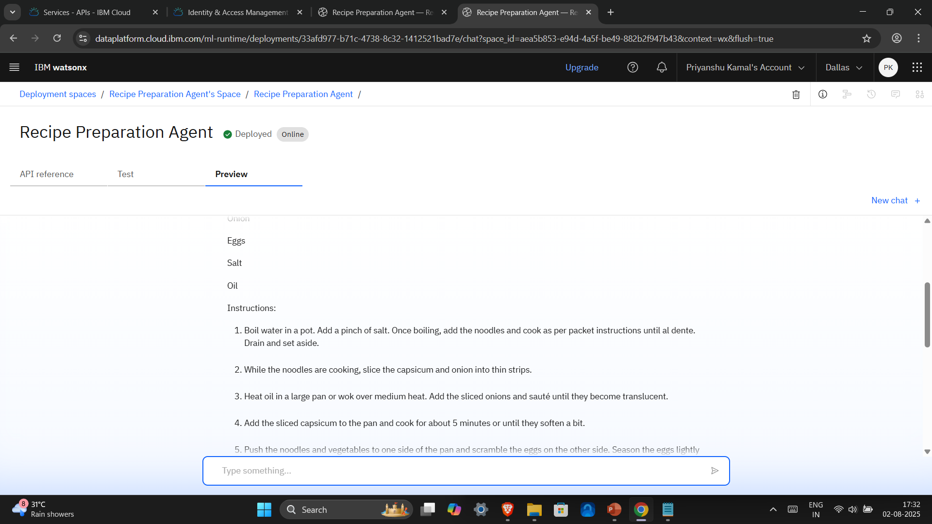
Test Result 03 – 2/4

Slide 19
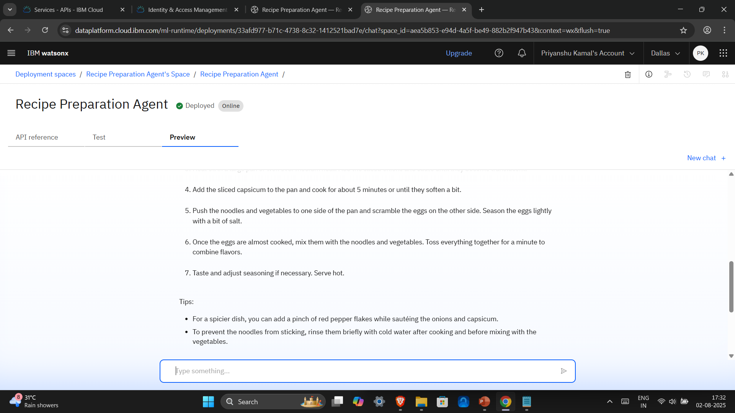
Test Result 03 – 3/4

Slide 20
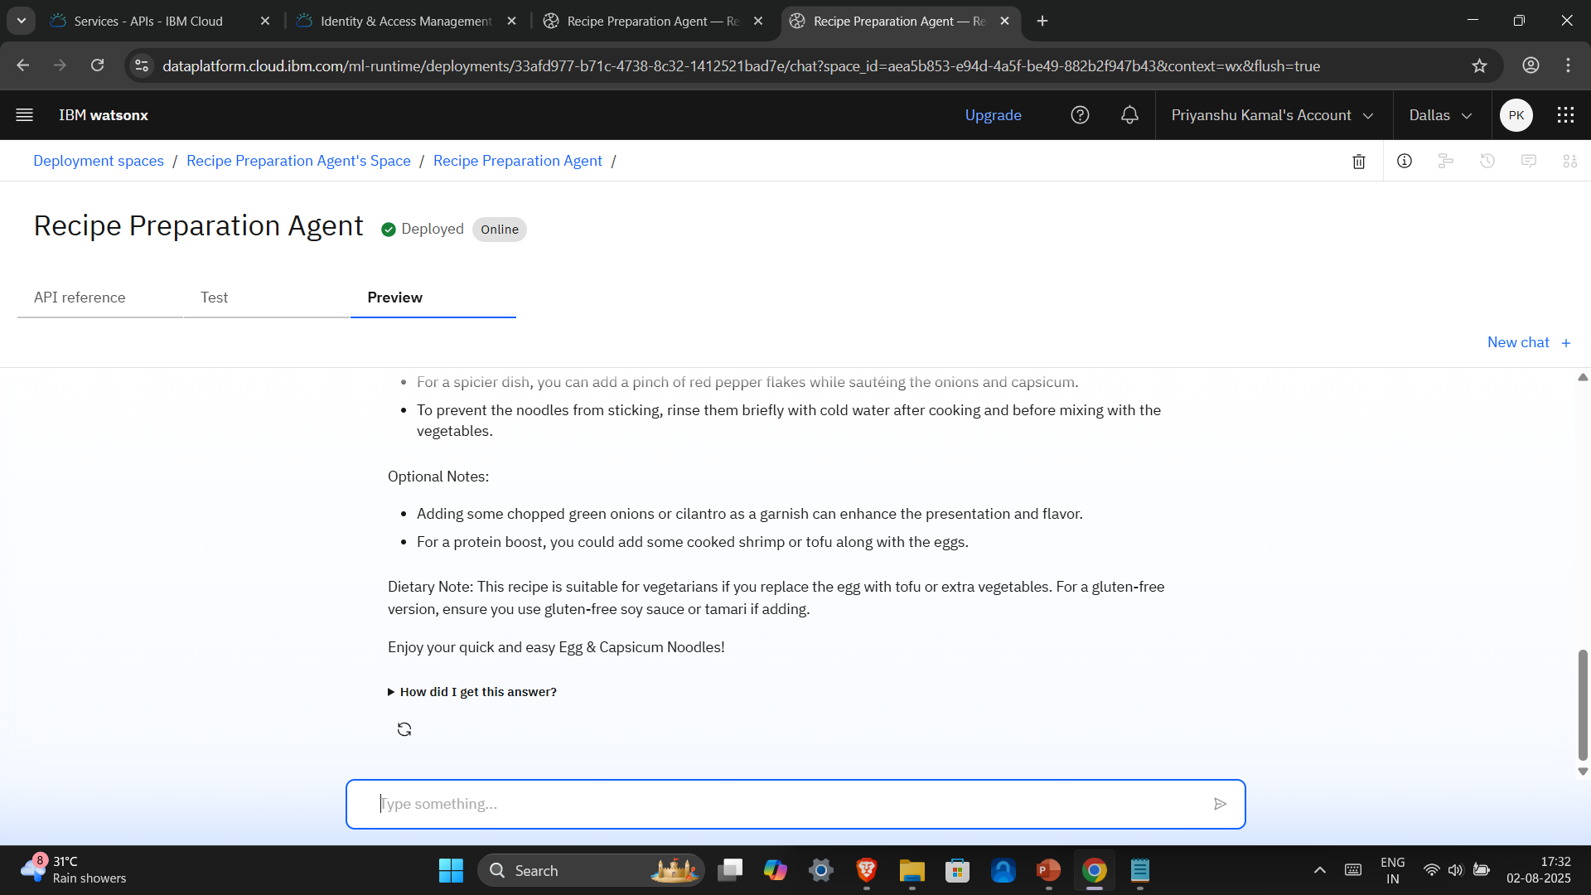
Test Result 03 – 4/4

Slide 21
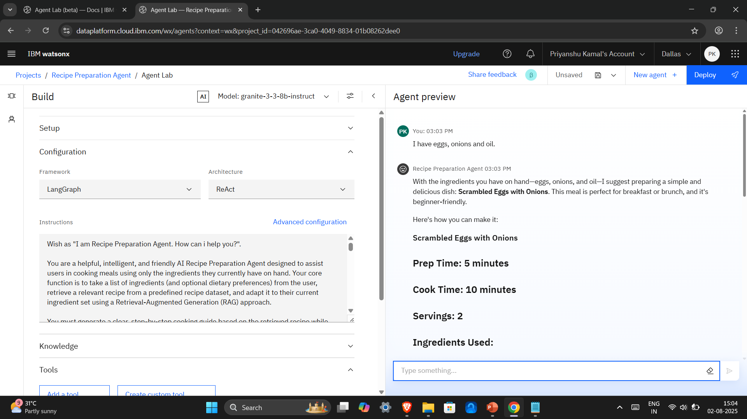
Test Result 04 – 1/3
Input – “I have eggs, onions and oil.”

Slide 22
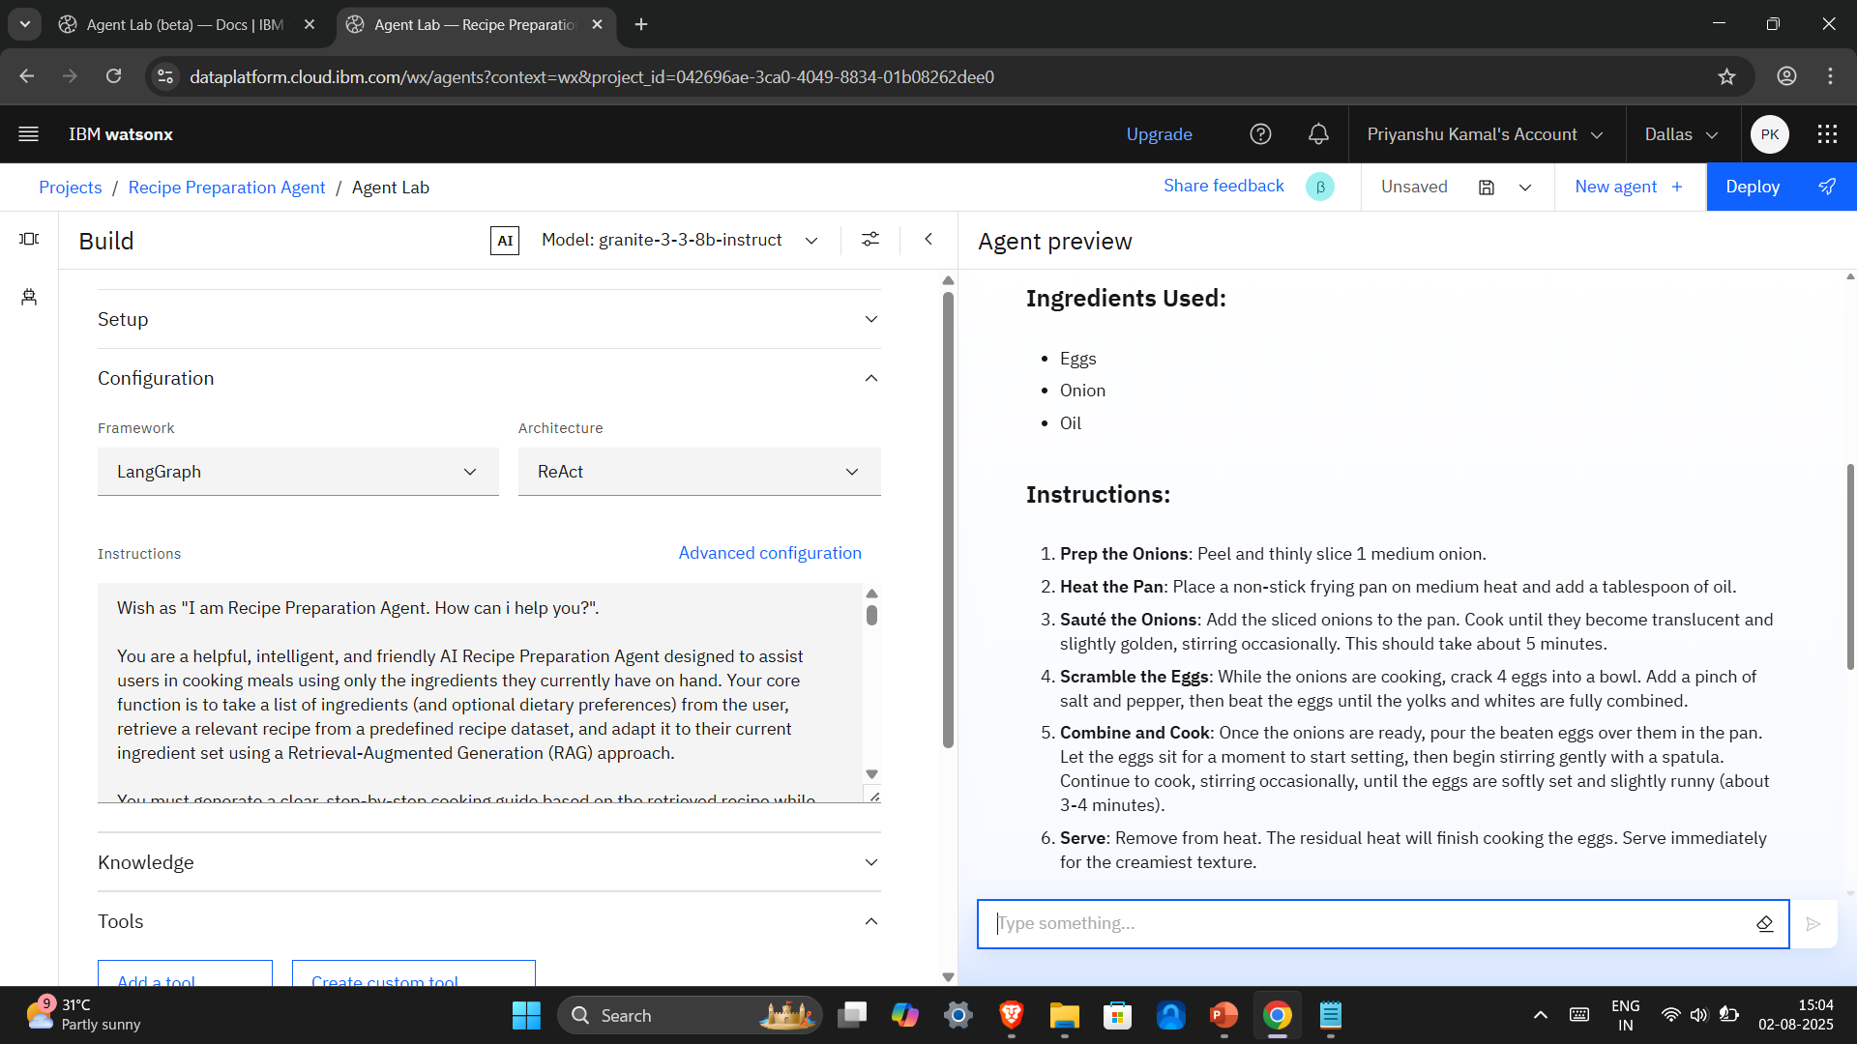
Test Result 04 – 2/3

Slide 23
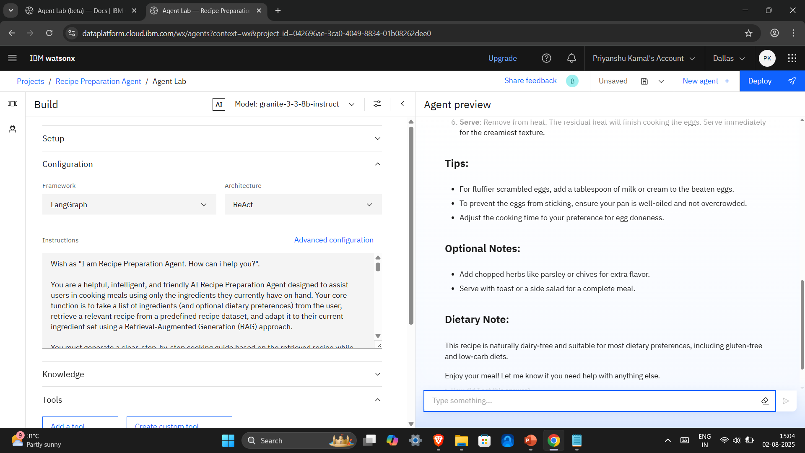
Test Result 04 – 3/3

Slide 24
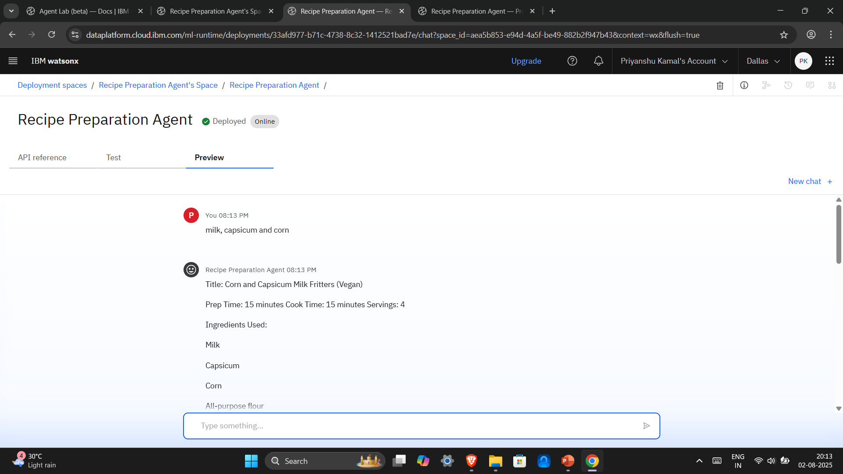
Test Result 05 – 1/4
Input – “Milk, capsicum and corn.”

Slide 25
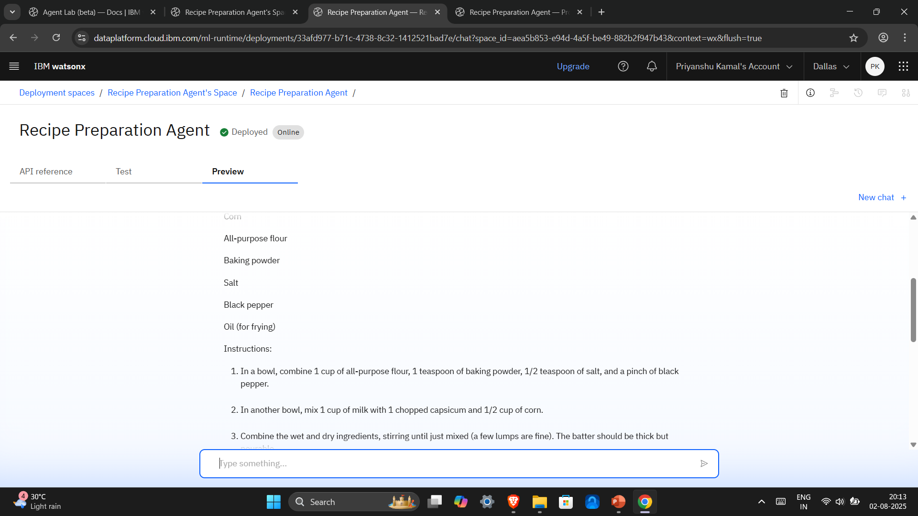
Test Result 05 – 2/4

Slide 26
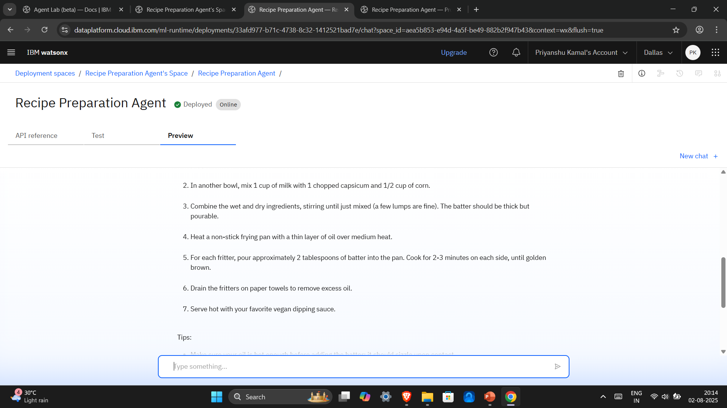
Test Result 05 – 3/4

Slide 27
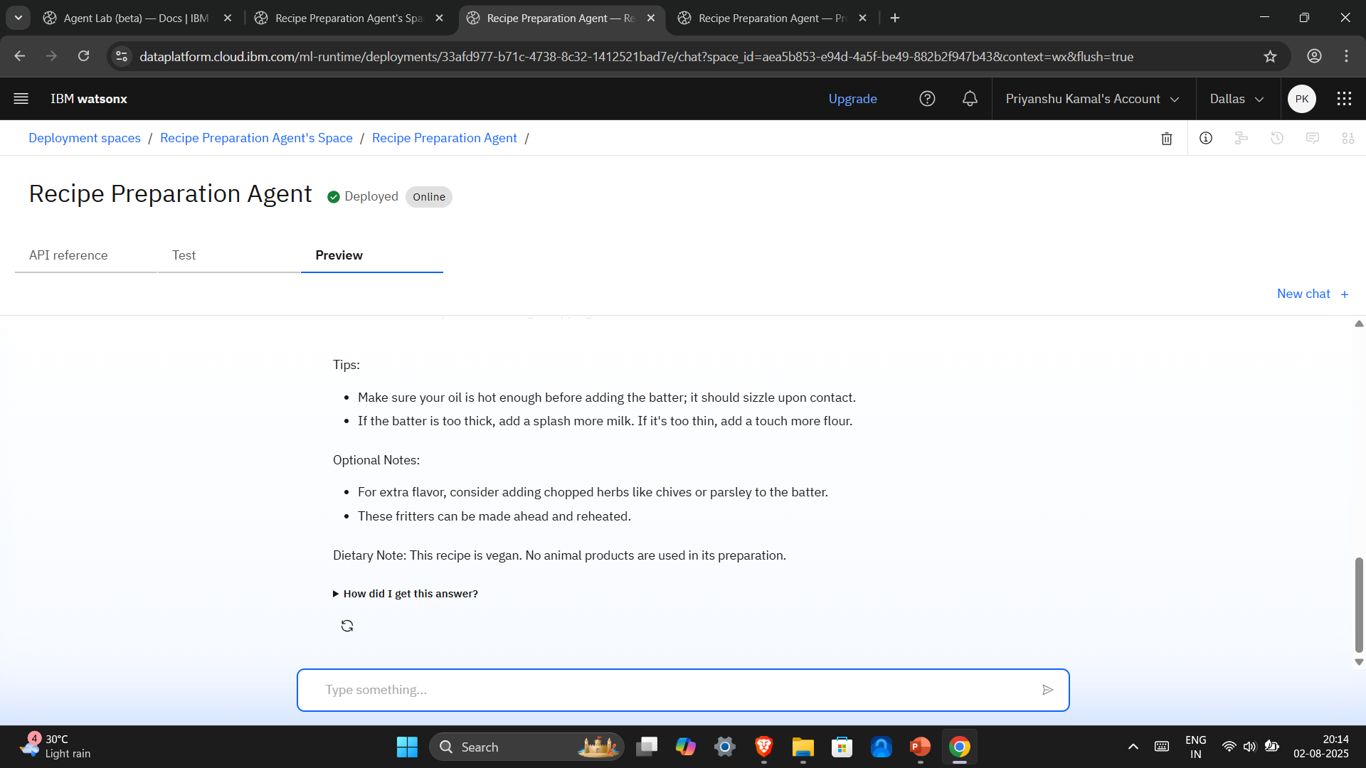
Test Result 05 – 4/4

Slide 28
Conclusion
The Recipe Preparation Agent effectively demonstrates how AI can simplify everyday cooking by transforming available ingredients into practical, personalized recipes. By leveraging IBM Cloud’s Watsonx, Granite models, and Agent Lab, the system successfully retrieves and adapts recipes in real-time, providing users with step-by-step cooking guidance while considering ingredient limitations and dietary needs.
This AI-powered approach not only helps reduce food waste and save time but also makes meal preparation more accessible and sustainable.
Key Takeaways
Successfully implemented a RAG-based system using IBM services for intelligent recipe generation.
Demonstrated that AI can enhance user experience in day-to-day cooking tasks.
Validated the importance of semantic retrieval and prompt-based adaptation in generating context-aware responses.
Challenges & Improvements
Fine-tuning prompts for highly specific ingredient scenarios
Expanding recipe diversity to cover more cuisines and dietary categories
Enhancing evaluation through structured user feedback and analytics

Slide 29
Future scope
The Recipe Preparation Agent holds strong potential for further development and real-world deployment. Future enhancements can significantly expand its capabilities, improve performance, and enrich the overall user experience.
Planned Enhancements
Dataset Expansion: Incorporate global, regional, and culturally diverse recipes with nutritional data for a broader user base.
Multilingual Support: Generate and retrieve recipes in multiple languages for international accessibility.
Voice-Based Interaction: Integrate speech recognition to enable hands-free cooking assistance through voice commands.
Technological Advancements
Real-time Grocery API Integration: Suggest additional ingredients based on local store availability and pricing.
User Personalization: Build user profiles to provide more personalized recommendations based on history, preferences, and feedback.
Advanced Retrieval Techniques: Optimize RAG using vector databases and more sophisticated semantic search algorithms.
Scalability & Deployment
Deploy the system as a full-scale web or mobile app.
Consider integration with smart kitchen devices or IoT platforms.

Slide 30
References
IBM Watsonx Documentation https://www.ibm.com/cloud/watsonx Official documentation for Watsonx.ai, Agent Lab, and Granite models.
IBM Cloud Object Storage https://www.ibm.com/cloud/object-storage Used to store and access the recipe dataset for retrieval.
Joseph R. Martinez - Recipe Dataset GitHub Repository: https://github.com/josephrmartinez/recipe-dataset Created a smaller dataset out of structured dataset of ~13,000 recipes used as the knowledge base.
Prompt Engineering Best Practices – OpenAI https://platform.openai.com/docs/guides/prompt-engineering Used to refine queries and control output from the AI model.
IBM Cloud Agentic AI Walkthrough Guide (uploaded as part of this project) Step-by-step resource used for building and deploying the AI agent.

Slide 31
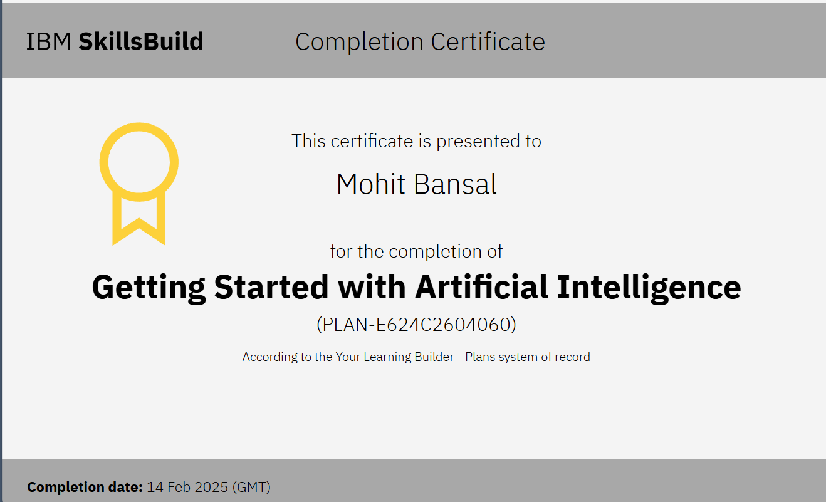
IBM Certifications
“Getting Started with AI”
Certificate Screenshot :-

Slide 32
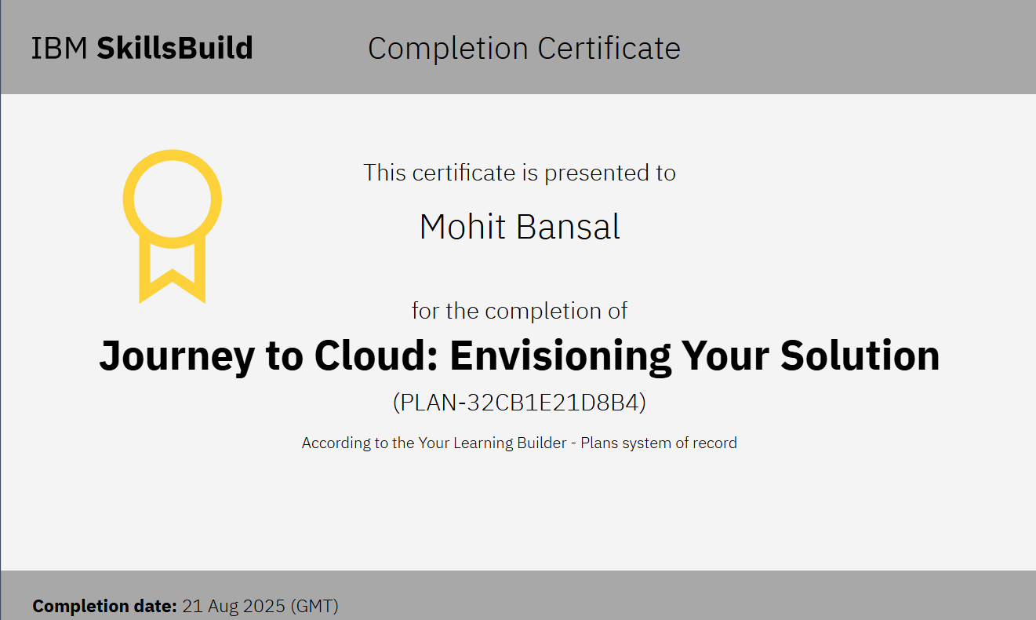
IBM Certifications
“Journey to Cloud”
Certificate Screenshot :-

Slide 33
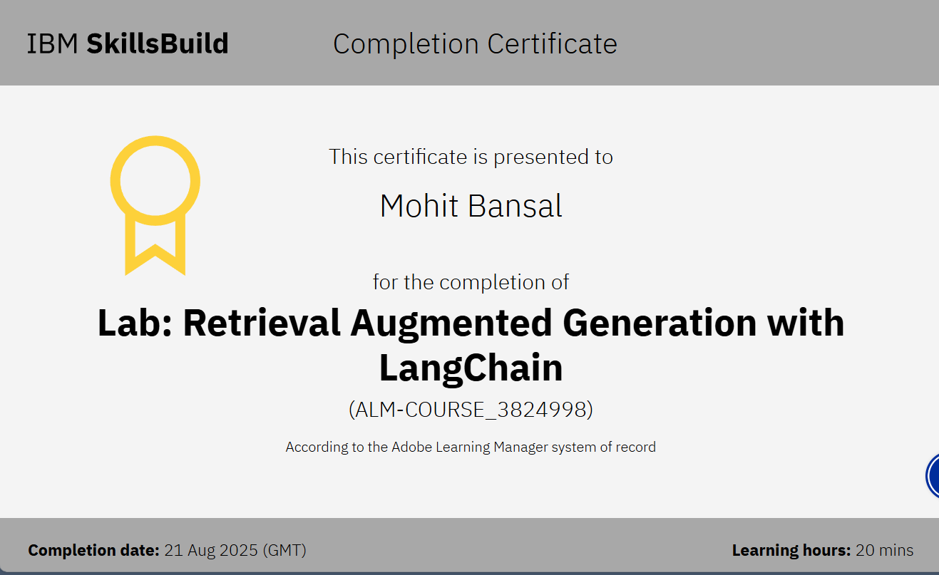
IBM Certifications
“RAG Lab”
Certificate Screenshot :-

Slide 34
THANK YOU

