Slide 1

DFIR Case
How to compromise a domain with Follina and Qbot

Slide 2

The plan is simple
Create “The Invite”
Get the “The Invite” to the employee
Get the “The Invite” to let Agent ‘Q’ in
Agent Q masquerades as Tech Support
Report back to HQ
Look around, dodge mechanisms and sneak around and get more Agent Qs in the company
Call for back-up from Agent `CS`
`CS` masquerades as Tech Support
Use some tools & gadgets
Access the goods
Get evicted

Slide 3
And now in a more technical way: Follina Vector
threat actor (TA) abused the CVE-2022-30190 (Follina) vulnerability
exploit code in malicious word document to gain initial access
MalDoc likely arrived by the means of thread-hijacked emails from distribution channels used by TA570
MalDoc gets executed
HTML file was retrieved HTML file was retrieved from a remote server containing a PowerShell payload
Payload contained base64-encoded content to download Qbot DDLs inside the user's Temp directory

Slide 4
And now in a more technical way: Qbot Vector
Qbot DLL executed via regsvr32.exe
was then injected into legitimate processes (explorer.exe) on the host
Injected process spawned Windows utilities such as whoami, net.exe and nslookup for discovery and to establish connection to the Qbot C2 servers
Approx. an hour later: leverage of the Windows built-in utility esentutl.exe to extract browser data
Qbot used scheduled task creation as a persistence mechanism
contained PowerShell command referencing multiple C2 IP addresses stored as base64-encoded blob in randomly named keys under the HKCU registry hive.
TA proceeded with remote creation of Qbot DLLs over SMB to other hosts throughout the environment
TA added folders to the Microsoft Defender exlusions list on each of the infected machines to evade defenses
Notes:
Regsvr32.exe is a command-line utility in Microsoft Windows that registers .dll files as command components in the Windows Registry. It is used to register and unregister object linking and embedding (OLE) controls, such as DLLs and ActiveX controls in the Windows operating system.
In the context of malware analysis, Regsvr32.exe is often used to launch malicious code or execute malicious scripts. Malware authors use this utility to bypass application whitelisting and UAC (User Account Control) controls. Malware analysts can analyze the behavior of the malicious code using Regsvr32.exe to assess the impact of the malicious code on the system.

Slide 5
And now in a more technical way: Qbot Vector
Remote services were then used in a similar fashion to execute the DLLs
Cobalt Strike server connection was witnessed within the first hour, but wasn't ustilised untill the lateral movement phase
nltest.exe and AdFind were executed by the injected Cobalt Strike process (explorer.exe)
also used to access the LSASS system process
TA installed remote management tool called Netsupport Manager
TA moved laterally to the domain controller via Remote Desktop session

Slide 6
And now in a more technical way: Qbot Vector: Domain Controller
A tool called Atera Remote Management was deployed (popular tool to control victim machines)
Next day: TA downloaded a tool named Network Scanner by SoftPerfect on the DC
Execution ran a port scan across the network
TA connected to one of the file share servers via RDP and accessed sensitive documents
No further activity was observed before the TA got evicted from the domain.

Slide 7
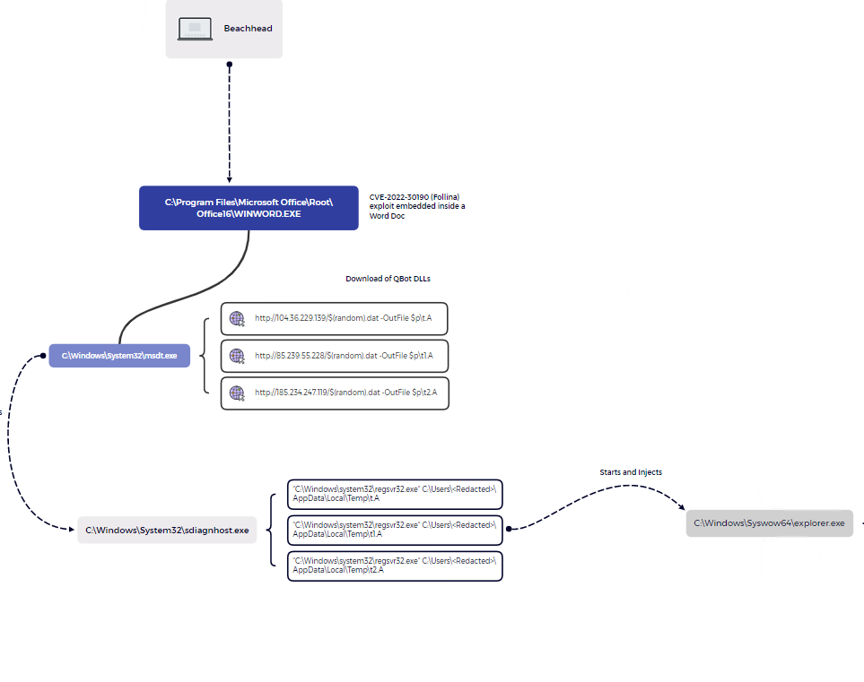

Slide 8
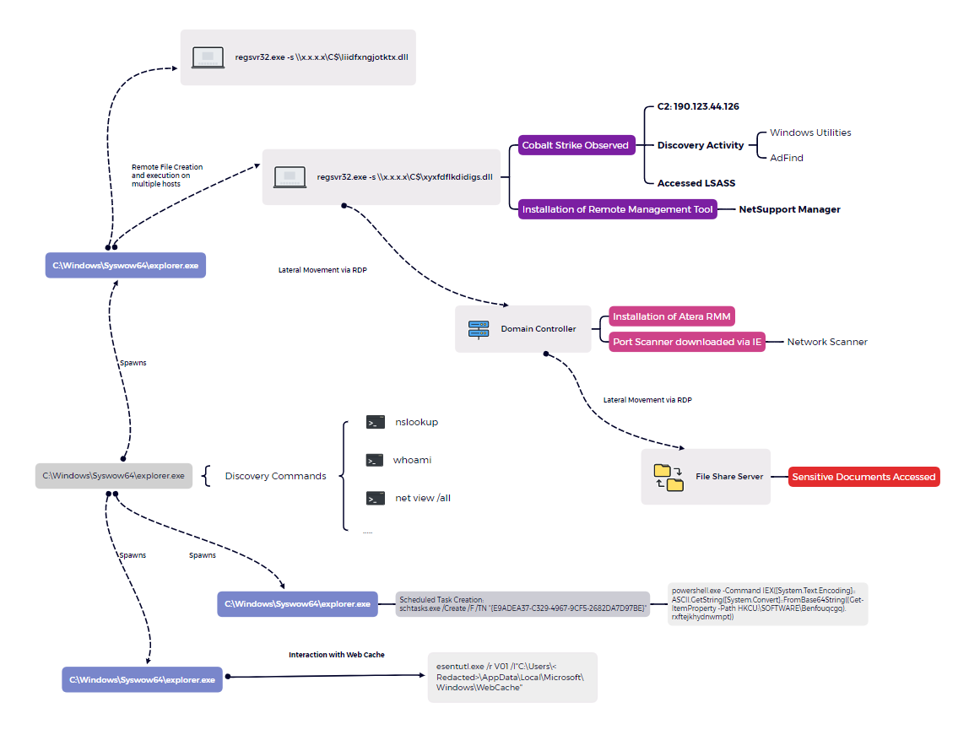

Slide 9
How to detect and monitor these vectors: Follina
How to detect exploitation of Follina
How to detect the malicious code in the MalDoc
How to prevent for Follina exploitation
Monitor for the process msdt.exe being spawned by a Microsoft Office application such as WINWORD.EXE
Decoded payload that is executed is logged in EventID 4104 (script block logging) upon execution by the PowerShell engine.
What is Follina (CVE-2022-30190)?
A high-severity vulnerability in the Microsoft Office Suite allowing RCE by leveraging msdt.exe (Microsoft Support Diagnostic Tool)
Delete HKEY_CLASSES_ROOT/ms-msdt file type handler entry from the Windows Registry system configuration database.

Slide 10
How to detect and monitor these vectors: Qbot
How to detect Qbot DLLs on disk
How to detect the behaviour of Qbot
How to prevent Qbot infections
Scan endpoints regularly on known filenames, hashes and/or signatures
What is Qbot?
also known as Qakbot, is a Windows malware that started as a banking trojan but evolved into a full-featured malware dropper.
Monitor Processes
Check Network Connections
Scan for Malware
Check Registry
Monitor for Unusual Activity
User awareness
Email gateways
Notes:
Monitor Processes: Qbot is a malicious program that is designed to run in the background of your system. Monitor processes to detect any suspicious or unknown processes that are running in the background.
Check Network Connections: Qbot often communicates with malicious servers to receive instructions or to download additional malicious components. Monitor network connections to detect any suspicious connections that may be related to Qbot.
Scan for Malware: Use a reliable anti-malware program to scan your system for any malicious files or programs that may be related to Qbot.
Check Registry: Qbot often adds malicious entries to the Windows registry. Check the registry for any suspicious entries that may be related to Qbot.
Monitor for Unusual Activity: Qbot can be used for activities such as data exfiltration, credential theft and more. Monitor for any unusual activity on your system that may be related to Qbot.

Slide 11
Other things of importance
Detecting MDE exclusions
Detecting the usage of Active Directory Discovery techniques
Nltest = a command-line tool used to troubleshoot and diagnose issues with the Windows NT LAN Manager (NTLM) authentication protocol. It can be used to test various aspects of the NTLM protocol, such as verifying trust relationships, testing secure channel status, and checking user and computer accounts.
AdFind = a command-line tool used to query Active Directory (AD). It can be used to search for and retrieve information about objects in AD, such as user accounts, computers, contacts, groups, and organizational units. Adfind can also be used to modify attributes, create, delete, and move objects, and perform other management tasks.
Process Execution & Command Line Logging - Windows Security Event Id 4688, Sysmon, or any CIM compliant EDR technology.
PowerShell Script Block Logging - Microsoft-Windows-PowerShell/Operational Event Id 4104.
How to detect:
Event logs: Windows Security Event Id 4657
Registry: Monitor registry key changes on the following key: HKEY_LOCAL_MACHINE/SOFTWARE/Microsoft/Windows Defender/Exclusions
Notes:
Monitor Processes: Qbot is a malicious program that is designed to run in the background of your system. Monitor processes to detect any suspicious or unknown processes that are running in the background.
Check Network Connections: Qbot often communicates with malicious servers to receive instructions or to download additional malicious components. Monitor network connections to detect any suspicious connections that may be related to Qbot.
Scan for Malware: Use a reliable anti-malware program to scan your system for any malicious files or programs that may be related to Qbot.
Check Registry: Qbot often adds malicious entries to the Windows registry. Check the registry for any suspicious entries that may be related to Qbot.
Monitor for Unusual Activity: Qbot can be used for activities such as data exfiltration, credential theft and more. Monitor for any unusual activity on your system that may be related to Qbot.

