Slide 1



IS4S706 Project Management & Research Methodology
Research Methods – Part 2
David Kidner (J302)
david.kidner@southwales.ac.uk

Slide 2
Research Methods: Last Time…
HOMEWORK EXERCISE:
Prepare a (Very Draft) Research Proposal …
Identify Subject Area; Topic; Some Possible Research Questions
Use FindIT Resources for Literature Identification (& Review)
Use SAGE Research Methods to identify resources & strategies in your project domain (e.g. Research Designs)
Develop a HYPOTHESIS
… Put some meat on the bones by suggesting / developing a methodology (i.e. your Research Design).
… and a proposal for your data collection and analysis strategies.

Slide 3
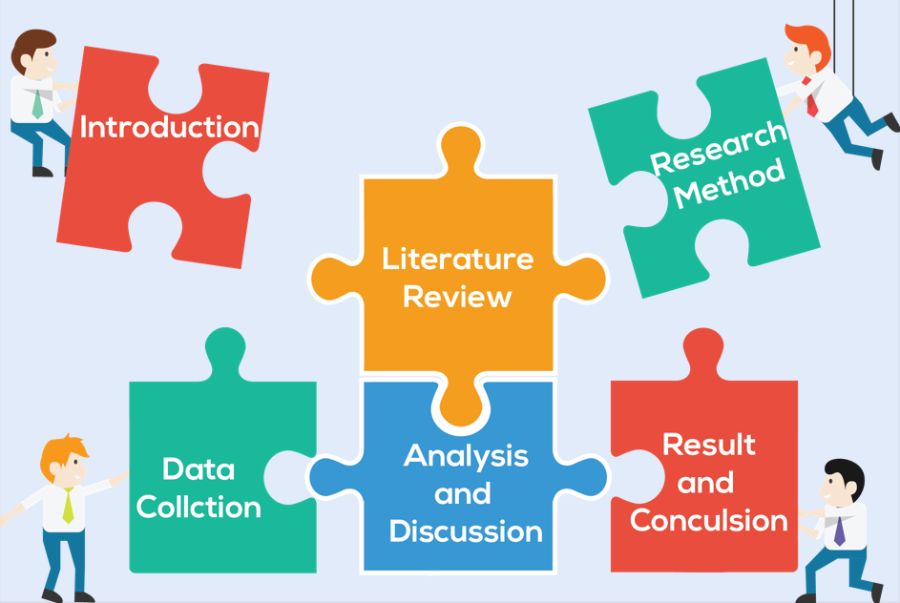
Research Methods: Last Time…

Slide 4
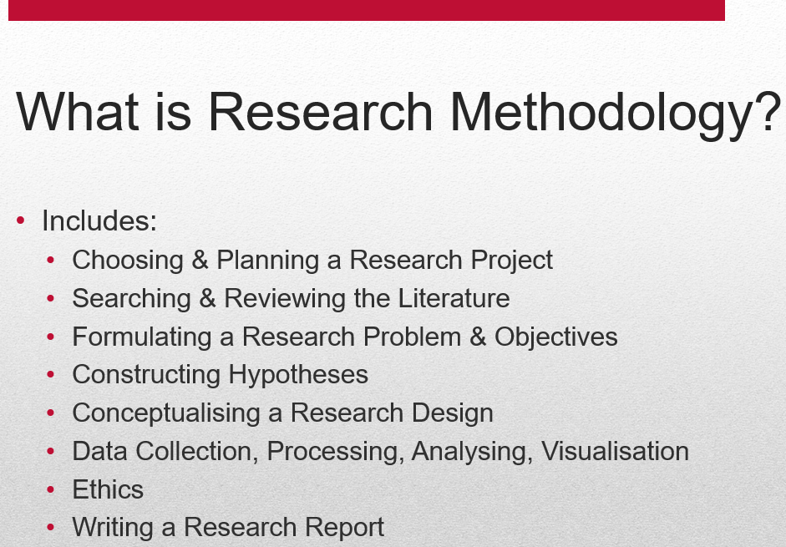
Research Methods: Last Time…
HOMEWORK EXERCISE:
Is What You Are Proposing FEASIBLE?
At this stage ….
Probably Yes.
Until We Dig Deeper …

Slide 5
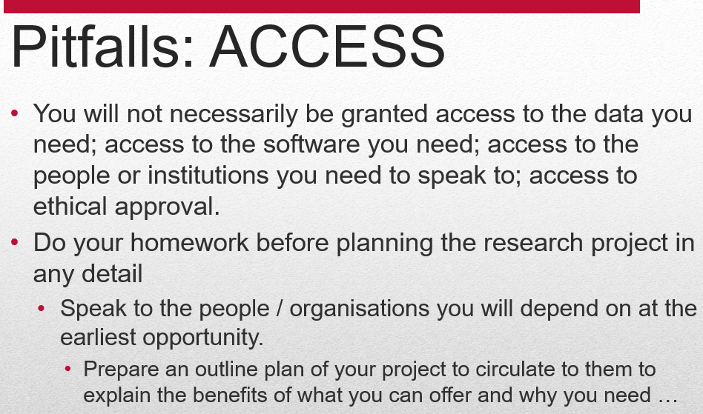
Data Collection, Processing, Analysing, Visualisation
DATA ACCESSIBILITY
Remember …

Slide 6
Research Design (with a Focus on Data Issues)
Identify the problem to be studied
Transform problem into a testable hypothesis or hypotheses
An idea that will be tested through systematic investigation
Identify the data (population) you need to examine in order to test your hypothesis / hypotheses
Identify the data (sample) you can reasonably access to gather data
Determine the appropriate method for data collection
Determine the appropriate set of instruments to collect data
Collect data
Analyse data
Interpret results (data transformed into information).

Slide 7
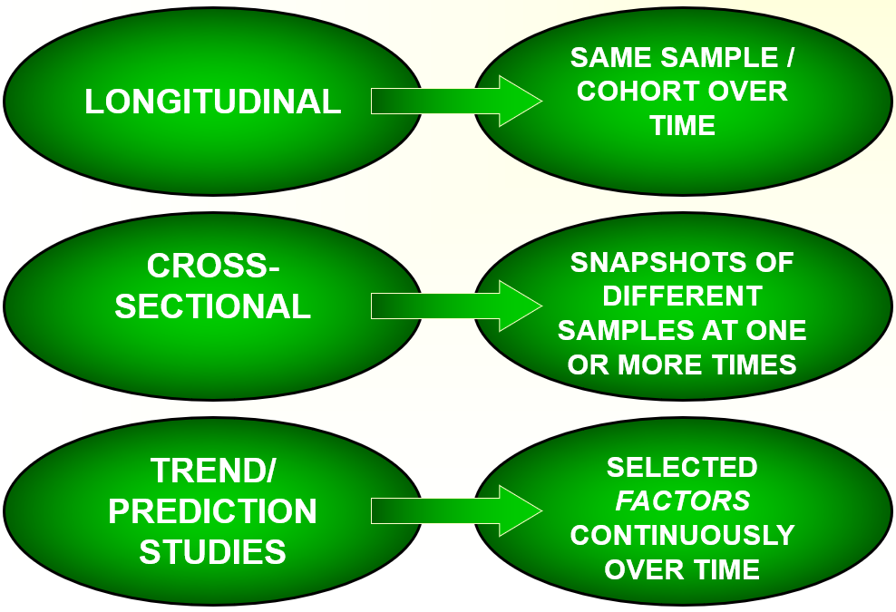
Research Design (with a Focus on Data Issues)
Depends upon:
Type of data you want / need
Cross-sectional, longitudinal, trend surveys
Quantitative or qualitative

Slide 8
Research Design (with a Focus on Data Issues)
Depends upon:
Type of data you want / need
Sample size
5, 50, 500, 5000, 5 million, ….
Access
(as before) … can you get hold of the data?
Location
Trefforest, RCT, Wales, UK, Europe, World, …
Time
Timeline for Data Collection
Resources
Costs (Financial & Time).

Slide 9
Research Design (with a Focus on Data Issues)
An outline of the overall research design accounting for each objective – variables to be considered, conditions to be controlled and conditions to be eliminated.
Be sure to state what samples are involved, what are the sources of the data, what processes will be used to gather the data and analyse it, what conditions will be controlled
Describe how you will manage your data.
Describe data analysis methods.

Slide 10
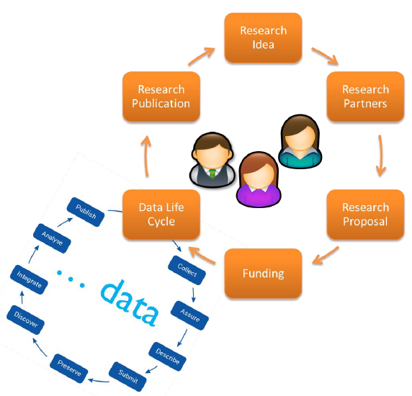
Research Life Cycle (& Data Life Cycle)
Soler, Ort & Steckel (2016)
An Introduction to Data Management, BEFmate.

Slide 11
Data Management
(1) Information about your Data and Data Format
Types of data that will be produced (e.g. experimental, observational, raw or derived, physical collections, models, images, etc.)
Volume of data
When, where and how the data will be acquired (e.g. methods, instruments)
How the data will be processed (e.g. software, algorithms and workflows)
File formats (e.g. csv, tab-delimited or naming conventions)
Quality assurance and control procedures used
Other sources of data (e.g. origins, relationship to one’s data and data integration plans)
Approaches for managing data in the near-term (e.g. version control, backing up, security and protection, and responsible party)
Soler, Ort & Steckel (2016) An Introduction to Data Management, BEFmate.

Slide 12
Data Management
(2) Metadata Content and Format (Data about Your Data)
Metadata that are needed
How metadata will be created or captured (e.g. lab notebooks, auto-generated by instruments, or manually created)
Format or standard that will be used for the metadata
(3) Policies for Access, Sharing and Re-Use
Requirements for sharing (e.g. by research sponsor or host institution)
Details of data sharing (e.g. when & how one can gain access to the data
Ethical and privacy issues associated with data sharing (e.g. human subject confidentiality or mobile phone locations)
Intellectual property and copyright issues
Intended future uses for data
Recommendations for how the data can be cited
Soler, Ort & Steckel (2016) An Introduction to Data Management, BEFmate.

Slide 13
Data Management
(4) Long-term Storage and Technical Data Management
Identification of data that will be preserved
Repository or data centre where the data will be preserved
Data transformations and formats needed (e.g. data centre requirements and community standards)
Identification of responsible parties
(5) Budget
Anticipated costs (e.g. data preparation and documentation, hardware and software costs, personnel costs and archive costs)
How costs will be paid (e.g. institutional support or budget line items)
(6) Responsibilities
Who is Responsible for What?
Soler, Ort & Steckel (2016) An Introduction to Data Management, BEFmate.

Slide 14
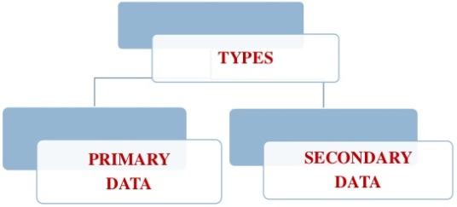
Data Collection

Slide 15
Primary Data
The data which are collected from the field (or experiment) under the control and supervision of an investigator
Primary data means original data that has been collected specially for the purpose in mind
This type of data are generally afresh and collected for the first time
It is useful for current studies as well as for future studies
For example: your own questionnaire.
For example: your own software (results, timings, efficiency, improvements, etc.).

Slide 16
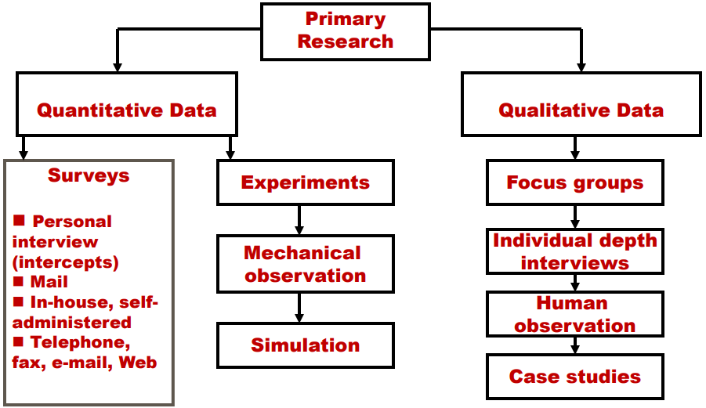
Primary Data

Slide 17
Secondary Data
Data gathered and recorded by someone else prior to and for a purpose other than the current project
It involves less cost, time and effort
Secondary data is data that is being re-used. Usually in a different context.
For example: data from a book
For example: Published Datasets (e.g. crime data, census data, “standard” test research datasets).

Slide 18
Secondary Data
Make sure you know what is already available (no point re-inventing the wheel), affordable, and accessible.
From Literature & Case Studies

Slide 19
Quantitative Methods
Experiment: Research situation with at least one independent variable, which is manipulated by the researcher
Independent Variable: The variable in the study under consideration. The cause for the outcome for the study.
Dependent Variable: The variable being affected by the independent variable. The effect of the study.

Slide 20
Quantitative Methods:
Experiments
Data should not be contaminated by poor measurement or errors in procedure.
Eliminate confounding variables from study or minimise effects on variables.
Representative: Does your sample represent the population you are studying? Must use random sample techniques.
Sampling is the problem of accurately acquiring the necessary data in order to form a representative view of the problem.

Slide 21
Quantitative Methods:
Experiments
Requirements:
Freedom from Bias
When observations favour some individuals in the population over others.
2. Freedom from Confounding
When the effects of two or more variables cannot be separated.
3. Control of Extraneous Variables
Any variable that has an effect on the dependent variable.
Statistical Precision to Test Hypothesis
Need to identify & minimise some variables.

Slide 22
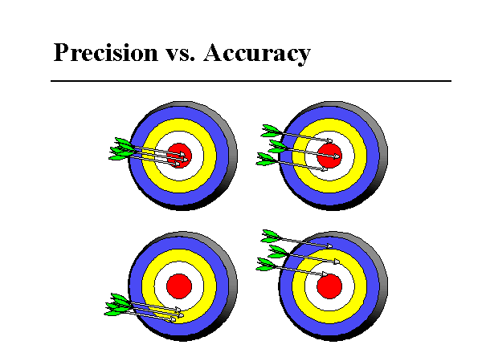
Precision versus Accuracy
"Precise" means sharply defined or measured.
"Accurate" means truthful or correct.
Both Accurate
and Precise
Accurate
Not precise
Not accurate
But precise
Neither accurate
nor precise

Slide 23
Data Collection …
State the objectives of the survey
Define the target population
Define the data to be collected
Define the variables to be determined
Define the required precision & accuracy
Define the measurement `instrument'
Define the sample size & sampling method, then select the sample.

Slide 24
Data Analysis, Processing & Visualisation
Bottom Line … No Getting Away from Statistics!
Analysis & processing will vary from Project to Project.
Visualisation … Some good techniques are applicable to every project.
T.B.C….

