Slide 1



IS4S706 Project Management & Research Methodology
Research Methods – Part 3
David Kidner (J302)
david.kidner@southwales.ac.uk

Slide 2
Research Methods: Last Time …
Data Management
Data Collection
& HOMEWORK EXERCISE (continued)!

Slide 3
Data Collection: Questionnaires
Planning (& Time Managing) your Project is absolutely essential
If well managed (& time allows) you might consider the use of Questionnaires for initial data collection and/or evaluation of your results / implementation / software / web site etc.
Independent Evaluation CAN be a key component of ANY Dissertation (or Research Project).
Puts YOUR Work Into Perspective!

Slide 4
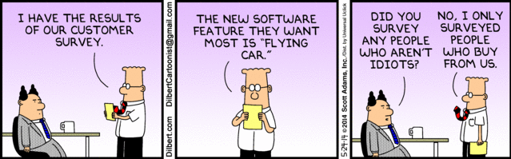

Slide 5
Questionnaire Types
Web-based Questionnaire
questionnaire designed as a web-page and hosted on website
E-mail Questionnaire
questions are submitted as part of the email itself
Questionnaire attached to an e-mail
questionnaire is sent as an attachment to an email e.g. as a word document
Paper-based Questionnaire
For a select cohort (e.g. Peers, colleagues, in-house).

Slide 6
Online Questionnaire?
Internet offers great methodological potential and versatility
Resulted in proliferation of online questionnaires
But use of online questionnaire must be appropriate and justified for each particular research project
e.g. to address aims of research, selection of most relevant questionnaire type and question format for addressing aims, establishing a justified sampling strategy to recruit relevant respondents and ensure appropriate response rate
…and done at an early stage, e.g. not July!

Slide 7
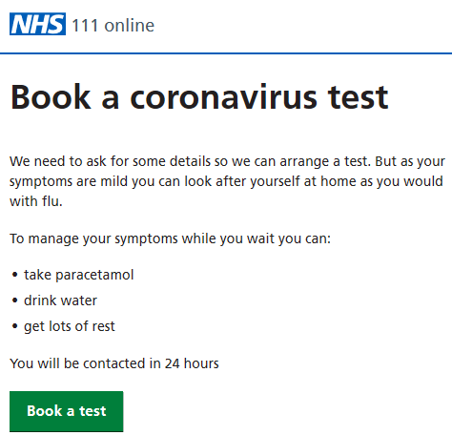
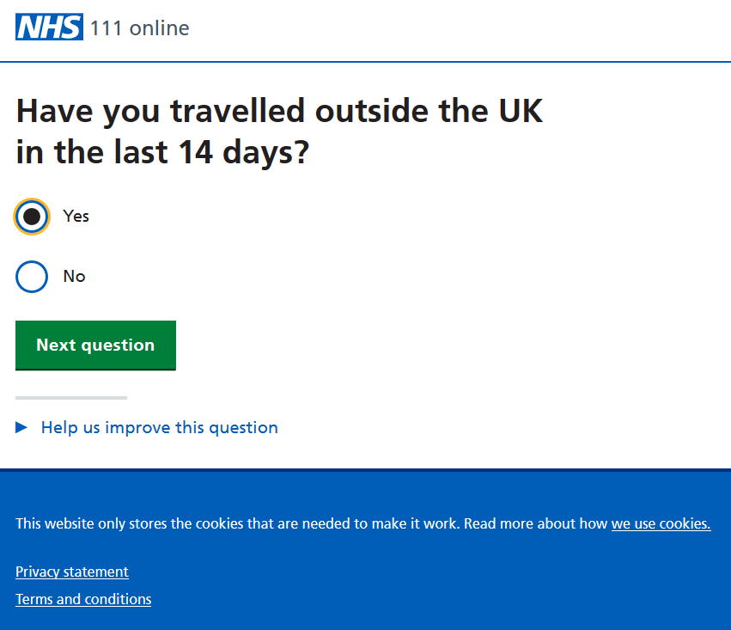
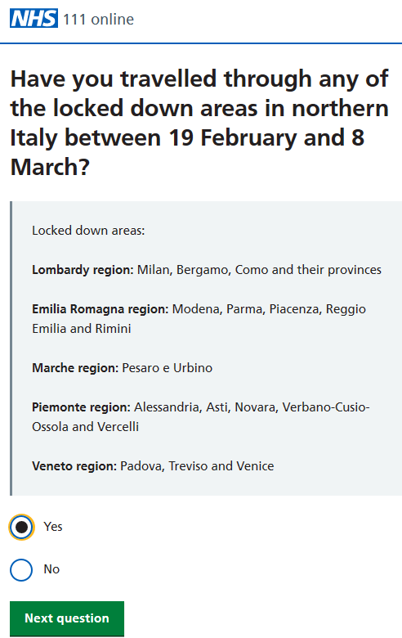
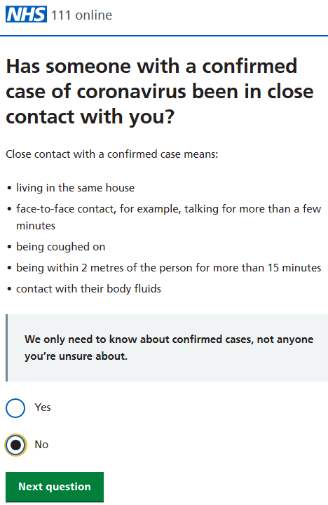
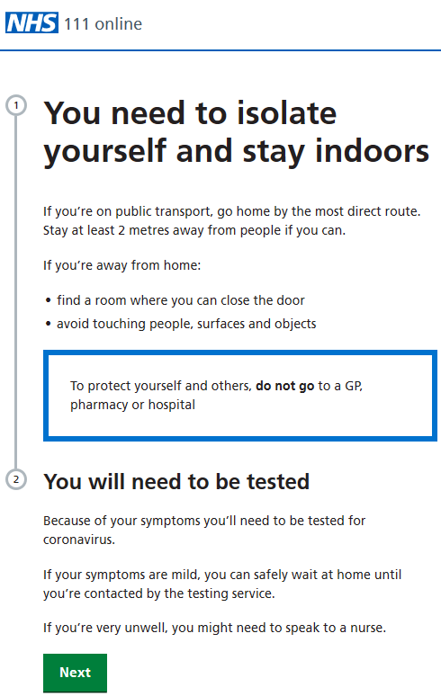
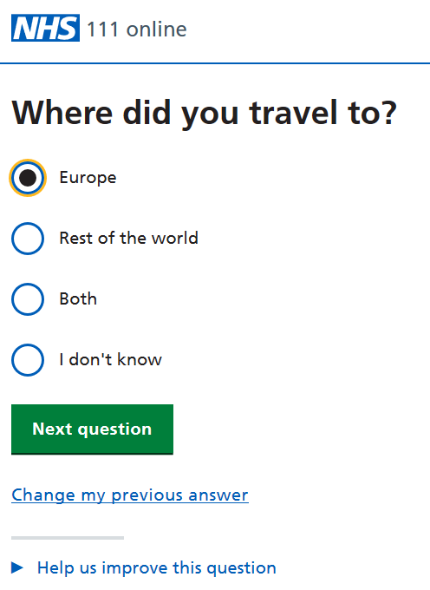
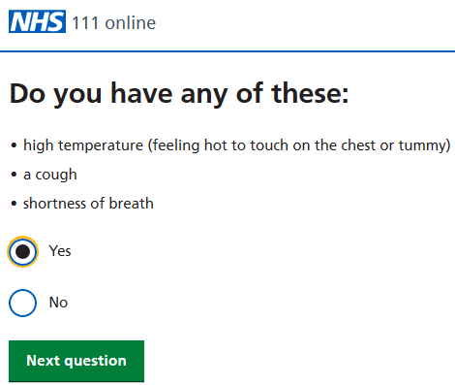

Slide 8
Advantages of Online Questionnaires
Speed and volume of data collection
Savings in costs
Flexible design
Data accuracy
Access to research populations
Anonymity
Respondent acceptability

Slide 9
Advantages of Online Questionnaires
Enable the researcher to contact a geographically dispersed population and so can be useful in internationalising research;
Be used to contact groups often difficult to reach, such as the less physically mobile (disabled/in prison/in hospital) or the socially isolated (drug dealers/terminally ill) or those living in dangerous places (war zones);
Provide savings in costs to the researcher (for example, the costs associated with travel, venue, data entry);
Supply data quickly, providing fast alternatives to postal, face-to-face and telephone surveys.

Slide 10
Disadvantages of Online Questionnaires
Sample bias
Online group, like-minded, identity verification, incentives,
Measurement error
Non-response bias
Length, response and drop out rates
Technical problems
Ethical issues

Slide 11
Questionnaire Considerations
Ensuring that the use of an online questionnaire is the most appropriate research tool to address the aims of the research;
Deciding on the most relevant questionnaire type and question format for addressing the aims of the research;
Establishing a justified sampling strategy to recruit relevant respondents and ensure an appropriate response rate;
Guaranteeing the ethical rights of respondents including informed consent, confidentiality and privacy.

Slide 12
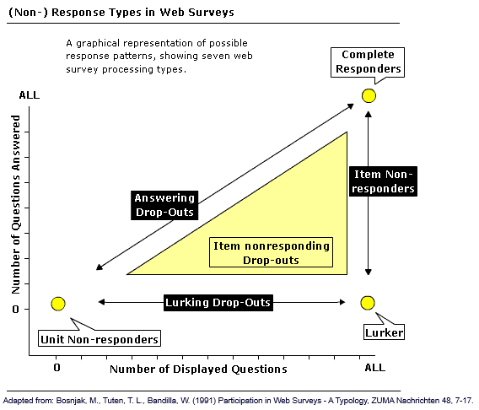
Responders
Complete responders:
Those responders who view and answer all questions.
Answering drop-outs:
Those who provide answers to those questions displayed, but quit prior to completing the survey.
Item nonresponders:
Those responders who view the whole questionnaire, but only answer some of the questions.
Item nonresponding Drop-outs:
Those who view some of the questions, answer some but not all of those viewed, and also quit prior to the end of the survey. A 'more accurate depiction of actual events in web surveys than the relatively basic categorization of complete participation, unit nonresponse, or item non-response.'
Lurking drop-outs:
Those who view some of the questions without answering, but also quit the survey prior to reaching the end, thus sharing some characteristics with 'answering drop-outs' and 'lurkers'.
Unit non-responders:
Those who do not participate in the survey. There are two possible variations: They may be 'technically hindered' or may 'purposefully withdraw after the welcome screen is displayed, but prior to viewing any questions'.
Lurkers:
Those who view all of the questions in the survey, but do not answer any of them.

Slide 13
E-mail Questionnaire
The questions are submitted as part of the email itself.
Advantages
Sent directly to respondent ensuring delivery to recipient.
Requires little preparation, so low cost.
Easy to design and answer.
Easy for respondent to return via email 'reply' button.
Few technical skills required.
Disadvantages
Questionnaire design usually simplistic.
Not attractive owing to limited design features.
Has to be quite short or get very low response rates.
Graphics and embedded objects can not be included.
Results must be hand-entered into a data base which increases time, costs. and data entry error.
Valid email addresses required for sampling purposes.
Anonymity of respondent may be jeopardised as email address returned with questionnaire and so may respond in a more socially desirable manner.

Slide 14
Questionnaire attached to E-mail
A questionnaire is sent as an attachment to an e-mail.
Advantages
Can use word-processing or spreadsheets, so simple to produce.
Can be more attractive than e-mail questionnaire as more design features.
Can increase response rates as more visually appealing.
Few technical skills required.
Reduced length of e-mail required and so increases participation.
Disadvantages
Reply may be complicated as respondent has to open, complete and save attachment and then reattach to e-mail and return.
Respondent must have software capable of reading attachment.
Attachments may expose respondents to more computer viruses.
Would you open an attachment from someone you don’t know?
Results may have to be hand-entered into a data base which increases time, costs and data entry error.
Valid e-mail addresses required for sample.

Slide 15
Questionnaire Response Rates
To Improve Response Rates: A Checklist
Send introductory letter outlining project and estimated time needed to complete the questionnaire
Provide clear instructions on how to complete the questionnaire
Request any personal information at the start of the questionnaire rather than at the end
Use simple questionnaire format and avoid unnecessary graphics
Avoid grid questions, open-ended questions and requests for e-mail addresses
Design survey so it takes approximately 10 minutes to complete
Do not include more than 15 questions
Send one or two follow up reminders
Include 'social presence' or missing data messages to reduce item non-response
Emphasise confidentiality

Slide 16
Questionnaire Design Issues
USABILITY: Will your questionnaire be easy to use?
Or will the interface, colours and question types frustrate people and put them off?
ACCESSIBILITY: Will your questionnaire be accessible?
Or will it crash on old computers, render weirdly on different operating systems or mobile phone, and be impossible to use with a screen reader?
Do you have the time to fully test?
DOABILITY: Will your questionnaire be doable?
Or are your multi-media dreams running ahead of your technical ability and are your data arriving in an unusable format?

Slide 17
Online Questionnaire Implementation
Wide range of options available for developing online questionnaires.
OnlineSurveys, SurveyMonkey, TypeForm, and many more
Most claim to be WYSIWYG and to require no technical knowledge. (BEWARE!)‏
Before deciding on what to use:
Do some research
Run a pilot
Don’t shell out money!
Build Your Own?
DIY questionnaire using your technical skills and the software and hardware resources available.
Typically using HTML, JavaScript, ASP, Flash etc.
TIME? Is it worth the effort (in the grand scheme of your MSc Project)?

Slide 18
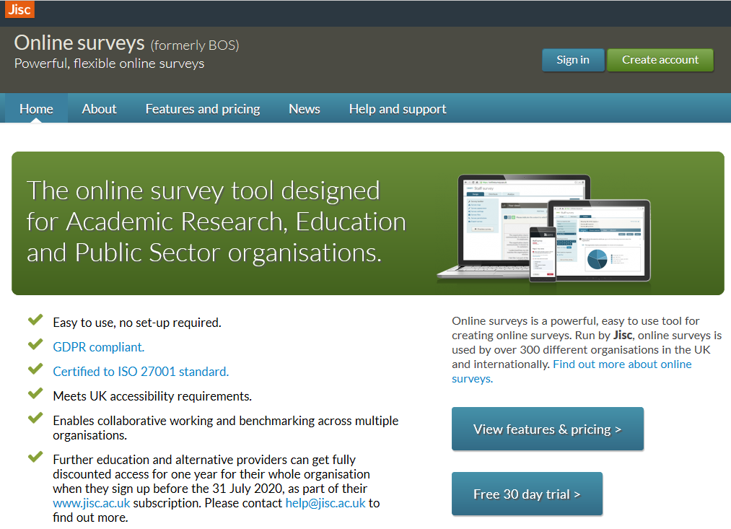
https://www.onlinesurveys.ac.uk/

Slide 19
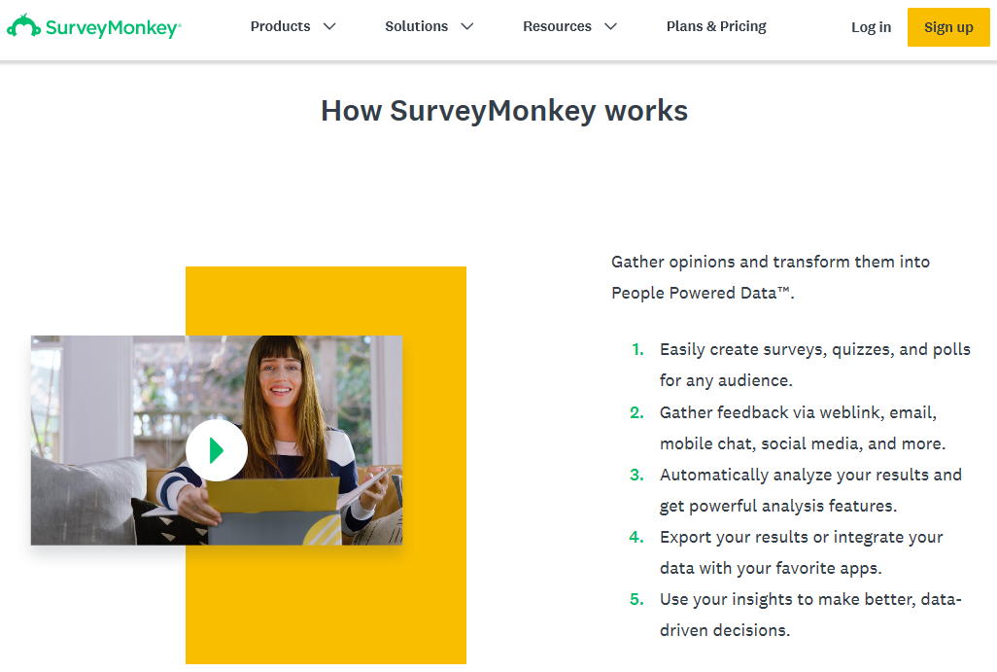
https://www.surveymonkey.com

Slide 20
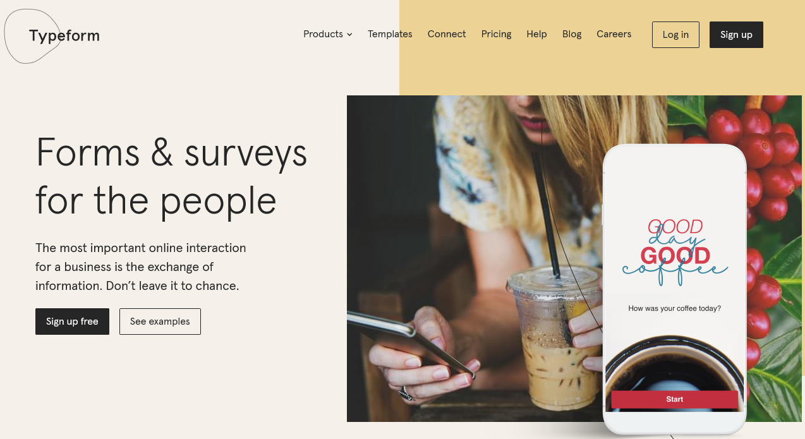
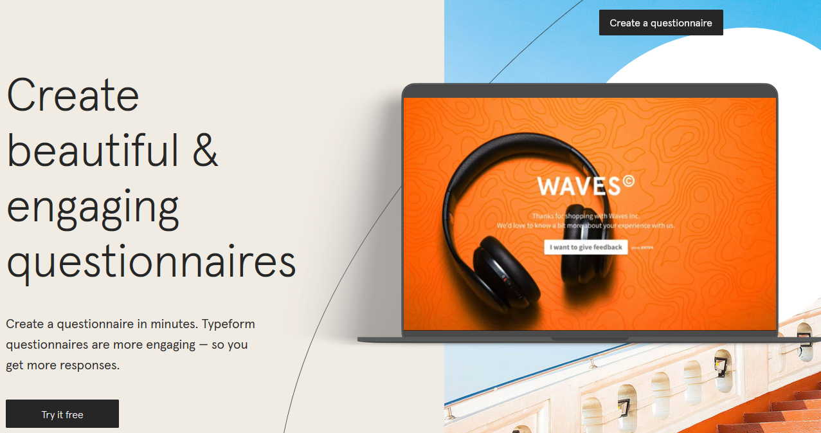
www.typeform.com

Slide 21
Questionnaire Development
Construction is key to valid and reliable research
Don’t just jump straight in. Liaise with your Supervisor.
Online tools (especially free ones) have limited capabilities and functionality.
Specify what information will be sought
Determine the type of questionnaire and method of administration
Determine the content of individual questions
Relate back to Your Research Questions and Hypotheses
Relate back to Your Data Variables
How can I use the data (responses) from this question?
Determine the form of response to each question
Determine the wording of each question

Slide 22
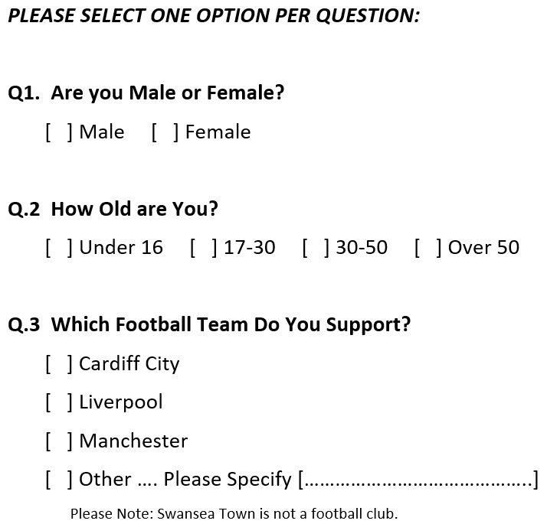
Jumping Straight In …

Slide 23
Questionnaires are Not Always Suitable …
Where the subject is not an expert in our area.
Where we want more information (than our 10 or 15 questions allow for).
Where we want to drill down for more specialised information.
… Telephone Questionnaire (Allows for different paths)
… Face-to-Face Interviews or Focus Groups
Unstructured or In-Depth Interviews
Suited for exploratory research
Open-ended items
Cannot standardise
Good for complex situations

Slide 24
Interviews Need Planning
Structured Interviews
Training is critical
Follow wording
Record responses (with permission, LSEPI issues)
Need Careful & Considerate Targeting (Sampling)
Not the Street Corner Approach
Smaller Samples (Higher Value Data)
Higher Cost (Visits).

Slide 25
Minimise the Questions & Maximise the Variables
Remember, don’t lose sight of the big picture (your research questions and hypotheses).
1 Question = 1 Variable
So, is Gender, Age, Job Title, Company, etc. necessary or superfluous?
Consider the following categories
Attitudes: feelings and opinions
Behaviours: what they actually do
We want to translate opinion into action; define strategy; evaluate programs
Demographics: who they are
Are opinions constant? (age, sex, job, geography etc.).

Slide 26
Minimise the Questions & Maximise the Variables
Brainstorm (with Others! And Supervisor)
Develop 20 Questions and Narrow to 15 or 12
Rank them by level of importance
Contribution to Research Questions & Variable Importance
How long does it take to complete?
Practice / Time It / Test It.
And the aesthetics …
Font, Spacing, Format, Layout, …
Grammar & Vocabulary
Target to your audience, e.g. jargon, terminology, …
But Avoid unfamiliar language or acronyms

Slide 27
Other Considerations…
Avoid ambiguity, confusion, and vagueness.
Make sure it is absolutely clear what you are asking and how you want it answered.
Avoid indefinite words or response categories.
Avoid emotional language, prestige bias and leading questions
Avoid double-barreled questions
Avoid asking questions beyond a respondent's capabilities
Avoid false premises
Avoid asking about future intentions (if you can)
Avoid negatives and especially double negatives

Slide 28
“The quantity of information that may be generated, and the speed at which responses can be collected, can result in pleasing piles of data - but we should be wary of being seduced by sheer quantity; data is only useful if it is representative of the larger population.”
Wakeford, N. (2000) New media, new methodologies: Studying the web,
in Gauntlett, D. (Ed.) Web.Studies: Rewiring Media Studies for the Digital Age. London. Arnold. pp. 31-41.

Slide 29
OnlineSurveys
If you are considering using a questionnaire for Primary Data collection, then please check out OnlineSurveys (much richer and flexible than the freebie solutions).
E-mail me at: david.kidner.southwales.ac.uk for access
Please include a brief synopsis (sentence or two) saying what you want to do with your questionnaire.

