Slide 1


IS4S706 Project Management & Research Methodology
Research Methods:
DATA ANALYSIS
David Kidner (J302)
david.kidner@southwales.ac.uk

Slide 2
Research Methods: Last Few Lectures …
Research
Question(s)
Methods
& Sample Selection
Data
Collection
Data Analysis,
Presentation &
Visualisation

Slide 3
What do we do with Our Data?
Once the data has been collected then it is essential that it is clearly displayed to identify key trends to the reader
The analysis of the data (often by statistical methods) will allow you as a researcher to identify these trends
There is nothing worse than reading a research paper and NEEDING a degree in statistics to understand what the author is trying to put forward to support their hypothesis
REMEMBER: “a picture is worth a thousand words”

Slide 4
BUT…
Before you move on, check the validity of your data first! Don’t use blindly!
Create a data dictionary
What are the variable names? What are the values?
Store your data securely, accessibly, and flexibly
Why not use EXCEL?
And REMEMBER TO DEACTIVATE YOUR ONLINE SURVEY!!!

Slide 5
Data Analysis: CLEANING
Clean your data…
Run descriptive statistics to…
Identify impossible values
How many hours of classes per week? …1001 hours…
Look for outliers in the data
How much student debt? Most respondents report £50,000, but a few report £300,000… not impossible?
Look for patterns that may indicate errors
Maybe skip logic was faulty or coding was not correct?
Identify duplicated data (e.g. two entries from same person)
Remove people who clicked through the survey, provided no usable data

Slide 6
Data Analysis: MISSING DATA
Most surveys will have missing data somewhere
Respondents do not answer question
Question voluntarily or accidentally skipped
Question not shown to / asked of respondent
Respondents provide data, but it is bad data
How many hours of classes per week? 1001…
Respondents discontinue survey
Survey attrition: can look at patterns to figure out if there is a “trigger” – perhaps a confusing question or overwhelming page…

Slide 7

Data Analysis: MISSING DATA
Missing data can be very harmful
Can contribute to nonresponse error
Those who answer questions are different than those who do not…
…and ultimately poor decision-making.

Slide 8
Data Analysis: MISSING DATA
Well worth examining patterns of missing data
Is the missing data random? Or is there a pattern of any kind?
Are some questions routinely skipped? (e.g., question asking students to evaluate a service that is rarely used)
Do many respondents drop out of the survey after or before the same item?
Do some kinds of respondents routinely skip some questions? (e.g., women don’t answer questions about favourite football team)
Sort your data to explore patterns of missing data more carefully

Slide 9
Data Analysis: MISSING DATA
Decide what you want to do about missing data
This will largely depend on the data and how you plan to analyse it
Common approaches
Listwise deletion – delete the entire row of data
Decreases statistical power in reporting
Leave blank – but report your n for the item
Enter the survey average for the item
Enter a random value (Be Very Careful! & Honest).

Slide 10
Tools to Collect & Present Data
Data can be presented in different formats that include tables, graphs, narratives.
Statistics is a tool that is used for quantitative research.
Qualitative research uses non-statistical tools.
Graphs can be used to present both qualitative and quantitative data.

Slide 11

Graphs
Graphical representations of data are probably the most common method for trying to explain a trend to a reader
There are many forms of graph available - in fact the hardest thing about using graphs is to decide which is the most appropriate!!!
Also graphs can be one of the best methods to use to highlight a ‘fact’ in adisproportionate way depending upon the measurement scale of the x or y axis -
e.g. don’t start at zero but at 70 in showing exam results compared with another lecturer who starts at 0 but finishes at 50 - can look the same!!!

Slide 12
Graphs
“the hardest thing about using graphs is to decide which is the most appropriate!!!”
Take a look at the examples on the next few slides (and spend no more than a minute in trying to understand the message).
By appreciating different types of graphs, then we might better understand how we can get across the message in our data …

Slide 13
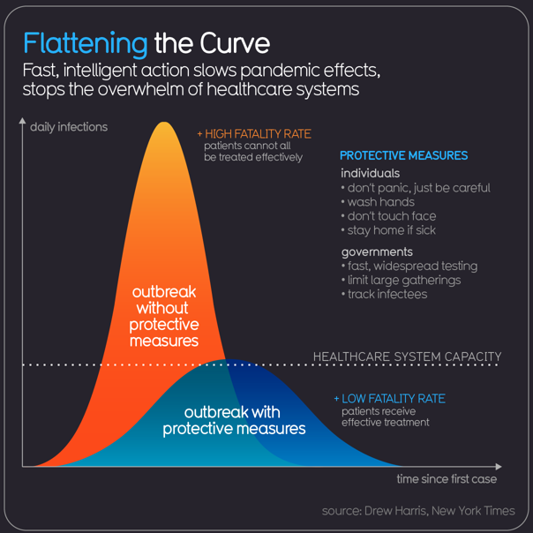
Graphs – Getting the Message Across
Probably the most widely used graph in the World in 2020.

Slide 14
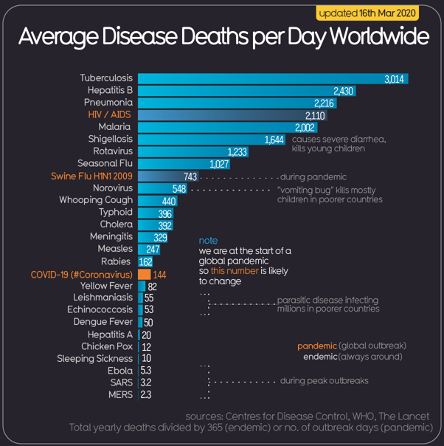
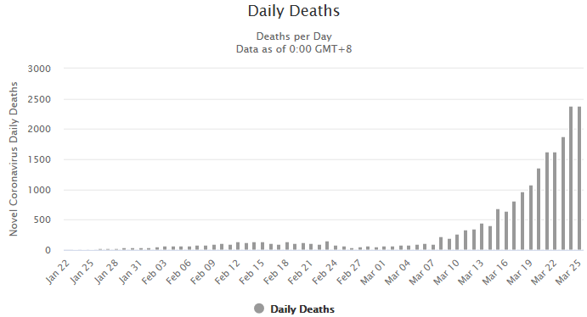
Graphs – Getting the Message Across
Bar / Column Chart:
Helps put our data into perspective
(w.r.t. other diseases)
N.B. Update 25/03/2020 …

Slide 15
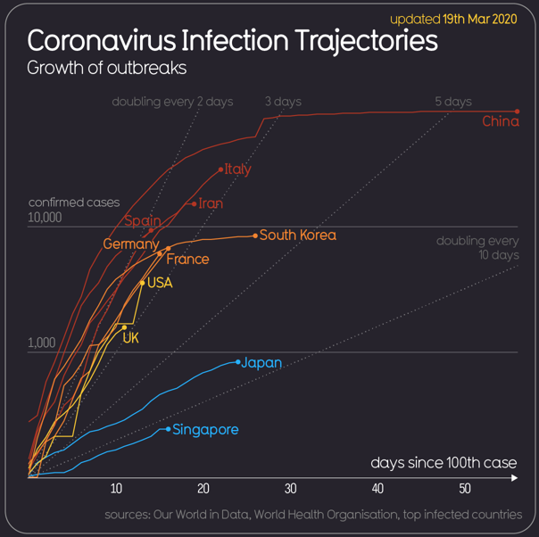
Graphs – Getting the Message Across
Line Graphs:
Good for comparisons

Slide 16
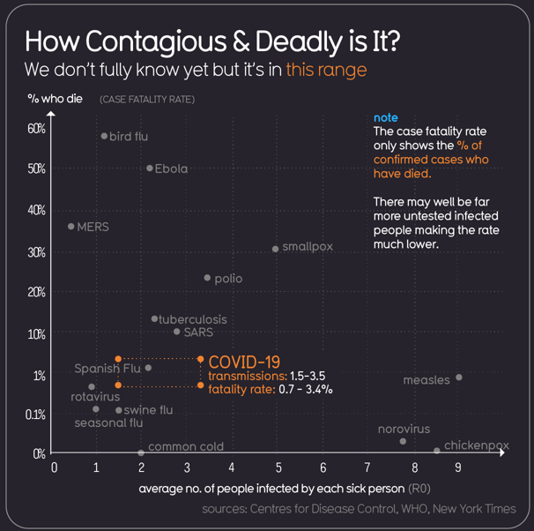
Graphs – Getting the Message Across
2D Scatter Plot

Slide 17
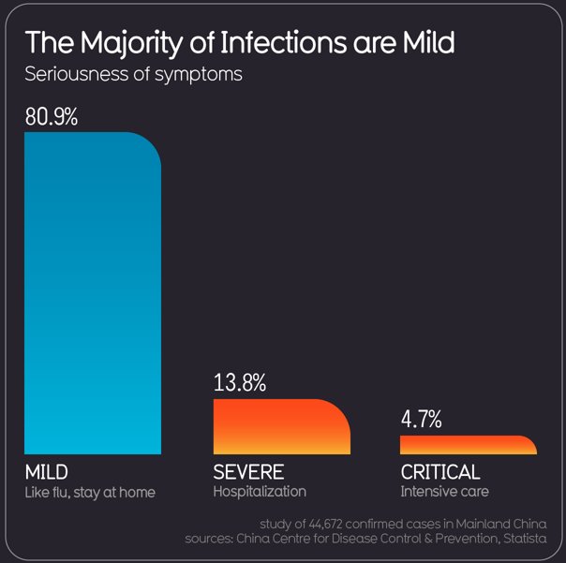
Graphs – Getting the Message Across
Simple Bar Chart:
Gets across key message in a simple and effective way

Slide 18
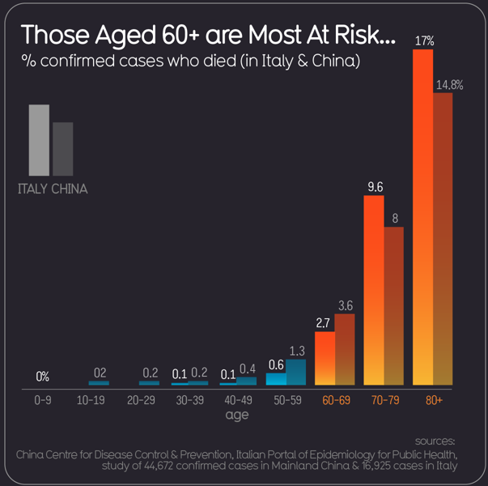
Graphs – Getting the Message Across
Comparative Bar Chart:
Re-inforces the message across multiple data sets

Slide 19
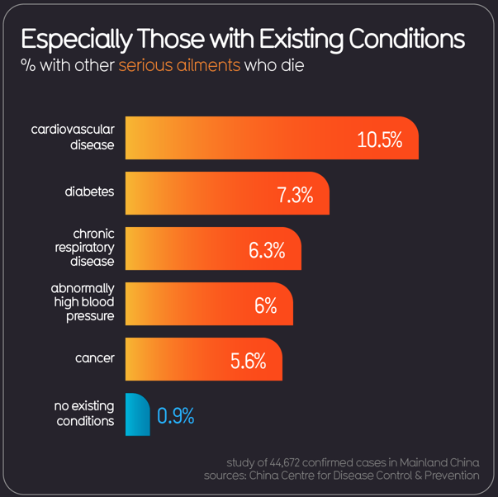
Graphs – Getting the Message Across
Simple Bar Chart:
Gets across key message in a simple and effective way

Slide 20
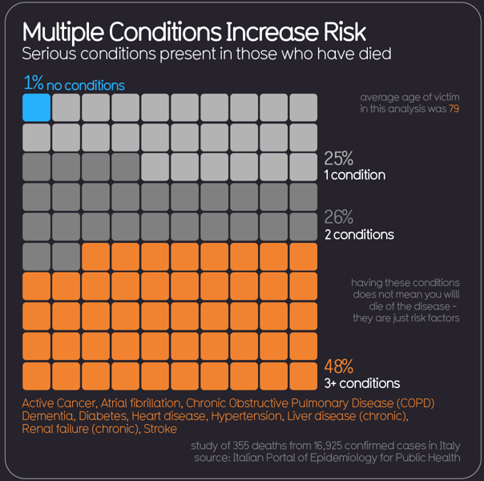
Graphs – Getting the Message Across
Cumulative Map Graph

Slide 21
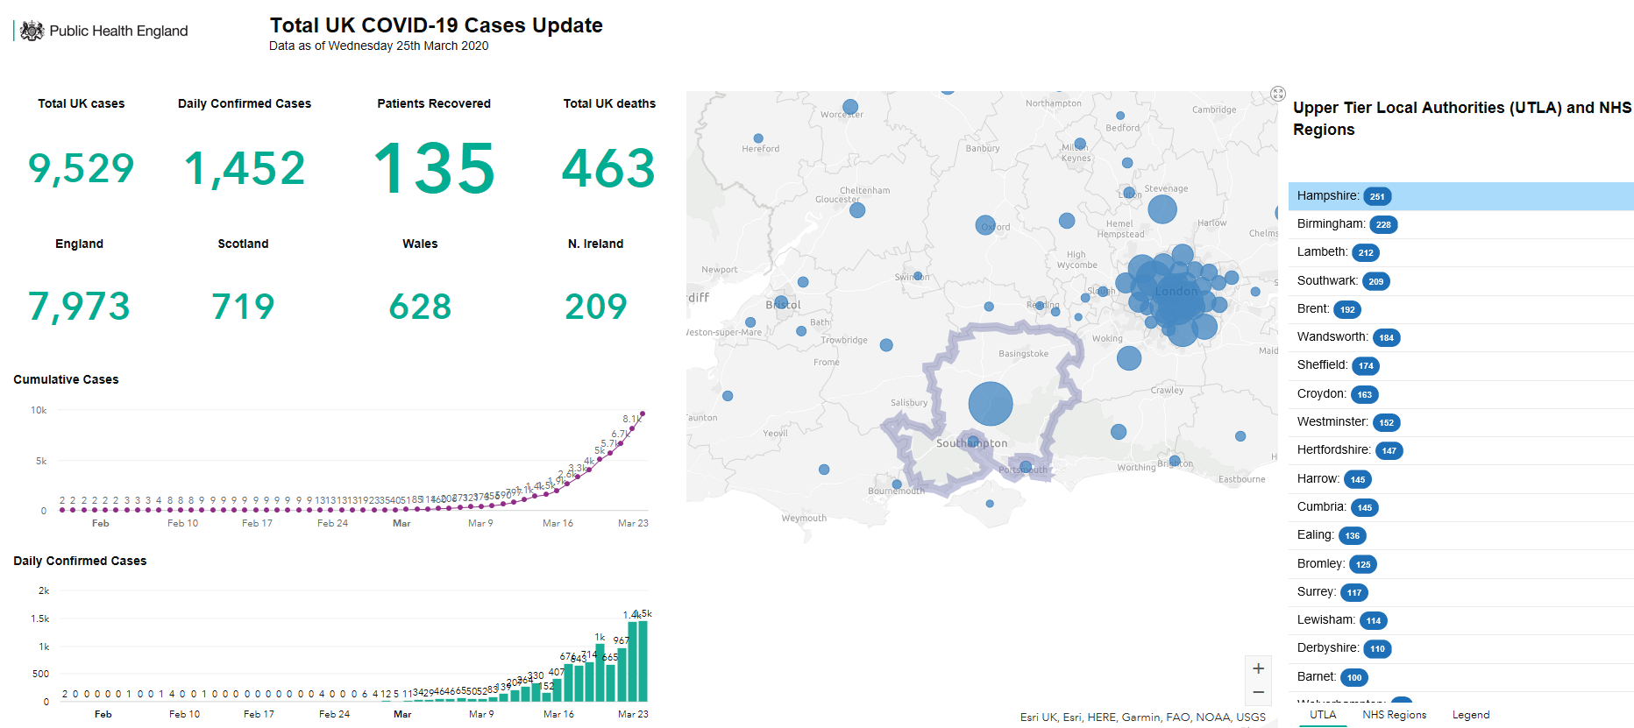
Graphs – Getting the Message Across
Putting it all together … https://www.gov.uk/government/publications/covid-19-track-coronavirus-cases

Slide 22
Visualisation of Data
Some Questions for you:
1. What data is important to show?
2. What do I want to emphasise in the data?
3. What options do I have for displaying this data?
4. Which option is most effective in communicating the data?

Slide 23
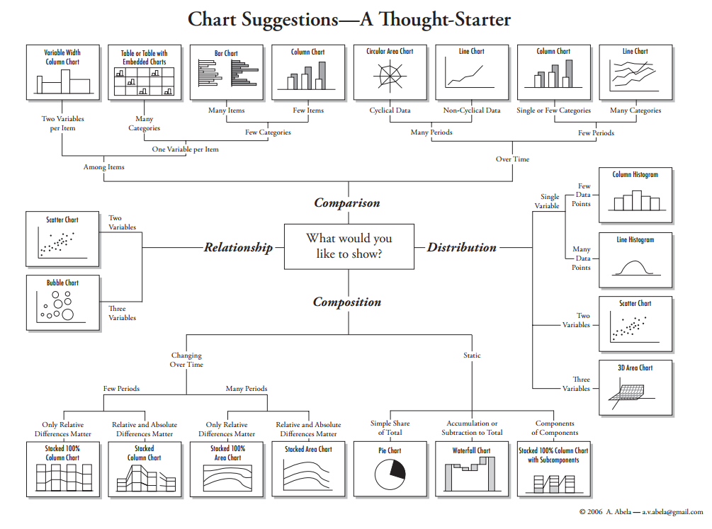

Slide 24
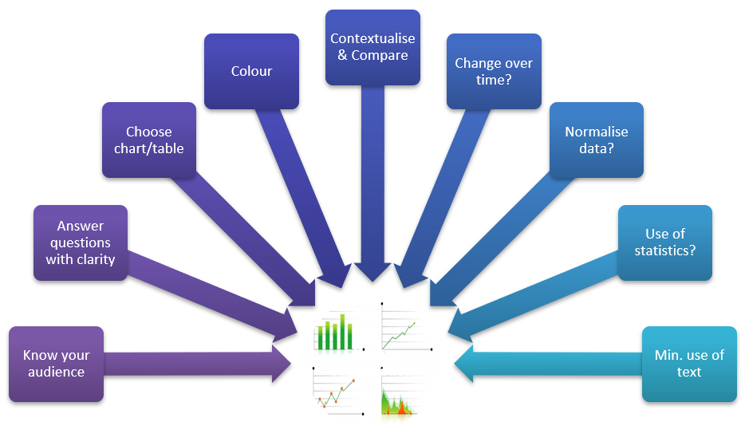

Slide 25
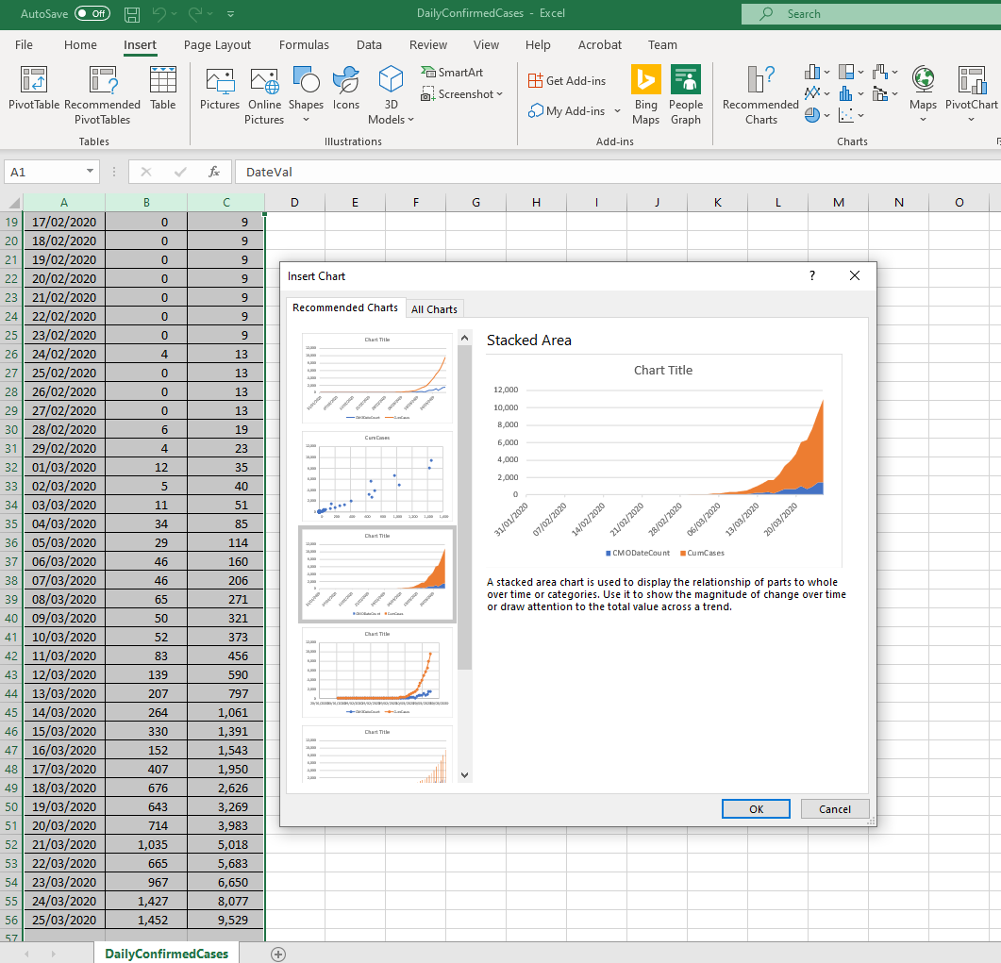
Graphs
Check out what is available in Microsoft Excel (simple to use, off-the-shelf charting …)
Previews
e.g. Stacked Area might be most appropriate for daily and cumulative Covid cases …

Slide 26
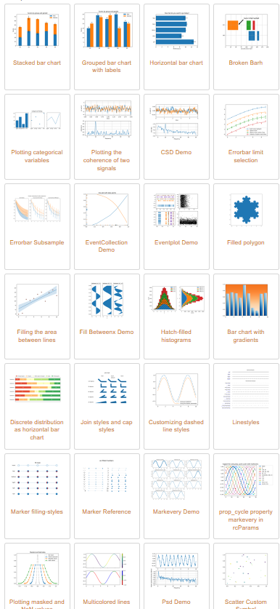

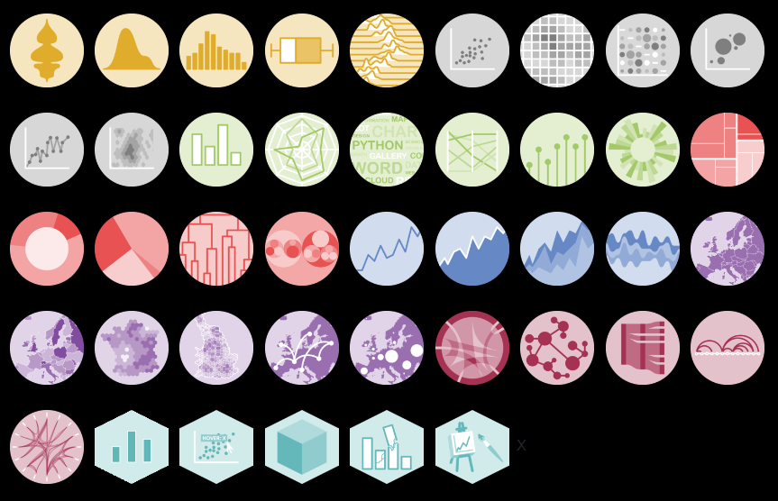
Graphs
Also check out the libraries available to you from software you are already familiar with:
Python, R, …

Slide 27
Graphs & Statistics …
Which comes first?
Statistical Analysis or Graphing / Charting Analysis?
Can be done in parallel with tools such as MS EXCEL
But some simple descriptive statistics is essential for all of our data

Slide 28
Data Analysis & Statistics
Analytic strategy (statistics) will depend on…
…your research question
…your data
…the recipient of analysis
…your statistical expertise
…your expertise with relevant statistical software (e.g. SPSS, Excel, Python & R Libraries)
Don’t be afraid to ask your project supervisor / tutor for help – the wrong statistical approach can lead to the wrong conclusions.

Slide 29
Variables
Remember, the ultimate goal of every research or scientific analysis is to find relations between variables.
In statistics, the dependent variable is the event studied and expected to change whenever the independent variable is altered.

Slide 30
Variables (terminology)
Qualitative variables, cannot be assigned a numerical value.
Quantitative variables, can be assigned a numerical value.
Discrete Data
values are distinct and separate, i.e. they can be counted
Categorical Data
values can be sorted according to category.
Nominal Data
values can be assigned a code in the form of a number, where the numbers are simply labels
Ordinal Data
values can be ranked or have a rating scale attached
Continuous Data
Values may take on any value within a finite or infinite interval

Slide 31
Frequency Table
A way to summarise your data (results/questionnaire).
It records how often each value of the variable occurs.
How to build it?
Identify lower and upper limits
Number of classes and width
Segment data in classes
Each value should fit in one (and no more) than one class: classes are mutually exclusive

Slide 32
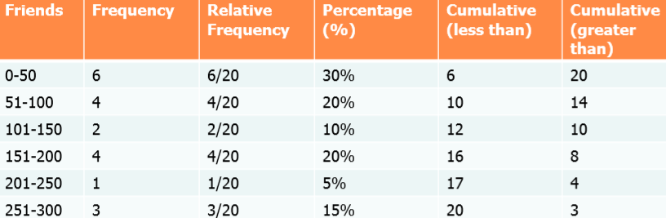
Frequency Table
Example: How many friends do you have on Facebook ? …. 23,44,156,246,37,79,156,123,267,0,145,88,95,156,32,287,167,55,256,47
Outlier, Error, or Mark Ware?

Slide 33
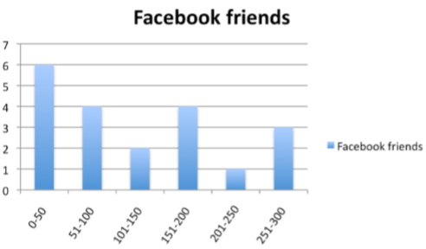
Histogram (Graph)
The graphical representation of a frequency table
Summarises categorical, nominal and ordinal data
Display bar vertically or horizontally, where the area is proportional to the frequency of the observations falling into that class.

Slide 34
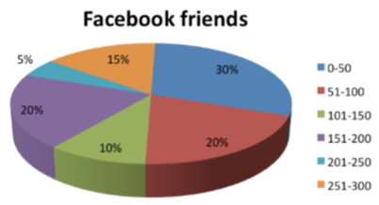
Pie Chart (Graph)
Suitable to represent categorical data
Used to show percentages
Areas are proportional to value of category.

Slide 35
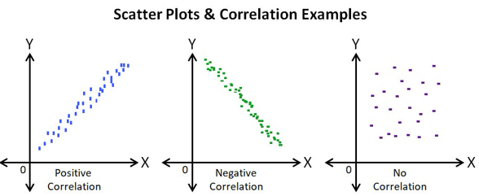
Scatter Plot (Graph)
Displays values for two variables for a set of data
The independent variable is plotted on the horizontal axis, the dependent variable on the vertical axis
It allows to determine correlation
Positive (bottom left -> top right)
Negative (top left -> bottom right)
Null (No Correlation)
with a trend line ‘drawn’ on the data.

Slide 36
… and more Graphs (as before)
Helps us to explore our data, (our variables), and the patterns or correlations therein.
Explore!

Slide 37
Descriptive Statistics Describe the Features of a Dataset
Measure of Central Tendency
Mean - Mathematical Average (extreme values problem)
Mode - Most Common Value (good for nominal data)
Median - Midpoint of a Range (extreme values effect removed?)
Measures of Spread - Response variability
Range - Simplest => Highest minus the Lowest - extremes!
Quartiles - Sub-Divide Range into four equal parts
Variance - uses all values to calculate spread around Mean
Standard Deviation - Square Root of the Mean of the squares of the deviations from the mean.

Slide 38
Measuring the Shape of Our Data
A Normal Curve:
bell-shaped
data distribution is symmetrical
mean, median and mode are all at highest point of the curve
If it is skewed then mean, median and mode fall at different points
A Normal Distribution is subject to rules concerning the Standard Deviation:
68.3% of cases will be within 1 standard deviation of the mean
95.4% of cases will be within 2 standard deviations of the mean
99.7% of cases will fall within 3 standard deviations of the mean
The number of standard deviations from the mean is also called the "Standard Score", "sigma" or "z-score".

Slide 39
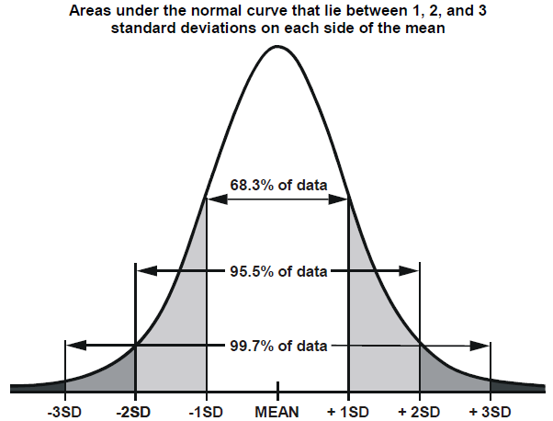
Normal Distribution

Slide 40
Significance Tests
Based on the idea of testing if the sample population fits into some known population or not
The output from the test is usually a number, which then has to be interpreted (by checking against standard probability tables)
Probability is represented as a number between 0 and 1 (0 is can’t happen to 1 a certainty)
Probability (Expectation) of 0.5 (tossing a coin as a head)
Many tests have been developed to accommodate the wide variety of problems and populations that exist

Slide 41
Significance Tests
Statistical Significance is generally referred to as a ‘p-value’, which assesses the actual probability that the findings are more than a coincidence.
Conventional p-values are 0.05, 0.01 and 0.001 which tell you that the probability of your findings have occurred by chance is 5/100, 1/100 or 1/1000 respectively.
The lower the p-value, the more confident that results are genuine
Generally if p-value is greater than 0.05 then the results are unacceptable for research purposes

Slide 42
Significance Tests
Difficult for Novices
What test do I apply?
How do I apply the test?
How will I interpret the results?
Test Results
Calculate by hand
Make use of statistical software (e.g. SPSS, Excel..)
Need to get a book!!!! (or YouTube) (or even an expert?)

Slide 43
The Bottom Line …
Explore Your Data
Visualise Your Data
E.g. try many of the different charting tools in Excel
Find the Patterns or Trends in Your Data
Statistically Analyse (or Prove) Your Data
The Very Bottom Line …
Use Your Supervisor or Research What Others Have Done with Similar Types of Data

