Slide 1


IS4S706 Project Management & Research Methodology
Research Methods:
WRITING UP
David Kidner (J302)
david.kidner@southwales.ac.uk

Slide 2
Research Methods: Previous Weeks
Research
Question(s)
Methods
& Sample Selection
Data
Collection
Data Analysis,
Presentation &
Visualisation

Slide 3
Research Methods: This Week
Methods
& Sample Selection
Data Analysis,
Presentation &
Visualisation
Research
Question(s)
Data
Collection
THE THESIS

Slide 4
The Thesis
The Informal Bits …
Don’t make the thesis any longer than is necessary to present your argument (but adhere to Word Counts)
Write in plain English and in a readable style. Aim to make your thesis an enjoyable read!
Read other theses to get a better idea of what is required.
Making a rough plan (which you need not necessarily stick to).
Timetabling specific writing times each week.
Setting smaller achievable goals and targets for yourself - "I will write 200 words about concept A" by lunchtime.
Writing something other than your thesis (a blog, a summary of an article, a book review etc). This may kick-start your writing process.
Keep a folder of ALL your research; literature; results; thoughts; other people’s work, results, quotes, figures…
I use a Powerpoint file to collate material and thoughts (everything goes in it; but then select bits from it; or re-draft / re-write for the report). Give it a Go!

Slide 5
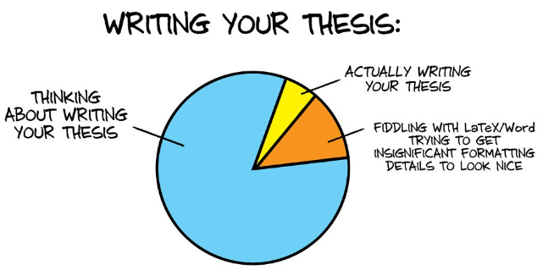
The Thesis

Slide 6
The Thesis
Follow the specific guidelines
Your MSc Project Handbook has them!
Remember the Audience
Carefully consider who you get to proof read it
Especially if English is Not your first language
Asking your parents/friend is OK for readability – but perhaps not for academic structure?
If you’ve included statistical inference then it doesn’t hurt to briefly explain why you have chosen a particular method – and a reference if the reader needs to “understand” a particular method
The Reader will be looking at what decision you’ve undertaken, how you’ve judged alternatives and the critical quality you’ve shown – hence it must be part of the narrative and can’t be expected to be inferred.

Slide 7
Thesis Structure
Title Page: Name, Date, USW, might not decide on a specific title until the end?
Contents Page: Chapter, Section or Sub-Section Headings
List of Illustrations: Title & Page Number of All Figures (& Tables)
Acknowledgements: Research Partners, Tutor(s)?, Employer?, Family & Friends?
Abstract: One Page Summary (or number of specified words)
Introduction: Clearly sets out Aims & Objectives. Rationale for the Research.
Background: Setting the scene; History/Need; Research (Secondary Sources) – Lit Review
Methodology & Methods: Choice & justification of choice of methodology/methods. Qualitative/Quantitative; Action Research/Grounded Theory; Fieldwork/Lab Experiments etc.
Findings/Analysis OR Findings & Separate Chapter on Discussion / Analysis
Conclusions: Pull Everything Together – Often Relating your findings to existing or previous research
Recommendations: What does your research output mean? What should happen because of it?
Further Research: How to Continue This Research Further
References: HARVARD (at USW). See document in this Blackboard folder.
Bibliography: What you’ve looked at – but not directly cited
Appendices: Questionnaires; Detailed Experiments/Fieldwork; Code?; Large Amounts of Data where a subset is discussed in main report.
Dawson, C. (2010) Introduction to research methods: a practical guide for anyone undertaking a research project. 4th ed. Oxford: How to Books.

Slide 8
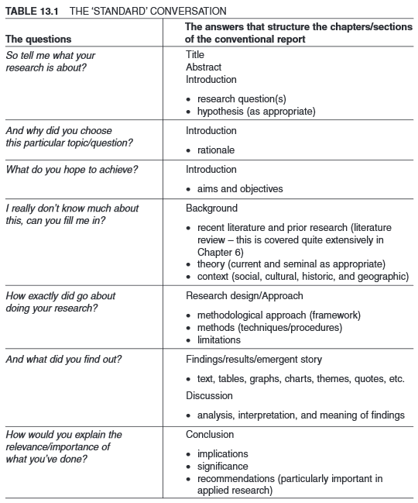
One Possible
Thesis Structure
(in context):
O’Leary (2014)
“Doing your Research Project”

Slide 9
Abstract
An abstract should briefly:
Establish the topic of the research
Give the research problem and/or main objective of the research (need to state this early on / first)
Present the hypothesis
Present the methodology used
Present the main findings – just a sentence or two
Present the main conclusions – just a sentence or two
Should help the reader decide
“Do I want to read the rest of this or not?”
Usually gets written LAST
Think of it as being a COMPLETE Summary of your work (and a Sales Leaflet / Advert).

Slide 10
Abstract
Common Problems:
Too Long:
Too Much Detail (& Reader Loses Interest)
Too Short:
Fails to include important information (& Reader Doesn’t Gain Interest)
It Sums up everything that you’ve done in a succinct and concise manner
The Reader HAS TO HAVE/READ YOUR REPORT

Slide 11
Introduction – Why Have It?
Background
What is the context of this problem?
In what situation or environment can this problem be observed?
Rationale
Why is this research important?
Should be ‘unique’????
Who will benefit?
Often group rather than individuals
Why do we need to know this?
Will add to knowledge, understanding, usage,
Why does this situation, method, model or piece of equipment need to be improved?
May be an alternative - Research could be - Will it improve???
Does not have to be correct – Research can be to prove a null hypothesis

Slide 12
Introduction – Clearly Defines Boundaries
Problem Statement
What is it we don’t know?
What is the gap in our knowledge this research will fill?
What needs to be improved?
Objectives
What steps will the researcher take to try and fill this gap or improve the situation?
Scope
Is there any aspect of the problem the researcher will not discuss?
Is the study limited to a specific geographical area or to only certain aspects of the situation?
Limitations
Is there any factor, condition or circumstance that prevents the researcher from achieving all of the objectives?
Assumptions
In considering the method, model, formulation or approach, does the researcher take certain conditions, states, requirements for granted?
Report Chapter/Section Outline

Slide 13
Introduction – Common Problems
Too much detail, and hence too long
Repetition of words, phrases or ideas
Unclear problem definition
Poor organisation of information
Don’t rely on keeping structure clear in your memory.
Remember the Powerpoint Map / Structure / Thoughts
Has not clearly defined the boundaries for the research process

Slide 14
Literature Review
What do we already know in the immediate area concerned
What have we found out via our secondary data search
What are the existing theories?
Where are the inconsistencies or other shortcomings in our knowledge and understanding?
What views need to be (further) tested?
What evidence is lacking, inconclusive, contradictory or too limited?
Why study (further) the research problem?
What contribution can the present study be expected to make?
What research designs or methods seem unsatisfactory?

Slide 15
A Good Literature Review?
Remember the Purpose
Read with a Purpose
Write with a Purpose
FOCUS!

Slide 16
Lit Review – Common Problems
Trying to Read Everything!
As you have probably already discovered, if you try to be comprehensive you will never be able to finish the reading!
The idea of the literature review is not to provide a summary of all the published work that relates to your research, but a survey of the most relevant and significant work.
Reading but Not Writing
It’s easier to read than to write
Set little goals, e.g. write a paragraph summary of the 6 or 10 most important papers (see Lit Review Lecture).
Not Keeping Bibliographic Information & Full References!

Slide 17
Method & Research Design
Often there are different methods that we can use to investigate a research problem.
Your methodology should make clear the reasons why you chose a particular method or procedure
Clearly explain your decision making
The Research Methods must be appropriate to the objectives of the study
In some cases, it is useful for other researchers to adapt or replicate your methodology, so provide sufficint information to allow others to use the work.

Slide 18
Common Problems in Selecting a Method
Irrelevant Detail
Unnecessary explanation of basic procedures
Not always easy to get the balance right
Problem Blindness
“Too Close” to the Problem
Ignore significant problems or pretend they do not exist

Slide 19
Presenting Your “Proposed Process”
Can become a problem
Need to present in the third person!
Must keep asking yourself WHY …
WHY is this correct?
WHY am I going to include this information?
WHY am I not doing it this particular way?
WHY do I think this is the next step to follow?

Slide 20
Results: How to Present Your Findings
Statement of Results
The results are presented in a format that is accessible to the reader
E.g. graph, table, diagram, or written text
Remember last week … “A picture is worth a thousand words”
Must be HONEST – don’t mislead by using inappropriate graphical means.
Notice that Raw Data is usually put in an Appendix – if it is included at all.

Slide 21
Results: How to Present Your Findings
Explanatory Text
All graphs, tables, diagrams and figures should be accompanied by text that guides the reader’s attention to significant results
Don’t just assume the reader “gets it”.
The text makes the results meaningful by pointing out (emphasising) the most important results, simplifying the results
Don’t get over-excited by a NEW way of displaying some results, or overdo it – only display what is essential to your discussion or argument.

Slide 22
Results – Common Problems
The text includes too much detail that simply repeats data presented in graphs, tables, etc. without making the results any more meaningful.
Solution
Remember that graphs & tables are used to present a lot of information efficiently, but that your job is to direct the reader’s attention to significant parts of this information
REMEMBER: This is where you SHOW your results, not DISCUSS them.

Slide 23
Organisation: You May Wish to Merge Results & Discussion
Presenting part of the results, then discuss. Present another part or experiment, then discuss.
Consider the flow of the results being presented – do they follow the objectives – if they naturally follow on then don’t split them up.
If however, each set of results is dependent upon a decision based on a previous set, then it makes more sense to segment them into Results/Discussion Blocks.

Slide 24
Discussion
Explanation of Results
The writer comments on whether or not the results were expected, and presents explanations for the results, particularly for those that are unexpected or unsatisfactory
References to Previous Research
Comparison of the results with those reported in the literature, or use of literature to support a claim, hypothesis or deduction.
Refer back to Objectives for Order of Discussion?
Deduction
A claim for how the results can be applied more generally
Use statistical analysis
Hypothesis
A more general claim or possible conclusion arising from the results (which will be proved or disproved in later research?).

Slide 25
Discussion – Common Problem
The Discussion does not Discuss
Simply supplies more detail about the results obtained
Solution:
Remember that the discussion should explain the results
Don’t be afraid to Discuss – Express YOURSELF & Explain Yourself. Present Possible Reasons … which leads onto our Conclusions

Slide 26
Conclusions
What was learned (this usually comes first).
What remains to be learnt (directions for future research)
The shortcomings of what was done (Evaluation)
The benefits, advantages, applications, etc. of the research (Evaluation)
Recommendations

Slide 27
Conclusions – Common Problems
Too Short (Sign of Being Rushed / Glad to Have Finished)
Too Long (2 or 3 Pages is Often Sufficient).
Too Much Detail
Conclusions section is not the place for details about your methodology or results (see Previous Slides)
Failure to comment on larger, more significant issues
Whereas your introduction moves from the general field to your specific research, your task here is to move from specific (your research) back to general (your field) – how your research will affect the World.
Failure to reveal the complexities of a conclusion
Negative aspects of your research should not be ignored.

Slide 28
Conclusions – Common Problems
Lack of a Concise Summary of what was learned.
In order to be able to discuss how your research fits back into your field of study you need to summarise it very briefly.
Often the summary is only a few sentences.
Failure to match the objectives of the research.
Often research objectives change while the research is being carried out.
This is usually not a problem unless you forget to rewrite your original objectives so that they actually reflect what you were trying to accomplish in your research.

Slide 29
Referencing
AUTHOR-DATE System
Harvard System – you must follow this for all your USW work. SEE HANDOUT ON BLACKBOARD.
Cite source within text at appropriate position …
Ant colony optimization has been shown to outperform simulated annealing (Richards et al., 2008)
Jones and Smith (1995) make the point that data compression has in fact increased in importance in the last decade.
“There is almost no evidence presented in the academic literature to suggest that performance will improve despite the large amount of research time and money spent.” (Berry and Fry, 2010)
If it’s not in quotes, make sure they’re your own words.

Slide 30
10 Reasons Why Reports Fail
There is No Logical Structure
Ideas are not well thought through
Work is disorganised
Assumptions are made that cannot be justified by evidence
There are too many grammatical & spelling mistakes
Sentences/Paragraphs are too long or too obscure
It is obvious that ideas and sentences have been taken from other sources
There is too much repetition
There is too much irrelevant information
Summary & Conclusions are Weak.
Dawson, C. (2010) Introduction to research methods: a practical guide for anyone undertaking a research project. 4th ed. Oxford: How to Books.

Slide 31
